Slide 1

主日信息
Sunday Sermon

Slide 3


Slide 4
Think of 2 stories in the Bible where God controls the rain
想想聖經中關於上帝控制雨的兩個故事

Slide 5

Genesis 7:4
Seven days from now I will send rain on the earth for forty days and forty nights
創世記 Genesis 7:4a
因為再過七天，我要降雨在地上四十晝夜

Slide 6

Genesis 9:14-15
Whenever I bring clouds over the earth and the rainbow appears in the clouds, I will remember my covenant between me and you and all living creatures of every kind. Never again will the waters become a flood to destroy all life
創世記 Genesis 9:14-15
我使雲彩蓋地的時候，必有虹現在雲彩中，我便記念我與你們和各樣有血肉的活物所立的約，水就再不氾濫、毀壞一切有血肉的物了。

Slide 7


Exodus 14:21 B
that night the Lord drove the sea back with a strong east wind and turned it into dry land.
出埃及記 Exodus 14:21b
耶和華便用大東風，使海水一夜退去，水便分開，海就成了乾地。

Slide 8
1 Kings 17:1
“there will be neither dew nor rain in the next few years except at my word.”
列王紀上 1 King 17:1b
這幾年我若不禱告，必不降露，不下雨。

Slide 9
Joshua 3:13
And as soon as the priests who carry the ark of the Lord—the Lord of all the earth—set foot in the Jordan, its waters flowing downstream will be cut off and stand up in a heap.
約書亞記 Joshua 3:13
等到抬普天下主耶和華約櫃的祭司把腳站在約旦河水裡，約旦河的水，就是從上往下流的水，必然斷絕，立起成壘。

Slide 10

Joshua 10:13
The sun stopped in the middle of the sky and delayed going down about a full day.
約書亞記 Joshua 10:13b
日頭在天當中停住，不急速下落，約有一日之久。

Slide 11
Mark 4:36-41
Leaving the crowd behind, they took him along, just as he was, in the boat. There were also other boats with him. A furious squall came up, and the waves broke over the boat, so that it was nearly swamped. Jesus was in the stern, sleeping on a cushion.
馬可福音 Mark 4:36-38a
門徒離開眾人，耶穌仍在船上，他們就把他一同帶去；也有別的船和他同行。 忽然起了暴風，波浪打入船內，甚至船要滿了水。 耶穌在船尾上，枕著枕頭睡覺。

Slide 12
馬可福音 Mark 4:38b-39
門徒叫醒了他，說：「夫子！我們喪命，你不顧嗎？」 耶穌醒了，斥責風，向海說：「住了吧！ 靜了吧！」 風就止住，大大地平靜了。
The disciples woke him and said to him, “Teacher, don’t you care if we drown?” He got up, rebuked the wind and said to the waves, “Quiet! Be still!” Then the wind died down and it was completely calm.

Slide 13
馬可福音 Mark 4:40-41
耶穌對他們說：「為甚麼膽怯？你們還沒有信心嗎？」 他們就大大地懼怕，彼此說：「這到底是誰，連風和海也聽從他了。」
He said to his disciples, “Why are you so afraid? Do you still have no faith?” They were terrified and asked each other, “Who is this? Even the wind and the waves obey him!”

Slide 14
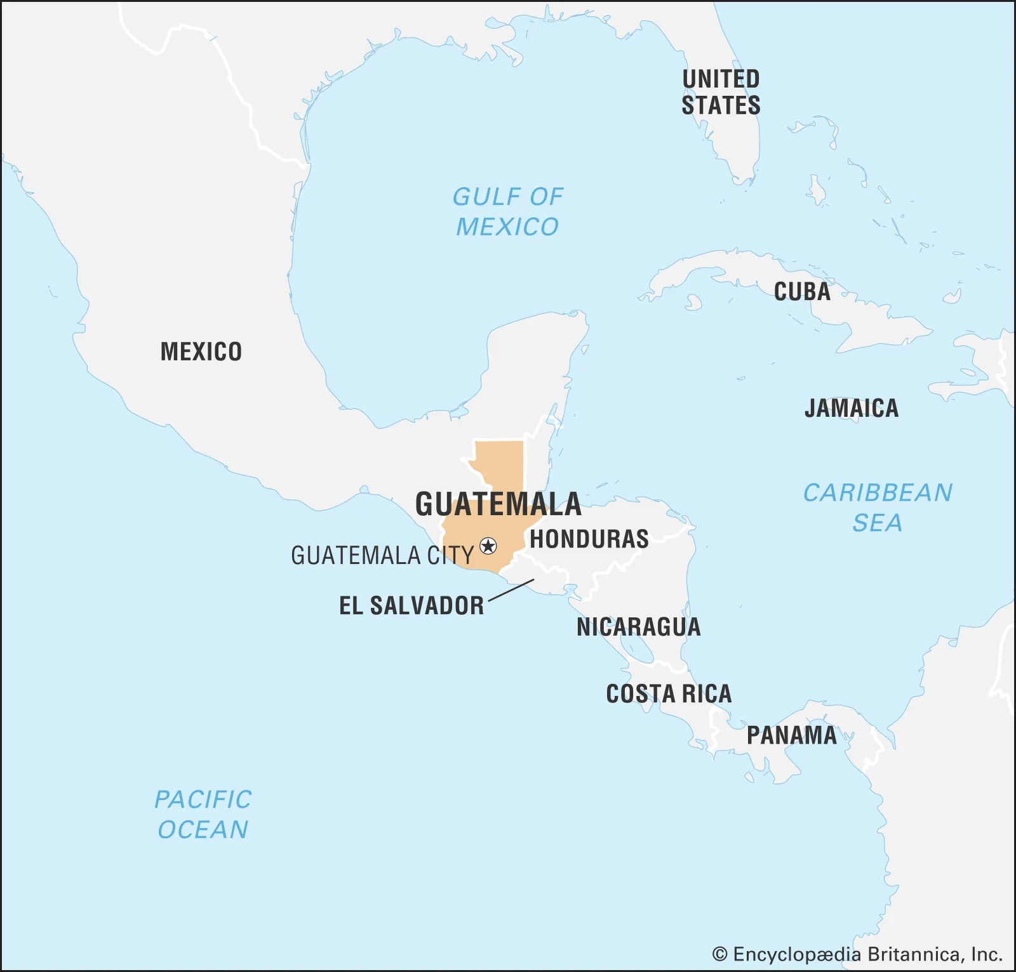

Slide 15
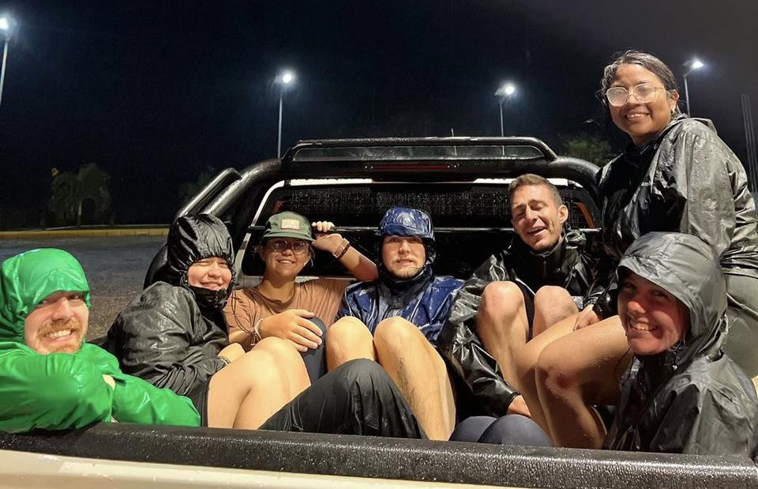

Slide 16
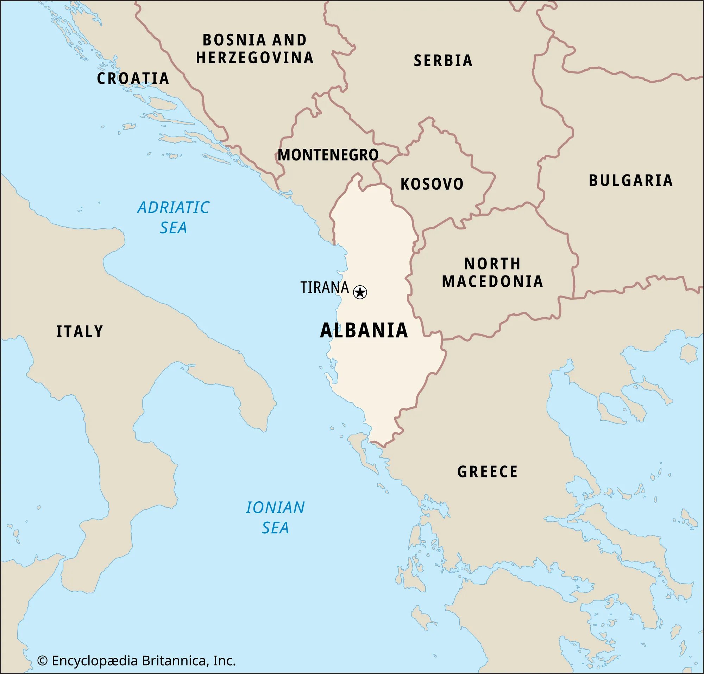

Slide 17
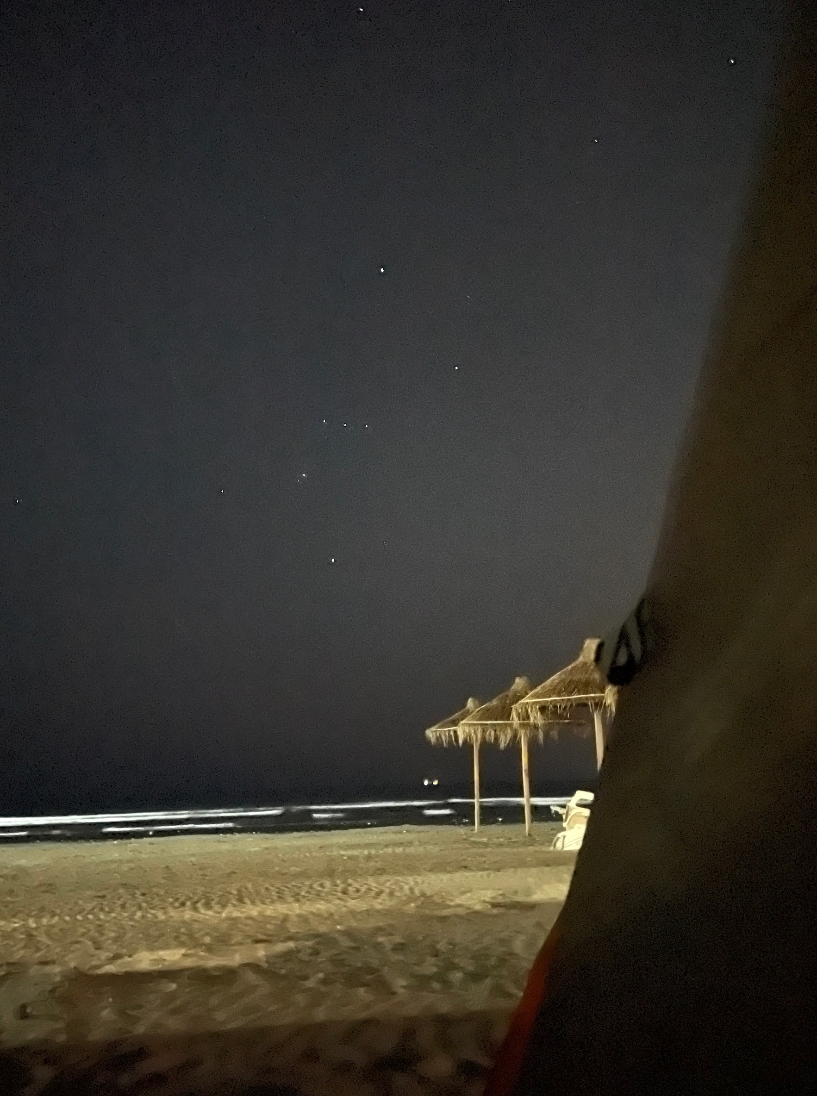
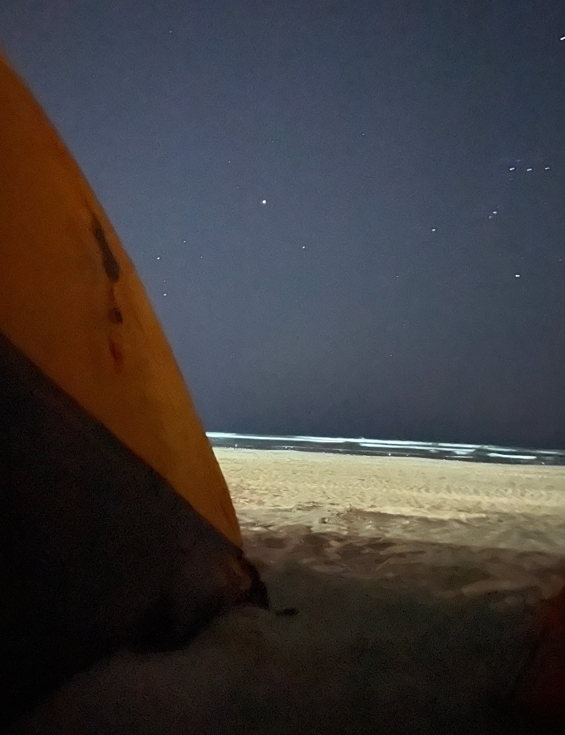

Slide 18
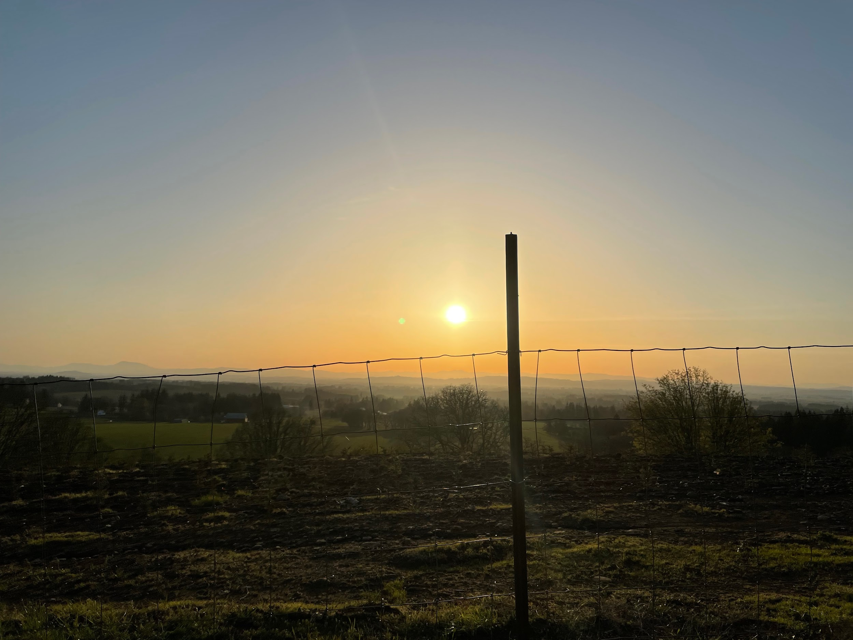

Slide 19
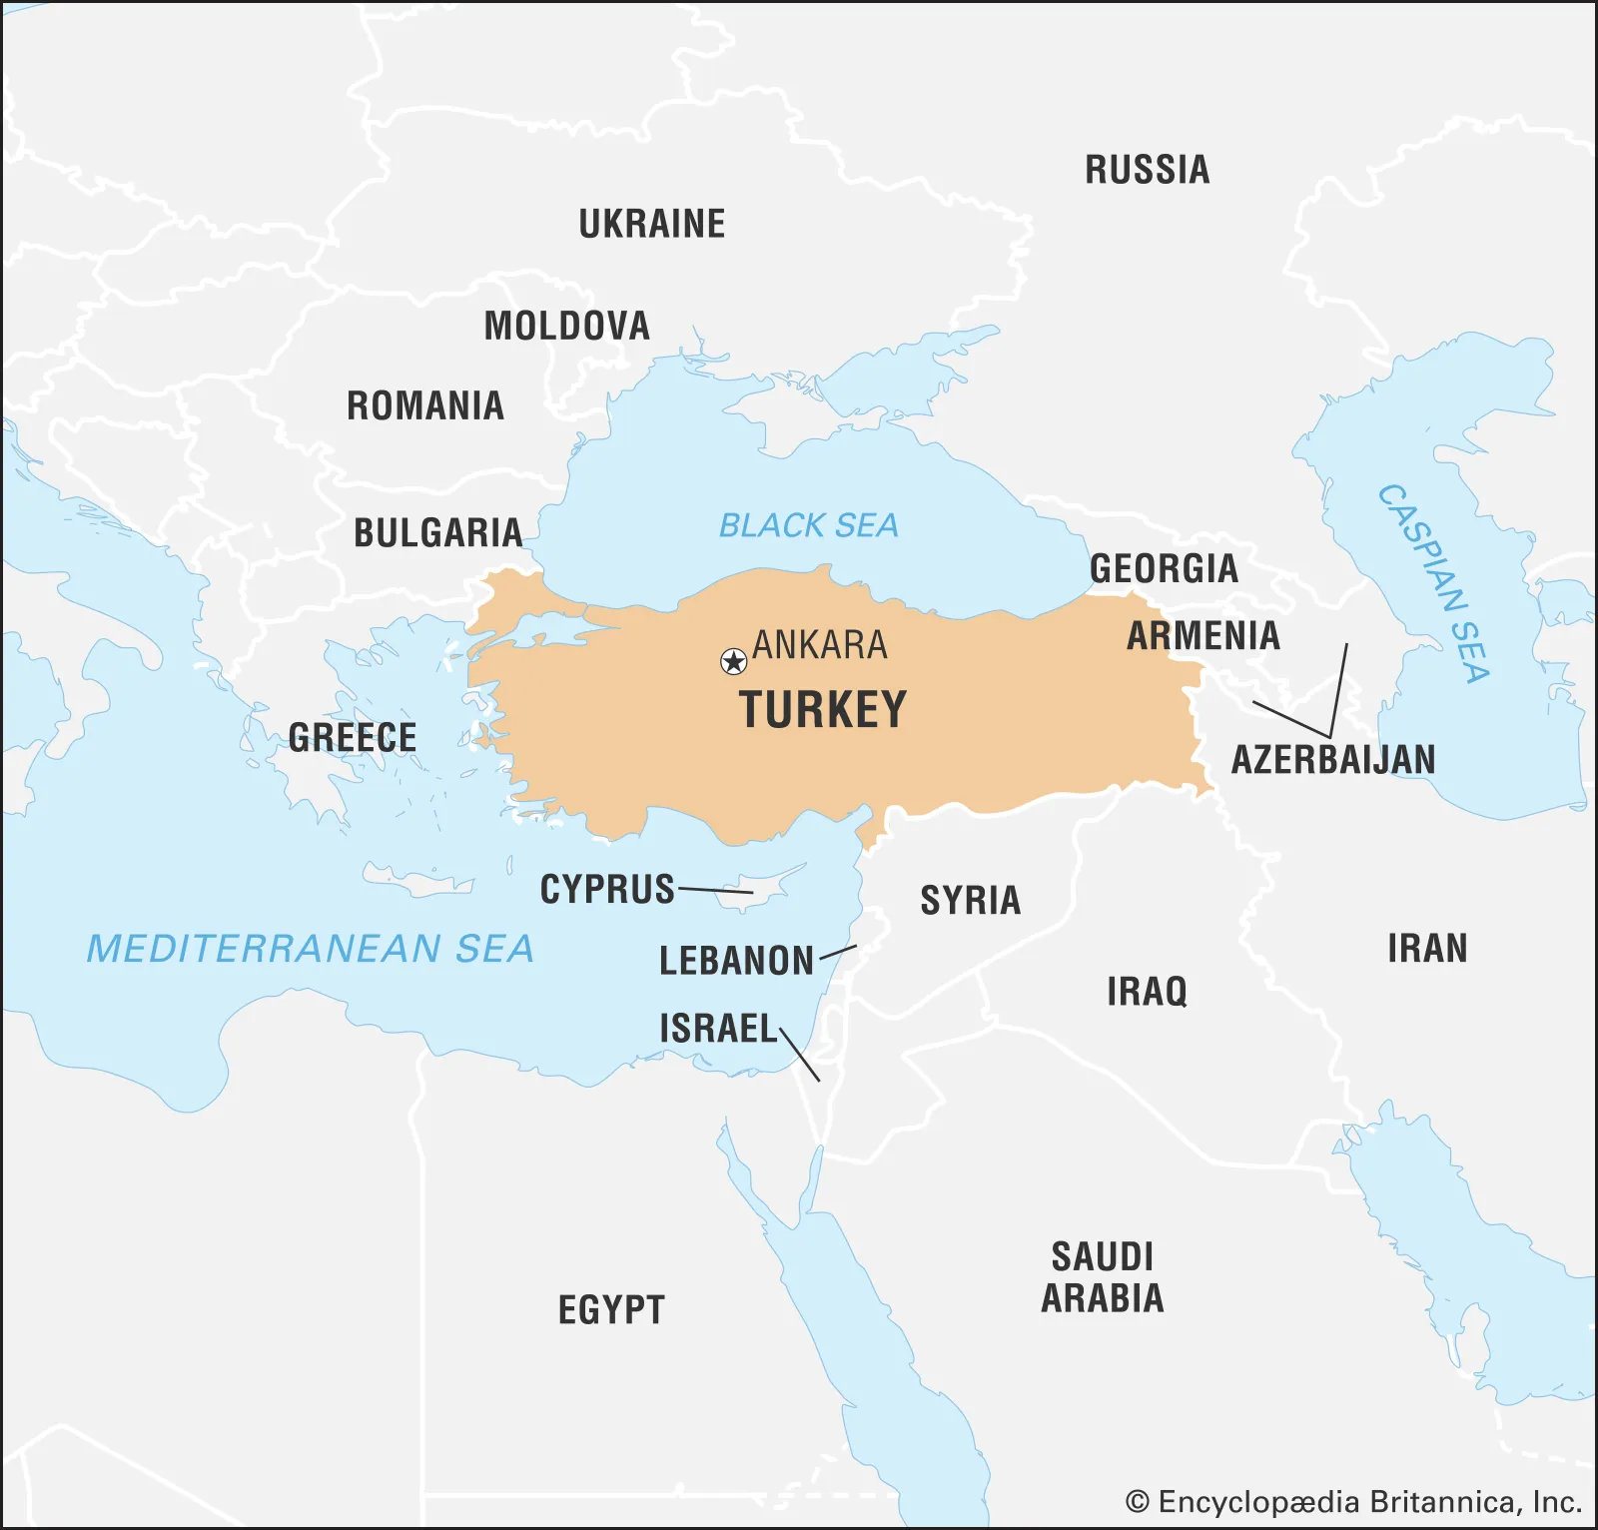

Slide 20
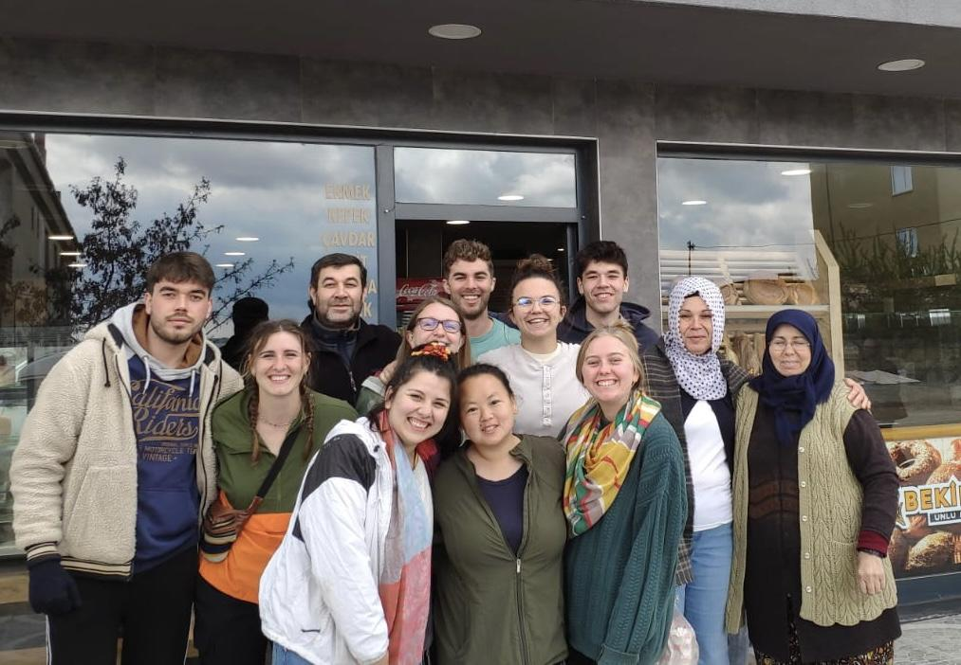

Slide 22
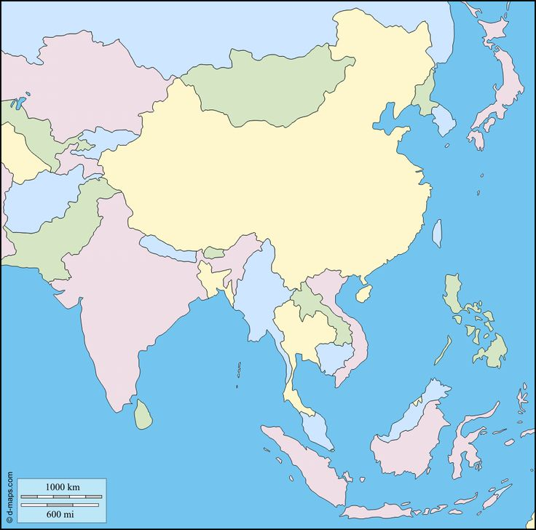

Slide 23
Ask questions, get my newsletters, and share your testimony with me:
971-719-8101
s.joy.dodd@gmail.com

