Slide 1

主日信息
Sunday Sermon

Slide 2

在禱告中認識神做事的法則
Knowing God’s Ways Through Prayers
波特蘭靈糧堂
June 9, 2024

Slide 3

詩篇 Psalm 95:9-10
那時，你們的祖宗試我探我，並且觀看我的作為。 四十年之久，我厭煩那世代，說：這是心裡迷糊的百姓，竟不曉得我的作為！
When your fathers tested Me,
They tried Me, though they had seen My work.
“For forty years I loathed that generation,
And said they are a people who err in their heart,
And they do not know My ways.
作為 ways ─ 神做事的法則

Slide 4
詩篇 Psalm 103:7
他使摩西知道他的法則，叫以色列人曉得他的作為。
He made known His ways to Moses,
His acts to the sons of Israel.
作為 ways ─ 神做事的法則

Slide 5


禱告是認識神做事的法則的
必經途徑

Slide 6
禱告是用你的心去傾聽神
並跟祂說話；不是強神之所難，
而是抓住祂的心意

Slide 7
神想要和我們有親密的關係
更勝於我們的祈求

Slide 8
禱告之所以
有功效、有恩膏、有權能
的秘訣是在於
和神的關係以及對神的心

Slide 9
歷代志下 2 Chronicles 7:14-15
這稱為我名下的子民，若是自卑、禱告，尋求我的面， 轉離他們的惡行，我必從天上垂聽，赦免他們的罪，醫治他們的地。 我必睜眼看、側耳聽在此處所獻的禱告。
and My people who are called by My name humble themselves and pray and seek My face and turn from their wicked ways, then I will hear from heaven, will forgive their sin and will heal their land. Now My eyes will be open and My ears attentive to the prayer offered in this place.

Slide 10

禱告不是為了結果，而是在這禱告的過程中，更多認識神、更多看清自己。 生活中發生的事情和遇見的問題使得我們藉此來到神面前禱告，把自己的心帶到神面前。 當我們的心對了，事情的成就無論是按著我們的心意或是不按，我們都能感謝讚美神，歸榮耀給神！

Slide 11
路加福音 Luke 9:54-55
他的門徒雅各、約翰看見了，就說：「主啊，你要我們吩咐火從天上降下來燒滅他們，像以利亞所做的嗎？」
耶穌轉身責備兩個門徒，說：「你們的心如何，你們並不知道。
When His disciples James and John saw this, they said, “Lord, do You want us to command fire to come down from heaven and consume them?” But He turned and rebuked them, and said, “You do not know what kind of spirit you are of;

Slide 12
禱告會顯露你
真實的想法和本性
(詩篇 Psalm 51:6)

Slide 13
詩篇 Psalm 51:6
你所喜愛的是內裡誠實；你在我隱密處，必使我得智慧。
Behold, You desire truth in the innermost being,
And in the hidden part You will make me know wisdom.

Slide 14
在生活中受苦和遇見難處時，
除了請別人幫你禱告以外，
自己也要禱告。
(雅各書 5:13)

Slide 15
雅各書 James 5:13-15
你們中間有受苦的呢，他就該禱告；有喜樂的呢，他就該歌頌。 你們中間有病了的呢，他就該請教會的長老來；他們可以奉主的名用油抹他，為他禱告。 出於信心的祈禱要救那病人，主必叫他起來；他若犯了罪，也必蒙赦免。
Is anyone among you in trouble? Let them pray. Is anyone happy? Let them sing songs of praise. Is anyone among you sick? Let them call the elders of the church to pray over them and anoint them with oil in the name of the Lord. And the prayer offered in faith will make the sick person well; the Lord will raise them up. If they have sinned, they will be forgiven.

Slide 16
雅各書 James 5:16-18
所以你們要彼此認罪，互相代求，使你們可以得醫治。 義人祈禱所發的力量是大有功效的。 以利亞與我們是一樣性情的人，他懇切禱告，求不要下雨，雨就三年零六個月不下在地上。 他又禱告，天就降下雨來，地也生出土產。
Therefore confess your sins to each other and pray for each other so that you may be healed. The prayer of a righteous person is powerful and effective. Elijah was a human being, even as we are. He prayed earnestly that it would not rain, and it did not rain on the land for three and a half years. Again he prayed, and the heavens gave rain, and the earth produced its crops.

Slide 17

克服不禱告的障礙
    依靠耶穌的寶血破除仇敵的謊言及迷思
    更多渴慕認識神的話語與神的屬性
    照著主耶穌所教導的方式禱告 (主禱文)
    尋找兩三個屬靈夥伴在一起同心禱告
    踏出第一步開口禱告

Slide 18
馬太福音 Matthew 18:19-20
我又告訴你們，若是你們中間有兩個人在地上同心合意地求甚麼事，我在天上的父必為他們成全。 因為無論在哪裡，有兩三個人奉我的名聚會，那裡就有我在他們中間。
“Again, truly I tell you that if two of you on earth agree about anything they ask for, it will be done for them by my Father in heaven. For where two or three gather in my name, there am I with them.”

Slide 19
復興禱告小組示範
RPG – Revival Prayer Group Demo

Slide 20
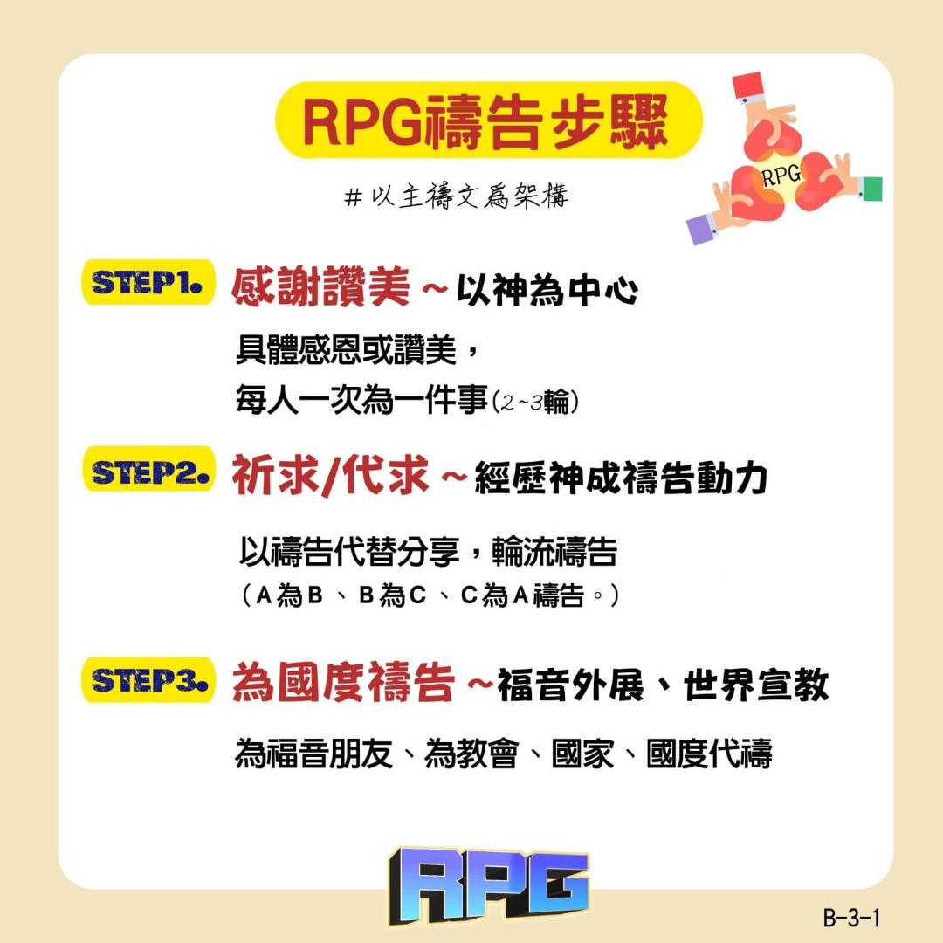
禱讀經文 (約翰福音 4:14)

Slide 21
約翰福音 John 4:14
人若喝我所賜的水就永遠不渴。 我所賜的水要在他裡頭成為泉源，直湧到永生。
but whoever drinks the water I give them will never thirst. Indeed, the water I give them will become in them a spring of water welling up to eternal life.

Slide 22
禱讀經文 (約翰福音 4:14)

Slide 23
復興禱告小組練習
RPG – Revival Prayer Group Practice

Slide 24

回應詩歌 Response Song
「我以祷告来到祢跟前」

