Slide 1

主日信息
Sunday Sermon

Slide 2

逆轉勝的關鍵
Keys to Comeback Victory
波特蘭靈糧堂
August 4, 2024

Slide 3

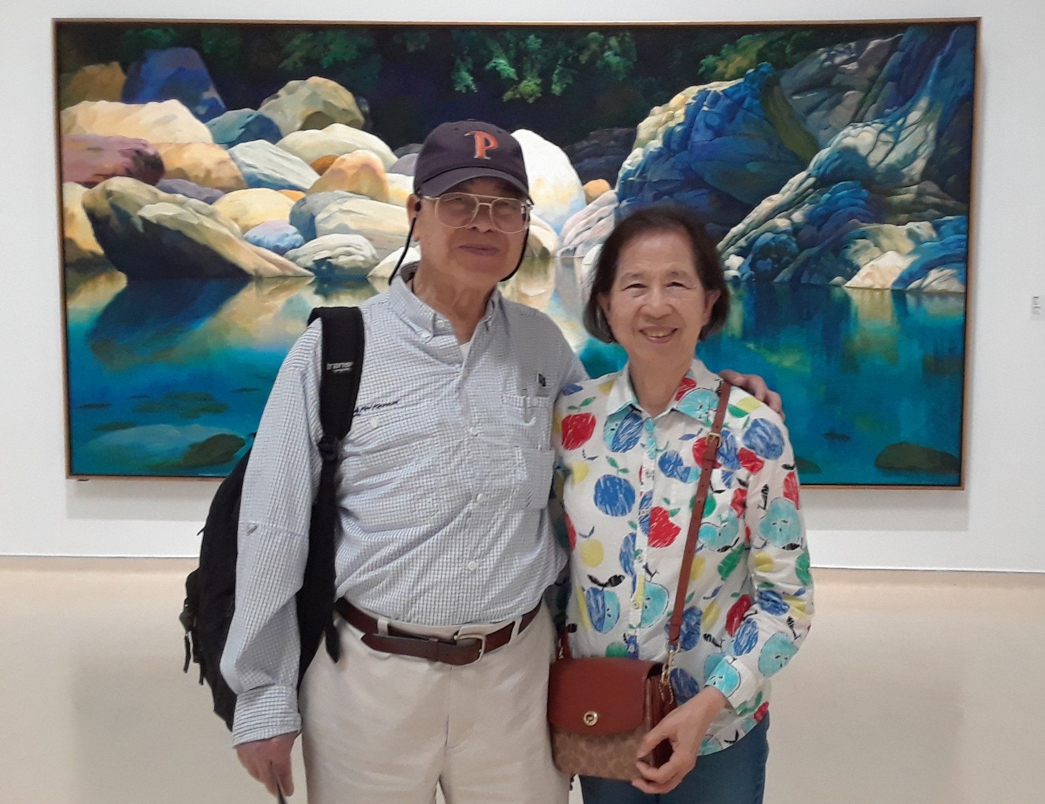
蕭慶松 教授夫婦的見證

Slide 4

羅馬書 Romans 5:3-5
不但如此，就是在患難中也是歡歡喜喜的；因為知道患難生忍耐，忍耐生老練，老練生盼望； 盼望不至於羞恥，因為所賜給我們的聖靈將 神的愛澆灌在我們心裡。
And not only this, but we also exult in our tribulations, knowing that tribulation brings about perseverance; and perseverance, proven character; and proven character, hope; and hope does not disappoint, because the love of God has been poured out within our hearts through the Holy Spirit who was given to us. (NASB)

Slide 5
逆轉勝的關鍵
        信心與忍耐 — 學習基督存心忍耐

Slide 6
帖撒羅尼迦後書 2 Thess. 3:5
願主引導你們的心，叫你們愛 神，並學基督的忍耐！
May the Lord direct your hearts into God’s love and Christ’s perseverance. (NIV)

Slide 7
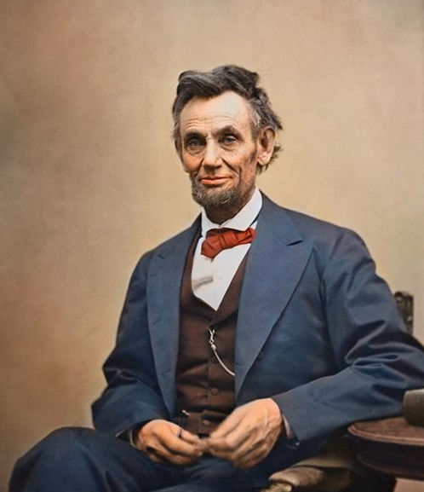
從不輕易放棄、百折不回的林肯 Abraham Lincoln

Slide 8
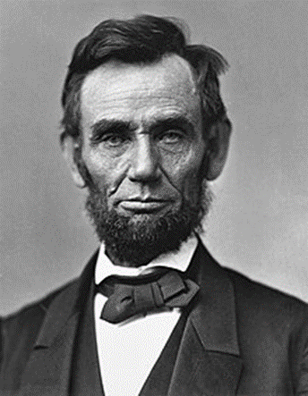
林肯一生的簡歷：
1809 出生貧窮家庭
1816 他的家人被趕出了住的地方
1831 經商失敗
1832 競選州議員 ― 落選
1833 借錢經商，但年底就破產了，花十七年把債還清。
1834 再次競選州議員 ― 當選
1836 因未婚妻過世，精神完全崩潰，臥病在牀六個月。

Slide 9
1843 參加國會大選 ― 落選
1846 再次參加國會大選 ― 當選
1848 尋求國會議員連任 ― 失敗
1854 競選美國參議員 ― 落選
1856 在黨全國代表大會上爭取副總統的提名 ― 失敗
1858 再度競選美國參議員 ― 再度落敗
1860 當選美國總統。

Slide 10


失敗為成功之母？

Slide 11
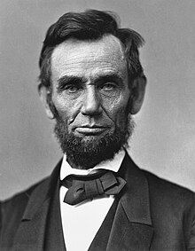
林肯 Abraham Lincoln 生下來就一貧如洗，終其一生都在面對挫敗，八次選舉八次都落敗，兩次經商失敗，甚至還精神崩潰過一次。 好多次，他大可放棄，但他並沒有如此，也正是因為他沒有放棄，才成為美國史上最偉大的總統之一。

Slide 12
I am a slow walker, but I never walk backwards.
雖然我步伐緩慢，但我從不後退！
— 林肯

Slide 13
每一個生命都有可貴之處，有神聖的使命待完成。
永遠以正面態度堅決迎向挑戰，永遠不要妥協，
因為失敗只發生在——我們自己放棄之時。

Slide 14
箴言 Proverbs 13:12
所盼望的遲延未得，令人心憂；所願意的臨到，卻是生命樹。
Hope deferred makes the heart sick,
But desire fulfilled is a tree of life. (NASB)

Slide 15
以賽亞書 Isaiah 64:4
從古以來，人未曾聽見、未曾耳聞、未曾眼見在你以外有甚麼神為等候他的人行事。
For from days of old they have not heard or perceived by ear,
Nor has the eye seen a God besides You,
Who acts in behalf of the one who waits for Him. (NASB)

Slide 16
雅各書 James 1:2-3
我的弟兄們，你們落在百般試煉中，都要以為大喜樂；因為知道你們的信心經過試驗，就生忍耐。 但忍耐也當成功，使你們成全、完備，毫無缺欠。
Consider it all joy, my brethren, when you encounter various trials, knowing that the testing of your faith produces endurance. And let endurance have its perfect result, so that you may be perfect and complete, lacking in nothing. (NASB)

Slide 17
逆轉勝的關鍵
        信心與忍耐 — 學習基督存心忍耐
        眼光的焦點 — 神的應許以及大能

Slide 18
耶利米哀歌 Lamentation 3:19-23
耶和華啊，求你記念我如茵蔯和苦膽的困苦窘迫。 我心想念這些，就在裡面憂悶。 我想起這事，心裡就有指望。 我們不致消滅，是出於耶和華諸般的慈愛；是因他的憐憫不致斷絕。 每早晨，這都是新的；你的誠實極其廣大！
Remember my affliction and my wanderings, the wormwood and the gall! My soul continually remembers it and is bowed down within me. But this I call to mind, and therefore I have hope:
The steadfast love of the Lord never ceases; his mercies never come to an end; they are new every morning; great is your faithfulness. (ESV)

Slide 19
哥林多後書 2 Cor. 4:7-10
我們有這寶貝放在瓦器裡，要顯明這莫大的能力是出於 神，不是出於我們。 我們四面受敵，卻不被困住；心裡作難，卻不至失望；遭逼迫，卻不被丟棄；打倒了，卻不至死亡。 身上常帶著耶穌的死，使耶穌的生也顯明在我們身上。
But we have this treasure in earthen vessels, so that the surpassing greatness of the power will be of God and not from ourselves; we are afflicted in every way, but not crushed; perplexed, but not despairing; persecuted, but not forsaken; struck down, but not destroyed; always carrying about in the body the dying of Jesus, so that the life of Jesus also may be manifested in our body. (NASB)

Slide 20
逆轉勝的關鍵
        信心與忍耐 — 學習基督存心忍耐
        眼光的焦點 — 神的應許以及作為
        恆切的禱告 — 傾心吐意向神呼求

Slide 21
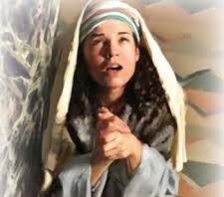
哈拿 ─ 改變歷史的禱告

Slide 22
撒母耳記上 1 Samuel 1:5-6
給哈拿的卻是雙分，因為他愛哈拿。 無奈耶和華不使哈拿生育。 毘尼拿見耶和華不使哈拿生育，就作她的對頭，大大激動她，要使她生氣。
but to Hannah he would give a double portion, for he loved Hannah, but the Lord had closed her womb. Her rival, however, would provoke her bitterly to irritate her, because the Lord had closed her womb. (NASB)

Slide 23
既然「無奈耶和華不使哈拿生育」，禱告和不禱告有什麼差別？

Slide 24
撒母耳記上 1 Samuel 1:10-11
哈拿心裡愁苦，就痛痛哭泣，祈禱耶和華，許願說：「萬軍之耶和華啊，你若垂顧婢女的苦情，眷念不忘婢女，賜我一個兒子，我必使他終身歸與耶和華，不用剃頭刀剃他的頭。」
She, greatly distressed, prayed to the Lord and wept bitterly. She made a vow and said, “O Lord of hosts, if You will indeed look on the affliction of Your maidservant and remember me, and not forget Your maidservant, but will give Your maidservant a son, then I will give him to the Lord all the days of his life, and a razor shall never come on his head.” (NASB)

Slide 25
撒母耳記上 1 Samuel 1:19-20
次日清早，他們起來，在耶和華面前敬拜，就回拉瑪。 到了家裡，以利加拿和妻哈拿同房，耶和華顧念哈拿，哈拿就懷孕。日期滿足，生了一個兒子，給他起名叫撒母耳，說：「這是我從耶和華那裡求來的。」
Then they arose early in the morning and worshiped before the Lord, and returned again to their house in Ramah. And Elkanah had relations with Hannah his wife, and the Lord remembered her. It came about [b]in due time, after Hannah had conceived, that she gave birth to a son; and she named him Samuel, saying, “Because I have asked him of the Lord.” (NASB)

Slide 26
詩篇 Psalm 118:5-6
我在急難中求告耶和華，他就應允我，把我安置在寬闊之地。 有耶和華幫助我，我必不懼怕，人能把我怎麼樣呢？
From my distress I called upon the Lord;
The Lord answered me and set me in a large place.
The Lord is for me; I will not fear;
What can man do to me? (NASB)

Slide 27
逆轉勝的關鍵
        信心與忍耐 — 學習基督存心忍耐
        眼光的焦點 — 神的應許以及作為
        恆切的禱告 — 傾心吐意向神呼求

Slide 28
羅馬書 Romans 15:13
但願使人有盼望的 神，因信將諸般的喜樂、平安充滿你們的心，使你們藉著聖靈的能力大有盼望！
Now may the God of hope fill you with all joy and peace in believing, so that you will abound in hope by the power of the Holy Spirit. (NASB)

Slide 29

回應詩歌 Response Song
「禱告等候」

