Slide 1

主日信息
Sunday Sermon

Slide 2

檢視我們的信仰
Examining the Faith
波特蘭靈糧堂
September 15, 2024

Slide 3


Slide 4
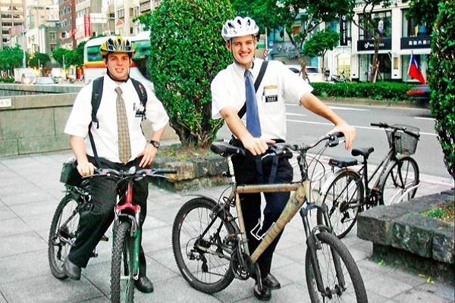

Slide 5
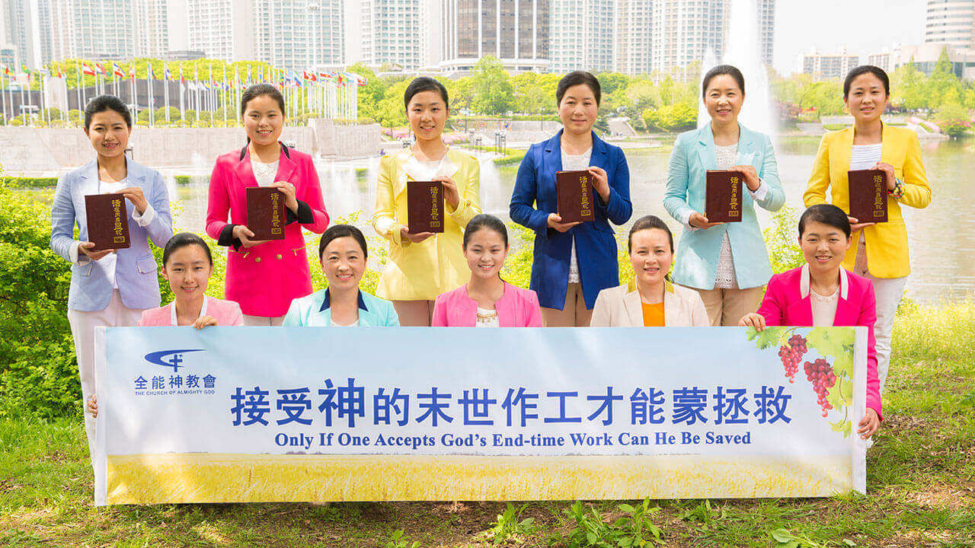

Slide 6

以弗所書 Ephesians 4:13-14
直等到我們眾人在真道上同歸於一，認識 神的兒子，得以長大成人，滿有基督長成的身量，
使我們不再作小孩子，中了人的詭計和欺騙的法術，被一切異教之風搖動，飄來飄去，就隨從各樣的異端；
until we all attain to the unity of the faith, and of the knowledge of the Son of God, to a mature man, to the measure of the stature which belongs to the fullness of Christ. As a result, we are no longer to be children, tossed here and there by waves and carried about by every wind of doctrine, by the trickery of men, by craftiness in deceitful scheming; (NASB)

Slide 7
信心與信仰
信心 ─ Faith
信仰 ─ The Faith

Slide 8
信仰的實質內容架構
啟示論 ─ 會說話的神的一般啟示與特殊啟示
神論 ─ 三位一體、同榮同尊、創造宇宙萬物的神
人論 ─ 人是神按祂的形象和樣式所造的
罪論 ─ 人類受亞當和夏娃的原罪影響而墮落
基督論 ─ 耶穌是完全的人也是完全的神
救恩論 ─ 神在愛中救贖我們的目的和計畫
聖靈論 ─ 認識聖靈的位格與聖靈的工作
教會論 ─ 教會是主耶穌的身體、是神的家
末世論 ─ 個人的末世 (永生) 和世界的末世

Slide 9

啟示論

Slide 10
啟示論
  神是說話的神，我們可以聽見聖靈的聲音
  一般啟示 ─ 神的創造顯明神的存在
  特殊啟示 ─ 神透過祂的話語和耶穌來啟示

Slide 11
羅馬書 Romans 1:19-20
神的事情，人所能知道的，原顯明在人心裡，因為 神已經給他們顯明。 自從造天地以來， 神的永能和神性是明明可知的，雖是眼不能見，但藉著所造之物就可以曉得，叫人無可推諉。
because that which is known about God is evident within them; for God made it evident to them. For since the creation of the world His invisible attributes, His eternal power and divine nature, have been clearly seen, being understood through what has been made, so that they are without excuse. (NASB)

Slide 12
提摩太後書 2 Timothy 3:16-17
聖經都是 神所默示的，於教訓、督責、使人歸正、教導人學義都是有益的，叫屬 神的人得以完全，預備行各樣的善事。
All Scripture is inspired by God and profitable for teaching, for reproof, for correction, for training in righteousness; so that the man of God may be adequate, equipped for every good work. (NASB)

Slide 13
神論

Slide 14
神論 Paterology
    神是聖父、聖子、聖靈三位一體的神
    聖父、聖子、聖靈三個位格同榮同尊
    三位一體的神是創造宇宙萬物的主宰

Slide 15
創世記 Genesis 1:1-3
起初， 神創造天地。 地是空虛混沌，淵面黑暗； 神的靈運行在水面上。 神說：「要有光」，就有了光。
In the beginning God created the heavens and the earth. The earth was formless and void, and darkness was over the surface of the deep, and the Spirit of God was moving over the surface of the waters. Then God said, “Let there be light”; and there was light. (NASB)

Slide 16
人論

Slide 17
人論 Christian Anthropology
    人是神按祂的形象和樣式所創造的
    人的受造是獨特的，是有靈的活人
    人的靈與神的靈原來是可以溝通的

Slide 18
創世記 Genesis 5:1-2
亞當的後代記在下面。（當 神造人的日子，是照著自己的樣式造的，並且造男造女。 在他們被造的日子， 神賜福給他們，稱他們為「人」。
This is the book of the generations of Adam. In the day when God created man, He made him in the likeness of God. He created them male and female, and He blessed them and named them Man in the day when they were created. (NASB)

Slide 19
罪論

Slide 20
罪論 Hamartiology
    人因為亞當夏娃犯罪而墮落
    亞當夏娃的原罪使全人類都陷在罪中
    人因為罪而使靈無法與神的靈溝通

Slide 21
哥林多前書 1 Cor. 15:21-22
死既是因一人而來，死人復活也是因一人而來。 在亞當裡眾人都死了；照樣，在基督裡眾人也都要復活。
For since by a man came death, by a man also came the resurrection of the dead. For as in Adam all die, so also in Christ all will be made alive. (NASB)

Slide 22
基督論

Slide 23
基督論 Christology
    基督教信仰的核心就是承認耶穌是基督，是永生神的兒子，是三位一體中的一位
    耶穌同時是完全的人也是完全的神
    耶穌道成肉身，祂有人的本性但沒有犯罪
    必須透過耶穌才能真正的認識神、相信神

Slide 24
馬太福音 Matthew 16:15-17
耶穌說：「你們說我是誰？」西門•彼得回答說：「你是基督，是永生 神的兒子。」 耶穌對他說：「西門•巴•約拿，你是有福的！ 因為這不是屬血肉的指示你的，乃是我在天上的父指示的。
He said to them, “But who do you say that I am?” Simon Peter answered, “You are the Christ, the Son of the living God.” And Jesus said to him, “Blessed are you, Simon Barjona, because flesh and blood did not reveal this to you, but My Father who is in heaven. (NASB)

Slide 25
約翰福音 John 1:18
從來沒有人看見 神，只有在父懷裡的獨生子將他表明出來。
No one has seen God at any time; the only begotten God who is in the bosom of the Father, He has explained Him. (NASB)

Slide 26
救恩論

Slide 27
救恩論 Soteriology
    主耶穌在十字架上成全了救恩
    因信稱義的救贖恩典需要透過人的信心
    救恩是白白的恩典，不是靠人的行為

Slide 28
以弗所書 Ephesians 2:8-9
你們得救是本乎恩，也因著信；這並不是出於自己，乃是 神所賜的；也不是出於行為，免得有人自誇。
For by grace you have been saved through faith; and that not of yourselves, it is the gift of God; not as a result of works, so that no one may boast. (NASB)

Slide 29
聖靈論

Slide 30
聖靈論 Pneumatology
    聖靈是三位一體中的一位，不是一種能力
    聖靈的洗使信徒重生、幫助信徒生命成聖
    隨己意賜下屬靈恩賜幫助個人和造就教會
    聖靈充滿結出聖靈的果子和有功效的服事
    聆聽聖靈的聲音、順從聖靈的引領

Slide 31
使徒行傳 Acts 1:8
但聖靈降臨在你們身上，你們就必得著能力，並要在耶路撒冷、猶太全地，和撒馬利亞，直到地極，作我的見證。
but you will receive power when the Holy Spirit has come upon you; and you shall be My witnesses both in Jerusalem, and in all Judea and Samaria, and even to the remotest part of the earth.” (NASB)

Slide 32
使徒行傳 Acts 13:2-4
他們事奉主、禁食的時候，聖靈說：「要為我分派巴拿巴和掃羅，去做我召他們所做的工。」於是禁食禱告，按手在他們頭上，就打發他們去了。
While they were worshiping the Lord and fasting, the Holy Spirit said, “Set apart for me Barnabas and Saul for the work to which I have called them.” So after they had fasted and prayed, they placed their hands on them and sent them off. (NASB)

Slide 33
教會論

Slide 34
教會論 Ecclesiology
    教會是主耶穌基督的身體，是神的家
    主耶穌賜給教會禱告的權柄來綑綁和釋放
    教會的崇拜、治理方式以及聖禮

Slide 35
以弗所書 Ephesians 1:22-23
又將萬有服在他的腳下，使他為教會作萬有之首。 教會是他的身體，是那充滿萬有者所充滿的。
And He put all things in subjection under His feet, and gave Him as head over all things to the church, which is His body, the fullness of Him who fills all in all. (NASB)

Slide 36
馬太福音 Matthew 16:18-20
我還告訴你，你是彼得，我要把我的教會建造在這磐石上；陰間的權柄，不能勝過他。我要把天國的鑰匙給你，凡你在地上所捆綁的，在天上也要捆綁；凡你在地上所釋放的，在天上也要釋放。」
I also say to you that you are Peter, and upon this rock I will build My church; and the gates of Hades will not overpower it. I will give you the keys of the kingdom of heaven; and whatever you bind on earth shall have been bound in heaven, and whatever you loose on earth shall have been loosed in heaven.” (NASB)

Slide 37
末世論

Slide 38
末世論 Eschatology
    個人的末世 (信耶穌的人得永生)
    世界的末世 (主再來、被提、大災難、死人復活、白色大寶座的審判、千禧年)
    神要恢復與人同住，他們要作他的子民

Slide 39
帖撒羅尼迦前書 1 Thess. 4:16-17
因為主必親自從天降臨，有呼叫的聲音和天使長的聲音，又有 神的號吹響；那在基督裡死了的人必先復活。 以後我們這活著還存留的人必和他們一同被提到雲裡，在空中與主相遇。這樣，我們就要和主永遠同在。
For the Lord Himself will descend from heaven with a shout, with the voice of the archangel and with the trumpet of God, and the dead in Christ will rise first. Then we who are alive [b]and remain will be caught up together with them in the clouds to meet the Lord in the air, and so we shall always be with the Lord. (NASB)

Slide 40
耶利米書 Jeremiah 24:7
我要賜他們認識我的心，知道我是耶和華。 他們要作我的子民，我要作他們的 神，因為他們要一心歸向我。」
I will give them a heart to know Me, for I am the Lord; and they will be My people, and I will be their God, for they will return to Me with their whole heart. (NASB)

Slide 41
啟示錄 Revelation 21:1-3
我又看見一個新天新地；因為先前的天地已經過去了，海也不再有了。我又看見聖城新耶路撒冷由 神那裡從天而降，預備好了，就如新婦妝飾整齊，等候丈夫。 我聽見有大聲音從寶座出來說：「看哪， 神的帳幕在人間。 他要與人同住，他們要作他的子民。 神要親自與他們同在，作他們的 神。

Slide 42
結語

Slide 43
提摩太前書 1 Timothy 4:1-2
聖靈明說，在後來的時候，必有人離棄真道，聽從那引誘人的邪靈和鬼魔的道理。 這是因為說謊之人的假冒；這等人的良心如同被熱鐵烙慣了一般。
But the Spirit explicitly says that in later times some will [a]fall away from the faith, paying attention to deceitful spirits and doctrines of demons, by means of the hypocrisy of liars seared in their own conscience as with a branding iron, (NASB)

Slide 44
加拉太書 Galatians 6:7-8
不要自欺， 神是輕慢不得的。 人種的是甚麼，收的也是甚麼。 順著情慾撒種的，必從情慾收敗壞；順著聖靈撒種的，必從聖靈收永生。
Do not be deceived, God is not mocked; for whatever a man sows, this he will also reap. For the one who sows to his own flesh will from the flesh reap corruption, but the one who sows to the Spirit will from the Spirit reap eternal life. (NASB)

Slide 45
提摩太後書 2 Timothy 2:24-26
然而主的僕人不可爭競，只要溫溫和和地待眾人，善於教導，存心忍耐，用溫柔勸戒那抵擋的人；或者 神給他們悔改的心，可以明白真道，叫他們這已經被魔鬼任意擄去的，可以醒悟，脫離他的網羅。
The Lord’s bond-servant must not be quarrelsome, but be kind to all, able to teach, patient when wronged, with gentleness correcting those who are in opposition, if perhaps God may grant them repentance leading to the knowledge of the truth, and they may come to their senses and escape from the snare of the devil, having been held captive by him to do his will. (NASB)

Slide 46

回應詩歌 Response Song
「神羔羊配得」

Slide 47


