Slide 1


Slide 2

主日信息
Sunday Sermon
Rabbi P. Gabriel Lumbroso
September 22, 2024

Slide 3


THE 5784 HAMAS/ISRAEL CONFLICT
A Biblical Perspective

Slide 4
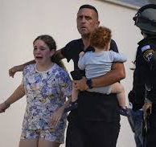
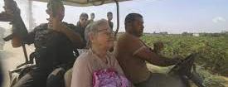
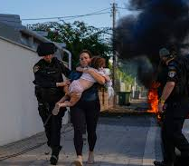
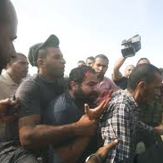
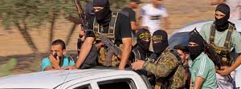

Slide 5
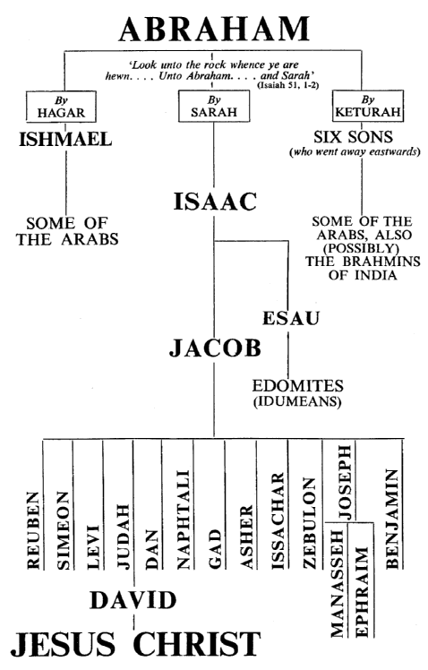
YESHUA

Slide 6
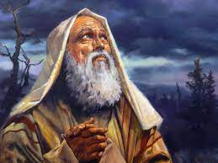
I will bless those who bless you, but I will curse anyone who curses you;
and by you all the families of the earth will be blessed."
(Genesis 12:3 CJB)

Slide 7

創世記 Genesis 12:3
為你祝福的，我必賜福與他；那咒詛你的，我必咒詛他。 地上的萬族都要因你得福。」

Slide 8
That day Adonai made a covenant with Avram: "I have given this land to your descendants -- from the Vadi of Egypt to the great river, the Euphrates River --the territory of the Keni, the K'nizi, the Kadmoni, the Hitti, the P'rizi, the Refa'im, the Emori, the Kena`ani, the Girgashi and the Y'vusi." (Genesis 15:7-21 CJB)

Slide 9
創世記 Genesis 15:7-21
18 當那日，耶和華與亞伯蘭立約，說：「我已賜給你的後裔，從埃及河直到幼發拉底大河之地，19 就是基尼人、基尼洗人、甲摩尼人、20 赫人、比利洗人、利乏音人、 21 亞摩利人、迦南人、革迦撒人、耶布斯人之地。」

Slide 10
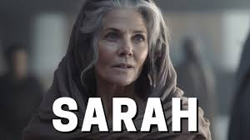
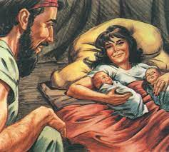
Now Sarai was barren; she had no child.
(Genesis 11:30 ESV)
And Isaac prayed to the LORD for his wife, because she was barren. And the LORD granted his prayer, and Rebekah his wife conceived.
(Genesis 25:21 ESV)

Slide 11
創世記 Genesis 11:30
撒萊不生育，沒有孩子。
創世記 Genesis 25:21
以撒因他妻子不生育，就為她祈求耶和華；耶和華應允他的祈求，他的妻子利百加就懷了孕。
2221

Slide 12
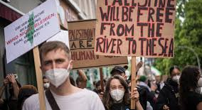
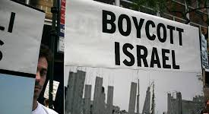
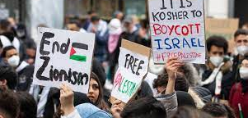
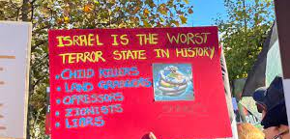

Slide 13
On that day the LORD made a covenant with Abram, saying, “To your offspring I give this land, from the river of Egypt to the great river, the river Euphrates,
(Genesis 15:18 ESV)

Slide 14
創世記 Genesis 15:18
當那日，耶和華與亞伯蘭立約，說：「我已賜給你的後裔，從埃及河直到幼發拉底大河之地，

Slide 15
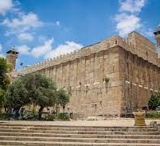
]. Thus the field of `Efron in Makhpelah, which is by Mamre -- the field, its cave and all the trees in and around it -- were deeded to Avraham as his possession in the presence of the sons of Het who belonged to the ruling council of the city.

Slide 16
創世記 Genesis 23:17-18
於是，麥比拉、幔利前、以弗崙的那塊田和其中的洞，並田間四圍的樹木，都定準歸與亞伯拉罕，乃是他在赫人面前並城門出入的人面前買妥的。

Slide 17
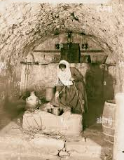
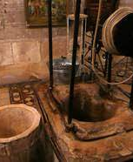
2.
Having traveled from Paddan-Aram, Ya`akov arrived safely at the city of Sh'khem, in Kena`an, and set up camp near the city. From the sons of Hamor Sh'khem's father he bought for one hundred pieces of silver the parcel of land where he had pitched his tent. There he put up an altar, which he called El-Elohei-Yisra'el [God, the God of Isra'el].
(Genesis 33:18-20 CJB)

Slide 18
創世記 Genesis 33:18-20
雅各從巴旦‧亞蘭回來的時候，平平安安地到了迦南地的示劍城，在城東支搭帳棚， 就用一百塊銀子向示劍的父親、哈抹的子孫買了支帳棚的那塊地，在那裡築了一座壇，起名叫伊利‧伊羅伊‧以色列（就是 神、以色列 神的意思）。

Slide 19
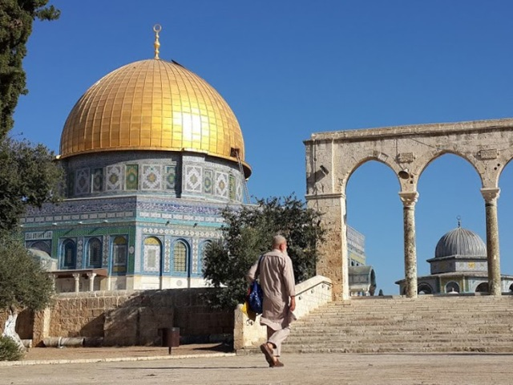
But the king said to Araunah, “No, but I will buy it from you for a price. I will not offer burnt offerings to the LORD my God that cost me nothing.” So David bought the threshing floor and the oxen for fifty shekels of silver. And David built there an altar to the LORD and offered burnt offerings and peace offerings. So the LORD responded to the plea for the land, and the plague was averted from Israel.
(2 Samuel 24:24-25 ESV)

Slide 20
撒母耳記下 2 Samuel 24:24-25
王對亞勞拿說：「不然我必要按著價值向你買；我不肯用白得之物作燔祭獻給耶和華─我的 神。」大衛就用五十舍客勒銀子買了那禾場與牛。 大衛在那裡為耶和華築了一座壇，獻燔祭和平安祭。如此，耶和華垂聽國民所求的，瘟疫在以色列人中就止住了。

Slide 21
YESHUA

Slide 22
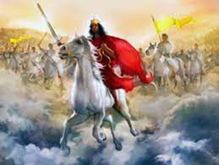

Slide 23
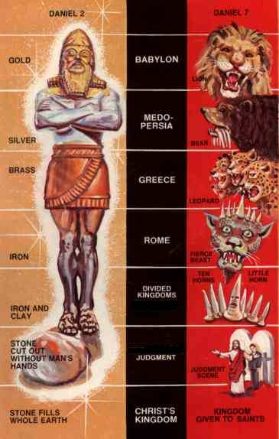

Slide 24
In 135 CE, after stamping out the province of Judea’s second insurrection, the Romans renamed the province Syria Palaestina—that is, “Palestinian Syria.”
They did so resentfully, as a punishment, to obliterate the link between the Jews (in Hebrew, Y’hudim and in Latin Judaei) and the province (the Hebrew name of which was Y’hudah). “Palaestina” referred to the Philistines, whose home base had been on the Mediterranean coast.

Slide 25
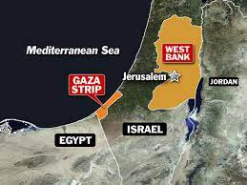

Slide 26
If your outcasts are in the uttermost parts of heaven, from there the LORD your God will gather you, and from there he will take you. And the LORD your God will bring you into the land that your fathers possessed, that you may possess it. And he will make you more prosperous and numerous than your fathers. And the LORD your God will circumcise your heart and the heart of your offspring, so that you will love the LORD your God with all your heart and with all your soul, that you may live. And the LORD your God will put all these curses on your foes and enemies who persecuted you.
(Deuteronomy 30:4-7 ESV)

Slide 27
申命記 Deuteronomy 30:4-7
你被趕散的人，就是在天涯的，耶和華─你的 神也必從那裡將你招聚回來。 耶和華─你的 神必領你進入你列祖所得的地，使你可以得著；又必善待你，使你的人數比你列祖眾多。 耶和華─你 神必將你心裡和你後裔心裡的污穢除掉，好叫你盡心盡性愛耶和華─你的 神，使你可以存活。 耶和華─你的 神必將這一切咒詛加在你仇敵和恨惡你、逼迫你的人身上。

Slide 28
The word that Isaiah the son of Amoz saw concerning Judah and Jerusalem. It shall come to pass in the latter days that the mountain of the house of the LORD shall be established as the highest of the mountains, and shall be lifted up above the hills; and all the nations shall flow to it, and many peoples shall come, and say: “Come, let us go up to the mountain of the LORD, to the house of the God of Jacob, that he may teach us his ways and that we may walk in his paths.” For out of Zion shall go forth the law, and the word of the LORD from Jerusalem. He shall judge between the nations, and shall decide disputes for many peoples; and they shall beat their swords into plowshares, and their spears into pruning hooks; nation shall not lift up sword against nation, neither shall they learn war anymore. O house of Jacob, come, let us walk in the light of the LORD.
(Isaiah 2:1-5 ESV)

Slide 29
以賽亞書 Isaiah 2:1-5
亞摩斯的兒子以賽亞得默示，論到猶大和耶路撒冷。 末後的日子，耶和華殿的山必堅立，超乎諸山，高舉過於萬嶺；萬民都要流歸這山。 必有許多國的民前往，說：來吧，我們登耶和華的山，奔雅各 神的殿。主必將他的道教訓我們；我們也要行他的路。因為訓誨必出於錫安；耶和華的言語必出於耶路撒冷。他必在列國中施行審判，為許多國民斷定是非。他們要將刀打成犁頭，把槍打成鐮刀。這國不舉刀攻擊那國；他們也不再學習戰事。 雅各家啊，來吧！我們在耶和華的光明中行走。

Slide 30
And I saw, coming out of the mouth of the dragon and out of the mouth of the beast and out of the mouth of the false prophet, three unclean spirits like frogs. For they are demonic spirits, performing signs, who go abroad to the kings of the whole world, to assemble them for battle on the great day of God the Almighty. (“Behold, I am coming like a thief! Blessed is the one who stays awake, keeping his garments on, that he may not go about naked and be seen exposed!”) And they assembled them at the place that in Hebrew is called Armageddon.
(Revelation 16:13-16 ESV)

Slide 31
啟示錄 Revelation 16:13-16
我又看見三個污穢的靈，好像青蛙，從龍口、獸口並假先知的口中出來。 他們本是鬼魔的靈，施行奇事，出去到普天下眾王那裡，叫他們在 神全能者的大日聚集爭戰。（看哪，我來像賊一樣。 那警醒、看守衣服、免得赤身而行、叫人見他羞恥的有福了！） 那三個鬼魔便叫眾王聚集在一處，希伯來話叫作哈米吉多頓。

Slide 32
Then I saw heaven opened, and behold, a white horse! The one sitting on it is called Faithful and True, and in righteousness he judges and makes war. His eyes are like a flame of fire, and on his head are many diadems, and he has a name written that no one knows but himself. He is clothed in a robe dipped in blood, and the name by which he is called is The Word of God. And the armies of heaven, arrayed in fine linen, white and pure, were following him on white horses. From his mouth comes a sharp sword with which to strike down the nations, and he will rule them with a rod of iron. He will tread the winepress of the fury of the wrath of God the Almighty. On his robe and on his thigh he has a name written, King of kings and Lord of lords. Then I saw an angel standing in the sun, and with a loud voice he called to all the birds that fly directly overhead, “Come, gather for the great supper of God, to eat the flesh of kings, the flesh of captains, the flesh of mighty men, the flesh of horses and their riders, and the flesh of all men, both free and slave, both small and great.” And I saw the beast and the kings of the earth with their armies gathered to make war against him who was sitting on the horse and against his army. And the beast was captured, and with it the false prophet who in its presence had done the signs by which he deceived those who had received the mark of the beast and those who worshiped its image. These two were thrown alive into the lake of fire that burns with sulfur. And the rest were slain by the sword that came from the mouth of him who was sitting on the horse, and all the birds were gorged with their flesh.
(Revelation 19:11-21 ESV)

Slide 33
啟示錄 Revelation 19:11-21
11 我觀看，見天開了。有一匹白馬，騎在馬上的稱為誠信真實，他審判，爭戰，都按著公義。 12 他的眼睛如火焰，他頭上戴著許多冠冕；又有寫著的名字，除了他自己沒有人知道。 13 他穿著濺了血的衣服；他的名稱為 神之道。 14 在天上的眾軍騎著白馬，穿著細麻衣，又白又潔，跟隨他。

Slide 34
啟示錄 Revelation 19:11-21
15 有利劍從他口中出來，可以擊殺列國。他必用鐵杖轄管他們，並要踹全能 神烈怒的酒醡。 16 在他衣服和大腿上有名寫著說：「萬王之王，萬主之主。」17 我又看見一位天使站在日頭中，向天空所飛的鳥大聲喊著說：「你們聚集來赴 神的大筵席，18 可以吃君王與將軍的肉，壯士與馬和騎馬者的肉，並一切自主的為奴的，以及大小人民的肉。」
19 我看見那獸和地上的君王，並他們的眾軍都聚集，要與騎白馬的並他的軍兵爭戰。 20 那獸被擒拿；那在獸面前曾行奇事、迷惑受獸印記和拜獸像之人的假先知，也與獸同被擒拿。他們兩個就活活地被扔在燒著硫磺的火湖裡；21 其餘的被騎白馬者口中出來的劍殺了；飛鳥都吃飽了他們的肉。

Slide 35
啟示錄 Revelation 19:11-21
19 我看見那獸和地上的君王，並他們的眾軍都聚集，要與騎白馬的並他的軍兵爭戰。 20 那獸被擒拿；那在獸面前曾行奇事、迷惑受獸印記和拜獸像之人的假先知，也與獸同被擒拿。 他們兩個就活活地被扔在燒著硫磺的火湖裡；21 其餘的被騎白馬者口中出來的劍殺了；飛鳥都吃飽了他們的肉。

Slide 36
ON BEHALF OF …
THE LAND OF ISRAEL
(Congregation)
May He bless the Land of Return of the Jewish people: lead and guide the Israeli military in order to fulfill their responsibilities.
We ask that those in power in Israel be led to accomplish towards what was ordained by the prophets long ago; that the forces of Your Divine wisdom prevail.
May He preserve and rescue those who fight for the defense of the Land from every trouble and distress and from every plague and illness. Send blessing and success in their every endeavor that may be fulfilled for them Your promise, “For it is the Lord your G-d, Who goes with you to battle your enemies for you to save you.” (Deut. 20:4)
Notes:
36

Slide 37

回應詩歌 Response Song
「Day of Messiah 彌賽亞的日子」

Slide 38
Day of Messiah
What will we do in the Day of Messiah?
What will we do in the Day
that He comes?
What will we do in the
Day of Mashiach?
When He comes to conquer
the Land?

Slide 39
Day of Messiah
CHORUS
The shofar will sound Jubilee
The captives at last will be free
To replenish the earth
Bring life and rebirth
When the Lion of Judah
Will reign

Slide 40
Day of Messiah
Who’ll take the stand in the
Day of Messiah?
Who’ll be strong in the day
that He comes?
Who will be found in the
Day of Mashiach
Faithful to keep His commands?

Slide 41
Day of Messiah
CHORUS
The shofar will sound Jubilee
The captives at last will be free
To replenish the earth
Bring life and rebirth
When the Lion of Judah
Will reign

Slide 42
Day of Messiah
Lai, lai, lai, lai…

Slide 43
Day of Messiah
CHORUS
The shofar will sound Jubilee
The captives at last will be free
To replenish the earth
Bring life and rebirth
When the Lion of Judah
Will reign

Slide 44
祝福禱告 Benediction Prayer
民數記 Numbers 6:24-26

Slide 45
Bircat HaKohanim בִּירכַּת הַכֹּהָנִים
Num 6:24-26
Standing
May Adonai bless you and keep you!
May Adonai make His face shine on you
And show you His favor!
May Adonai lift up His face towards you
and give you peace.
יְבָרֶכְךָ יְיָ וְיִשְׁמְרֶךָ׃
כֵן יְהִי רָצוֹן
יָאֵר יְיָ פָּנָיו אֵלֶיךָ וִיחֻנֶּךָּ׃
כֵן יְהִי רָצוֹן
יִשָּׂא יְיָ פָּנָיו אֵלֶיךָ
וְיָשֵׂם לְךָ שָׁלוֹם׃
כֵן יְהִי רָצוֹן
Ken, y’hi ratzon
(May it be Your will)

Slide 46
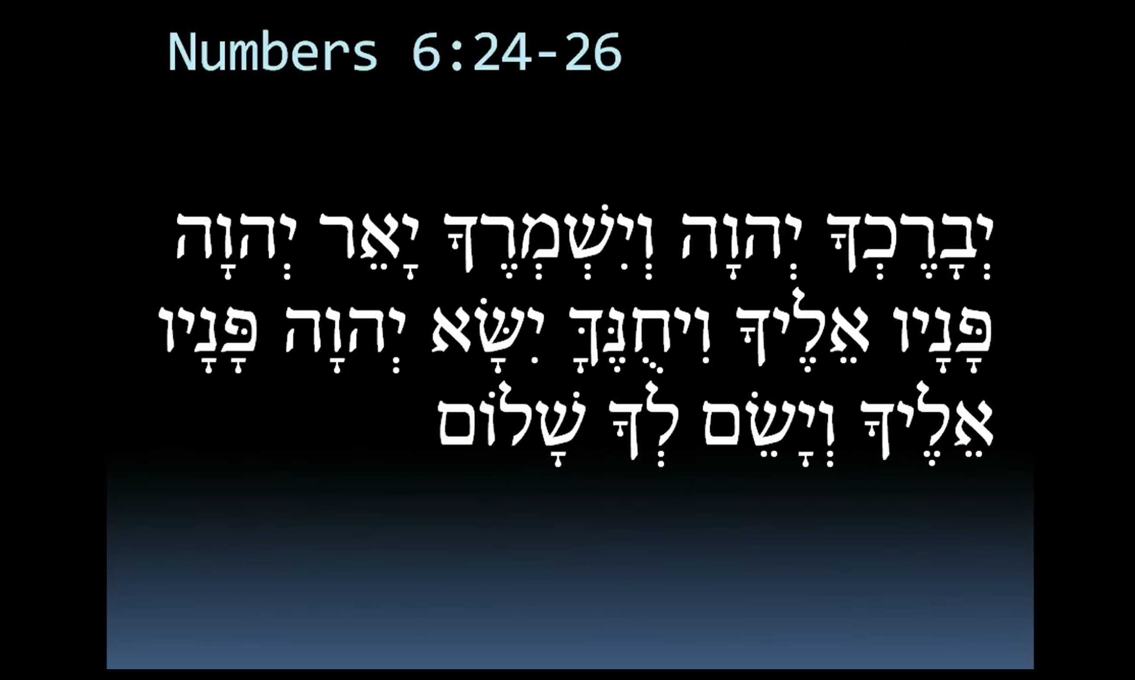
民數記 Numbers 6:24-26
願耶和華賜福給你，保護你。
願耶和華使他的臉光照你，賜恩給你。
願耶和華向你仰臉，賜你平安。

Slide 47


