Slide 1

主日信息
Sunday Sermon

Slide 2

夠用的恩典
Sufficient Grace
波特蘭靈糧堂
September 29, 2024

Slide 3

哥林多後書 2 Cor. 12:9
他對我說：「我的恩典夠你用的，因為我的能力是在人的軟弱上顯得完全。」 所以，我更喜歡誇自己的軟弱，好叫基督的能力覆庇我。」
And He has said to me, “My grace is sufficient for you, for power is perfected in weakness.” Most gladly, therefore, I will rather boast about my weaknesses, so that the power of Christ may dwell in me. (NASB)

Slide 4
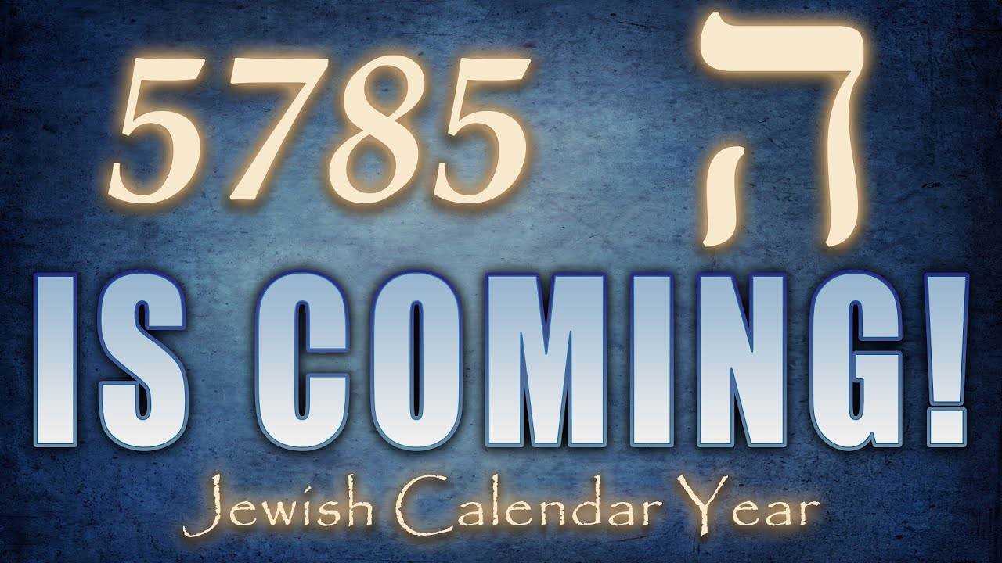

Slide 5
5785 夠用的恩典 Sufficient Grace in 5785
      倚靠聖靈經歷神蹟 Receiving miracles by the Spirit
      憐憫的愛彰顯基督 Magnifying Christ through merciful love

Slide 6
撒迦利亞書 Zechariah 4:6-7
他對我說：「這是耶和華指示所羅巴伯的。萬軍之耶和華說：不是倚靠勢力，不是倚靠才能，乃是倚靠我的靈方能成事。
Then he said to me, “This is the word of the Lord to Zerubbabel saying, ‘Not by might nor by power, but by My Spirit,’ says the Lord of hosts. (NASB)

Slide 7
撒迦利亞書 Zechariah 4:6-7
他對我說：「這是耶和華指示所羅巴伯的。萬軍之耶和華說：不是倚靠勢力，不是倚靠才能，乃是倚靠我的靈方能成事。
Then he said to me, “This is the word of the Lord to Zerubbabel saying, ‘Not by might nor by power, but by My Spirit,’ says the Lord of hosts. (NASB)
勢力、才能 ─ 你所擁有的 (自我限制)
Might/Power ─ what you own (self-limits)

Slide 8
約翰福音 John 6:5-7
耶穌舉目看見許多人來，就對腓力說：「我們從哪裡買餅叫這些人吃呢？」（他說這話是要試驗腓力；他自己原知道要怎樣行。） 腓力回答說：「就是二十兩銀子的餅，叫他們各人吃一點也是不夠的。」
Therefore Jesus, lifting up His eyes and seeing that a large crowd was coming to Him, said to Philip, “Where are we to buy bread, so that these may eat?” This He was saying to test him, for He Himself knew what He was intending to do. Philip answered Him, “Two hundred denarii worth of bread is not sufficient for them, for everyone to receive a little.” (NASB)

Slide 9
5785 夠用的恩典 Sufficient Grace in 5785
      倚靠聖靈經歷神蹟 Receiving miracles by the Spirit
      憐憫的愛彰顯基督 Magnifying Christ through merciful love

Slide 10
馬太福音 Matthew 9:36-38
他看見許多的人，就憐憫他們；因為他們困苦流離，如同羊沒有牧人一般。 於是對門徒說：「要收的莊稼多，做工的人少。 所以，你們當求莊稼的主打發工人出去收他的莊稼。」
Seeing the people, He felt compassion for them, because they were distressed and dispirited like sheep without a shepherd. Then He said to His disciples, “The harvest is plentiful, but the workers are few. Therefore beseech the Lord of the harvest to send out workers into His harvest.” (NASB)

Slide 11
路加福音 Luke 4:17-19
主的靈在我身上，因為他用膏膏我，叫我傳福音給貧窮的人；差遣我報告：被擄的得釋放，瞎眼的得看見，叫那受壓制的得自由，報告 神悅納人的禧年。
“The Spirit of the Lord is upon Me,
Because He anointed Me to preach the gospel to the poor.
He has sent Me to proclaim release to the captives,
And recovery of sight to the blind,
To set free those who are oppressed,
To proclaim the favorable year of the Lord.” (NASB)

Slide 12
5785 夠用的恩典 Sufficient Grace in 5785
      倚靠聖靈經歷神蹟 Receiving miracles by the Spirit
      憐憫的愛彰顯基督 Magnifying Christ through merciful love

Slide 13

回應詩歌 Response Song
「恩典夠用 Sufficient Grace」

