Slide 1


Slide 2

主日信息
Sunday Sermon

Slide 3

耶和華的意念與道路
The Thoughts and Ways of God
波特蘭靈糧堂
October 27, 2024

Slide 4
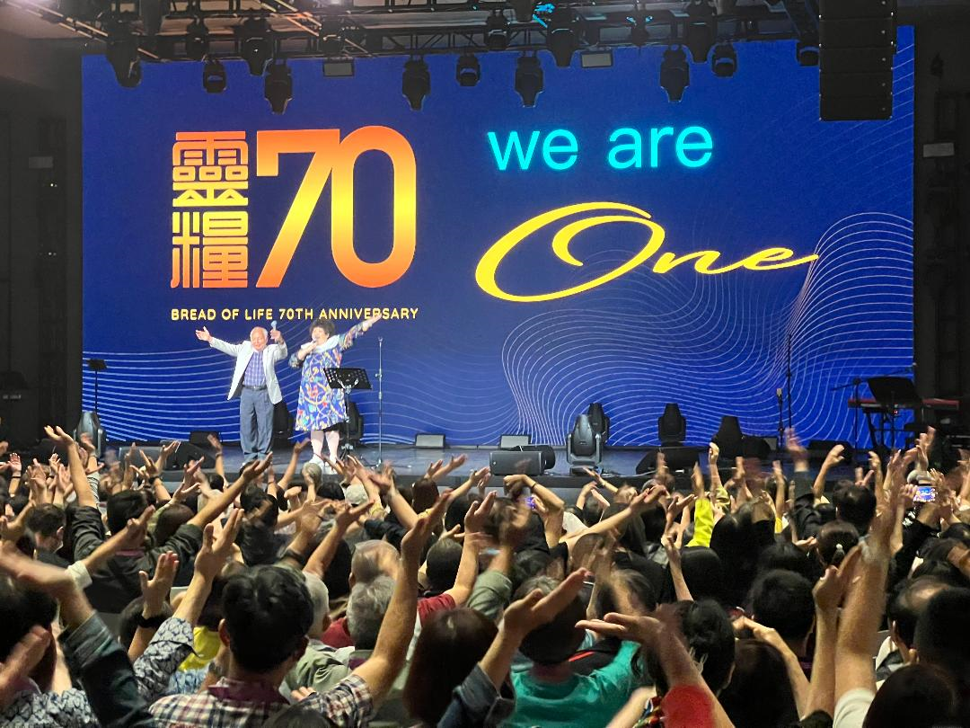

Slide 5
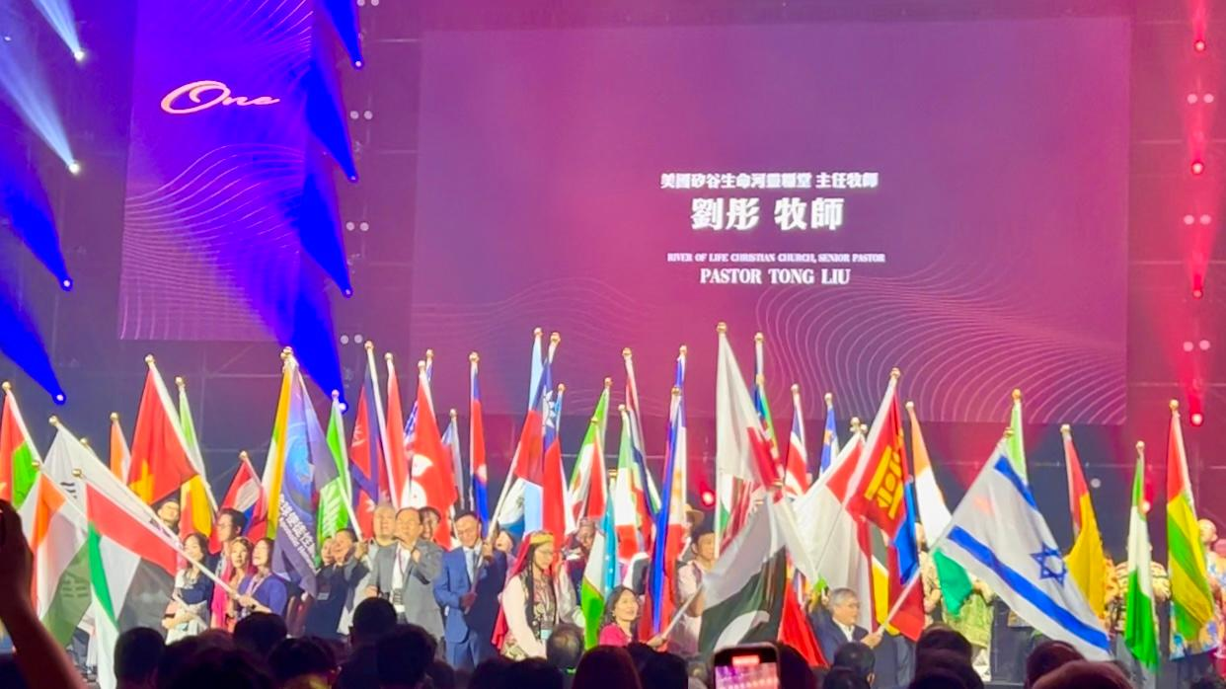

Slide 6

以賽亞書 Isaiah 55:8-9
耶和華說：我的意念非同你們的意念；我的道路非同你們的道路。 天怎樣高過地，照樣，我的道路高過你們的道路；我的意念高過你們的意念。
For My thoughts are not your thoughts,
Nor are your ways My ways,” declares the Lord.
For as the heavens are higher than the earth,
So are My ways higher than your ways
And My thoughts than your thoughts.

Slide 7
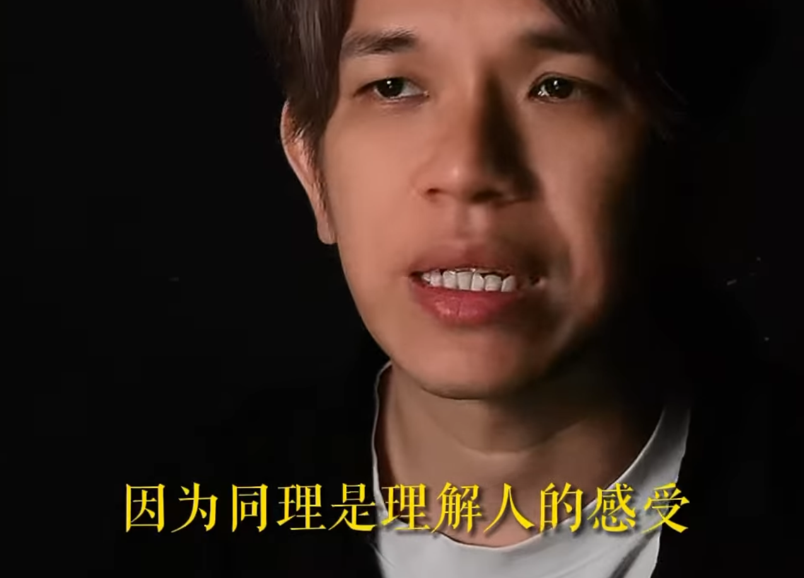

Slide 8
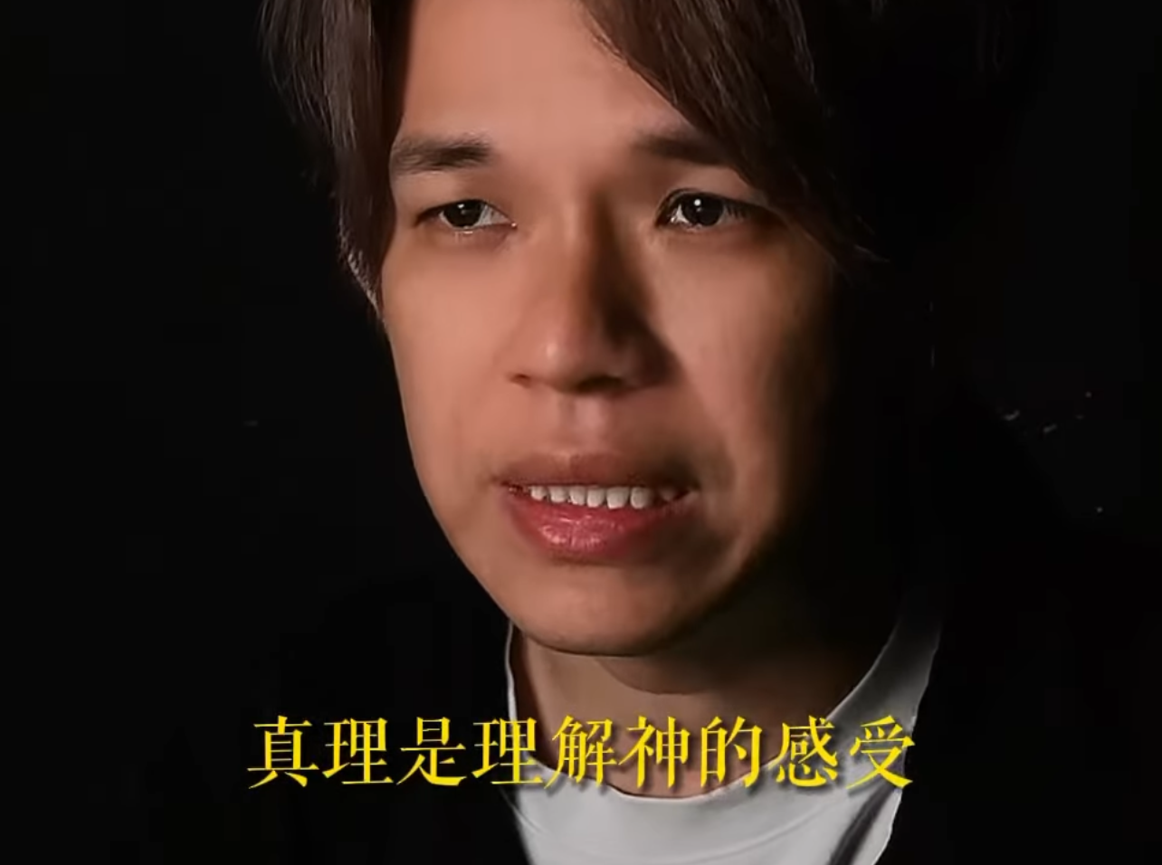

Slide 9
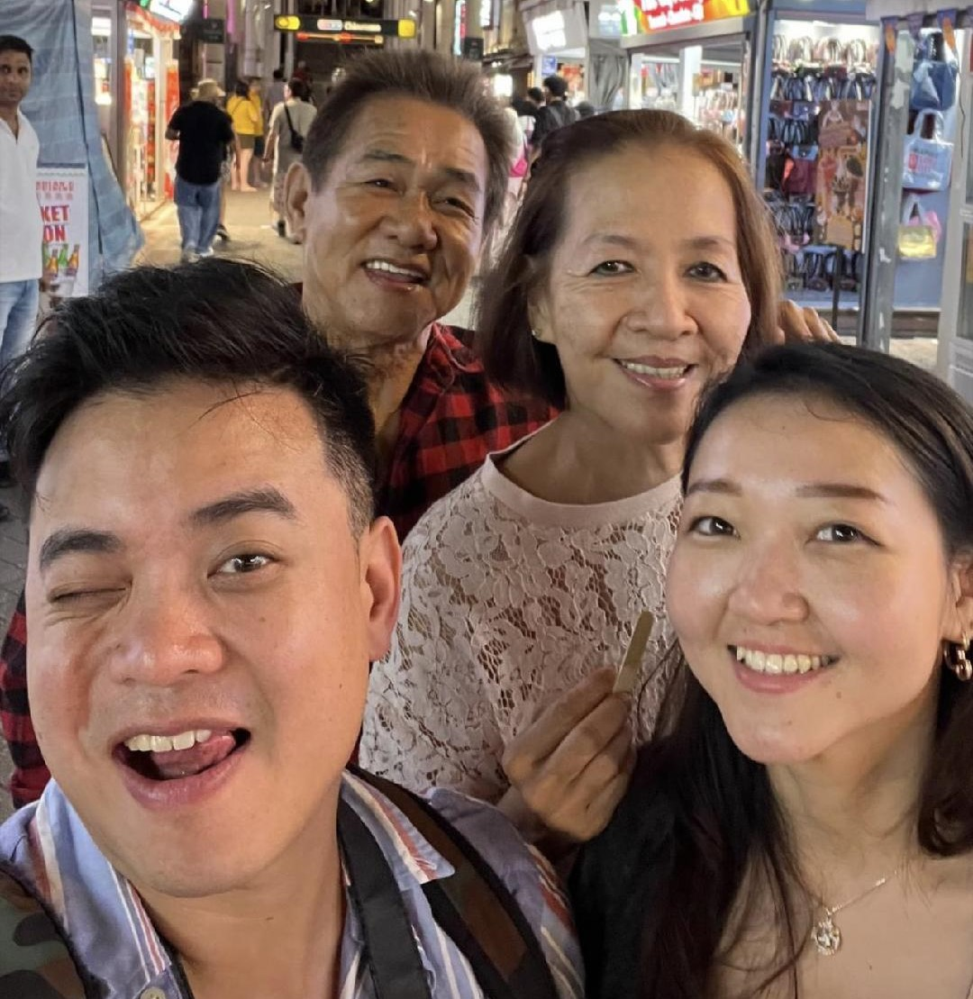
我的親家 ─ Mr. & Mrs. Lukito

Slide 10
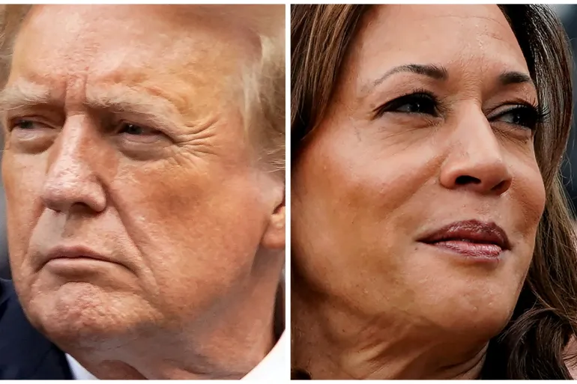
US Election 2024

Slide 11


合神心意的候選人？

Slide 12
使徒行傳 Luke 13:22
既廢了掃羅，就選立大衛作他們的王，又為他作見證說：『我尋得耶西的兒子大衛，他是合我心意的人，凡事要遵行我的旨意。』
After He had removed him, He raised up David to be their king, concerning whom He also testified and said, ‘I have found David the son of Jesse, a man after My heart, who will do all My will.’

Slide 13
屬靈追求的目的？

Slide 14
馬太福音 Matthew 17:4
彼得對耶穌說：「主啊，我們在這裡真好！ 你若願意，我就在這裡搭三座棚，一座為你，一座為摩西，一座為以利亞。」
Peter said to Jesus, “Lord, it is good for us to be here; if You wish, I will make three tabernacles here, one for You, and one for Moses, and one for Elijah.”

Slide 15

回應詩歌 Response Song
「祢的意念高過我的意念」

