Slide 1


Slide 2

主日信息
Sunday Sermon

Slide 3

不跳電的傳承
Sustainable Inheritance
波特蘭靈糧堂
November 3, 2024

Slide 4

路加福音 Luke 4:17-18
有人把先知以賽亞的書交給他，他就打開，找到一處寫著說：主的靈在我身上，因為他用膏膏我，叫我傳福音給貧窮的人；差遣我報告：被擄的得釋放，瞎眼的得看見，叫那受壓制的得自由，報告 神悅納人的禧年。
18 “The Spirit of the Lord is upon Me, Because He anointed Me to preach the gospel to the poor. He has sent Me to proclaim release to the captives, And recovery of sight to the blind, To set free those who are oppressed,19 To proclaim the favorable year of the Lord.”

Slide 5
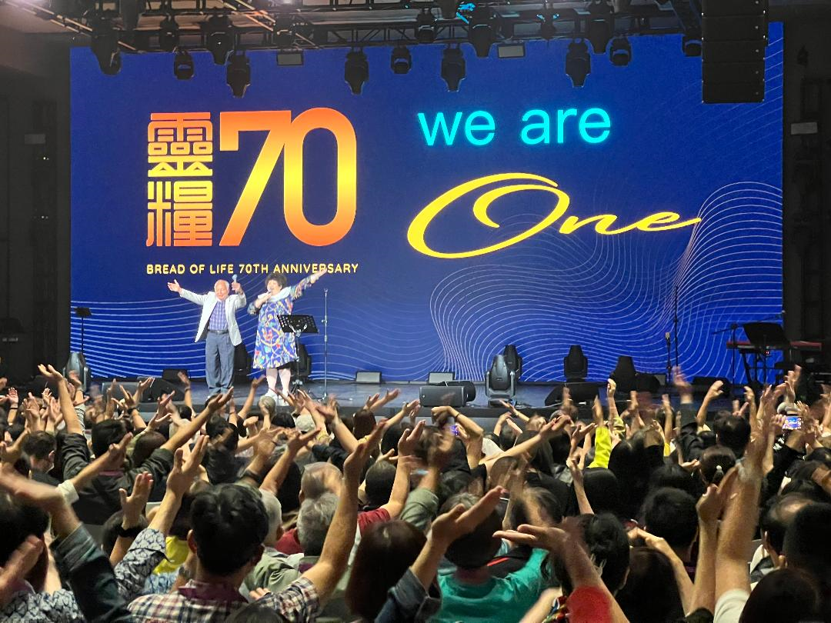

Slide 6
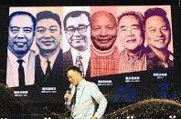
台北靈糧堂歷任主任牧師
趙世光、寇世遠、鄭昌國、周神助、區永亮、周巽正

Slide 7
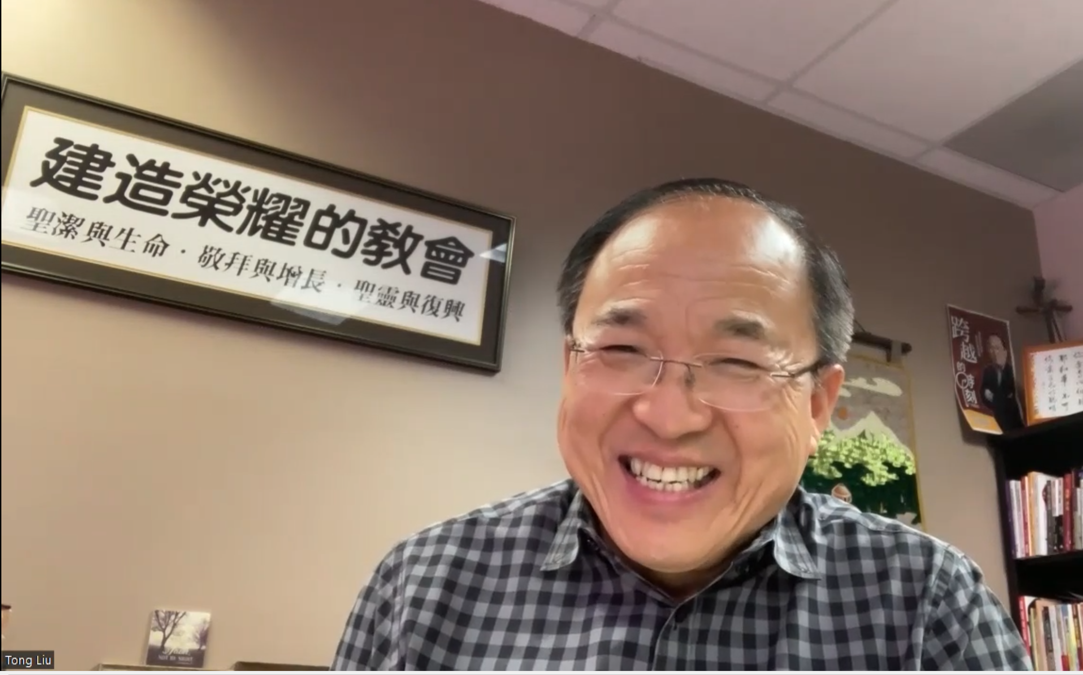

Slide 8


Slide 9


「空前絕後」 的講道？！

Slide 10
路加福音 Luke 4:18
主的靈在我身上，因為他用膏膏我，叫我傳福音給貧窮的人；差遣我報告：被擄的得釋放，瞎眼的得看見，叫那受壓制的得自由，報告 神悅納人的禧年。
“The Spirit of the Lord is upon Me, Because He anointed Me to preach the gospel to the poor. He has sent Me to proclaim release to the captives, And recovery of sight to the blind, To set free those who are oppressed,19 To proclaim the favorable year of the Lord.”

Slide 11
箴言 Proverbs 4:23
你要保守你心，勝過保守一切，因為一生的果效是由心發出。
Watch over your heart with all diligence,
For from it flow the springs of life.

Slide 12

回應詩歌 Response Song
「帶我進水深處」

Slide 13

同領聖餐 Holy Communion

Slide 14

哥林多前書 1 Corinthians 11:23-24
主耶穌被賣的那一夜，拿起餅來， 祝謝了，就擘開，說：「這是我的身體，為你們捨的，你們應當如此行，為的是記念我。」
The Lord Jesus, on the night he was betrayed, took bread, and when he had given thanks, he broke it and said, “This is my body, which is for you; do this in remembrance of me.”

Slide 15
哥林多前書 1 Corinthians 11:25
飯後，也照樣拿起杯來，說：「這杯是用我的血所立的新約，你們每逢喝的時候，要如此行，為的是記念我。」
In the same way, after supper he took the cup, saying, “This cup is the new covenant in my blood; do this, whenever you drink it, in remembrance of me.”

Slide 16
哥林多前書 1 Corinthians 11:26, 28
你們每逢吃這餅，喝這杯，是表明主的死，直等到他來。
For whenever you eat this bread and drink this cup, you proclaim the Lord’s death until he comes.
人應當自己省察，然後吃這餅、喝這杯。
Everyone ought to examine themselves before they eat of the bread and drink from the cup.

Slide 17
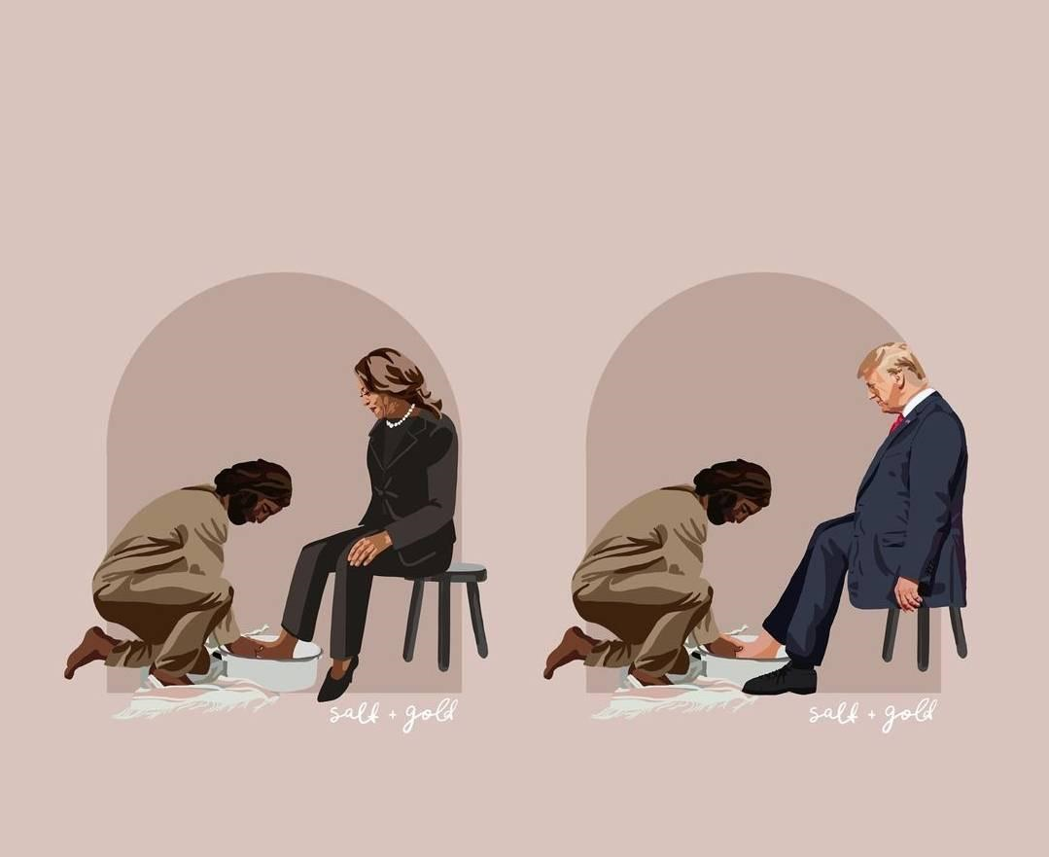

Slide 18
約翰福音 John 13:13-15
你們稱呼我夫子，稱呼我主，你們說的不錯，我本來是。 我是你們的主，你們的夫子，尚且洗你們的腳，你們也當彼此洗腳。 我給你們作了榜樣，叫你們照著我向你們所做的去做。
You call Me Teacher and Lord; and you are right, for so I am. If I then, the Lord and the Teacher, washed your feet, you also ought to wash one another’s feet. For I gave you an example that you also should do as I did to you.

Slide 19
以弗所書 Ephesians 4:2-4
凡事謙虛、溫柔、忍耐，用愛心互相寬容， 用和平彼此聯絡，竭力保守聖靈所賜合而為一的心。 身體只有一個，聖靈只有一個，正如你們蒙召同有一個指望。
with all humility and gentleness, with patience, showing tolerance for one another in love, being diligent to preserve the unity of the Spirit in the bond of peace. There is one body and one Spirit, just as also you were called in one hope of your calling;

Slide 20
以弗所書 Ephesians 4:30-32
不要叫 神的聖靈擔憂；你們原是受了他的印記，等候得贖的日子來到。 一切苦毒、惱恨、忿怒、嚷鬧、毀謗，並一切的惡毒，都當從你們中間除掉；並要以恩慈相待，存憐憫的心，彼此饒恕，正如 神在基督裡饒恕了你們一樣。
30 And do not grieve the Holy Spirit of God, with whom you were sealed for the day of redemption. 31 Get rid of all bitterness, rage and anger, brawling and slander, along with every form of malice.

Slide 21

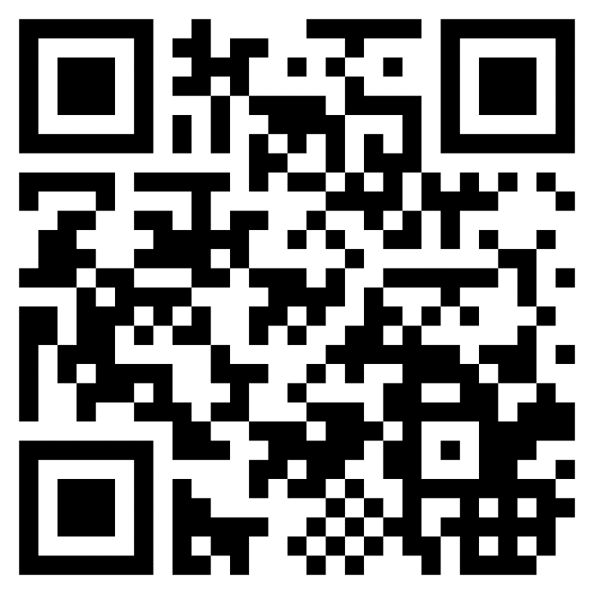
愛心奉獻 Offering
網上奉獻： 除了 Paypal 奉獻以外，歡迎使用 ZELLE 奉獻給教會帳號 bolip.donation@gmail.com
請在 comment 註明奉獻要歸給: 一般常費、會堂基金、宣教基金、 或是 慈惠基金。
支票奉獻：抬頭請寫 BOLIP

Slide 22

哥林多後書‬ 2 Corinthians. 9:6-7
「少種的少收，多種的多收」，這話是真的。 各人要隨本心所酌定的，不要作難，不要勉強，因為捐得樂意的人是 神所喜愛的。
Now this I say, he who sows sparingly will also reap sparingly, and he who sows bountifully will also reap bountifully. Each one must do just as he has purposed in his heart, not grudgingly or under compulsion, for God loves a cheerful giver.

Slide 23
奉獻禱告

