Slide 1


Slide 2

主日信息
Sunday Sermon

Slide 3

天父的愛
The Love of Father God
波特蘭靈糧堂
November 10, 2024

Slide 4


Slide 5


Slide 6
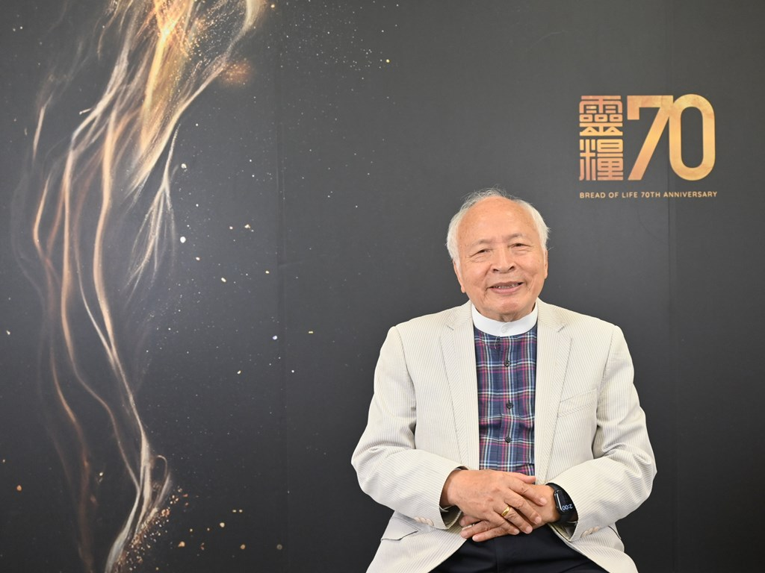

「從不曾被父親擁抱，到擁有為父的心」

Slide 7

哥林多前書 1 Cor. 4:14-16
我寫這話，不是叫你們羞愧，乃是警戒你們，好像我所親愛的兒女一樣。 你們學基督的，師傅雖有一萬，為父的卻是不多，因我在基督耶穌裡用福音生了你們。 所以，我求你們效法我。
I do not write these things to shame you, but to admonish you as my beloved children. For if you were to have countless tutors in Christ, yet you would not have many fathers, for in Christ Jesus I became your father through the gospel. Therefore I exhort you, be imitators of me.

Slide 8

「天父的愛」

Slide 9
約翰福音 John 14:23
耶穌回答說：「人若愛我，就必遵守我的道；我父也必愛他，並且我們要到他那裡去，與他同住。
Jesus answered and said to him, “If anyone loves Me, he will keep My word; and My Father will love him, and We will come to him and make Our abode with him.

Slide 10
約翰福音 John 16:27
父自己愛你們；因為你們已經愛我，又信我是從父出來的。
for the Father Himself loves you, because you have loved Me and have believed that I came forth from the Father.

Slide 11
「奴僕的心」 與 「兒子的心」

Slide 12
羅馬書 Romans 8:14-16
因為凡被 神的靈引導的，都是 神的兒子。 你們所受的，不是奴僕的心，仍舊害怕；所受的，乃是兒子的心，因此我們呼叫：「阿爸！父！」 聖靈與我們的心同證我們是 神的兒女；
For all who are being led by the Spirit of God, these are sons of God. For you have not received a spirit of slavery leading to fear again, but you have received a spirit of adoption as sons by which we cry out, “Abba! Father!”

Slide 13


奴僕的心
「住在家裡卻想家」？
當心裡找不到歸屬感…

Slide 14
約翰福音 John 8:35-36
奴僕不能永遠住在家裡；兒子是永遠住在家裡。 所以天父的兒子若叫你們自由，你們就真自由了。
The slave does not remain in the house forever; the son does remain forever. So if the Son makes you free, you will be free indeed.

Slide 15
「家」 的氛圍打開屬靈的天空

Slide 16
路加福音 15 章
大兒子 ─ 「奴僕的心」

Slide 17
路加福音 Luke 15:31-32
父親對他說：『兒啊！你常和我同在，我一切所有的都是你的；只是你這個兄弟是死而復活、失而又得的，所以我們理當歡喜快樂。』
And he said to him, ‘Son, you have always been with me, and all that is mine is yours. But we had to celebrate and rejoice, for this brother of yours was dead and has begun to live, and was lost and has been found.’

Slide 18
孤兒 / 奴僕的心 (世界系統)
      個人主義 individualism
      行為導向 performance oriented
      沒有安全感 insecure
      比較 / 計較 comparison
      冒犯與對立 hostility

Slide 19


Slide 20
約翰福音 John 14:18
我不撇下你們為孤兒，我必到你們這裡來。
I will not leave you as orphans; I will come to you.

Slide 21
兒子的心 (天父的愛)
      兒子的身分 identity
      家人的氛圍 family atmosphere
      安全感 secure
      尊榮文化 / 界線 honor culture
      真實的合一 unity

Slide 22
羅馬書 Romans 5:5
盼望不至於羞恥，因為所賜給我們的聖靈將 神的愛澆灌在我們心裡。
and hope does not disappoint, because the love of God has been poured out within our hearts through the Holy Spirit who was given to us.

Slide 23
以弗所書 Ephesians 3:18-19
能以和眾聖徒一同明白基督的愛是何等長闊高深，並知道這愛是過於人所能測度的，便叫 神一切所充滿的，充滿了你們。
may be able to comprehend with all the saints what is the breadth and length and height and depth, and to know the love of Christ which surpasses knowledge, that you may be filled up to all the fullness of God.

Slide 24

回應詩歌 Response Song
「阿爸天父」

