Slide 1

主日信息
Sunday Sermon

Slide 2

彼此配搭的學習
Learning to Serve Together
波特蘭靈糧堂
February 2, 2025

Slide 3

羅馬書 Romans 12:3-5
我憑著所賜我的恩對你們各人說：不要看自己過於所當看的；要照著 神所分給各人信心的大小，看得合乎中道。 正如我們一個身子上有好些肢體，肢體也不都是一樣的用處。 我們這許多人，在基督裡成為一身，互相聯絡作肢體，也是如此。
4 For just as each of us has one body with many members, and these members do not all have the same function, in Christ we, though many, form one body, and each member belongs to all the others.

Slide 4

彼此配搭的學習
    認識神所創造的自己
      認識自己的有限
      認識自己的優點
      認識自己的恩賜

Slide 5
出埃及記 Exodus 17:8-11
那時，亞瑪力人來在利非訂，和以色列人爭戰。 摩西對約書亞說：「你為我們選出人來，出去和亞瑪力人爭戰。 明天我手裡要拿著 神的杖，站在山頂上。」 於是約書亞照著摩西對他所說的話行，和亞瑪力人爭戰。 摩西、亞倫，與戶珥都上了山頂。 摩西何時舉手，以色列人就得勝，何時垂手，亞瑪力人就得勝。
11 As long as Moses held up his hands, the Israelites were winning, but whenever he lowered his hands, the Amalekites were winning.

Slide 6
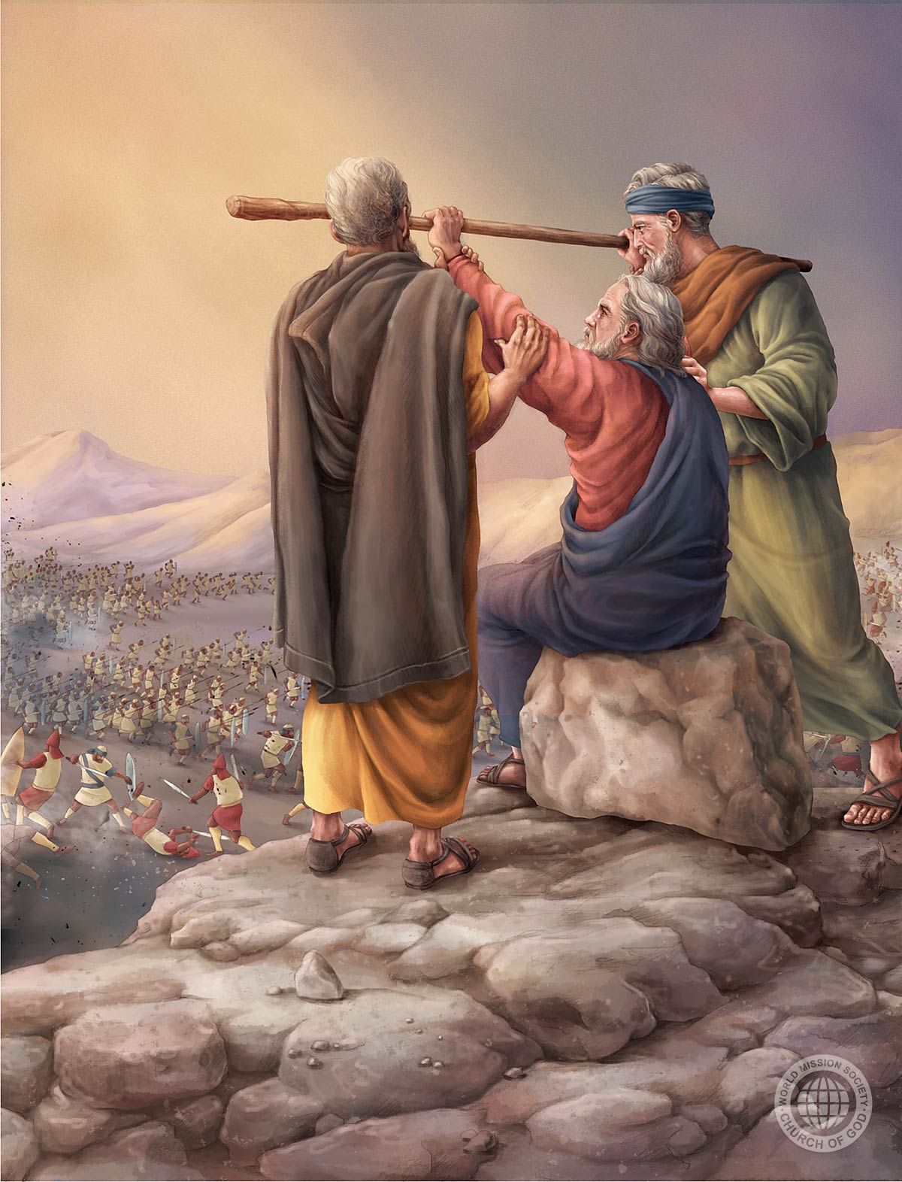

Slide 7
出埃及記 Exodus 17:12-13
但摩西的手發沉，他們就搬石頭來，放在他以下，他就坐在上面。 亞倫與戶珥扶著他的手，一個在這邊，一個在那邊，他的手就穩住， 直到日落的時候。 約書亞用刀殺了亞瑪力王和他的百姓。
When Moses’ hands grew tired, they took a stone and put it under him and he sat on it. Aaron and Hur held his hands up—one on one side, one on the other—so that his hands remained steady till sunset. So Joshua overcame the Amalekite army with the sword.

Slide 8
彼此配搭的學習
    認識神所創造的自己
    追求團隊配搭的卓越
      求主賜柔和謙卑的心
      把握神所預備的資源

Slide 9
出埃及記 Exodus 18:13-14
第二天，摩西坐著審判百姓，百姓從早到晚都站在摩西的左右。 摩西的岳父看見他向百姓所做的一切事，就說：「你向百姓做的是甚麼事呢？ 你為甚麼獨自坐著，眾百姓從早到晚都站在你的左右呢？」
The next day Moses took his seat to serve as judge for the people, and they stood around him from morning till evening. When his father-in-law saw all that Moses was doing for the people, he said, “What is this you are doing for the people? Why do you alone sit as judge, while all these people stand around you from morning till evening?”

Slide 10
出埃及記 Exodus 18:15-17
摩西對岳父說：「這是因百姓到我這裡來求問 神。 他們有事的時候就到我這裡來，我便在兩造之間施行審判；我又叫他們知道 神的律例和法度。」摩西的岳父說：「你這做的不好。 你和這些百姓必都疲憊；因為這事太重，你獨自一人辦理不了。
17 Moses’ father-in-law replied, “What you are doing is not good. You and these people who come to you will only wear yourselves out. The work is too heavy for you; you cannot handle it alone.

Slide 11
出埃及記 Exodus 18:19-21
現在你要聽我的話。 我為你出個主意，願 神與你同在。你要替百姓到 神面前，將案件奏告 神；又要將律例和法度教訓他們，指示他們當行的道，當做的事；並要從百姓中揀選有才能的人，就是敬畏 神、誠實無妄、恨不義之財的人，派他們作千夫長、百夫長、五十夫長、十夫長，管理百姓，
21 But select capable men from all the people—men who fear God, trustworthy men who hate dishonest gain—and appoint them as officials over thousands, hundreds, fifties and tens.

Slide 12
出埃及記 Exodus 18:22-24
叫他們隨時審判百姓，大事都要呈到你這裡，小事他們自己可以審判。這樣，你就輕省些，他們也可以同當此任。 你若這樣行， 神也這樣吩咐你，你就能受得住，這百姓也都平平安安歸回他們的住處。」 於是，摩西聽從他岳父的話，按著他所說的去行。
23 If you do this and God so commands, you will be able to stand the strain, and all these people will go home satisfied.”

Slide 13
使徒行傳 Acts 6:1
那時，門徒增多，有說希臘話的猶太人向希伯來人發怨言，因為在天天的供給上忽略了他們的寡婦。
In those days when the number of disciples was increasing, the Hellenistic Jews among them complained against the Hebraic Jews because their widows were being overlooked in the daily distribution of food.

Slide 14
使徒行傳 Acts 6:3
所以弟兄們，當從你們中間選出七個有好名聲、被聖靈充滿、智慧充足的人，我們就派他們管理這事。
Brothers and sisters, choose seven men from among you who are known to be full of the Spirit and wisdom. We will turn this responsibility over to them

Slide 15
使徒行傳 Acts 6:7
神的道興旺起來；在耶路撒冷門徒數目加增的甚多，也有許多祭司信從了這道。
So the word of God spread. The number of disciples in Jerusalem increased rapidly, and a large number of priests became obedient to the faith.

Slide 16
彼得前書 1 Peter 4:9-10
你們要互相款待，不發怨言。 各人要照所得的恩賜彼此服事，作 神百般恩賜的好管家。
Offer hospitality to one another without grumbling. Each of you should use whatever gift you have received to serve others, as faithful stewards of God’s grace in its various forms.

Slide 17
哥林多前書 1 Cor. 12:18-21
但如今， 神隨自己的意思把肢體俱各安排在身上了。 若都是一個肢體，身子在哪裡呢？ 但如今肢體是多的，身子卻是一個。 眼不能對手說：「我用不著你。」頭也不能對腳說：「我用不著你。」
If But in fact God has placed the parts in the body, every one of them, just as he wanted them to be. If they were all one part, where would the body be? As it is, there are many parts, but one body. The eye cannot say to the hand, “I don’t need you!” And the head cannot say to the feet, “I don’t need you!”

Slide 18
彼此配搭的學習
    認識神所創造的自己
    追求團隊配搭的卓越
    聆聽與順從聖靈引領

Slide 19
出埃及記 Exodus 33:7-9
摩西素常將帳棚支搭在營外，離營卻遠，他稱這帳棚為會幕。凡求問耶和華的，就到營外的會幕那裡去。 當摩西出營到會幕去的時候，百姓就都起來，各人站在自己帳棚的門口，望著摩西，直等到他進了會幕。 摩西進會幕的時候，雲柱降下來，立在會幕的門前，耶和華便與摩西說話。
9 As Moses went into the tent, the pillar of cloud would come down and stay at the entrance, while the Lord spoke with Moses.

Slide 20
羅馬書 Romans 8:5-6
因為，隨從肉體的人體貼肉體的事；隨從聖靈的人體貼聖靈的事。 體貼肉體的，就是死；體貼聖靈的，乃是生命、平安。
Those who live according to the flesh have their minds set on what the flesh desires; but those who live in accordance with the Spirit have their minds set on what the Spirit desires. The mind governed by the flesh is death, but the mind governed by the Spirit is life and peace.

Slide 21
彼此配搭的學習
    認識神所創造的自己
    追求團隊配搭的卓越
    聆聽與順從聖靈引領

Slide 22

回應詩歌 Response Song
「活出愛 Living Out Love」

