Slide 1

Play Video
「劉牧師的信息」

Slide 2

主日信息
Sunday Sermon

Slide 3

我在這裡，請差遣我！
Here am I. Send me!
波特蘭靈糧堂
March 2, 2025

Slide 4

馬太福音 Matthew 25:1-5
那時，天國好比十個童女拿著燈出去迎接新郎。 其中有五個是愚拙的，五個是聰明的。 愚拙的拿著燈，卻不預備油；聰明的拿著燈，又預備油在器皿裡。 新郎遲延的時候，她們都打盹，睡著了。
At that time the kingdom of heaven will be like ten virgins who took their lamps and went out to meet the bridegroom. Five of them were foolish and five were wise. The foolish ones took their lamps but did not take any oil with them. The wise ones, however, took oil in jars along with their lamps. The bridegroom was a long time in coming, and they all became drowsy and fell asleep.

Slide 5
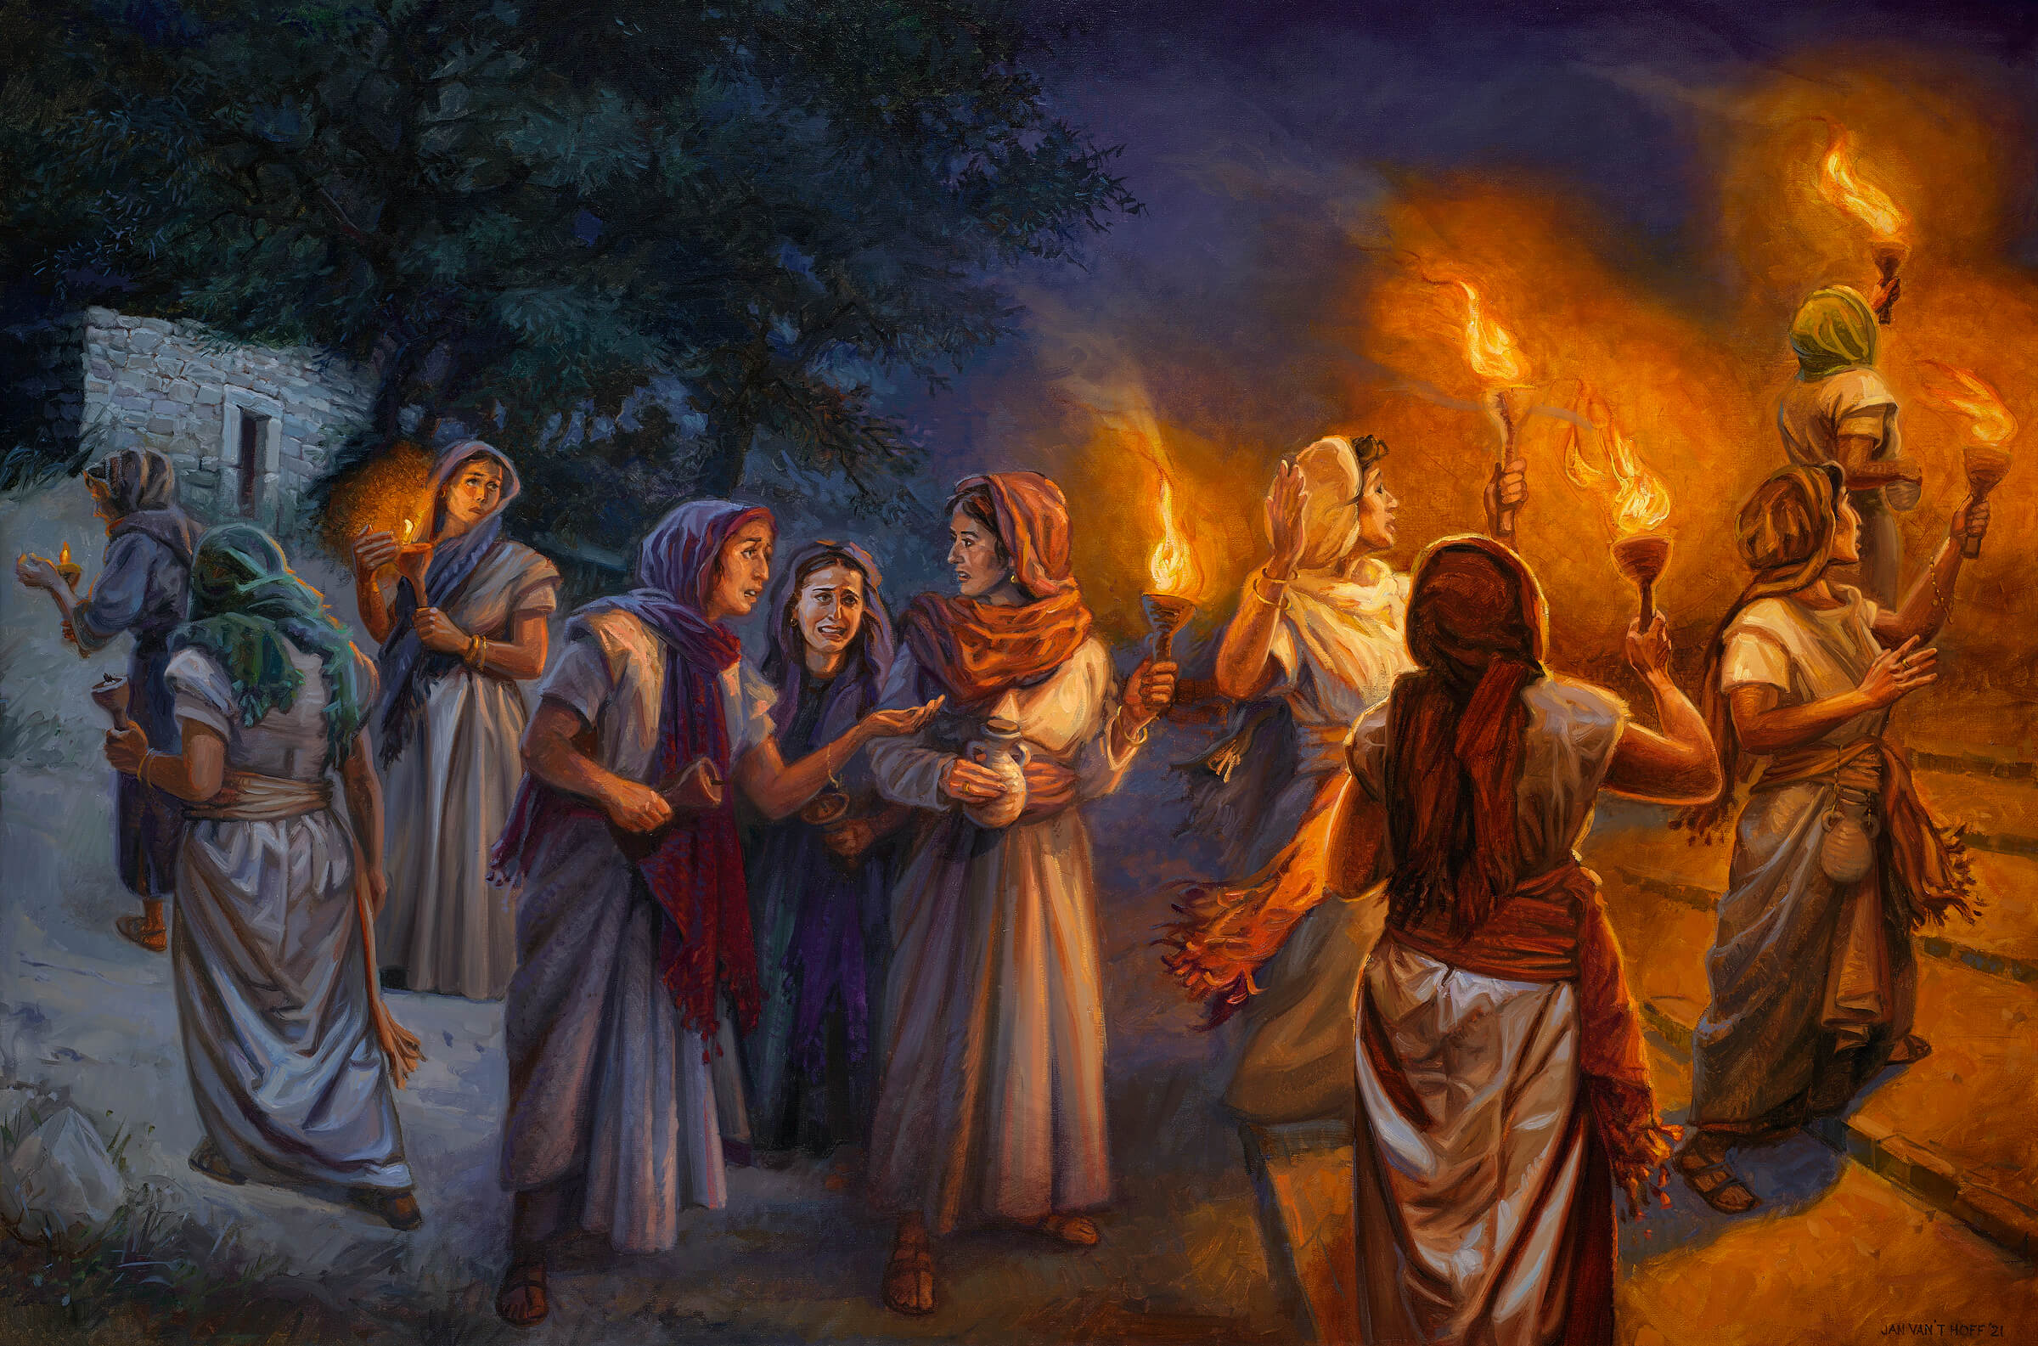

Slide 6
馬太福音 Matthew 25:6-10
半夜有人喊著說：『新郎來了，你們出來迎接他！』 那些童女就都起來收拾燈。 愚拙的對聰明的說：『請分點油給我們，因為我們的燈要滅了。』 聰明的回答說：『恐怕不夠你我用的；不如你們自己到賣油的那裡去買吧。』 她們去買的時候，新郎到了。 那預備好了的，同他進去坐席，門就關了。
6 At midnight the cry rang out: ‘Here’s the bridegroom! Come out to meet him! Then all the virgins woke up and trimmed their lamps.

Slide 7
馬太福音 Matthew 25:14-15
天國又好比一個人要往外國去，就叫了僕人來，把他的家業交給他們，按著各人的才幹給他們銀子：一個給了五千，一個給了二千，一個給了一千，就往外國去了。
For it is just like a man about to go on a journey, who called his own slaves and entrusted his possessions to them. To one he gave five talents, to another, two, and to another, one, each according to his own ability; and he went on his journey.

Slide 8
馬太福音 Matthew 25:19-21
過了許久，那些僕人的主人來了，和他們算帳。 那領五千銀子的又帶著那另外的五千來，說：『主啊，你交給我五千銀子。 請看，我又賺了五千。』 主人說：『好，你這又良善又忠心的僕人，你在不多的事上有忠心，我要把許多事派你管理；可以進來享受你主人的快樂。』
21 His master said to him, ‘Well done, good and faithful slave. You were faithful with a few things, I will put you in charge of many things; enter into the joy of your master.’

Slide 9
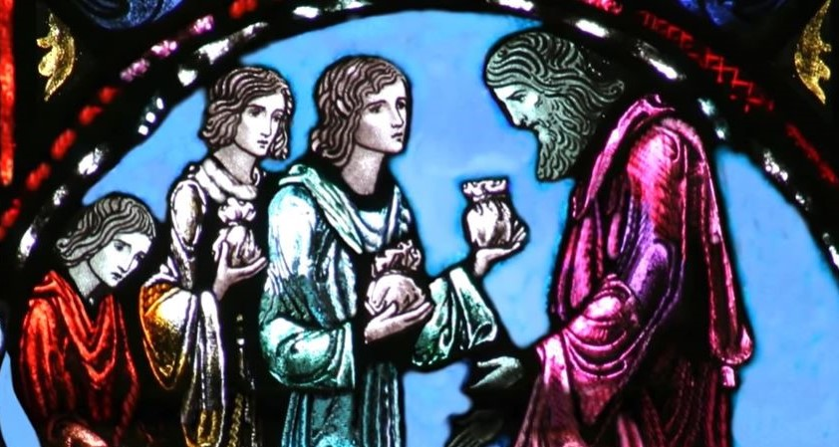

Slide 10
馬太福音 Matthew 25:25-27
那領一千的也來，說：『主啊，我知道你是忍心的人，沒有種的地方要收割，沒有散的地方要聚斂，我就害怕，去把你的一千銀子埋藏在地裡。 請看，你的原銀子在這裡。』 主人回答說：『你這又惡又懶的僕人，你既知道我沒有種的地方要收割，沒有散的地方要聚斂，就當把我的銀子放給兌換銀錢的人，到我來的時候，可以連本帶利收回。

Slide 11

領一千的
    ① 輕看從神領受的恩賜
    ② 因自己只領了一千,別人卻都領五千而嫉妒,猜忌, 並故意埋沒其恩賜。

Slide 12
馬太福音 Matthew 25:28-29
奪過他這一千來，給那有一萬的。 因為凡有的，還要加給他，叫他有餘；沒有的，連他所有的也要奪過來。
Therefore take away the talent from him, and give it to the one who has the ten talents. For to everyone who has, more shall be given, and he will have an abundance; but from the one who does not have, even what he does have shall be taken away.

Slide 13
羅馬書 Romans 12:3-5
我憑著所賜我的恩對你們各人說：不要看自己過於所當看的；要照著 神所分給各人信心的大小，看得合乎中道。 正如我們一個身子上有好些肢體，肢體也不都是一樣的用處。 我們這許多人，在基督裡成為一身，互相聯絡作肢體，也是如此。
4 For just as each of us has one body with many members, and these members do not all have the same function, in Christ we, though many, form one body, and each member belongs to all the others.

Slide 14
彼得前書 1 Peter 4:9-10
你們要互相款待，不發怨言。 各人要照所得的恩賜彼此服事，作 神百般恩賜的好管家。
Offer hospitality to one another without grumbling. Each of you should use whatever gift you have received to serve others, as faithful stewards of God’s grace in its various forms.

Slide 15
以賽亞書 Isaiah 6:8
我又聽見主的聲音說：「我可以差遣誰呢？誰肯為我們去呢？」 我說：「我在這裡，請差遣我！」
Then I heard the voice of the Lord, saying, “Whom shall I send, and who will go for Us?” Then I said, “Here am I. Send me!”

Slide 16
    הִנְנִי שְׁלָחֵנִי
    請差遣我 我在這裡
    我在這裡，請差遣我！ (以賽亞書 6:8)

Slide 17
回應詩歌 Response Song
「He Ne Ni」

