Slide 1
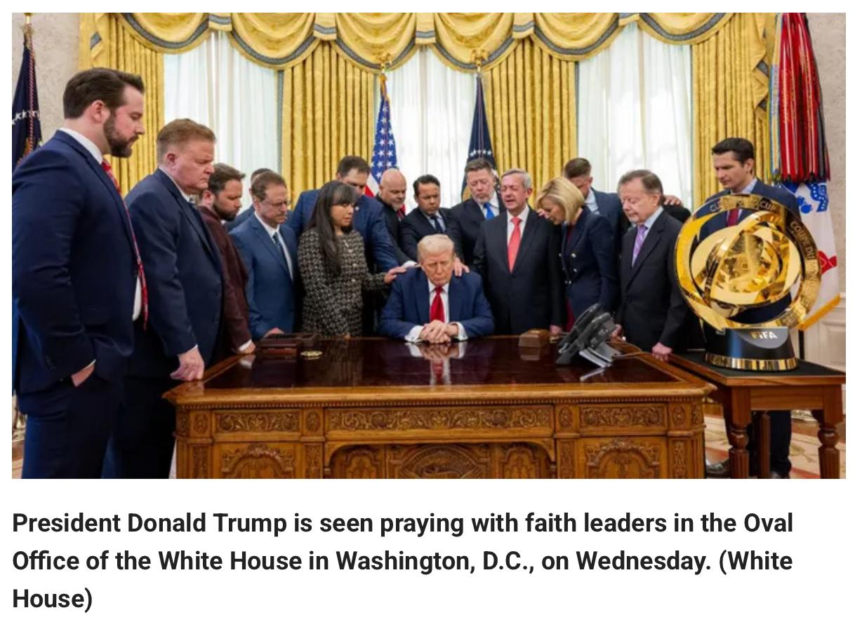

Slide 2

提摩太前書 1 Timothy 2:1-3
我勸你，第一要為萬人懇求、禱告、代求、祝謝；為君王和一切在位的，也該如此，使我們可以敬虔、端正、平安無事地度日。 這是好的，在 神我們救主面前可蒙悅納。
First of all, then, I urge that entreaties and prayers, petitions and thanksgivings, be made on behalf of all men, for kings and all who are in authority, so that we may lead a tranquil and quiet life in all godliness and dignity. This is good and acceptable in the sight of God our Savior,

Slide 3

主日信息
Sunday Sermon

Slide 4

安息
Rest
波特蘭靈糧堂
March 23, 2025

Slide 5
希伯來書 Hebrews 4:10-11
因為那進入安息的，乃是歇了自己的工，正如 神歇了他的工一樣。 所以，我們務必竭力進入那安息，免得有人學那不信從的樣子跌倒了。
For the one who has entered His rest has himself also rested from his works, as God did from His. Therefore let us be diligent to enter that rest, so that no one will fall, through following the same example of disobedience.

Slide 6
希伯來書 Hebrews 6:19
我們有這指望，如同靈魂的錨，又堅固又牢靠，且通入幔內。
This hope we have as an anchor of the soul, a hope both sure and steadfast and one which enters within the veil,

Slide 7
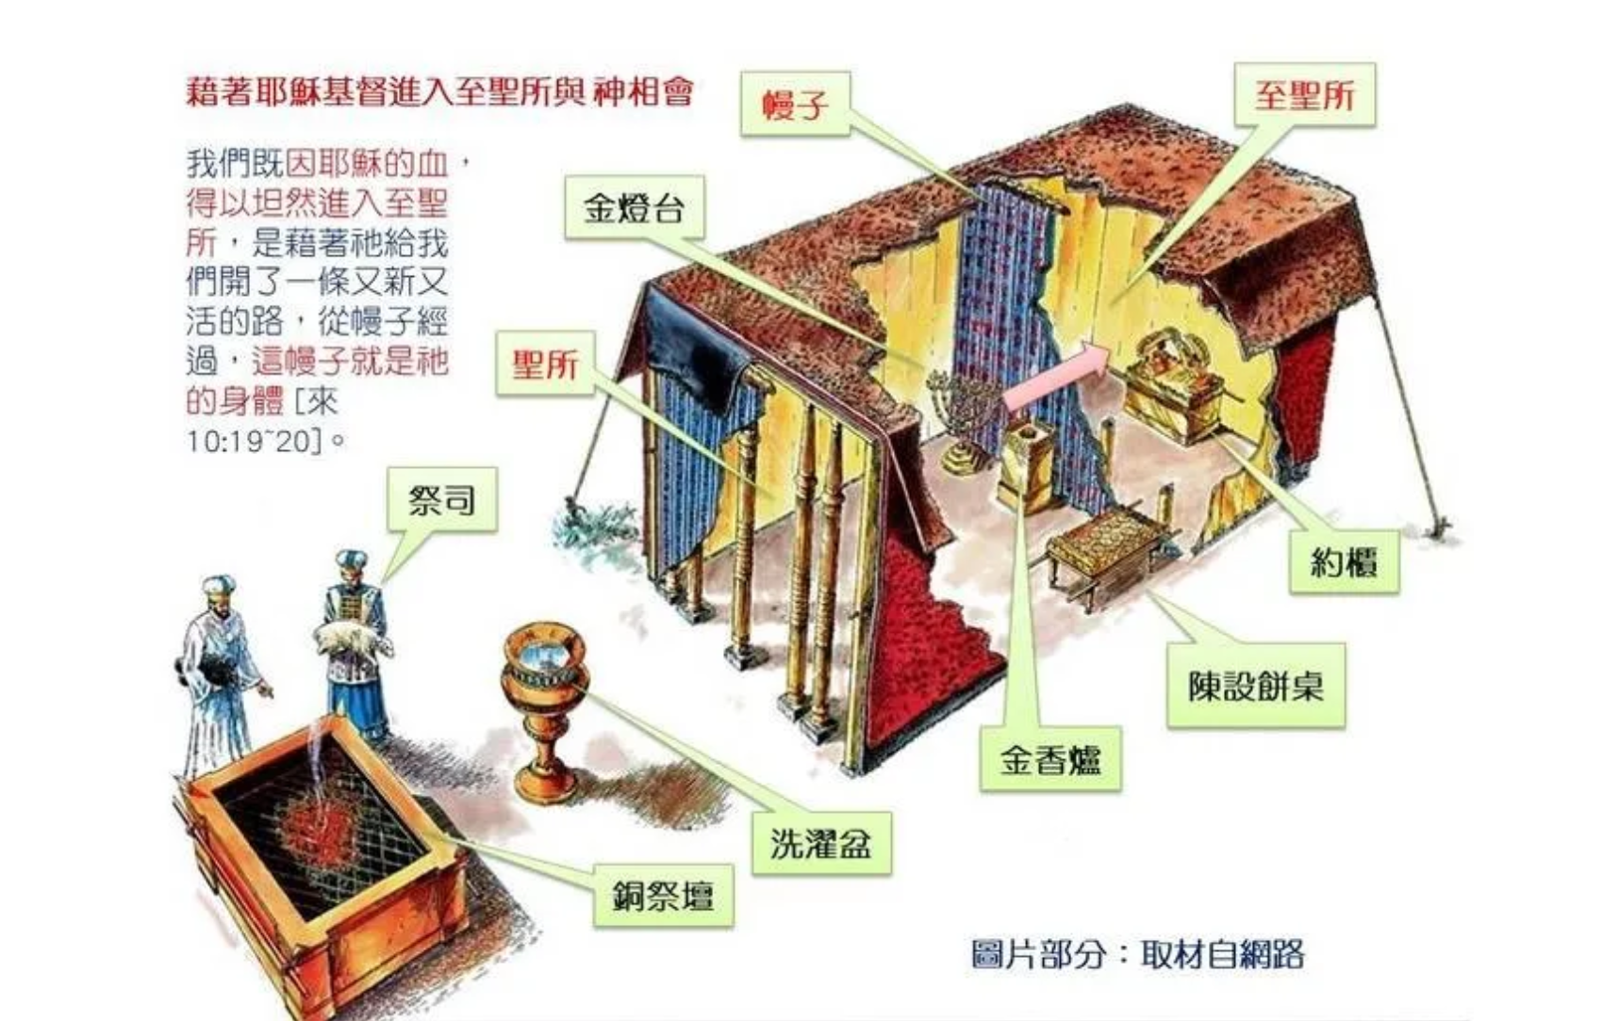

Slide 8
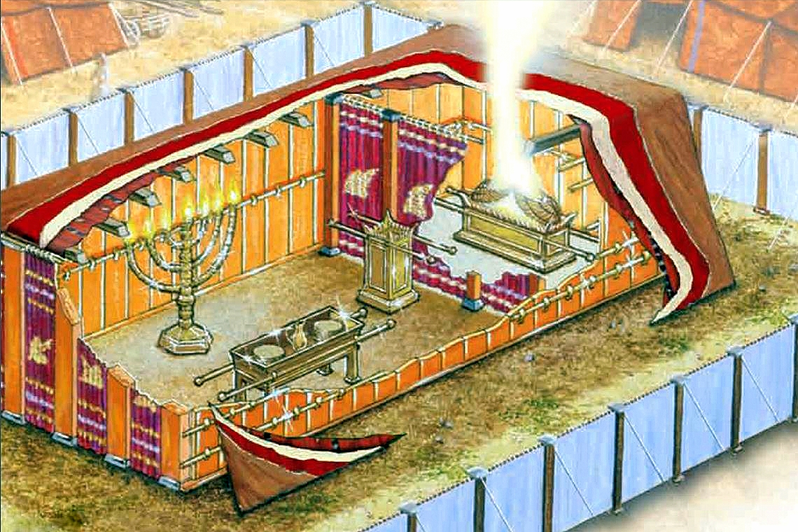

Slide 9

安息
          安息是對神應許的確信

Slide 10
羅馬書 Romans 1:17
因為 神的義正在這福音上顯明出來；這義是本於信，以至於信。 如經上所記：「義人必因信得生。」
For in it the righteousness of God is revealed from faith to faith; as it is written, “But the righteous man shall live by faith.”

Slide 11
哥林多後書 2 Cor. 5:7
因我們行事為人是憑著信心，不是憑著眼見。
for we walk by faith, not by sight

Slide 12
安息
          安息是對神應許的確信
          安息中仰望全能的天父

Slide 13
彌迦書 Micah 7:7-8
至於我，我要仰望耶和華，要等候那救我的 神；我的 神必應允我。 我的仇敵啊，不要向我誇耀。 我雖跌倒，卻要起來；我雖坐在黑暗裡，耶和華卻作我的光。
But as for me, I will watch expectantly for the Lord;
I will wait for the God of my salvation. My God will hear me.
Do not rejoice over me, O my enemy.
Though I fall I will rise;
Though I dwell in darkness, the Lord is a light for me.

Slide 14
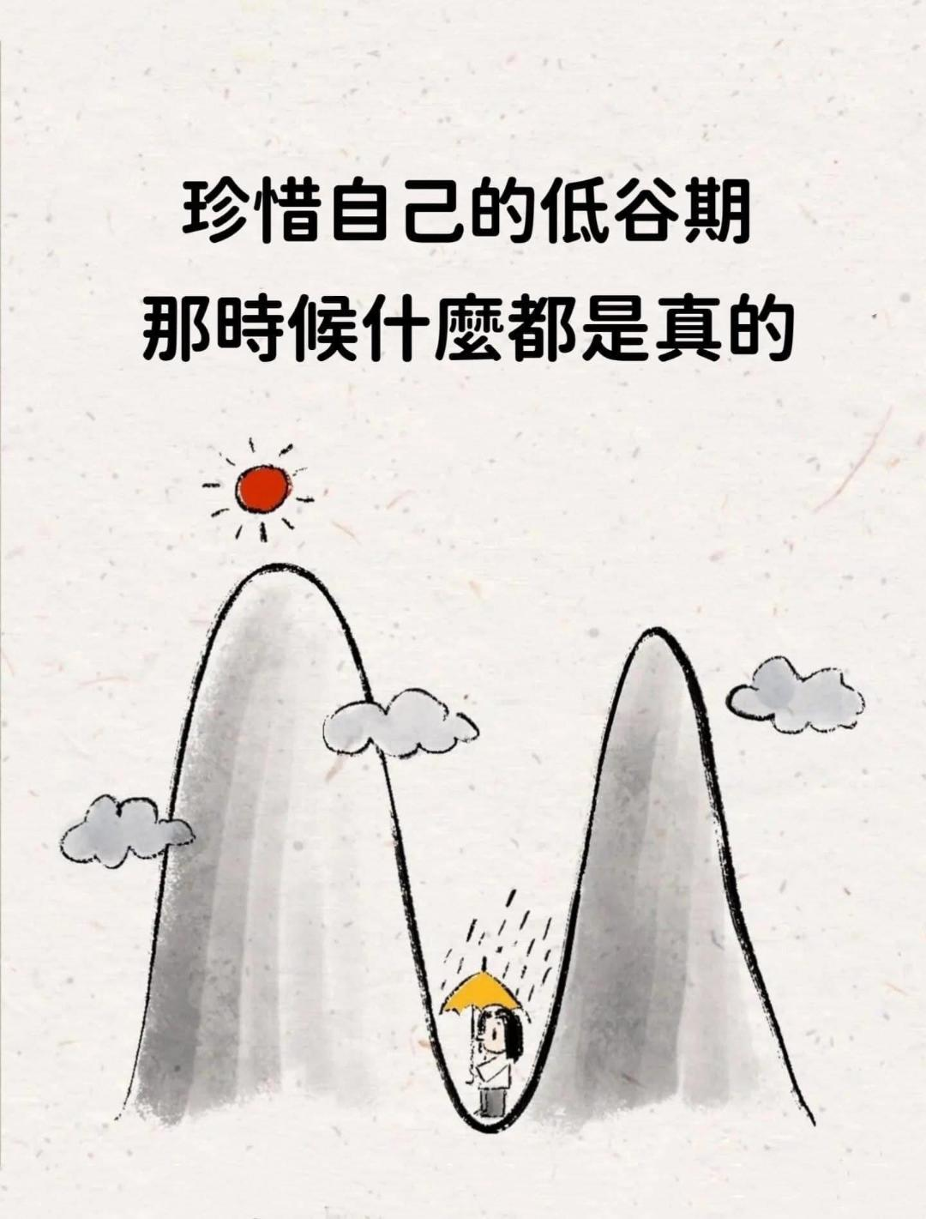

Slide 15
以賽亞書 Isaiah 64:3-4
你曾行我們不能逆料可畏的事。 那時你降臨，山嶺在你面前震動。 從古以來，人未曾聽見、未曾耳聞、未曾眼見在你以外有甚麼神為等候他的人行事。
When You did awesome things which we did not expect,
You came down, the mountains quaked at Your presence.
For from days of old they have not heard or perceived by ear,
Nor has the eye seen a God besides You,
Who acts in behalf of the one who waits for Him.

Slide 16
以賽亞書 Isaiah 43:18-19
耶和華如此說：你們不要記念從前的事，也不要思想古時的事。 看哪，我要做一件新事；如今要發現，你們豈不知道嗎？ 我必在曠野開道路，在沙漠開江河。
Do not call to mind the former things, or ponder things of the past.
“Behold, I will do something new,
Now it will spring forth; Will you not be aware of it?
I will even make a roadway in the wilderness, rivers in the desert.

Slide 17
安息
          安息是對神應許的確信
          安息中仰望全能的天父
          安息中領受神啟示恩膏

Slide 18
以賽亞書 Isaiah 30:15-16
主耶和華─以色列的聖者曾如此說：你們得救在乎歸回安息；你們得力在乎平靜安穩；你們竟自不肯。你們卻說：不然，我們要騎馬奔走。所以你們必然奔走；又說：我們要騎飛快的牲口。 所以追趕你們的，也必飛快。
15 For thus the Lord God, the Holy One of Israel, has said,
“In repentance and rest you will be saved,
In quietness and trust is your strength.”

Slide 19
創世記 Genesis 26:22-24
以撒離開那裡，又挖了一口井，他們不為這井爭競了，他就給那井起名叫利河伯（就是寬闊的意思）。 他說：「耶和華現在給我們寬闊之地，我們必在這地昌盛。」 以撒從那裡上別是巴去。 當夜耶和華向他顯現，說：「我是你父親亞伯拉罕的 神，不要懼怕！ 因為我與你同在，要賜福給你，並要為我僕人亞伯拉罕的緣故，使你的後裔繁多。」

Slide 20
愛我們的天父，讓我們在靈裡面能夠進入真正的安息，幫助我們在人生重擔中得享屬天安息。 願祢透過聖靈的工作，讓我們知道祢應許的真實，讓我們不要忙得好像与神要失去交通了，而是學習劳伦斯里面与神的交通一点不受外面事情的影响。 奉主耶穌的名禱告！

Slide 21

回應詩歌 Response Song
「安靜 Be Still」

