Slide 1

主日信息
Sunday Sermon

Slide 2
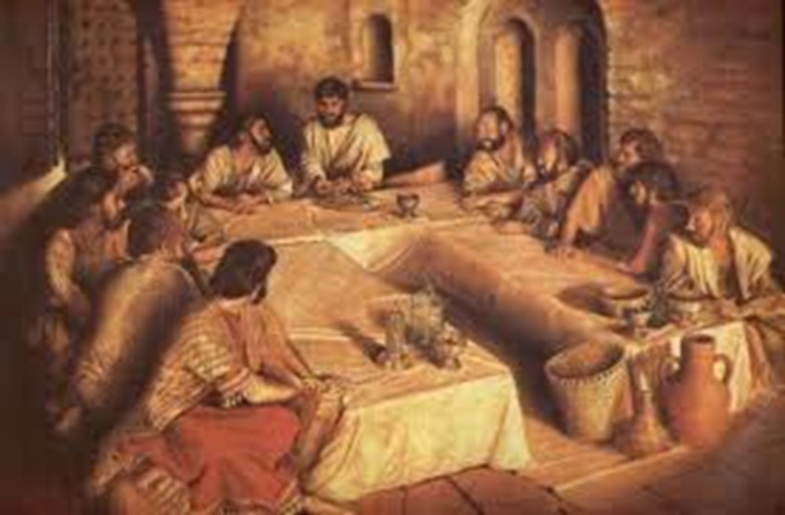
L
A
S
T
S
E
D
E
R
J
E
S
U
S’
Notes:
Shalom
It means hello; goodbye; peace unto you;
When Jesus, whom His mother called “Yeshua”, appeared to His disciples after the resurrection He said,
SHALOM
SLIDE

Slide 3
THE SEDER PROGRAM
Song and dance
Introduction to the Seder
Candlighting / Seder begins
First two cups & handwashing
Plague presentation
Meal
In search of the lost Afikomen
Last two cups
Song and dance
Notes:
Song and dance
Introduction to the Seder
Candlighting / Seder begins
First two cups & handwashing
Plague presentation
Meal
In search of the lost Afikomen
Last two cups
Song and dance
PRAYER
During this seder, I will refer to Jesus by the Hebrew name His mother called by: YESHUA.
Yeshua is the Agent of God’s creation.
Through Him the seasons bring us to their appointed time, such as this time of Passover.
We will start with a song in both English and Hebrew.
The Hebrew part is a praise saying, Bless the Eternal God forever.
Can we do that?
SONG
SLIDE

Slide 4
Gadol Elohai
Joshua Aaron / Chris Tomlin
Gadol Elohai
Shiru ki Gadol Elohai
Kol echad Yirei
Ki gadol Elohai

Slide 5
Gadol Elohai
Joshua Aaron / Chris Tomlin
Shem me'al kol shem
Otcha raui le'halel
Libi yashir
ki gadol Elohai

Slide 6
Gadol Elohai
Joshua Aaron / Chris Tomlin
How great is our God
Sing with me - how great is our God
And all will sing how great,
how great is our God

Slide 7
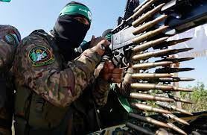
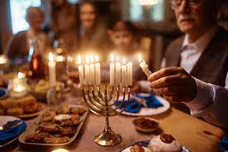
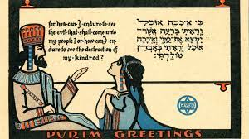
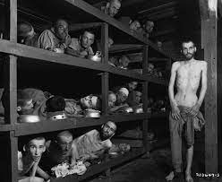
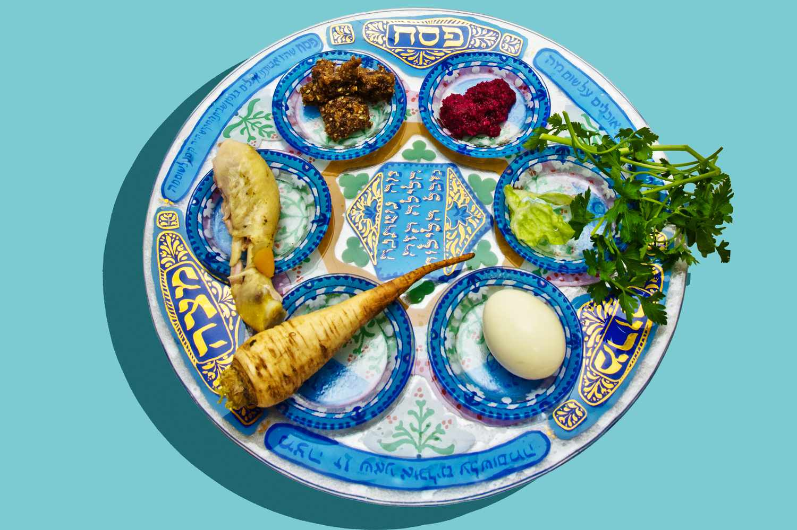
A PERTINENT WORD…
Notes:
A few months ago, we celebrated Chanukah, the time when we remember when one man, a Greco-Syrian king, tries to subvert God’s plan for the redemption of humanity by prohibiting Jews to worship God, the God of heaven and earth, according to the way he told them to.
It failed.
You can the story in the Book of Maccabees.
Some weeks ago, we celebrated Purim, a story that tells us about a wicked man, wicked Haman, who also tries to subvert God’s plan for the redemption of humanity, by engaging hos whole country as an unholy army to annihilate all of Israel.
It failed.
You can read the story in the Book of Esther.
Tonight, we are celebrating Passover, the story of another wicked king Pharaoh, from Egypt, who also tries to subvert God’s plan for the redemption of humanity , by forcing the Jews into slavery to build his cities, and drowning all their baby boys in the Nile River.
It failed.
You can read the story in the Book of Exodus.
Less than 100 years ago, a man, a very wicked man named Adolph Hitler, also tries to subvert God’s plan for the redemption of humanity by committing Genocide against the Jewish people.
It failed.
You can read the story in history books.
Today, there another entity, a new baby-killing pharaoh, a new genocide-committing Haman, and a new Antiochus Epiphanes, Hamas, who has vowed the destruction of Israel by any means possible.
It also failed.
And we will the story in history books.
People wonder…
People have questions about the way this war is being fought…
But more important than “what”, we need to think of “why”
The question “Why” presents us with the big picture of things.
To explain what I mean, I will use the life of a man in the Bible who really exemplifies Israel as a nation: Job.
Why does Job represent Israel as a nation?
Because much like the people of Israel, he was noticed by God, which made the devil jealous.
As a result, Satan had to harass Job.
Counsellors came to Job to help him, and just like people do with Israel today, his counselors told him that the reason for his trouble was because of his own sin.
The story started by telling us that Job was righteous, so the counselors were wrong.
Job’s defense was that “The Almighty God has the prerogative to let bad things happen to good people.”
Also,
In his arguments, though that’s all his counselors could look at, Job never once asked for deliverance of his immediate problems.
What did he do instead?
He spoke of the redemption of the world.
SLIDE

Slide 8
“Naked I came from my mother's womb, and naked shall I return. The LORD gave, and the LORD has taken away; blessed be the name of the LORD.” In all this Job did not sin or charge God with wrong.
(Job 1:21-22 ESV)
Shall we receive good from God, and shall we not receive evil?”
(Job 2:10 ESV)
Notes:
Instead of begging for deliverance of his problems, he accepted his problems , saying, And he said, “Naked I came from my mother's womb, and naked shall I return. The LORD gave, and the LORD has taken away; blessed be the name of the LORD.” In all this Job did not sin or charge God with wrong.
(Job 1:21-22 ESV)
Shall we receive good from God, and shall we not receive evil?”
(Job 2:10 ESV)
How could he do that?
Simple.
Instead of concentrating on his present problems, he had the greater picture of the redemption of humanity on his mind.
Here is what he said:
For I know that my Redeemer lives, and at the last he will stand upon the earth. And after my skin has been thus destroyed, yet in my flesh I shall see God,
(Job 19:25-26 ESV)
"But I know that my Redeemer lives, that in the end he will rise on the dust; so that after my skin has been thus destroyed, then even without my flesh, I will see God.
(Job 19:25-26 CJB)
Even so, when we look at the situation in the world, we need to have the bigger picture in mind; the bigger picture, the larger plan of God’s scenario that eventually brings us to the end of all wars, the wiping of all tears, justice, joy, love and laughter for all, in essence, the eventual redemption of ALL of humanity.
May it be soon HaShem, in Your time!
SLIDE

Slide 9

約伯記 Job 1:21-22
「我赤身出於母胎，也必赤身歸回；賞賜的是耶和華，收取的也是耶和華。 耶和華的名是應當稱頌的。」 在這一切的事上約伯並不犯罪，也不以 神為愚妄。
約伯記 Job 1:21-22
約伯卻對她說：「你說話像愚頑的婦人一樣。 噯！ 難道我們從 神手裡得福，不也受禍嗎？」在這一切的事上約伯並不以口犯罪。

Slide 10
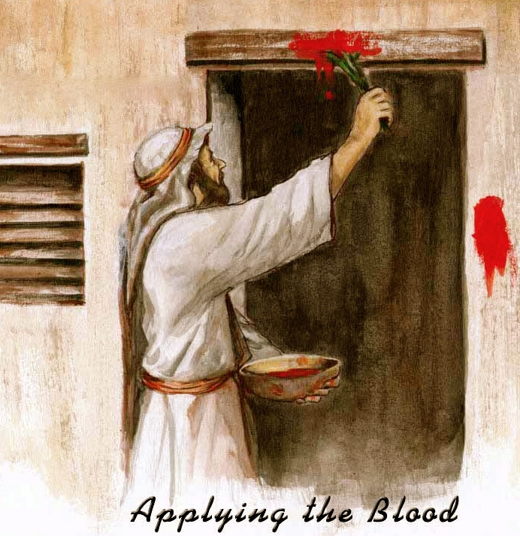
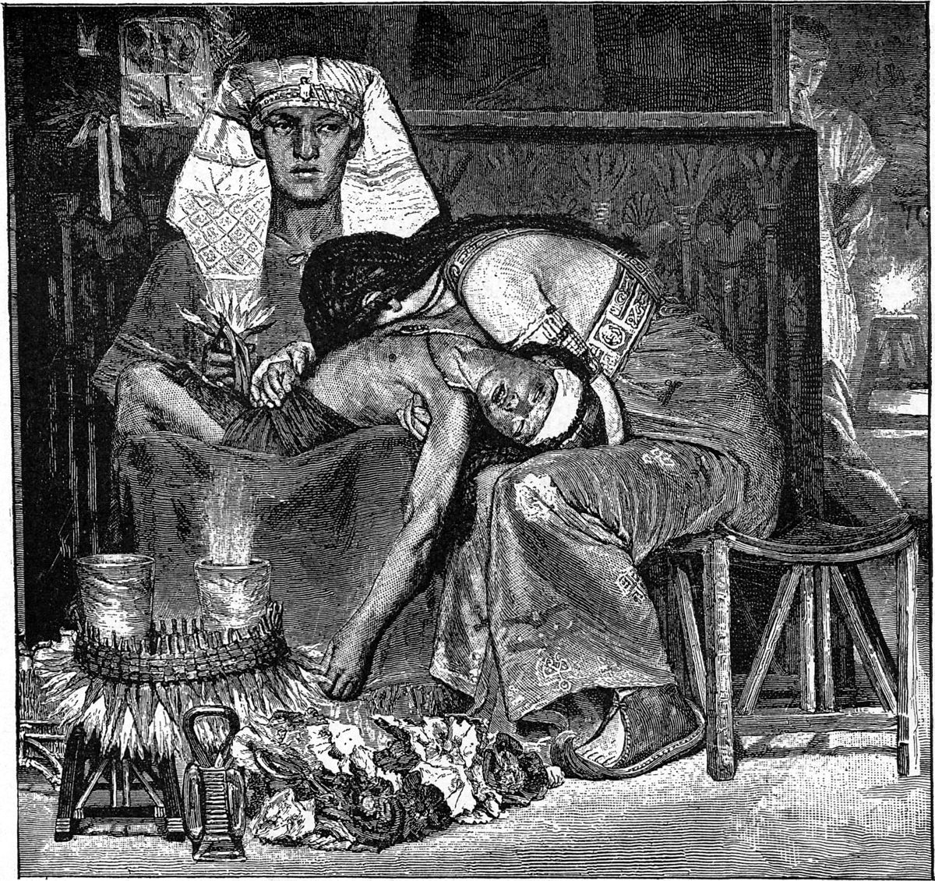
Notes:
Today we will be talking about the Exodus; about the mighty deliverance brought to His people.
But even Israel’s deliverance from pharaoh required the death of many lambs, as well as that of many innocent Egyptian firstborns.
So whether it is that of the firstborn of Egypt, or of all those throughout history who lost their lives for the causes of God, the price of the fulfilment of God’s will on earth as it is in Heaven, seems to require innocent death.
History is a testament to the fact that the fulfillment of God’s will on earth often comes through the death of many innocent folks.
This often happens through wars.
Whole countries have been wiped out because of ungodly leaders.
Sodom and Gomorrah, Egypt, Amalek,
And in all these situations, there were children, old folks, people who had no stake in the conflict at all, but who nevertheless died horrible deaths just so that God’s will may be done.
Mothers saw their children die and children saw their parents die.
We can’t take sides and be callous about it.
We can’t be cavalier about it.
These are people; people made in God’s image.
Old folks; children.
Tears should fill our eyes when we talk about it.
I believe tears fill God’s eyes when He sees how we live our lives, sometimes even committing atrocities, even in His Name!
If we talk about it, we should do it in the spirit of Jeremiah, the weeping prophet.
Most of the time they were people who just wanted to live their lives in peace, but they got drafted, or attacked.
Worldwide images of war give a reality check on its atrocities; on its lack of humanity.
SLIDE

Slide 11
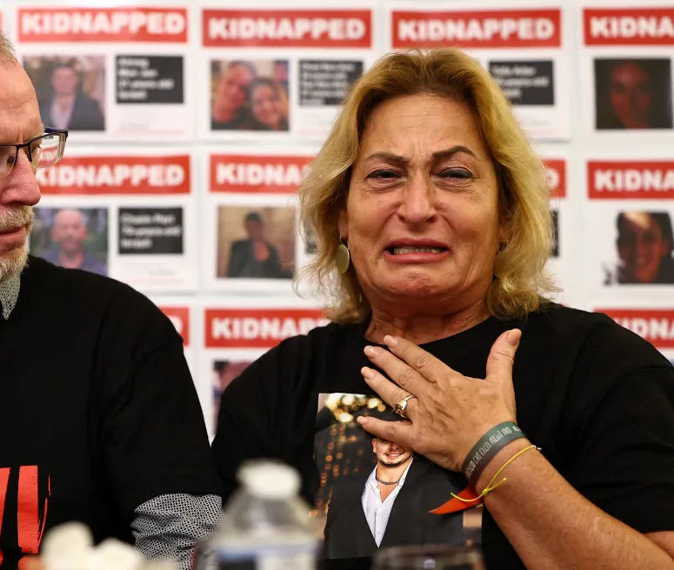
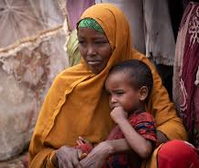
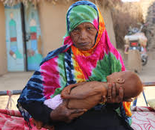
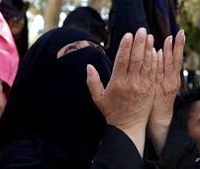
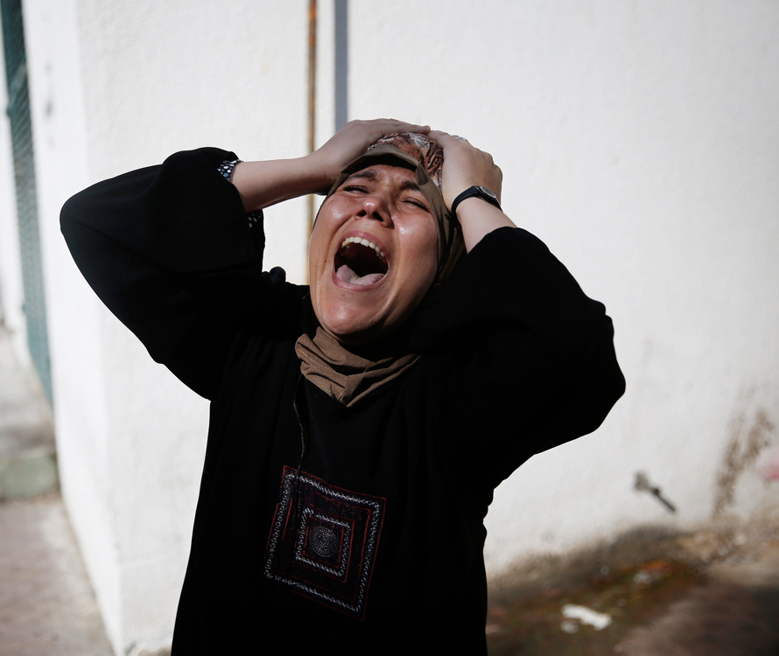
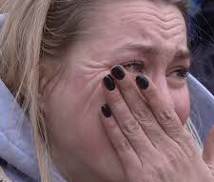
Notes:
It is customary in Jewish practice that at every festival we remember the destruction of the Temple.
That is why you have a roasted egg on your seder plate.
But tonight, as we rejoice for a divine deliverance that happened 3400 years ago,
We also need to remember that today, at this very moment,
Mothers cry in Israel.
Mothers cry in Gaza.
Mothers cry in Ukraine.
Mothers cry in Russia, Yemen, several countries of Africa …
To deliver Israel, mothers cried in Egypt because of the death of their firstborns.
The Egyptian’s firstborns were as valuable to God as the Jewish firstborns.
And God did not let the COI forget the cry and pain of the Egyptians mothers and fathers for their children.
They had to remember the sacrifice of the Egyptians mothers by dedicating their own first-born to God, and later the whole tribe of Levi was taken instead.
Even so today, the sacrifices that are required for the fulfillment of God’s plan on earth due to man’s sin, the deaths and suffering that universal redemption demands are not to be forgotten.
Even 1 sparrow is not forgotten.
Even one hair on our head is not forgotten.
We often talk about what miracle it is that God accomplishes His will for Israel throughout History, but how many deaths did it take?
It took the deaths of Egyptians, Amalekites, Philistines, Moabites, Ammonites, Jebusites, etc… who are all also precious to God as they were also created in His Image.
In modern history, we can also talk about the lives of Israelis, Palestinians, Jordanians Egyptians, Syrians, Saudians, Irakis, British, Turkish, …
Many people on both side of the conflict die to ensure the security of Israel.
How many people died in the wars?
These are of the sacrifices that bring the fulfillment of God’s plan on earth, sacrifices that I do not believe God forgets, just like He did not want us to take the death of the Egyptian first-born for granted.
Here is how Peter, the apostle puts it…
SLIDE

Slide 12
2 Peter 3:9 (CJB)
The Lord is not slow in keeping his promise, as some people think of slowness; on the contrary, he is patient with you;
for it is not his purpose that anyone should be destroyed,
but that everyone should turn from his sins.

Slide 13
彼得後書 2 Peter 3:9
主所應許的尚未成就，有人以為他是耽延，其實不是耽延，乃是寬容你們，不願有一人沉淪，乃願人人都悔改。

Slide 14

WHAT IS A PASSOVER SEDER?
PASSOVER: The day God saved the Israelites in Egypt
from the plague of the death of the firstborn.
The night the children of Israel left Egypt.
SEDER: “Order,” as in an ordered meal.
Notes:
WHAT IS A PASSOVER SEDER?
Let’s learn some Hebrew: In Hebrew, Passover is Pesach. It means to “Pass over.”
Seder means order, organized.
Seders are rarely organized and orderly.
SLIDE

Slide 15
WHAT IS A PASSOVER SEDER?
A PASSOVER SEDER:
An ordered meal to remember and commemorate the wonderful things God did for us when he saved us from…
Mean old Pharoah
The plague of the firstborn
…and when He sent us on our way to the Promised Land.
Notes:
WHAT IS A PASSOVER SEDER?
A themed meal to remember and commemorate the wonderful things God did for us when He saved us from mean old pharaoh, though the plague of the firstborn, and sent us on our way to the promised land.
For us who believe that Yeshua is the Messiah Redeemer, it holds an extra significance since He was crucified, and He resurrected exactly on the schedule of the Passover celebrations.
Here is a little calendar…
SLIDE

Slide 16
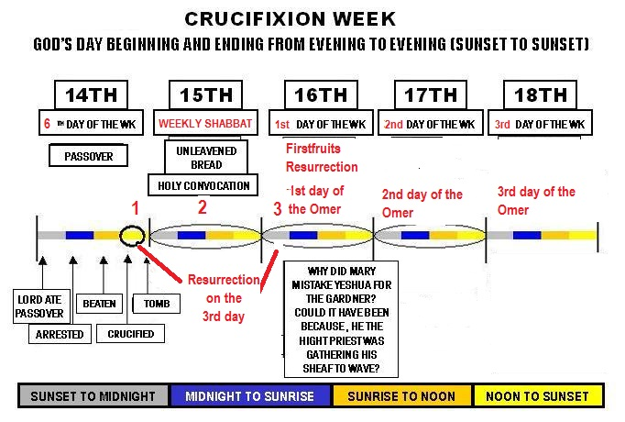
SCHEDULE OF EVENTS
On the tenth day of this month every man shall take a lamb according to their fathers' houses, … you shall keep it until the fourteenth day … shall kill their lambs … “Then they shall take some of the blood and put it on the two doorposts and the lintel of the houses in which they eat it. (Exodus 12:3-7 ESV)
Notes:
SHORT CALENDAR EXPLANATION, INCLUDING FIRST FRUIT.
The way it was celebrated was that on the 10th of Nissan, 4 days before, according to what God commanded them through Moses in Exodus 12, as you can see on the slide, the High priest would go and choose a lamb from a place called Shepherds field in Bethlehem.
This day this year corresponds to the Gregorian date of the 8th of April.
4 days later is Passover; on that day Yeshua was crucified. That was the first day.
If you remember in the narrsative of the Gospels the women got Yeshua’s body off the cross early and they couldn’t embalm him because …
… the next day was the beginning of the Feast of Unleavened Bread. It is a Sabbath, and, on that year, it fell at the same time as the weekly 7th day sabbath. It was the second day.
The day after that starts the feast of firstfruit. Yeshua resurrects. It is the 3rd. He resurrects on the 3rd day.
Back to our lambs on the 10th of Nissan.
These lambs were specially raised to be sacrificed at the Temple.
SLIDE

Slide 17
出埃及記 Exodus 12:3-7
你們吩咐以色列全會眾說：本月初十日，各人要按著父家取羊羔，一家一隻。若是一家的人太少，吃不了一隻羊羔，本人就要和他隔壁的鄰舍共取一隻。你們預備羊羔，要按著人數和飯量計算。 要無殘疾、一歲的公羊羔，你們或從綿羊裡取，或從山羊裡取，都可以。 要留到本月十四日，在黃昏的時候，以色列全會眾把羊羔宰了。 各家要取點血，塗在吃羊羔的房屋左右的門框上和門楣上。

Slide 18
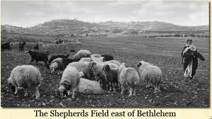
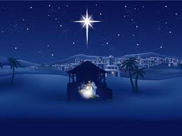
THE LAMB FROM BETHLEHEM
“Behold, the Lamb of God, who takes away the sin of the world!”
(Joh 1:29 ESV)
“Fear not, for behold, I bring you good news of great joy that will be for all the people. For unto you is born this day in the city of David a Savior, who is Christ the Lord.” (Luk 2:10-11 ESV)
Notes:
This place called Shepherds Field is the place where angels appeared to certain shepherds to tell them that the Messiah of Israel was born.
The high-priest would bring this 1-year-old unspotted lamb from Bethlehem and the people would welcome him by waving palm branches while proclaiming the words, Hosannah, which in Hebrew would be HOSHIYAH-NAH, meaning please, save us.
However, in 30 CE, things went a little differently.
On the 10th day of the first month of Nissan, the high priest did go choose a lamb from Bethlehem.
He didn’t get the memo from the angels about which “lamb” to choose!
He hadn’t heard that 3 years before, another priest called John the Baptist had already declared that his cousin, Yeshua was the actual lamb that takes away the sin of the world.
SLIDE

Slide 19
約翰福音 John 1:29
次日，約翰看見耶穌來到他那裡，就說：「看哪， 神的羔羊，除去世人罪孽的！
路加福音 Luke 2:10-11
那天使對他們說：「不要懼怕！我報給你們大喜的信息，是關乎萬民的；因今天在大衛的城裡，為你們生了救主，就是主基督。

Slide 20
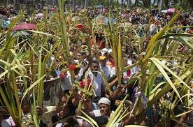
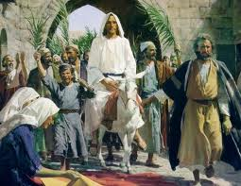
THE LAMB FROM BETHLEHEM
“Hosanna! Blessed is he who comes in the name of the Lord, even the King of Israel!” (Joh 12:13 ESV)
Notes:
So he was very surprised when people who knew Yeshua acclaimed Him in the same way they acclaimed the Passover lamb, but this time adding to their Hosannah, “Blessed is He who comes in the Name of the Lord, even the King of Israel!” thus declaring that He was the Messiah.
SLIDE

Slide 21
約翰福音 John 12:13
就拿著棕樹枝出去迎接他，喊著說：和散那！奉主名來的以色列王是應當稱頌的！

Slide 22
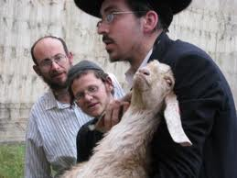
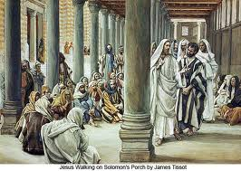
THE LAMB FROM BETHLEHEM
Your lamb shall be without blemish, a male a year old. You may take it from the sheep or from the goats, and you shall keep it until the fourteenth day of this month, when the whole assembly of the congregation of Israel shall kill their lambs at twilight. (Exo 12:5-6 ESV)
“Look, the world has gone after him.” (Joh 12:19 ESV)
Notes:
For 4 days the people were to observe the Lamb to make sure he was ‘perfect/without blemish’.
A one-year-old lamb is in his prime.
For 4 days they checked how he walked; how he ate …
That year when Yeshua arrived in Jerusalem at about the same time as the lamb, he spent his time in the city, mostly in the Temple.
For 4 days, this young rabbi in his prime who had so impacted the nation that even the priest said, “Look, the world has gone after him.” (Joh 12:19 ESV)
That young rabbi was also inspected as pharisees, Sadducees, zealots, Herodians….all asked him questions.
Then came the 13th of Nissan.
We read in Luke 22
SLIDE

Slide 23
出埃及記 Exodus 12:5-6
要無殘疾、一歲的公羊羔，你們或從綿羊裡取，或從山羊裡取，都可以。 要留到本月十四日，在黃昏的時候，以色列全會眾把羊羔宰了。

Slide 24
THEN CAME THE DAY OF UNLEAVENED BREAD, ON WHICH THE PASSOVER LAMB HAD TO BE SACRIFICED. (LUKE 22:7 ESV)
So Yeshua sent Peter and John, saying, “Go and prepare the Passover for us, that we may eat it.” They said to him, “Where will you have us prepare it?” He said to them, “Behold, when you have entered the city, a man carrying a jar of water will meet you. Follow him into the house that he enters and tell the master of the house, ‘The Teacher says to you, Where is the guest room, where I may eat the Passover with my disciples?’ And he will show you a large upper room furnished; prepare it there.” (Luk 22:8-12 ESV)
Notes:
Having been in the city for 3 days answering questions from priests, pharisees, Sadducees, even from zealots;
After having also given his message about the endtime, and about the fate of Jerusalem, the time has come.
He knows it.
The disciples don’t yet.
He told them, but they are in denial.
It is the 13th of Nissan.
They need a day to prepare everything, so the Master charges Peter and John with,
“Go and prepare the Passover for us, that we may eat it.”
They said to him, “Where will you have us prepare it?”
He said to them, “Behold, when you have entered the city, a man carrying a jar of water will meet you. Follow him into the house that he enters and tell the master of the house, ‘The Teacher says to you, Where is the guest room, where I may eat the Passover with my disciples?’ And he will show you a large upper room furnished; prepare it there. (Luk 22:8-12 ESV)
Yeshua was going to rehearse that year’s seder because he knew that the next night, the actual night of the seder, He would be in the tomb waiting to resurrect on the day of Firstfruits.
It was not the night of the Seder.
It was the preceding night.
People often did a rehearsal of celebrations in those days to make sure everything was OK; a little like you have a rehearsal of a wedding.
In my family, we always had 2 seders.
I remember my cousin telling me when I asked her why 2? She said, the first is a preparation of the second.
SLIDE

Slide 25
路加福音 Luke 22:7-12
除酵節，須宰逾越羊羔的那一天到了。 耶穌打發彼得、約翰，說：「你們去為我們預備逾越節的筵席，好叫我們吃。」他們問他說：「要我們在哪裡預備？」耶穌說：「你們進了城，必有人拿著一瓶水迎面而來，你們就跟著他，到他所進的房子裡去，對那家的主人說：『夫子說：客房在哪裡？ 我與門徒好在那裡吃逾越節的筵席。』 他必指給你們擺設整齊的一間大樓，你們就在那裡預備。」

Slide 26

ON THE 14TH OF NISSAN
Notes:
And now we are sitting with Yeshua for this seder.
What did He do?
How did He do it?
Why did He do it?
Though it has evolved and changed over the millennia, the seder is as old as the children of Israel in the desert.
The idea is simple.
Remember what God did for us by eating unleavened bread for 7 days, some bitter herbs, and lamb.
I could make lamb and lettuce matzah sandwich, and we’re done.
But that’s not as fun.
To remember, we need to make it a party with food.
We need to do something fun with the children.
We need to tell the story.
The seder is just that.
Telling the story of the Exodus using food.
That’s what we’ll do during this first part of the seder, then, we’ll eat.
After we eat, the punch line will come.
I am usually told not to be too long in the first part because everybody will leave after dinner and miss the punchline.
So, I thought we should withhold desert until afterward, until after the punchline.
After dinner, I will show you how Yeshua … and that’s when someone says, “SPOILER ALERT!”
I now want to take you through a seder similar to that which was done in my family, but also similar to that which was done by Yeshua.
How do I know that?
Simple.
One day, I read a very important book that changed my life.
I still read it.
It’s called the Bible.
The most detailed chapter of Yeshua’s seder is in Luke 22, which any honest to God Jew would recognize as describing a Passover seder meal.
The Passover seder is composed of several steps each illustrating a different principle.
There is also a round plate on each table.
The elements in it are to help tell the story.
To not make this too lengthy, I will not over explain, but I will be available for questions until sunrise service.
I will ask you to repeat the short prayers in Hebrew with me, the ones Yeshua probably prayed that night with His disciples.
SLIDE

Slide 27
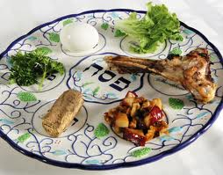
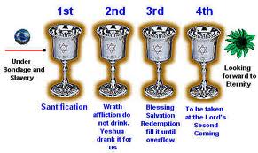
A TRADITIONAL SEDER THE WAY YESHUA DID IT REVOLVES AROUND A SEDER PLATE AND FOUR CUPS
Notes:
A traditional seder the way Yeshua did it revolves around a seder plate (show the plate).
Each element on the plate represents a part of the command God gave the COI.
It also revolves around 4 cups of the fruit of the vine, wine or grape juice.
Each cup represents a promise God has made and sealed with his people.
The reason for grape juice or wine is that a long time ago, promises, covenants, or contracts were sealed by the blood of a sacrificed animal.
Deuteronomy 32:14 calls the fruit of the vine “The blood of grapes.”
SLIDE

Slide 28
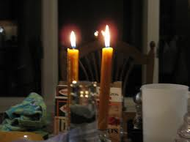
THE CANDLES
ברוך אתה יי אלהינו מלך העולם אשר קדשנו במיצותין וציונו להדליק נר של פסח
Baruch Attah Adonai Eloheinu Melech ha’olam
asher kideshanu bemitsvotav vetsivanu l’hadlik ner shel pesach
Blessed are you, O Lord our God, maker of the universe,
who has commanded us to celebrate Passover.
Notes:
The seder is a family affair.
It’s a dinner.
I believe there were more than 13 men in that upper room.
I believe there were women and children.
The seder starts with the lighting of candles that initiates every Jewish festival to this day.
A woman traditionally lights the candles.
I can imagine that on that night, Yeshua may have asked His mother to do it, but in the absence of Mary tonight, I will ask my wife to light the candles.
(Christina leads candle lighting and blessing)
Now the Seder starts.
But that night was the night before the actual day of the Seder.
Yeshua knows it.
The disciples know it.
What the disciples don’t know is that in less than 24 hours, their lives are going to change forever.
In less than 24 hours, they will be doing the actual seder by themselves.
In less than 24 hours Yeshua will dead, in the tomb, after having experienced an excruciating death.
Unbeknownst to His disciples, what Yeshua does on that early seder night, was preparing His disciples for the actual seder on the next day.
What did the Master do?
What did the Master say?
SLIDE

Slide 29
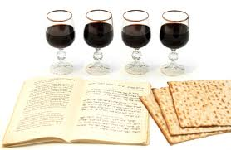
THE FOUR CUPS
Exodus 6:6-8
"Therefore, say to the people of Isra'el: 'I am Adonai. I will free you from the forced labor of the Egyptians, rescue you from their oppression, and redeem you with an outstretched arm and with great judgments. I will take you as my people, and I will be your God.”
Notes:
As the oldest child in His family, Yeshua probably led many Seders in His house, especially after the death of Joseph, His earthly father.
He is familiar with the promises represented by the 4 cups, the 4 promises that say,
Exo 6:6 " ‘I am Adonai. I will free you from the forced labor of the Egyptians, rescue you from their oppression, and redeem you with an outstretched arm and with great judgments.
Exo 6:7 I will take you as my people, and i will be your god. Then you will know that I am Adonai your god, who freed you from the forced labor of the Egyptians.
You have 2 cups in front of your plate, a small one and bigger one.
The bigger one is for drinking during the meal, the smaller one is for the Seder.
You can fill it and drink it in four gulps or fill it every time.
For now, we will follow Yeshua with the first cup, or the first promise.
SLIDE

Slide 30
出埃及記 Exodus 6:6-8
所以你要對以色列人說：『我是耶和華；我要用伸出來的膀臂重重地刑罰埃及人，救贖你們脫離他們的重擔，不做他們的苦工。我要以你們為我的百姓，我也要作你們的 神。你們要知道我是耶和華─你們的 神，是救你們脫離埃及人之重擔的。我起誓應許給亞伯拉罕、以撒、雅各的那地，我要把你們領進去，將那地賜給你們為業。我是耶和華。』」

Slide 31
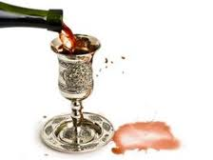
THE FIRST CUP: The cup of sanctification
“I WILL BRING YOU OUT …”
“I have earnestly desired to eat this Passover with you before I suffer. For I tell you I will not eat it until it is fulfilled in the kingdom of God.”
(Luke 22:15-16 ESV)
Notes:
As He started this very special seder Yeshua said to His friends, His disciples,
“I have earnestly desired to eat this Passover with you before I suffer. For I tell you I will not eat it until it is fulfilled in the kingdom of God.”
(Luke 22:15-16 ESV)
SLIDE

Slide 32
路加福音 Luke 22:15-16
耶穌對他們說：「我很願意在受害以先和你們吃這逾越節的筵席。 我告訴你們，我不再吃這筵席，直到成就在 神的國裡。」

Slide 33
THE FIRST CUP: The cup of sanctification
“I WILL BRING YOU OUT …”
Blessed are you O Lord our God King of the universe
who creates the fruit of the vine.
Luke 22:17-18 (ESV)
And he took a cup, and when he had given thanks he said, “Take this, and divide it among yourselves. For I tell you that from now on I will not drink of the fruit of the vine until the kingdom of God comes.”
Baruch ata Adonai eloheynu melech ha-olam, boreh peri hagefen.
Notes:
Then,
He took a cup, and when he had given thanks he said, “Take this, and divide it among yourselves. For I tell you that from now on I will not drink of the fruit of the vine until the kingdom of God comes.” (Luke 22:17-18 ESV)
Let us now follow Yeshua as He took that cup and said the blessing.
You can now pour in the small glass, and lift it,
Say bracha in Hebrew,
Say with me in English, “Blessed are you O Lord our God, king of the universe who creates the fruit of the vine.”
Drink a sip
This cup is called the cup of sanctification.
Sanctification means to be set apart for God, just like Israel was et apart to be a people for Him as they left Egypt.
SLIDE

Slide 34
路加福音 Luke 22:17-18
耶穌接過杯來，祝謝了，說：「你們拿這個，大家分著喝。我告訴你們，從今以後，我不再喝這葡萄汁，直等 神的國來到。」

Slide 35
THE WASHING
Yeshua rose from supper. He laid aside his outer garments, and taking a towel, tied it around his waist. Then he poured water into a basin and began to wash the disciples' feet and to wipe them with the towel that was wrapped around him. He came to Simon Peter, who said to him, “Lord, do you wash my feet?” Jesus answered him, “What I am doing you do not understand now, but afterward you will understand.” John 13:4-7 (ESV)
Notes:
Yeshua then proceeded to the next part of the seder which is a ceremonial hand wash.
It is not for hygiene but for ritual purity.
It has its roots in the book of Leviticus and is at the origins of what is called to baptism.
In John 13 we read that Yeshua added something to this ritual. It says that,
Yeshua rose from supper. He laid aside his outer garments, and taking a towel, tied it around his waist. Then he poured water into a basin and began to wash the disciples' feet and to wipe them with the towel that was wrapped around him. He came to Simon Peter, who said to him, “Lord, do you wash my feet?” Jesus answered him, “What I am doing you do not understand now, but afterward you will understand.” (John 13:4-7 ESV)
Technically only the hands are to be washed but Yeshua added the feet.
Peter protested.
Only priests wash hands and feet in the laver of the temple court before entering the Holy.
Yeshua tells him that he does not understand now why he bestows the disciples such an honor.
Later, Peter understood that his Master was fulfilling a prophecy uttered by Moses that says,
SLIDE

Slide 36
約翰福音 John 13:4-7
就離席站起來，脫了衣服，拿一條手巾束腰， 隨後把水倒在盆裡，就洗門徒的腳，並用自己所束的手巾擦乾。挨到西門•彼得，彼得對他說：「主啊，你洗我的腳嗎？」耶穌回答說：「我所做的，你如今不知道，後來必明白。」

Slide 37
THE WASHING
Now therefore, if you will indeed obey my voice and keep my covenant, you shall be my treasured possession among all peoples, … and you shall be to me a kingdom of priests and a holy nation.’ “ Exodus 19:5-6 (ESV)
But you are a chosen race, a royal priesthood, a holy nation, a people for his own possession, that you may proclaim the excellencies of him who called you out of darkness into his marvelous light.
1 Peter 2:9 (ESV)
Notes:
Now therefore, if you will indeed obey my voice and keep my covenant, you shall be my treasured possession among all peoples, … and you shall be to me a kingdom of priests and a holy nation.’ “ (Exodus 19:5-6 ESV)
Peter later understood as he told the Romans disciples.
But you are a chosen race, a royal priesthood, a holy nation, a people for his own possession, that you may proclaim the excellencies of him who called you out of darkness into his marvelous light. (1 Peter 2:9 ESV)
There is a blessing for the hand washing
SLIDE

Slide 38
出埃及記 Exodus 19:5-6
如今你們若實在聽從我的話，遵守我的約，就要在萬民中作屬我的子民，因為全地都是我的。 你們要歸我作祭司的國度，為聖潔的國民。』 這些話你要告訴以色列人。」
路加福音 1 Peter 2:9
惟有你們是被揀選的族類，是有君尊的祭司，是聖潔的國度，是屬 神的子民，要叫你們宣揚那召你們出黑暗入奇妙光明者的美德。

Slide 39
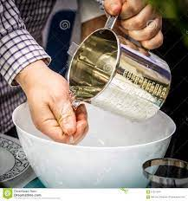
THE WASHING
"Blessed are you, O Lord, our God, King of the Universe, who has sanctified us through your commandments and teaches us concerning the washing of hands"
בָּרוּךְ אַתָּה הָ׳ אֱלֹהֵינוּ מֶלֶךְ הָעוֹלָם אֲשֶׁר קִדְּשָׁנוּ בְּמִצְוֹתָיו וְצִוָּנוּ עַל נְטִילַת יָדַיִם).
“What comes out of a person is what defiles him. For from within, out of the heart of man, come evil thoughts, immorality, theft, murder, adultery, coveting, wickedness, deceit, sensuality, envy, slander, pride, foolishness. All these evil things come from within, and they defile a person.”
Mark 7:15-23 (ESV)
Notes:
In Mark 7 it is recorded that Yeshua had a small interaction with some of His rabbi colleagues concerning the issue of hand wash before eating.
We read that, “they saw that some of his disciples ate with hands that were defiled, that is, unwashed.” Mark 7:2
Yeshua and some other disciples probably washed theirs, but at the moment, He saw a larger problem.
He knew that washing hands was a man established tradition as an application of a Levitical command, a good tradition, but nevertheless established by religious leaders,
Whereas to publicly embarrass, shame, or criticize someone in public was strictly forbidden in the Laws God gave to Moses as akin to murder.
Thereby, Yeshua protected His disciples calling out their accusers with, , “You leave the commandment of God and hold to the tradition of men.” v 7
Then He reminded them that,
Mar 7:15 There is nothing outside a person that by going into him can defile him, but the things that come out of a person are what defile him.”
….
Mar 7:21 For from within, out of the heart of man, come evil thoughts, immorality, theft, murder, adultery,
Mar 7:22 coveting, wickedness, deceit, sensuality, envy, slander, pride, foolishness.
Mar 7:23 All these evil things come from within, and they defile a person.”
Follow me now in the blessing for the hand wash as Yeshua would have said it,
"Blessed are you, O Lord, our God, King of the Universe, who has sanctified us through your commandments and teaches us concerning the washing of hands"
ORGANISE HAND WASH WHILE MUSIC PLAYS
Joshua Aaron: As the Waters cover the sea
Blessing
SLIDE

Slide 40
馬可福音 Mark 7:15-23
從外面進去的不能污穢人，惟有從裡面出來的乃能污穢人。」有耳可聽的，就應當聽！耶穌離開眾人，進了屋子，門徒就問他這比喻的意思。 耶穌對他們說：「你們也是這樣不明白嗎？豈不曉得凡從外面進入的，不能污穢人，因為不是入他的心，乃是入他的肚腹，又落到茅廁裡。」；又說：「從人裡面出來的，那才能污穢人；因為從裡面，就是從人心裡，發出惡念、苟合、偷盜、凶殺、姦淫、貪婪、邪惡、詭詐、淫蕩、嫉妒、謗讟、驕傲、狂妄。 這一切的惡都是從裡面出來，且能污穢人。」

Slide 41
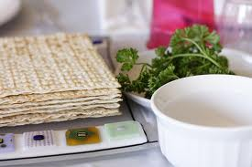
THE PARSLEY AND THE SALT WATER
  The parsley represents the springtime
  Festival.
  The salt water represents the tears
  shed because of slavery.
  BARUCH ATA ADONAI ELOHEYNU
  MELECH HA’OLAM, BOREH PERI
  HA’DAMA
  ברוך אתא יי אלהינו מלך העולם בורא פרי האדמה
Notes:
Now that our hands are clean, we can touch the food.
Yeshua continued with His seder.
As was the custom, the table was dressed with several items, items which you have on a platter in front of you.
Can you find the parsley?
The parsley tells of a springtime festival.
The salt water in the middle is a reminder of the tears of Egyptian slavery.
Yeshua lifted the parsley and said the blessing in Hebrew, let us hold the parsley.
I say a blessing in Hebrew
ברוך אתא יי אלהינו מלך העולם בורא פרי האדמה
Blessed are you O Lord our God who creates the fruit of the earth.
Let us follow Yeshua and how on that night, He dipped the parsley in the salt water and ate it.
SLIDE

Slide 42
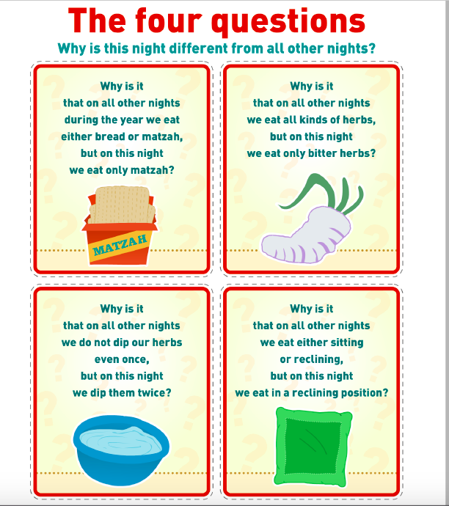
AND WHEN YOUR CHILDREN SAY TO YOU, ‘WHAT DO YOU MEAN BY THIS SERVICE?’ YOU SHALL SAY, ‘IT IS THE SACRIFICE OF THE LORD'S PASSOVER, FOR HE PASSED OVER THE HOUSES OF THE PEOPLE OF ISRAEL IN EGYPT, WHEN HE STRUCK THE EGYPTIANS BUT SPARED OUR HOUSES.’”
(Exodus 12:26-27 ESV)
Notes:
I will blah blah blah, then Seth interrupts me saying something like,
“Waaaait!!! We do this every year but really, Why is this nigh ….” in a conversation form.
Then I say,
“Moses warned us about this.”
He said:
And when your children say to you, ‘What do you mean by this service?’ you shall say, ‘It is the sacrifice of the LORD's Passover, for he passed over the houses of the people of Israel in Egypt, when he struck the Egyptians but spared our houses.’”(Exodus 12:26-27 ESV)
Well, we are going to have to answer these questions.
SLIDE

Slide 43
出埃及記 Exodus 12:26-27
你們的兒女問你們說：『行這禮是甚麼意思？』 你們就說：『這是獻給耶和華逾越節的祭。 當以色列人在埃及的時候，他擊殺埃及人，越過以色列人的房屋，救了我們各家。』」於是百姓低頭下拜。

Slide 44
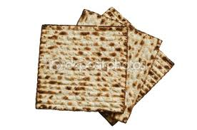
FIRST QUESTION: WHY MATZAH?
Your boasting is not good. Do you not know that a little leaven leavens the whole lump? Cleanse out the old leaven that you may be a new lump, as you really are unleavened. For Christ, our Passover lamb, has been sacrificed. Let us therefore celebrate the festival, not with the old leaven, the leaven of malice and evil, but with the unleavened bread of sincerity and truth.
(1 Corinthians 5:6-8 ESV)
Notes:
WHY MATZAH?
We eat Matzah because our fathers did not have time to leaven their bread
In the Bible, leaven symbolic of sin:
When exhorting the Corinthian congregation, Paul uses the Passover imagery when he says,
Your boasting is not good. Do you not know that a little leaven leavens the whole lump? Cleanse out the old leaven that you may be a new lump, as you really are unleavened. For Christ, our Passover lamb, has been sacrificed.
He then gives instructions to the Corinthians on how to celebrate the Passover
He says:
Let us therefore celebrate the festival, not with the old leaven, the leaven of malice and evil, but with the unleavened bread of sincerity and truth.
(1 Corinthians 5:6-8 ESV)
SLIDE

Slide 45
哥林多前書 Exodus 5:6-8
你們這自誇是不好的。豈不知一點麵酵能使全團發起來嗎？你們既是無酵的麵，應當把舊酵除淨，好使你們成為新團；因為我們逾越節的羔羊基督已經被殺獻祭了。所以，我們守這節不可用舊酵，也不可用惡毒、邪惡的酵，只用誠實真正的無酵餅。

Slide 46
FIRST QUESTION: WHY MATZAH?
But he was wounded for our transgressions; he was crushed for our iniquities; upon him was the chastisement that brought us peace, and with his stripes we are healed.
Isaiah 53:5
Baruch ata Adonai Eloheinu melech ha’olam, hamotzi lechem min ha’aretz.
Notes:
What I am going to do with them is part of an ancient tradition that really no one can properly trace in any documentation, but it predates Yeshua, so He also did it..
I have three matzot on my table.
Different people have different ideas about the meaning of the traditional three matzot.
The most common one is that they represent Abraham, Isaac, and Jacob.
Remember that Isaac climbing Mt Moriah carrying his own sacrificial wood on his back was a foreshadowing of Yeshua, who would also climb the very same mountain with his sacrificial wood.
Look at the Matzah, it is pieced and striped, like Yeshua knew He would be less than 24 hours later, as Isaiah said, But he was wounded for our transgressions; he was crushed for our iniquities; upon him was the chastisement that brought us peace, and with his stripes we are healed. Isaiah 53:5
As was the custom, Yeshua broke the middle matza, Isaac, He put it in a white cloth, and hid it.
This piece of matzah has a name. It is called the Afikomen.
NOW, I will ask for someone to take the children 11 on down away while I hide this matzah that is wrapped in a white cloth.
At the end of dinner, they will have to find it.
After the children come back,
Share the rest with everybody; Blessing: Baruch ata Adonai Eloheinu melech ha’olam, hamotsei lechem min ha’aretz
Now Yeshua answered the first question.
Let’s see what He will say about the other 3.
SLIDE

Slide 47
以賽亞書 Isaiah 53:5
哪知他為我們的過犯受害，為我們的罪孽壓傷。因他受的刑罰，我們得平安；因他受的鞭傷， 我們得醫治。

Slide 48
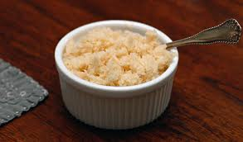
SECOND QUESTION: WHY BITTER HERBS?
But the more the Egyptians oppressed them, the more they multiplied and expanded, until the Egyptians came to dread the people of Isra'el and worked them relentlessly, making their lives bitter with hard labor — digging clay, making bricks, all kinds of field work; and in all this toil they were shown no mercy.
(Exodus 1:12-14 )
Baruch ata Adonai eloheynu melech ha’olam
asher kideshanu bemitsvotav ve tsivanu al achilat maror
Notes:
WHY BITTER HERBS? DIP HORSERADISH AND MATZAH
Yeshua compares the bitter herbs to the bitterness of hard labor under pharaoh.
He may even have quoted,
But the more they were oppressed, the more they multiplied and the more they spread abroad. And the Egyptians were in dread of the people of Israel. So they ruthlessly made the people of Israel work as slaves and made their lives bitter with hard service, in mortar and brick, and in all kinds of work in the field. In all their work they ruthlessly made them work as slaves.
(Exodus 1:12-14 ESV)
As was the custom, Yeshua invited His friends, his disciples, to remember and partake of the bitterness of slavery, of the pain of our ancestors, by putting a good spoonful of horseradish on a piece of matzah to experience the bitterness of their labor.
He said the blessing:
Baruch ata Adonai eloheynu melech ha’olam asher kideshanu bemitsvotav ve tsivanu al achilat maror
Blessed are you O Lord our God king of the universe who has blessed us with His commandment to eat the bitter herb.
Except for the extra foot wash, so far, Yeshua was following the script of a regular seder as remembrance of the Exodus from Egypt.
It will change soon.
SLIDE

Slide 49
出埃及記 Exodus 1:12-14
只是越發苦害他們，他們越發多起來，越發蔓延；埃及人就因以色列人愁煩。埃及人嚴嚴地使以色列人做工，使他們因做苦工覺得命苦；無論是和泥，是做磚，是做田間各樣的工，在一切的工上都嚴嚴地待他們。

Slide 50
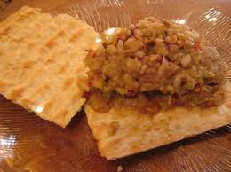
THIRD QUESTION: WHY DO WE DIP TWICE?
And as they were reclining at table and eating, Jesus said, “Truly, I say to you, one of you will betray me, one who is eating with me.” They began to be sorrowful and to say to him one after another, “Is it I?” He said to them, “It is one of the twelve, one who is dipping bread into the dish with me.
(Mark 14:18-20 ESV)
Notes:
Another dipping happens at a seder.
This time with matzah and charoset. (tell everybody what is in the charoset)
The apples and nuts speak to us of the bricks we made in Egypt.
The sweetness reminds us that even the times of bitterest sorrow can be sweetened with the hope that we have a God who loves us and cares for us.
Now something particular happened as Yeshua was getting to that part of the seder.
As they were reclining at table and eating, Jesus said, “Truly, I say to you, one of you will betray me, one who is eating with me.” They began to be sorrowful and to say to him one another, “Is it I?” He said to them, “It is one of the twelve, one who is dipping bread into the dish with me. (Mark 14:18-20 ESV)
Let us again partake with Yeshua of the bitter herbs with a piece of matzah, with lettuce, and somehow dip it in the charoset
Now Yeshua answered the 3rd question.
.
We’re telling the story in a sandwich.
Let’s go to the 4th question.
SLIDE

Slide 51
馬可福音 Mark 14:18-20
他們坐席正吃的時候，耶穌說：「我實在告訴你們，你們中間有一個與我同吃的人要賣我了。」 他們就憂愁起來，一個一個地問他說：「是我嗎？」 耶穌對他們說：「是十二個門徒中同我蘸手在盤子裡的那個人。

Slide 52
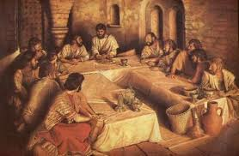
FOURTH QUESTION: WHY DO WE RECLINE?
Notes:
(CHRISTINA TAKES THE CHILDREN OUT)
Why do we recline?
Yeshua explains that reclining at the table is a symbol of freedom.
To recline when eating was a sign of being free men.
Slaves ate standing.
Yesterday we were slaves, but today, we are free.
We are free when we are free from the clutches of sin, of pride, of anger, of jealousy, of selfishness, of all these things called the fruits of flesh that are the worldly culture of Egypt and of the world around us.
May we all learn not only to leave Egypt, but to also let Egypt leave us.
Yeshua went through all these things as part of the first Passover cup.
Then, as was the custom, they read the story
Leader
The story of Passover is a story of miracles, a story of redemption, a story of the mighty power of God to overcome evil.
Reader 1
The Lord had promised the land of Israel to Abraham, Isaac, and Jacob. Yet here were their children in Egypt. The Pharoah who had come to power feared them. These foreigners in our midst are prospering and have grown numerous, he thought. Suppose they join with our enemies and turn against us! Pharoah decided to exert greater control over this people, imposing harsh and bitter slavery upon the Israelites. Still, God blessed His people in strength and number.
Reader 2
Pharoah grew more frightened and ordered every baby boy among the Israelites to be drowned in the Nile River. One Israelite couple hid their little boy for three months. Finally, entrusting his future to God, they set him in a basket and place him upon the river. His sister, Miriam, watched as he floated downstream. Coming upon the basket, Pharoah’s daughter took pity on the child and chose to raise him as her own son. She called him Moses, meaning “drawn from the water.”
Reader 3
Moses grew and became aware of the travail of his people. One day, in a rage, he lost control of himself and killed an Egyptian who was beating a Hebrew slave. Fleeing the palace and the eye of Pharoah, Moses became a shepherd in the land of Midian, far from the cries of his suffering brothers.
Reader 4
The Lord, however, saw the affliction of the children of Israel and heard their groaning. He would raise up a deliverer to lead them out of bondage. It was then that He appeared to Moses in the midst of a bush that burned with fire, yet was not consumed. Moses drew close and listened as God commissioned him to go to Pharoah. Fearful and reluctant, still Moses agreed to bring God’s message to the king of Egypt, “Let my people go!”
Leader
Moses left the wilderness to return to Pharoah’s palace, the very place where he had been raised. He returned with the message which the Lord had given him. But God Himself warned Moses of the resistance he would encounter.
God sent plagues, one by one, yet with each plague, Pharoah hardened his heart. The Egyptians became afflicted with discomfort and disease, bane and blight. Still, Pharoah would not relent. With the tenth and most awful plague, God pierced through the hardness of Pharoah’s impenetrable heart.
Which takes us to the 2nd cup…Then with the second cup: I will free you ….
SLIDE

Slide 53
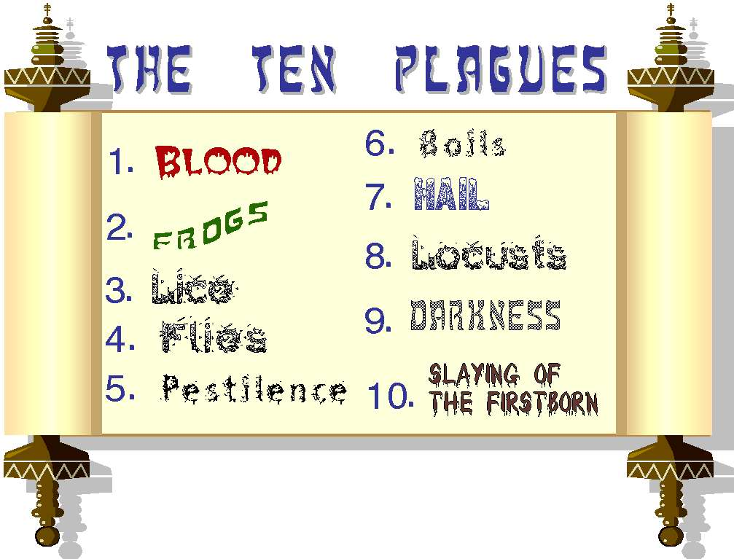
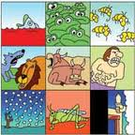
THE SECOND CUP : THE CUP OF PLAGUES
“ I will deliver you …“
Notes:
At this point of the seder, it is customary to have a recitation of the 10 plagues.
The first plague was water changing to Blood.
BLOOD
FROGS
LICE
BEASTS
CATTLE DESEASE
BOILS
HAIL
LOCUSTS
DARKNESS
DEATH OF THE FIRSTBORN
Let’s fill our cup again.
We remember that our freedom came at the price of much death therefore our joy is lessened.
We will then dip our finger in the cup 10 times to take a drop out of our drink as I enumerate the plagues.
It is a good lesson in times of joy to always acknowledge that that joy may have come at a price.
Let us now join Yeshua in drinking the rest of the second cup.
SLIDE

Slide 54
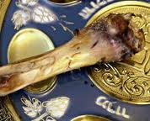
THE SHANK BONE
The Lamb without defect
whose blood served as a
sign to the angel of death
to PASSOVER:
The Lamb which takes away the sin of the world!
YESHUA
Notes:
The original seder was usually served with lamb, which is today represented by the shank bone on the platter.
Later, a roasted egg was added to represent the burnt Temple.
Now, we will go to the next four seder questions.
You can read them yourselves,
SLIDE

Slide 55
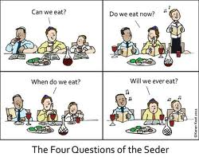
THE NEXT FOUR QUESTIONS
Notes:
This answer is, NOW!
Dinner will be brought to you by out Yedidei Adonai volunteers in blue and white t-shirts.
The punchline of the seder comes at the end of the dinner.
PRAYER FOR THE FOOD
ABBA
SLIDE

Slide 56
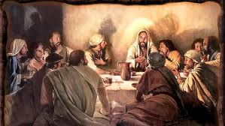
Notes:
PLAY BACKGROUND MUSIC
SLIDE

Slide 57
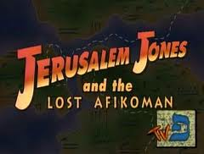
IN SEARCH OF THE AFIKOMEN
Notes:
Have children look for the Afikomen.

Slide 58
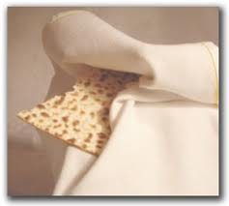
“EAT, THIS IS MY BODY …”
And he took bread, and when he had given thanks, he broke it and gave it to them, saying, “This is my body, which is given for you. Do this in remembrance of me.”
(Luke 22:19 ESV)
Notes:
Yeshua took the Afikomen that was remitted to Him.
At that moment, Yeshua went off script and added a special wrinkle to this last seder that He would have with His friends and disciples.
Yeshua was aware of the fear and anguish that they would feel the following night when they would do the actual, official Seder without Him, a seder that maybe Peter, Andrew, John, or James would lead while He would be in the tomb after having gone through excruciating suffering,
At that time, the concerned Master gives His disciples preparatory words of instruction.
He took bread, and when he had given thanks, he broke it and gave it to them, saying, “This is my body, which is given for you.”
Then He told them, “Tomorrow, tomorrow when you do this, tomorrow when you come to that part of the seder, remember me; do it in remembrance of me.” (Luke 22:19 ESV)
The disciples must have wondered what Yeshua meant, but they were probably used to their Master’s cryptic sayings.
But Yeshua was preparing the disciples, telling them that on the next night, when they do this Seder…
On the next night … when they break this striped and pierced afikomen matzah that spoke of Isaac climbing the mountain carrying the wood of his sacrifice just as their master did a couple of hours before,…
He was telling them that this afikomen matzah that was wrapped in burial cloth and hidden for a time…
That it will be found again, that it will rise from that burial cloth so that we can receive life, being nourished by His teachings.
The disciples probably didn’t fully understand what Yeshua was saying that night, but the next night, these words must have come alive for them, just as they come alive for us today.
Let’s now all partake of Yeshua’s life.
Of His body striped, pieced, and given for us by eating a piece of matzah.
I’d like one person per table to take a matzah and break off pieces that they will give to everyone at the table.
SLIDE

Slide 59
路加福音 Luke 22:19
又拿起餅來，祝謝了，就擘開，遞給他們，說：「這是我的身體，為你們捨的，你們也應當如此行，為的是記念我。」

Slide 60
THE THIRD CUP:
THE CUP OF REDEMPTION
“I WILL REDEEM YOU…”
And likewise the cup after they had eaten, saying, “This cup that is poured out for you is the new covenant in my blood.
(Luke 22:20 ESV)
Notes:
Then Yeshua took the 3rd cup, the seder cup which is called the cup of redemption, and said:
“This cup that is poured out for you is the new covenant in my blood.” (Luke 22:20 ESV)
This is the cup the disciples understood as the cup of the new covenant, prophesied by Jeremiah the prophet, saying…
SLIDE

Slide 61
路加福音 Luke 22:20
飯後也照樣拿起杯來，說：「這杯是用我血所立的新約，是為你們流出來的。

Slide 62
THE THIRD CUP: THE CUP OF REDEMPTION “I WILL REDEEM YOU…”
“Behold, the days are coming, declares the LORD, when I will make a new covenant with the house of Israel and the house of Judah, not like the covenant that I made with their fathers on the day when I took them by the hand to bring them out of the land of Egypt, my covenant that they broke, though I was their husband, declares the LORD. For this is the covenant that I will make with the house of Israel after those days, declares the LORD: I will put my law within them, and I will write it on their hearts. And I will be their God, and they shall be my people. And no longer shall each one teach his neighbor and each his brother, saying, ‘Know the LORD,’ for they shall all know me, from the least of them to the greatest, declares the LORD. For I will forgive their iniquity, and I will remember their sin no more.”
(Jeremiah 31:31-34 ESV)
Notes:
“Behold, the days are coming, declares the LORD, when I will make a new covenant with the house of Israel and the house of Judah, not like the covenant that I made with their fathers on the day when I took them by the hand to bring them out of the land of Egypt, my covenant that they broke, though I was their husband, declares the LORD. For this is the covenant that I will make with the house of Israel after those days, declares the LORD: I will put my law within them, and I will write it on their hearts. And I will be their God, and they shall be my people. And no longer shall each one teach his neighbor and each his brother, saying, ‘Know the LORD,’ for they shall all know me, from the least of them to the greatest, declares the LORD. For I will forgive their iniquity, and I will remember their sin no more.”
(Jeremiah 31:31-34 ESV)
SLIDE

Slide 63
耶利米書 Jeremiah 31:31-34
耶和華說：「日子將到，我要與以色列家和猶大家另立新約，不像我拉著他們祖宗的手，領他們出埃及地的時候，與他們所立的約。我雖作他們的丈夫，他們卻背了我的約。這是耶和華說的。」耶和華說：「那些日子以後，我與以色列家所立的約乃是這樣：我要將我的律法放在他們裡面，寫在他們心上。我要作他們的 神，他們要作我的子民。他們各人不再教導自己的鄰舍和自己的弟兄說：『你該認識耶和華』，因為他們從最小的到至大的都必認識我。我要赦免他們的罪孽，不再記念他們的罪惡。這是耶和華說的。」

Slide 64
THE THIRD CUP: THE CUP OF REDEMPTION “I WILL REDEEM YOU…”
And he took a cup, and when he had given thanks he gave it to them, saying, “Drink of it, all of you, for this is my blood of the covenant, which is poured out for many for the forgiveness of sins. I tell you I will not drink again of this fruit of the vine until that day when I drink it new with you in my Father's kingdom.”
(Matthew 26:27-29 ESV)
Notes:
“Drink of it, all of you,” he said, , “for this is my blood of the covenant, which is poured out for many for the forgiveness of sins. I tell you I will not drink again of this fruit of the vine until that day when I drink it new with you in my Father's kingdom.” (Matthew 26:27-29 ESV)
This is the cup that says that after he delivered and freed us, he bought us at a high price.
Israel is received again with the renewing of their covenant with God, a covenant that the nations will share in, and that is why you are here today, all believers and followers of the Jewish Messiah.
So let’s follow Yeshua is the drinking for this 3rd cup.
Pour cup and drink.
SLIDE

Slide 65
馬太福音 Matthew 26:27-29
又拿起杯來，祝謝了，遞給他們，說：「你們都喝這個；因為這是我立約的血，為多人流出來，使罪得赦。但我告訴你們，從今以後，我不再喝這葡萄汁，直到我在我父的國裡同你們喝新的那日子。」

Slide 66
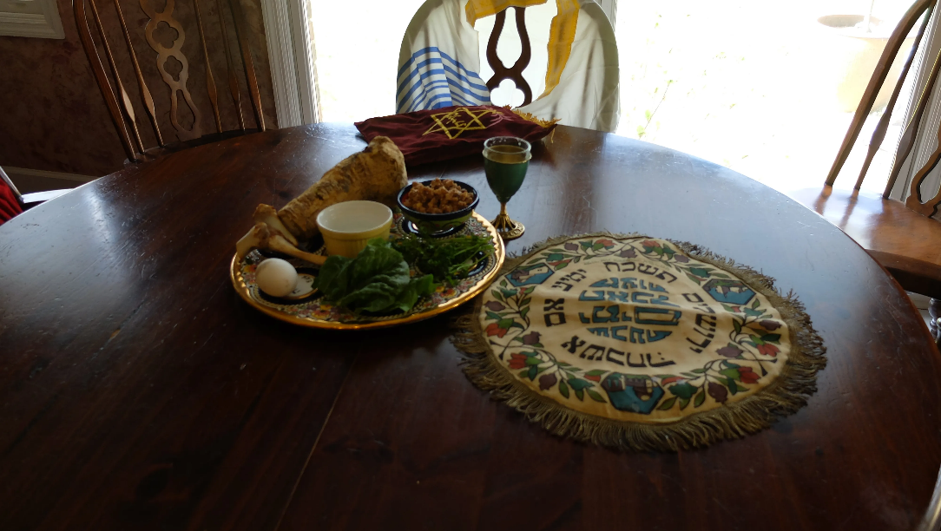
A PLACE FOR ELIJAH
“Behold, I will send you Elijah the prophet before the great and awesome day of the LORD comes. And he will turn the hearts of fathers to their children and the hearts of children to their fathers, lest I come and strike the land with a decree of utter destruction.”
(Malachi 4:5-6 ESV)
Notes:
An empty place is often reserved at a seder for Elijah the prophet.
This is according to the prophecy:
“Behold, I will send you Elijah the prophet before the great and awesome day of the LORD comes. And he will turn the hearts of fathers to their children and the hearts of children to their fathers, lest I come and strike the land with a decree of utter destruction.”
(Malachi 4:5-6 ESV)
John the Baptist whom Yeshua said came in the spirit of Elijah was born at the season of Passover.
But as Elijah came to prepare the way for the first coming, he will come also to prepare the way for the second coming.
Tell about tradition of leaving the door open.
Send a child to see if Elijah came.
SLIDE

Slide 67
瑪拉基書 Malachi 4:5-6
「看哪，耶和華大而可畏之日未到以前，我必差遣先知以利亞到你們那裡去。他必使父親的心轉向兒女，兒女的心轉向父親，免得我來咒詛遍地。」

Slide 68
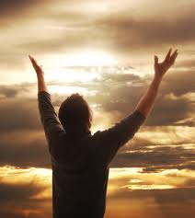
THE FOURTH CUP: THE CUP OF PRAISE
“I WILL TAKE YOU AS MY PEOPLE”
And when they had sung a hymn, they went out to the mount of olives. (Matthew 26:30 ESV)
Give thanks to the LORD, for he is good, for his steadfast love endures forever. Give thanks to the God of gods, for his steadfast love endures forever. Give thanks to the Lord of lords, for his steadfast love endures forever;
(Psalms 136:1-3 ESV)
Notes:
And now, we come to the end of our seder with the 4th cup, the cup of praise.
Let’s follow Yeshua again in filling our glass for the 4th time, acknowledging the promise that was made at Mt. Horeb, a promise for us also today, “I will take you as my people…”
Psalms are sang at the end of the seder just as it is written that “When they had sung a hymn, they went out to the Mount of Olives.
(Matthew 26:30 ESV)
Read Ps 136: 1-15
SLIDE

Slide 69
詩篇 Psalm 136:1-3
你們要稱謝耶和華，因他本為善；他的慈愛永遠長存。 你們要稱謝萬神之神，因他的慈愛永遠長存。 你們要稱謝萬主之主，因他的慈愛永遠長存。

Slide 70
THE FOURTH CUP: THE CUP OF PRAISE
“I WILL TAKE YOU AS MY PEOPLE”
Give thanks to Adonai, for he is good, for his grace continues forever. Give thanks to the God of gods, for his grace continues forever. Give thanks to the Lord of lords, for his grace continues forever; to him who alone has done great wonders, for his grace continues forever; to him who skillfully made the heavens, for his grace continues forever; to him who spread out the earth on the water, for his grace continues forever; to him who made the great lights, for his grace continues forever; the sun to rule the day, for his grace continues forever; the moon and stars to rule the night, for his grace continues forever; to him who struck down Egypt's firstborn, for his grace continues forever; and brought Isra'el out from among them, for his grace continues forever; with a mighty hand and an outstretched arm, for his grace continues forever; to him who split apart the Sea of Suf, for his grace continues forever; and made Isra'el cross right through it, for his grace continues forever; but swept Pharaoh and his army into the Sea of Suf, for his grace continues forever;
Psalms 136:1-15 (CJB)

Slide 71
詩篇 Psalm 136:1-15
你們要稱謝耶和華，因他本為善；他的慈愛永遠長存。你們要稱謝萬神之神，因他的慈愛永遠長存。 你們要稱謝萬主之主，因他的慈愛永遠長存。稱謝那獨行大奇事的，因他的慈愛永遠長存。稱謝那用智慧造天的，因他的慈愛永遠長存。稱謝那鋪地在水以上的，因他的慈愛永遠長存。稱謝那造成大光的，因他的慈愛永遠長存。他造日頭管白晝，因他的慈愛永遠長存。他造月亮星宿管黑夜，因他的慈愛永遠長存。稱謝那擊殺埃及人之長子的，因他的慈愛永遠長存。他領以色列人從他們中間出來，因他的慈愛永遠長存。他施展大能的手和伸出來的膀臂，因他的慈愛永遠長存。稱謝那分裂紅海的，因他的慈愛永遠長存。他領以色列從其中經過，因他的慈愛永遠長存；卻把法老和他的軍兵推翻在紅海裡，因他的慈愛永遠長存。

Slide 72
Adon Olam
Adon Olam asher malach
B’terem kol yetsir nivra
Le-eit na-a- sa,
V’chef tso kol a zai melech
shemo nikra
The Lord of the Universe who reigned
before anything was created.
When all was made by his will
He was acknowledged as King.

Slide 73

回應詩歌 Response Song
「以利亞的日子
Days of Elijah」

Slide 74
Days of Elijah
Paul Wilbur
These are the days of Elijah,
Declaring the Word of The LORD
And these are the days of Your servant, Moses,
Righteousness being restored.

Slide 75
Days of Elijah
Paul Wilbur
And though these are days of great trials
Of famine and darkness and sword,
Still we are the voice in the desert crying
“Prepare ye the Way of The LORD!”

Slide 76
Days of Elijah
Paul Wilbur
Behold He comes, riding on the clouds
Shining like the sun, at the trumpet call!
So lift your voice,
it’s the year of jubilee
Out of Zion’s hill Salvation comes!

Slide 77
Days of Elijah
Paul Wilbur
And these are the days of Ezekiel
The dry bones becoming as flesh,
And these are the days of Your servant, David,
Rebuilding a temple of praise!

Slide 78
Days of Elijah
Paul Wilbur
And these are the days of the harvest
The fields are white in the world,
And we are Your laborers in Your vineyard
Declaring the Word of The LORD!

Slide 79
Days of Elijah
Paul Wilbur
Behold He comes, riding on the clouds
Shining like the sun, at the trumpet call!
So lift your voice,
it’s the year of jubilee
Out of Zion’s hill Salvation comes!

Slide 80
Days of Elijah
Paul Wilbur
There’s no one like Yeshua!
There’s no one like Yeshua!
There’s no one like Yeshua!
There’s no one like Yeshua!
(x2)

Slide 81
Days of Elijah
Paul Wilbur
Who was and who is and who is to come!
Who was and who is and who is to come!

