Slide 1


波特蘭靈糧堂十周年感恩崇拜
BOLIP 10th Anniversary Thanksgiving Worship Service

Slide 2


Slide 3


Slide 4


Slide 5


Slide 6


Slide 8

Give thanks to the Lord
Our God and King
His love endures forever
For He is good, He is above all things
His love endures forever
Sing praise, sing praise

Slide 9
With a mighty hand
and outstretched arm
His love endures forever
For the life that's been reborn
His love endures forever
Sing praise, sing praise
Sing praise, sing praise

Slide 10
Forever God is faithful
Forever God is strong
Forever God is with us
Forever
Forever

Slide 12


Slide 13


Slide 14


Slide 15


Slide 16


Slide 17
我靈歌唱,讚美救主我神,
你真偉大,何等偉大.
(x2)
Then sings my soul,
my Savior God, to Thee;
How great Thou art,
How great Thou art.
(x2)

Slide 18

活出愛 Live Out Love
有一份愛 從天而來
比山高 比海深
測不透 摸不著 卻看得見
因為有你 因為有我
甘心給 用心愛
把心中 這一份愛 活出來

Slide 19

耶穌的愛激勵我
敞開我的生命
讓自己成為別人祝福
耶穌的愛點燃我
心中熊熊愛火
我們一起 向世界 活出愛
2006 Clay Music 泥土音樂

Slide 21
感恩與祝福
Thanksgiving and Blessings
(波特蘭靈糧堂小組
BOLIP Cell Groups)

Slide 22
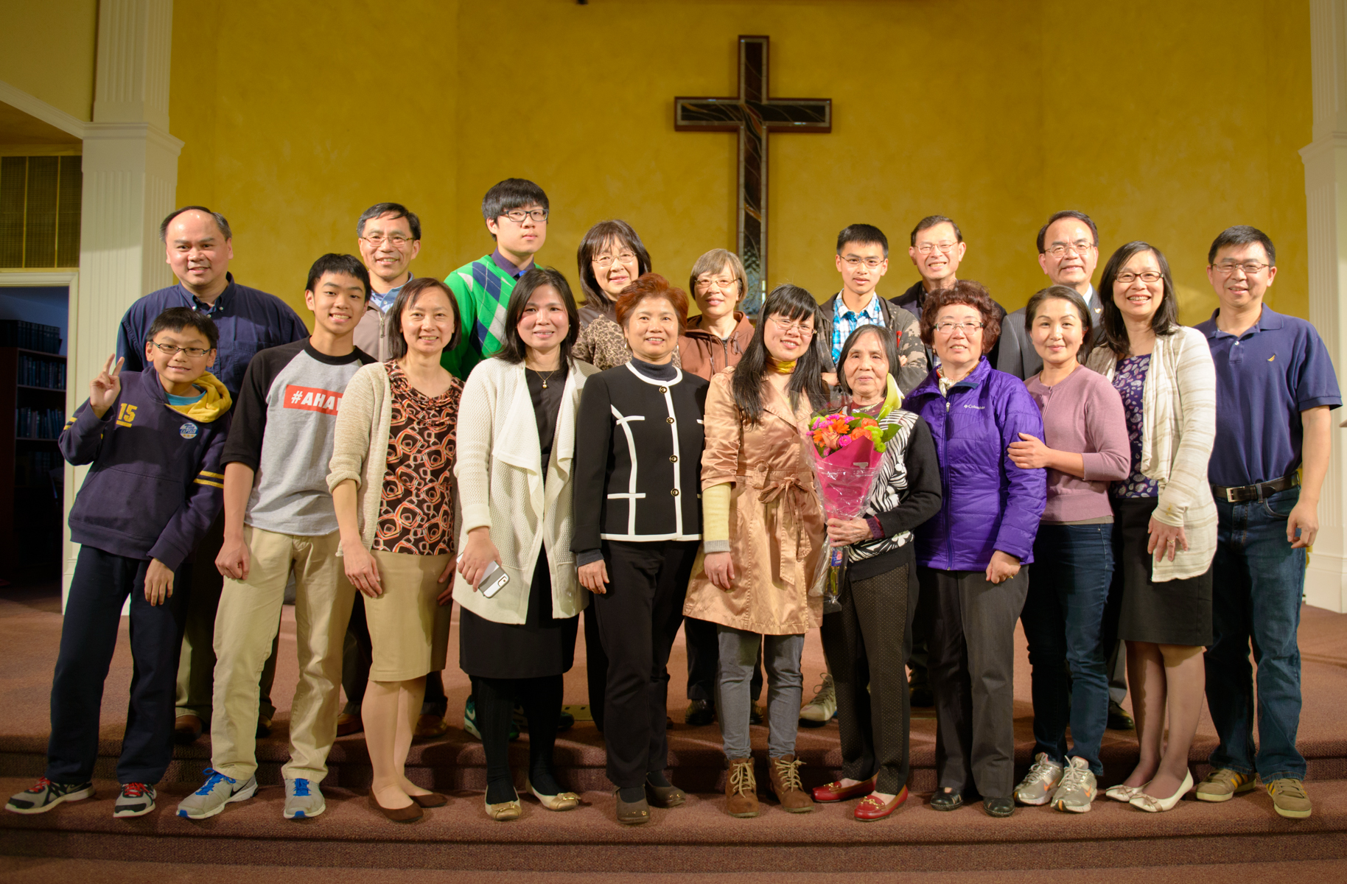
恩典小組 (Beaverton 家庭) Grace Cell Group

Slide 23
有一件事，我曾求耶和華，我仍要尋求：就是一生一世住在耶和華的殿中，瞻仰他的榮美，在他的殿裡求問。 (詩篇 Psalm 27:4）
One thing I ask from the Lord,
this only do I seek:
that I may dwell in the house of the Lord
all the days of my life,
to gaze on the beauty of the Lord
and to seek him in his temple.

Slide 24
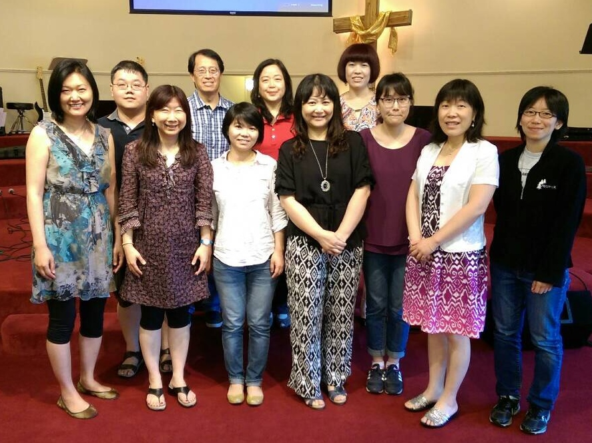
點線面小組 (Beaverton 單身) DLS Cell Group

Slide 25
你們是世上的光。城造在山上是不能隱藏的。 人點燈，不放在斗底下，是放在燈臺上，就照亮一家的人。 你們的光也當這樣照在人前，叫他們看見你們的好行為，便將榮耀歸給你們在天上的父。 (馬太福音 Matthew 5:14-16）
“You are the light of the world. A town built on a hill cannot be hidden. Neither do people light a lamp and put it under a bowl. Instead they put it on its stand, and it gives light to everyone in the house. In the same way, let your light shine before others, that they may see your good deeds and glorify your Father in heaven.

Slide 26
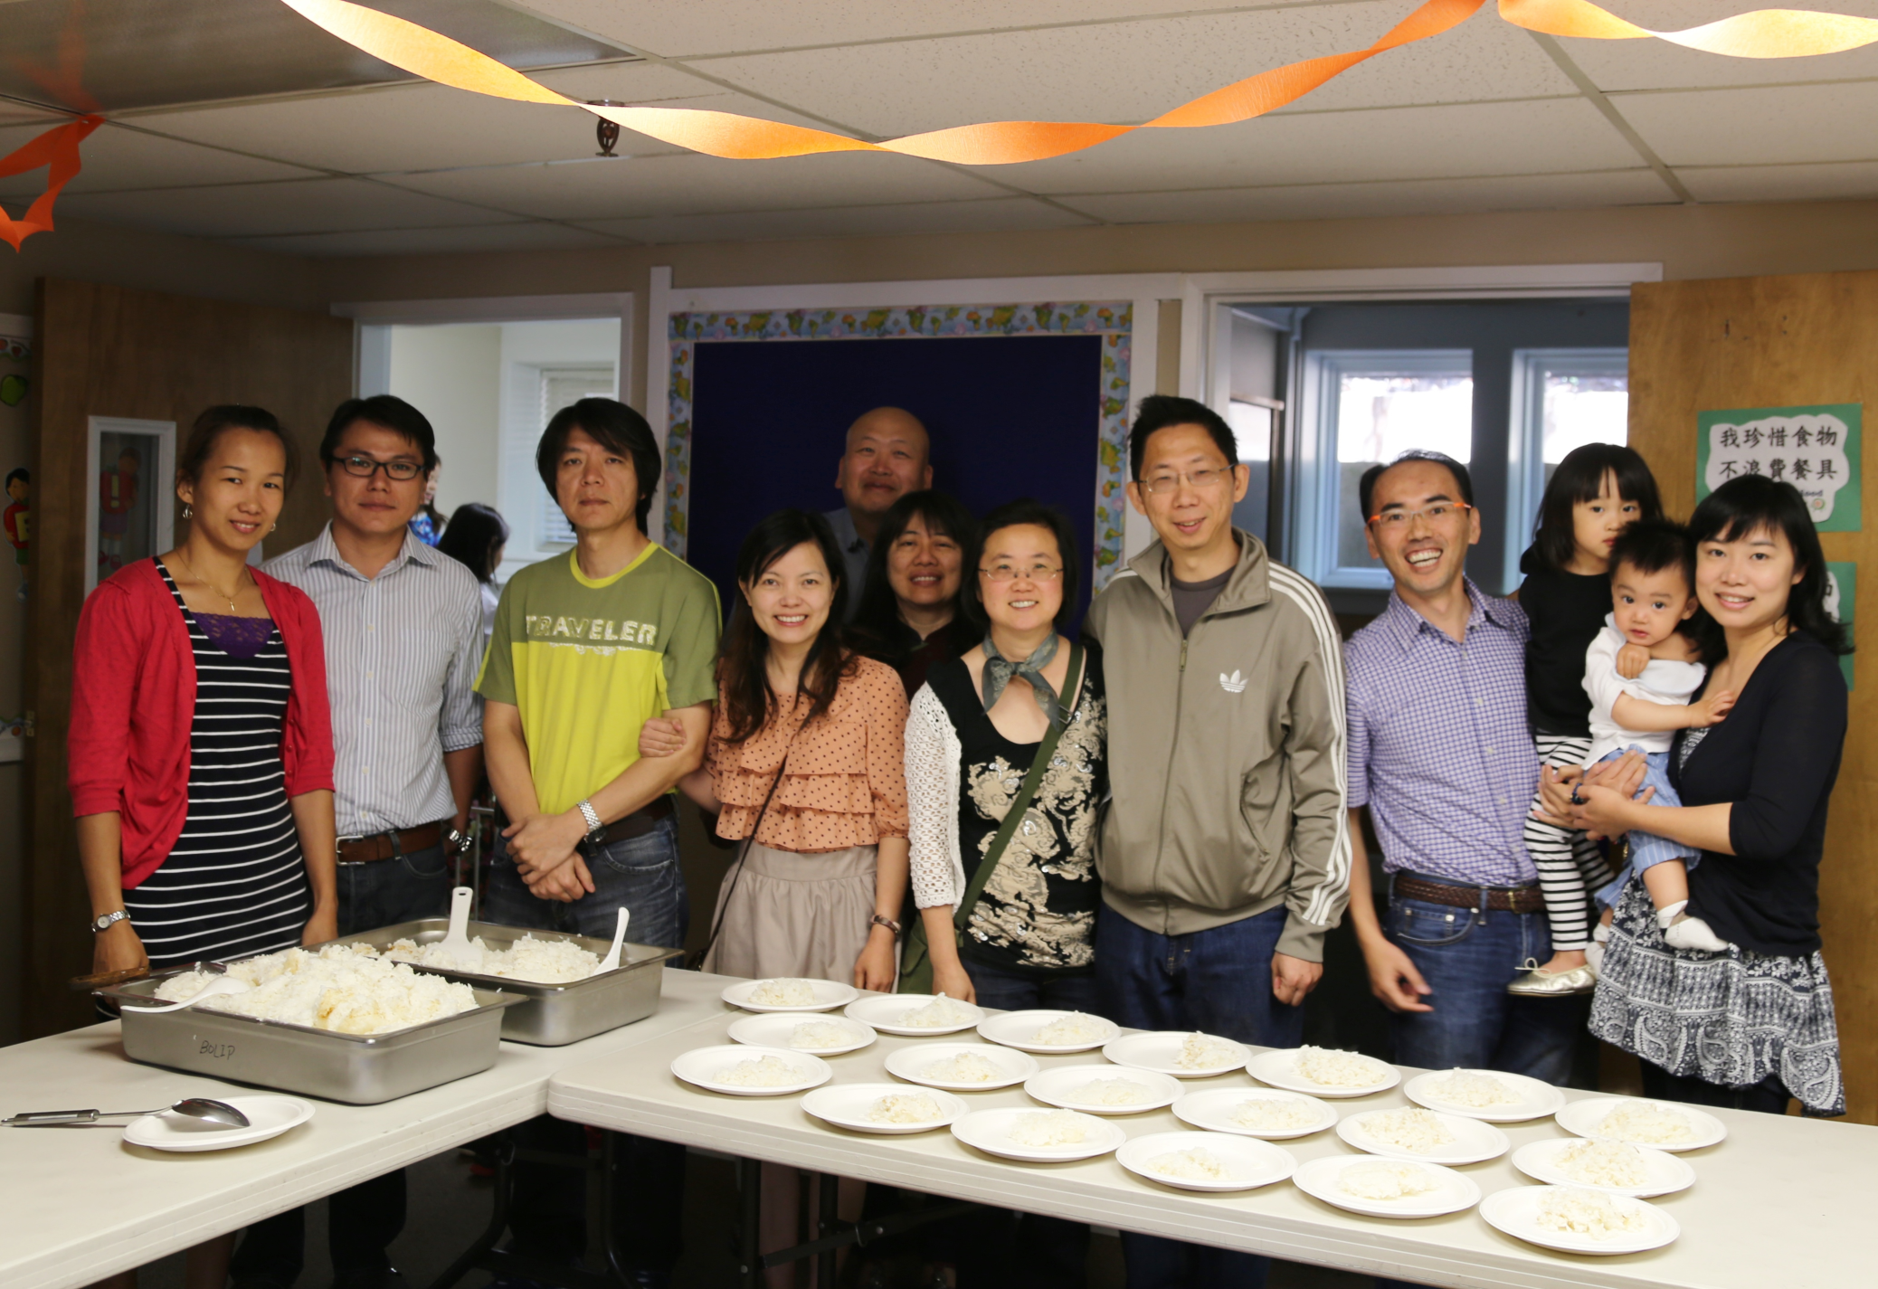
加利利小組 (Camas 家庭) Galilee Cell Group

Slide 27
耶和華的僕人夜間站在耶和華殿中的，你們當稱頌耶和華！ 你們當向聖所舉手，稱頌耶和華！ 願造天地的耶和華，從錫安賜福給你們！ (詩篇 Psalm 134:1-3）
Praise the Lord, all you servants of the Lord
who minister by night in the house of the Lord.
Lift up your hands in the sanctuary
and praise the Lord.
May the Lord bless you from Zion,
he who is the Maker of heaven and earth.

Slide 28
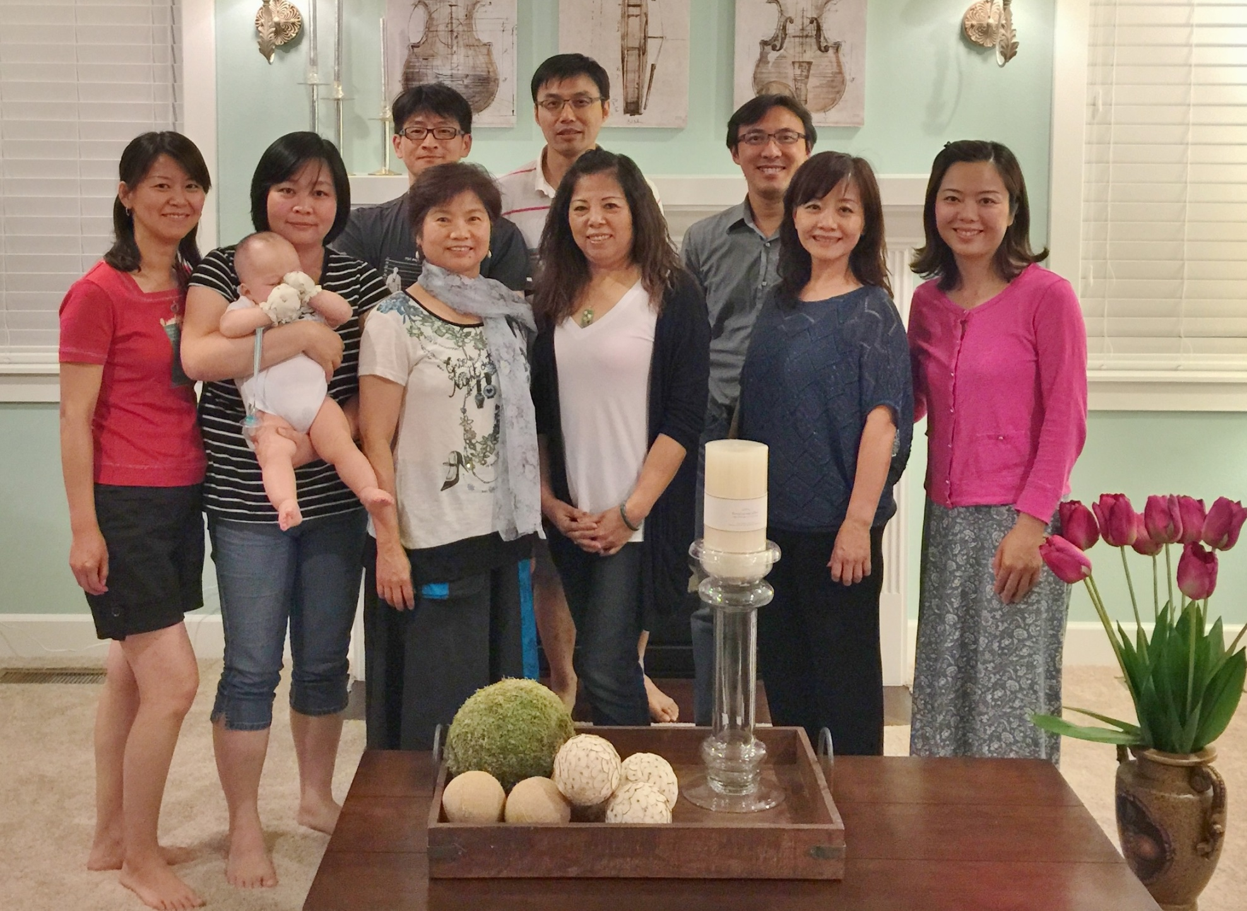
雅歌小組 (Camas 家庭) New Song Cell Group

Slide 29
倚靠耶和華的人好像錫安山，永不動搖。 眾山怎樣圍繞耶路撒冷，耶和華也照樣圍繞他的百姓，從今時直到永遠。
(詩篇 Psalm 125:1-2）
Those who trust in the Lord are like Mount Zion,
which cannot be shaken but endures forever.
As the mountains surround Jerusalem,
so the Lord surrounds his people
both now and forevermore.

Slide 30
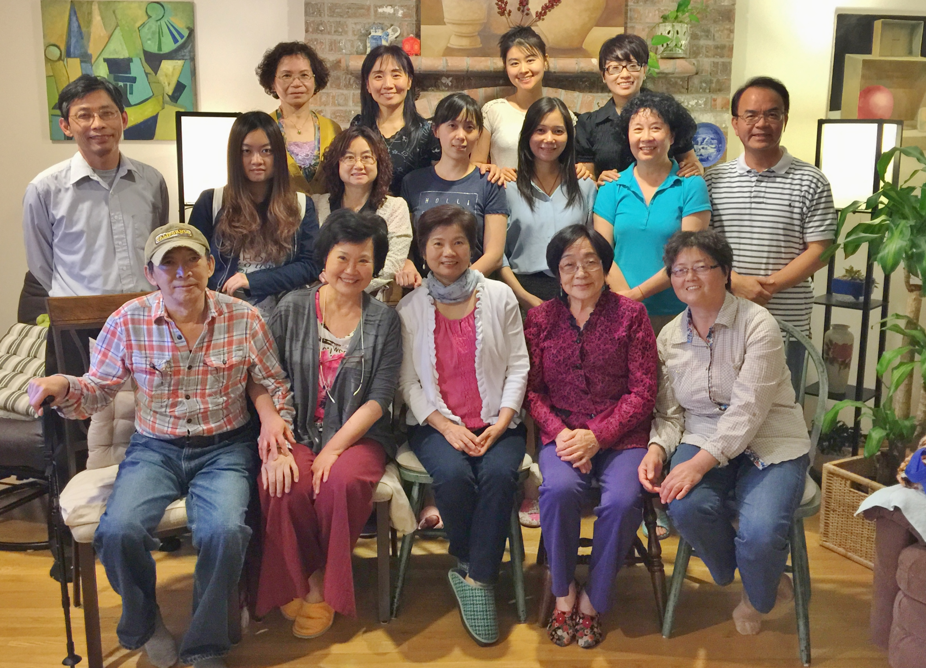
喜樂小組 (Happy Valley 家庭) Rejoice Cell Group

Slide 31
若不是耶和華建造房屋，建造的人就枉然勞力；若不是耶和華看守城池，看守的人就枉然警醒。 (詩篇 Psalm 127:1）
Unless the Lord builds the house,
the builders labor in vain.
Unless the Lord watches over the city,
the guards stand watch in vain.

Slide 32
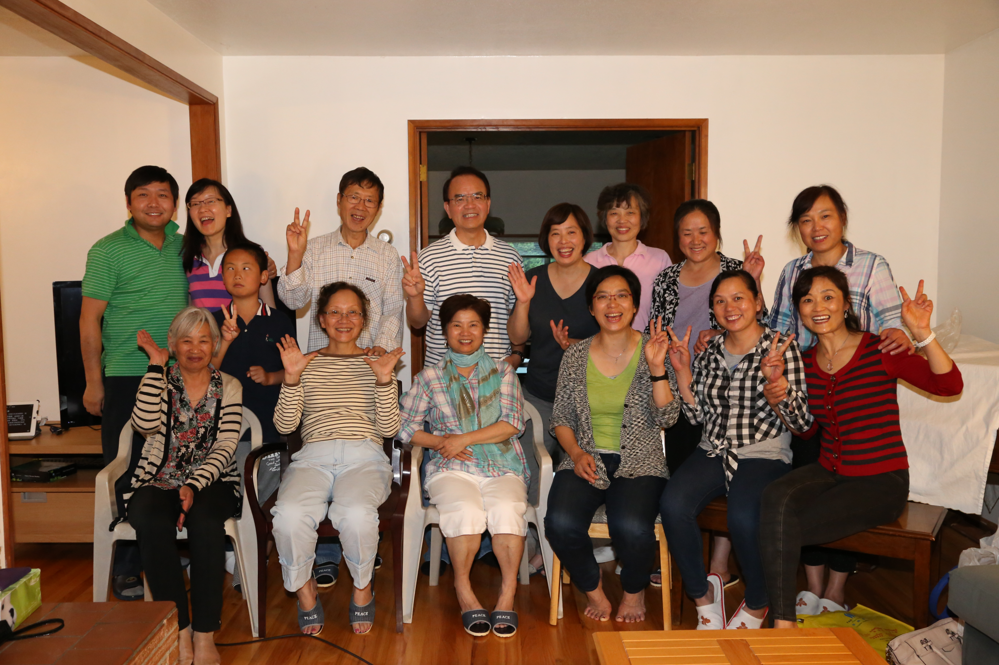
迦南小組 (Lake Oswego 家庭) Canaan Cell Group

Slide 33
7 親愛的弟兄啊，我們應當彼此相愛，因為愛是從 神來的。 凡有愛心的，都是由 神而生，並且認識 神。
12 從來沒有人見過 神，我們若彼此相愛， 神就住在我們裡面，愛他的心在我們裡面得以完全了。 (約翰一書 1 John 4 : 7,12）
7 Dear friends, let us love one another, for love comes from God. Everyone who loves has been born of God and knows God.
12 No one has ever seen God; but if we love one another, God lives in us and his love is made complete in us.

Slide 34
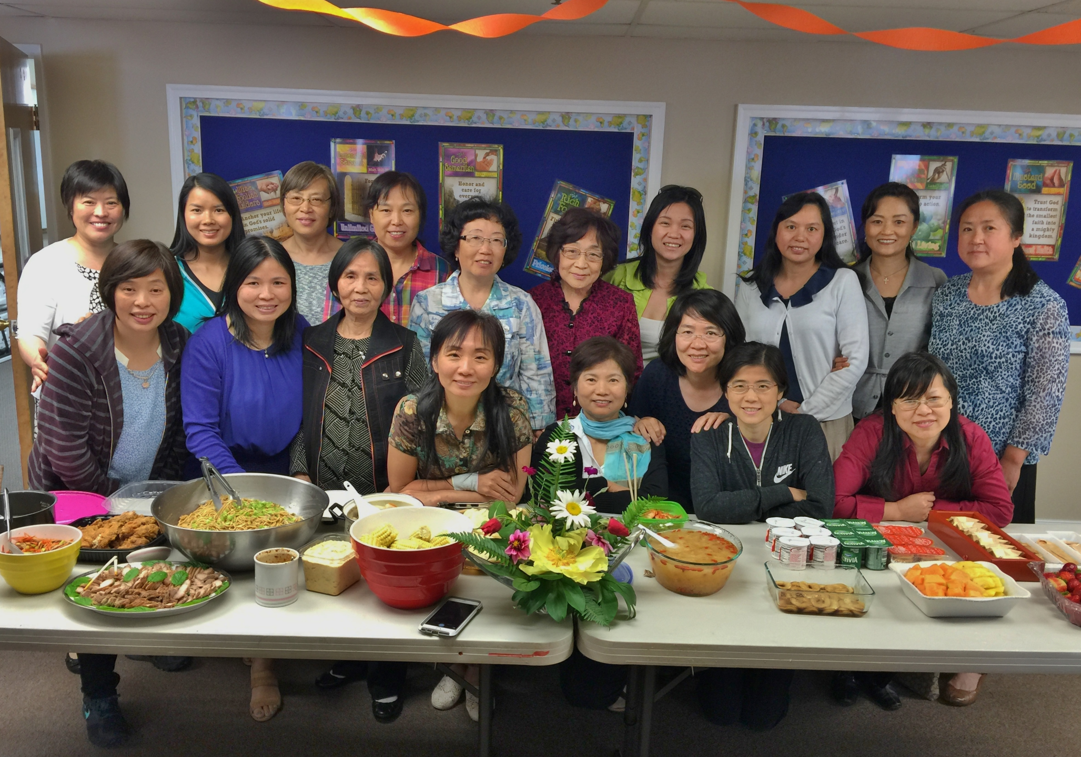
路得小組 (Portland 姐妹小組) Ruth Cell Group

Slide 35
若有人服事我，就當跟從我；我在哪裡，服事我的人也要在那裡；若有人服事我，我父必尊重他。 (約翰福音 John 12:26）
Whoever serves me must follow me; and where I am, my servant also will be. My Father will honor the one who serves me.

Slide 36
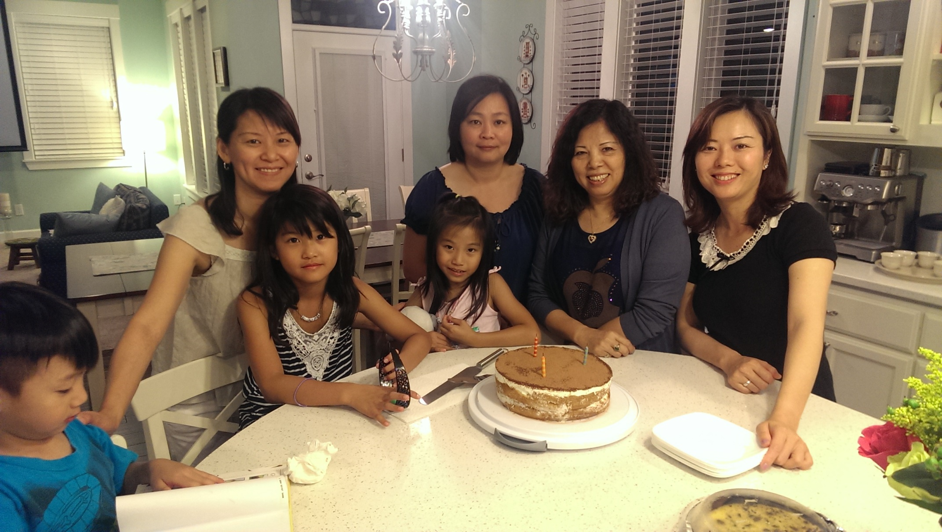
以斯帖小組 (Camas 姐妹小組) Esther Cell Group

Slide 37
當稱謝進入他的門；當讚美進入他的院。 當感謝他，稱頌他的名！ (詩篇 Psalm 100:4）
Enter his gates with thanksgiving
and his courts with praise;
give thanks to him and praise his name.

Slide 38
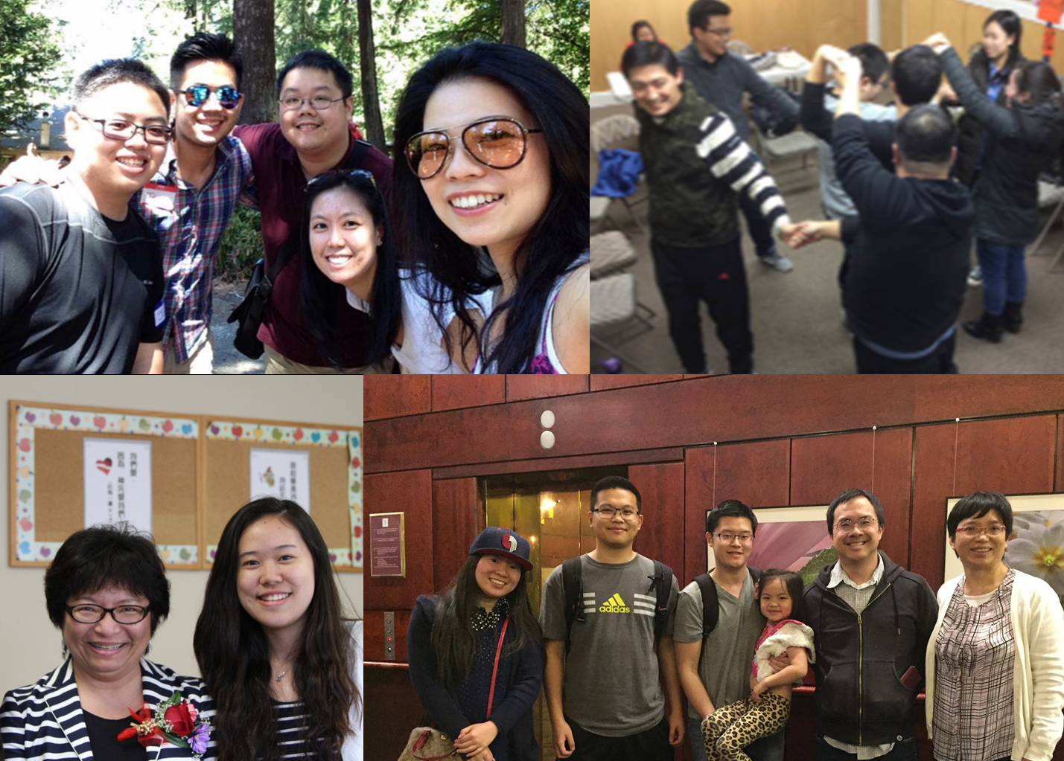
飛揚小組 (大專青年) Fly Young Cell Group

Slide 39
這代要對那代頌讚你的作為，也要傳揚你的大能。 (詩篇 Psalm 145:4）
One generation commends your works to another;
they tell of your mighty acts.

Slide 40
『尼希米記』帶給我們的啟示和祝福
Revelation and Blessings from Nehemiah
(裝備中心 Equipping Center)

Slide 41
以祿月二十五日，城牆修完了，共修了五十二天。 (尼希米記 Nehemiah 6:15）
到了七月，以色列人住在自己的城裡。 那時，他們如同一人聚集在水門前的寬闊處，請文士以斯拉將耶和華藉摩西傳給以色列人的律法書帶來。他們清清楚楚地念 神的律法書，講明意思，使百姓明白所念的。 省長尼希米和作祭司的文士以斯拉，並教訓百姓的利未人，對眾民說：「今日是耶和華─你們 神的聖日，不要悲哀哭泣。」又對他們說：「你們去吃肥美的，喝甘甜的，有不能預備的就分給他，因為今日是我們主的聖日。 你們不要憂愁，因靠耶和華而得的喜樂是你們的力量。」 (尼希米記 Nehemiah 8:1, 7-10）

Slide 43
『讚美之泉』
Stream of Praise
<播放 video>
(波特蘭靈糧堂敬拜舞蹈團
BOLIP Worship Dance Team)

Slide 45
生命河靈糧堂牧者的勉勵與祝福
Exhortation and Blessings from ROLCC
<播放 video>
(劉彤牧師與劉梅蕾師母
Pastor & Mrs. Liu)

Slide 47
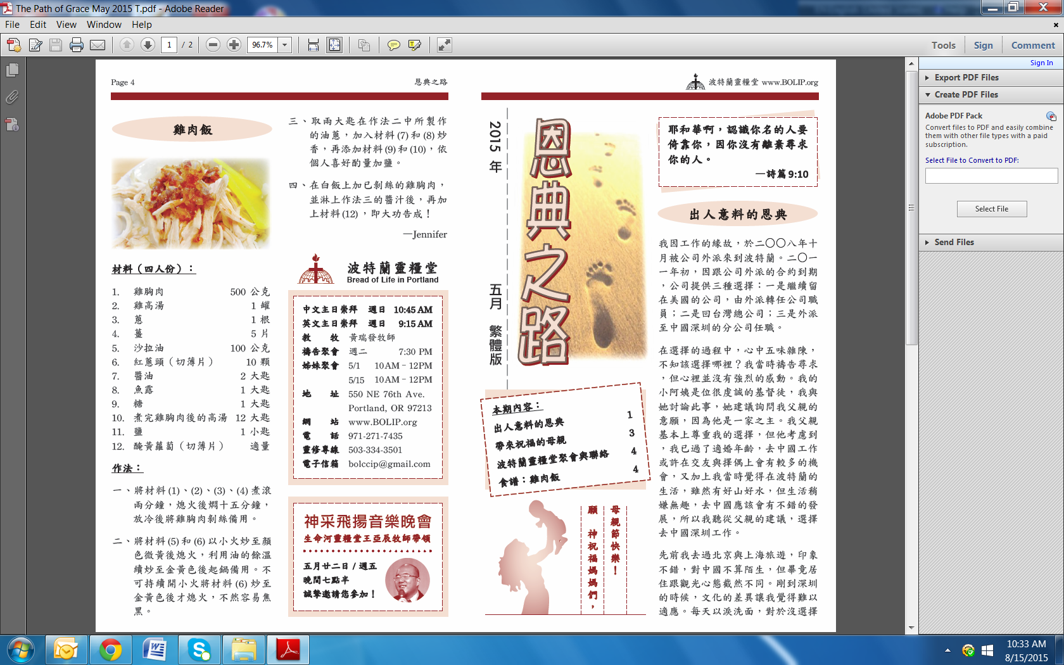
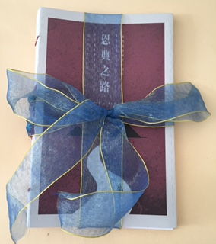
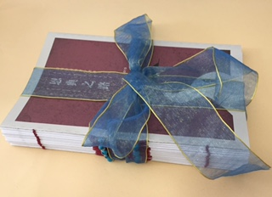
恩典之路文字事工
2013年二月創刊
你以恩典為年歲的冠冕，
你的路徑都滴下脂油。
感謝主，
將榮耀歸給 神
!

Slide 48

(『恩典之路』福音月刊編輯團隊
“Path of Grace” Monthly Gospel Tracks Editing Team)

Slide 50
“Bless This House”
『上帝的愛真奇妙』
『佳美之地』
(波特蘭靈糧堂詩班
BOLIP Choir)

Slide 51
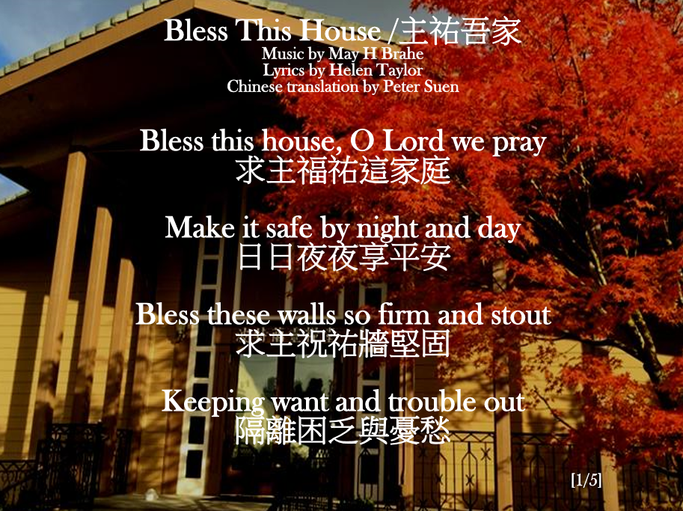

Slide 52
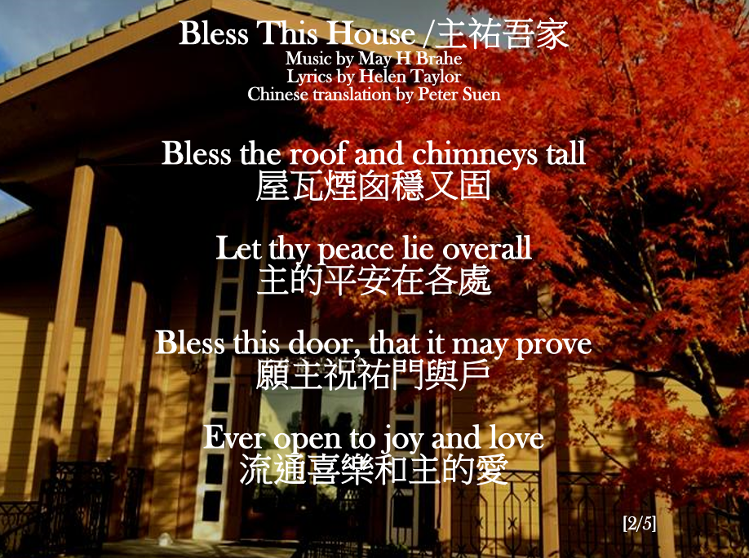

Slide 53
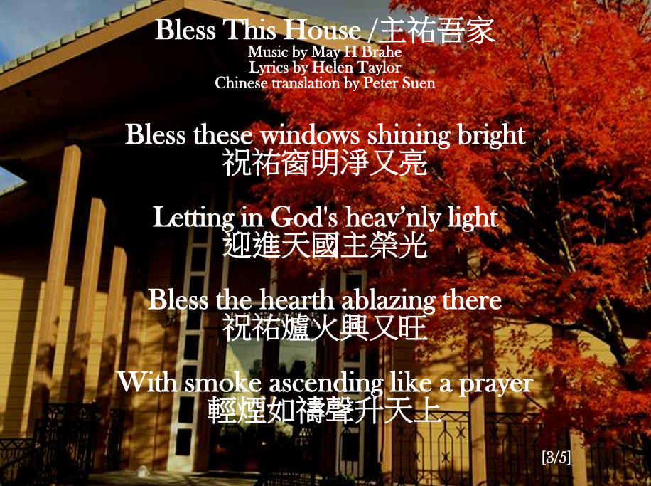

Slide 54
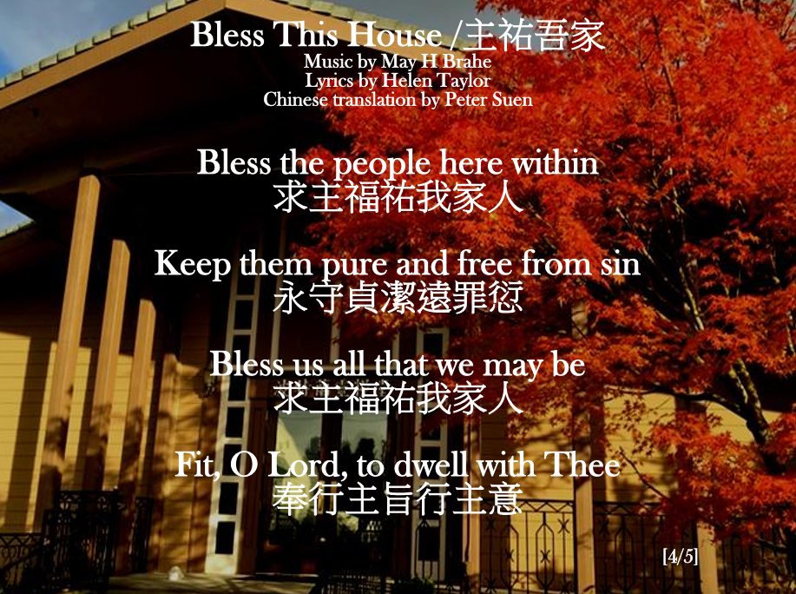

Slide 55
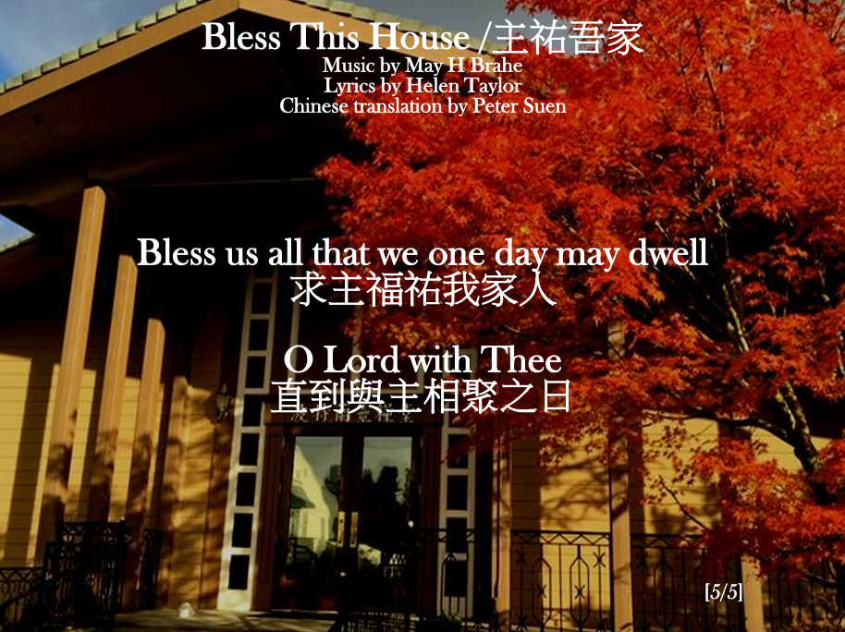

Slide 56
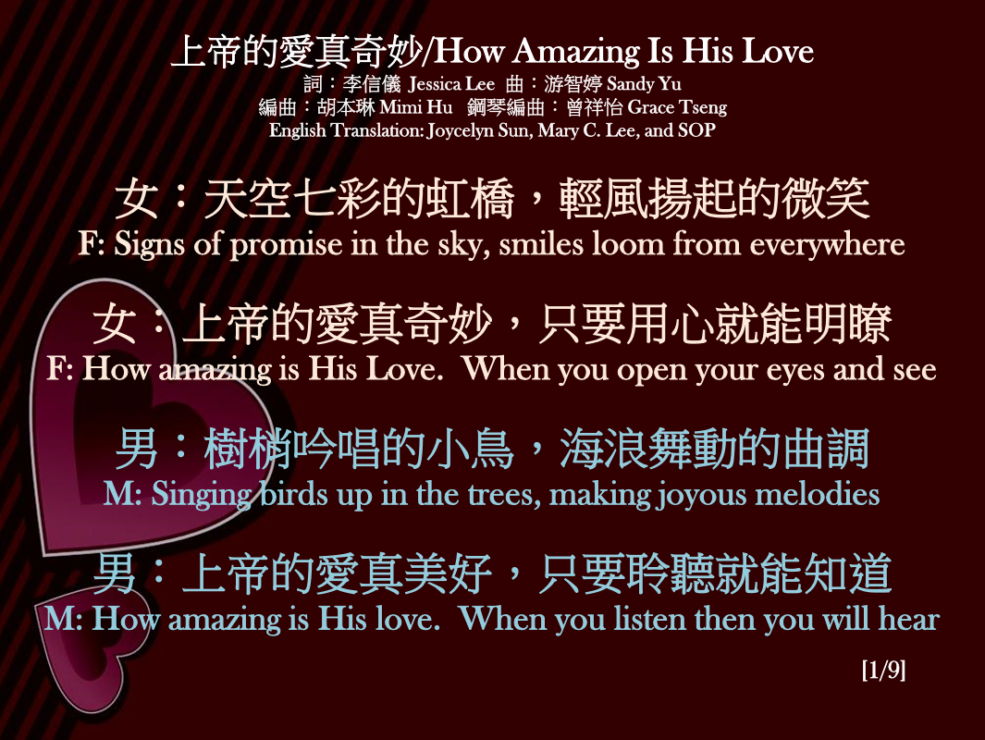

Slide 57
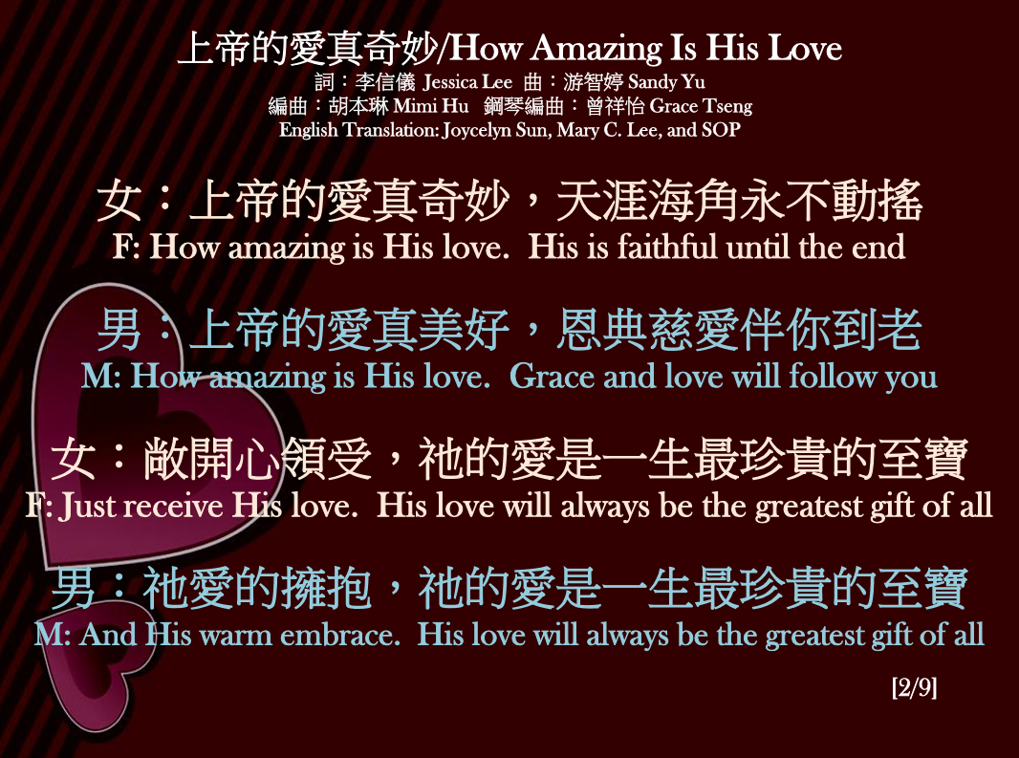

Slide 58
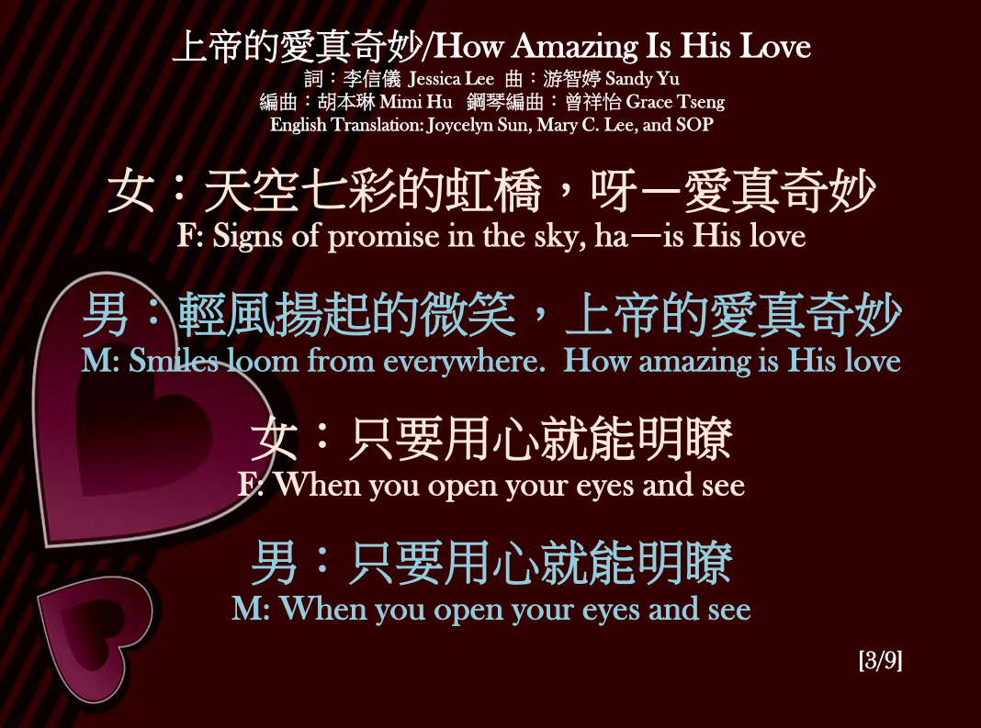

Slide 59
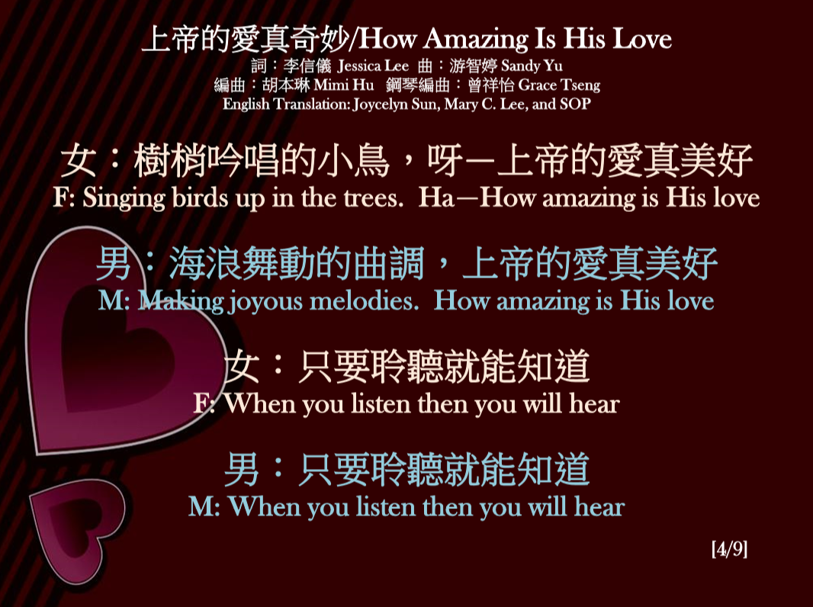

Slide 60
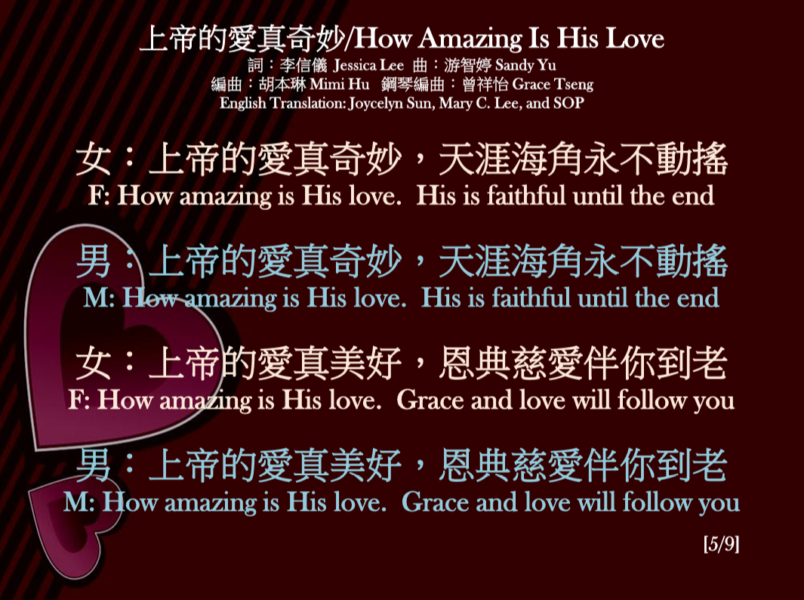

Slide 61
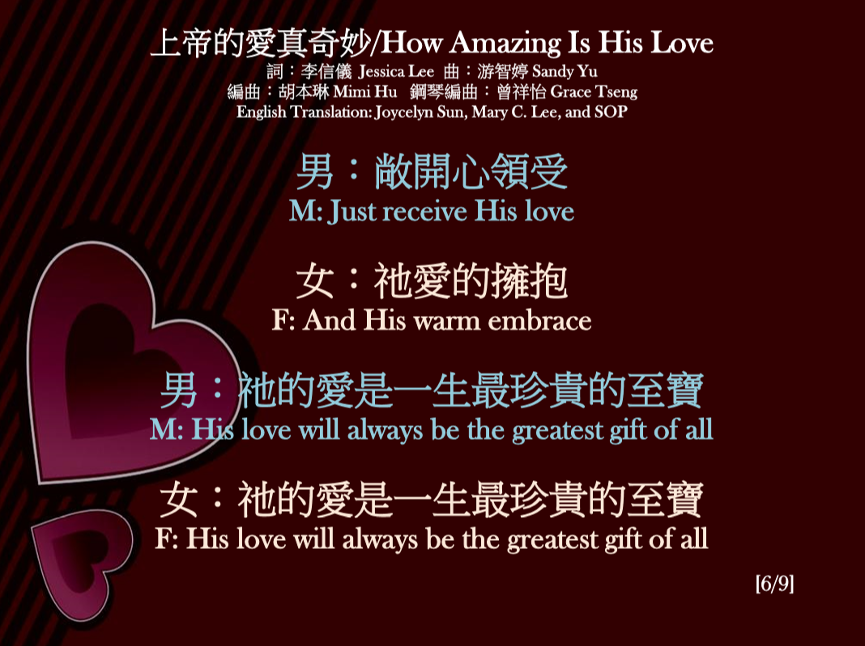

Slide 62
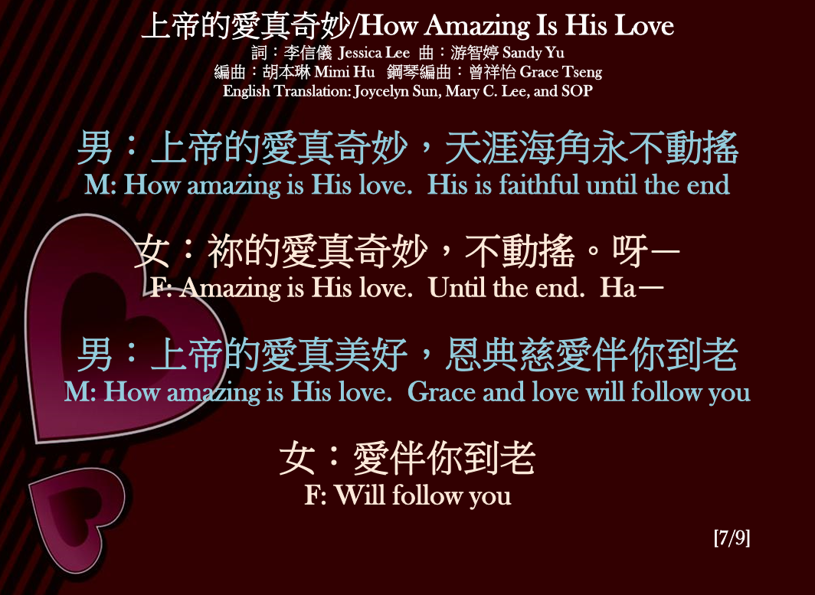

Slide 63
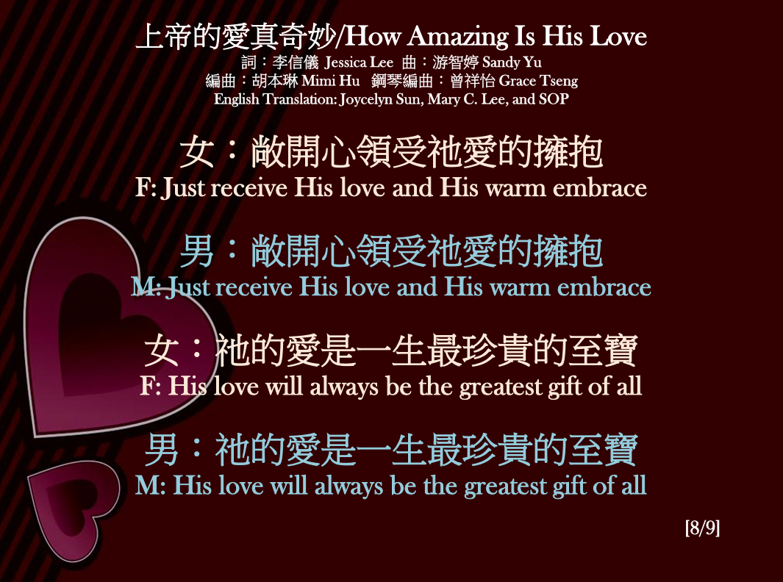

Slide 64
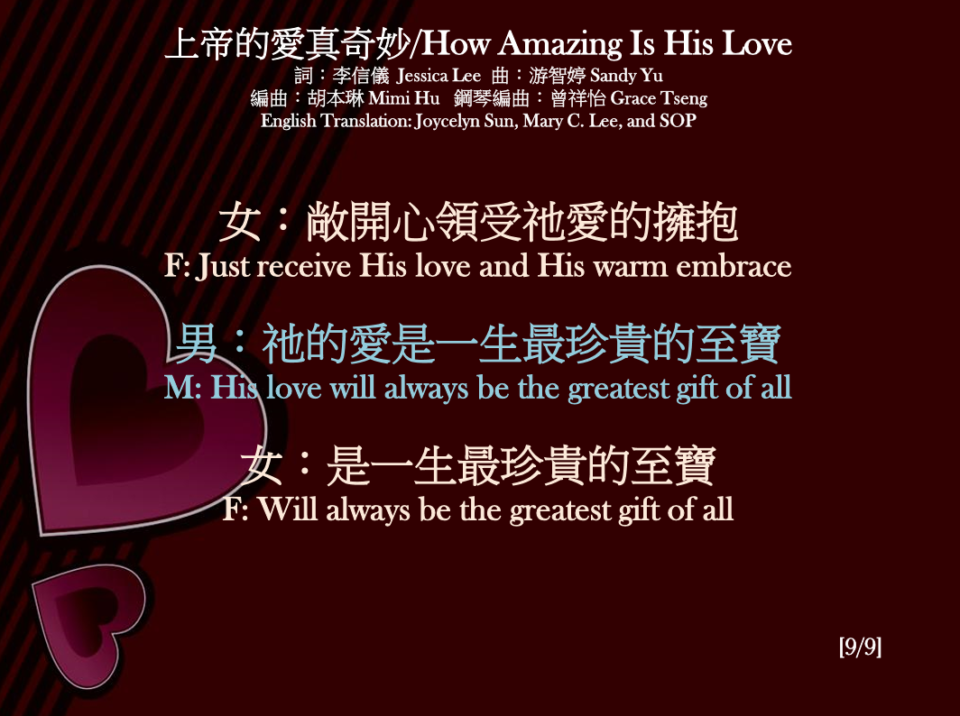

Slide 65


Slide 66


Slide 67


Slide 68
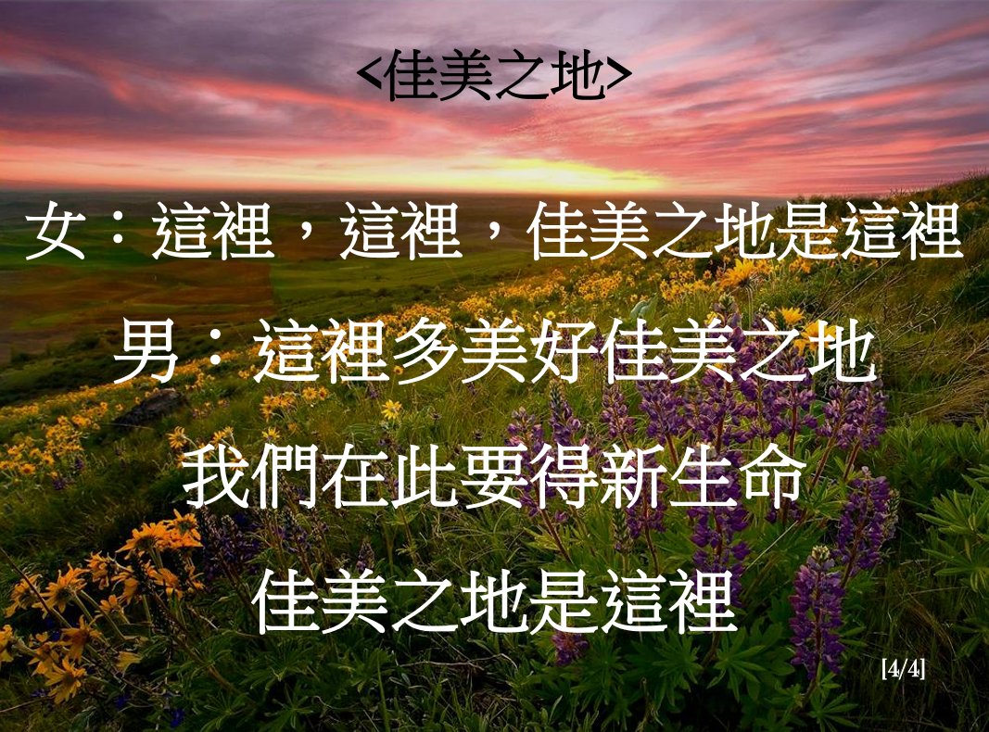

Slide 70
見證分享
Sharing Testimony
(顏百輝傳道 Pastor Phil Yien)

Slide 71


Slide 73
獻上讚美
Offering Praises
(台灣原住兒合唱團 Taiwan Aborigine Choir)

Slide 75
他必興旺，我必衰微。
He must become greater; I must become less.
(約翰福音 John 3:30）
(黃瑞發牧師 Pastor alpha Hwong)

Slide 76
我對你們舉薦我們的姊妹非比；她是堅革哩教會中的女執事。 請你們為主接待她，合乎聖徒的體統。 她在何事上要你們幫助，你們就幫助她；因她素來幫助許多人，也幫助了我。 (羅馬書 Romans 16:1-2）
I commend to you our sister Phoebe, a deacon of the church in Cenchreae. I ask you to receive her in the Lord in a way worthy of his people and to give her any help she may need from you, for she has been the benefactor of many people, including me.

Slide 77
神能照著運行在我們心裡的大力充充足足地成就一切，超過我們所求所想的。 但願他在教會中，並在基督耶穌裡，得著榮耀，直到世世代代，永永遠遠。 阿們！
(以弗所書 Ephesians 3:20-21）
Now to him who is able to do immeasurably more than all we ask or imagine, according to his power that is at work within us, to him be glory in the church and in Christ Jesus throughout all generations, for ever and ever! Amen.

Slide 78
願你榮耀降臨 4/6
願你榮耀降臨這地
讓它從我們中間流到萬邦
願你恩膏充滿這地
我們同心尋求你面
Let your glory fall in this room
Let it go forth from here to the nations
Let your fragrance rest in this place
As we gather to seek your face

Slide 79
願你榮耀降臨 5/6
願你國度降臨^{(願你國度降臨)}
願你旨意成全^{(願你旨意成全)}
讓全地看見^{(讓全地看見)}
神兒子的榮耀 (2次)
Let your kingdom come
Let your will be done
Let us see on earth
The glory of your Son (twice)

Slide 80
願你榮耀降臨 6/6
願你榮耀降臨這地
讓它從我們中間流到萬邦
願你恩膏充滿這地
我們同心尋求你面
Let your glory fall in this room
Let it go forth from here to the nations
Let your fragrance rest in this place
As we gather to seek your face

Slide 82
愛心奉獻 Love Offering
「少種的少收，多種的多收」，這話是真的。 各人要隨本心所酌定的，不要作難，不要勉強，因為捐得樂意的人是 神所喜愛的。 (哥林多後書 2 Corinthians 9:6-7）
Remember this: Whoever sows sparingly will also reap sparingly, and whoever sows generously will also reap generously. Each of you should give what you have decided in your heart to give, not reluctantly or under compulsion, for God loves a cheerful giver.
奉獻支票抬頭:“BOLIP”
請將奉獻投入大堂後面的木頭奉獻箱

Slide 83
八月29日 (週六) 9 AM – 1 PM 教會將在停車場舉行社區外展 garage sale, 並將邀請社區附近的鄰舍來參觀選購和認識我們的教會。 歡迎弟兄姐妹踴躍支持這項社區外展的活動，有感動參與的請和張文鋒弟兄聯絡。
There will be a garage sale sponsored by our church from 9 AM – 1 PM on Aug 29 (Saturday). Neighbors in our community will be invited to visit our sale event and get to know our church. Please contact Wenfeng if you are willing to contribute or participate in the community outreach activity.

Slide 84
歡迎新朋友─ 認識教會小組
Introducing Newcomers
getting to know church cell groups

