Slide 1

12:20 PM Aug 29, 2015

Slide 2

1:10 AM Aug 30, 2015

Slide 3
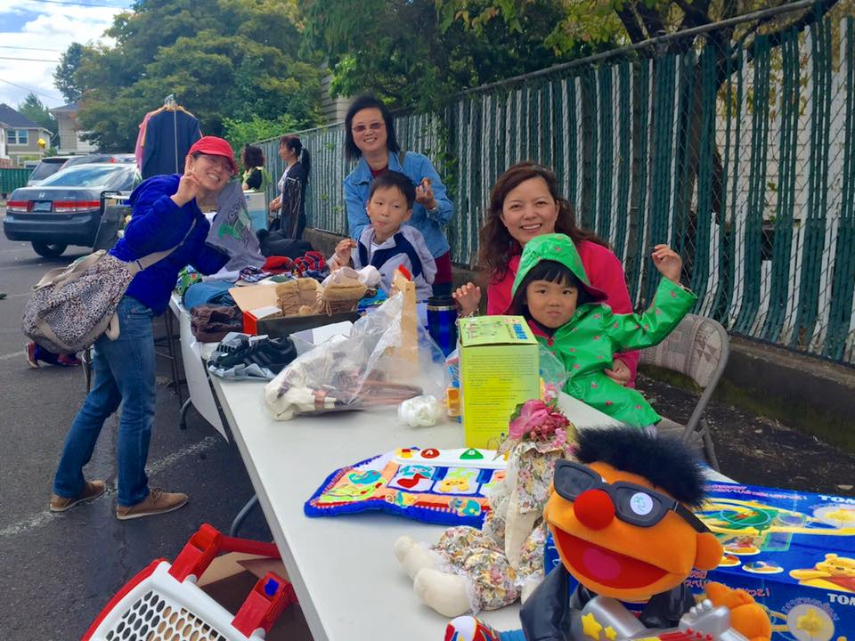
Aug 29 教會社區外展 garage sale

Slide 4
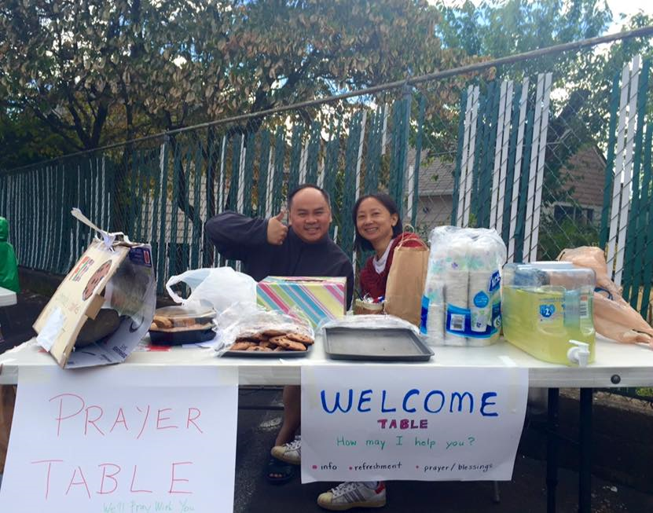
Aug 29 教會社區外展 prayer table

Slide 6
領受兒子的心
Receiving a Spirit of Adoption as Sons
波特蘭靈糧堂 BOLIP
August 30, 2015

Slide 7
因為凡被 神的靈引導的，都是 神的兒子。 你們所受的，不是奴僕的心，仍舊害怕；所受的，乃是兒子的心，因此我們呼叫：「阿爸！父！」 聖靈與我們的心同證我們是 神的兒女；既是兒女，便是後嗣，就是 神的後嗣，和基督同作後嗣。(羅馬書 Romans 8:14-17）
For all who are being led by the Spirit of God, these are sons of God. For you have not received a spirit of slavery leading to fear again, but you have received a spirit of adoption as sons by which we cry out, “Abba! Father!” The Spirit Himself testifies with our spirit that we are children of God, and if children, heirs also, heirs of God and fellow heirs with Christ

Slide 8
奴僕的心 a spirit of slavery leading to fear
孤兒的靈、走捷徑的靈
對父母、權柄失去基本的信任、築起牆
害怕領受他人的愛、安慰與勸誡
心逐漸封閉起來、拒絕親密關係
不安全感、凡事獨立自主、無法交託 神
與人的關係變得膚淺表面、保持距離
覺得沒有人關心我、能滿足我的需要
追尋錯誤的情感和成就感作替代品
時常與緊繃、憤怒、不安的堅固營壘搏鬥

Slide 9
「看哪，耶和華大而可畏之日未到以前，我必差遣先知以利亞到你們那裡去。 他必使父親的心轉向兒女，兒女的心轉向父親，免得我來咒詛遍地。」 (瑪拉基書 Malachi 4:5-6）
“Behold, I am going to send you Elijah the prophet before the coming of the great and terrible day of the Lord. He will restore the hearts of the fathers to their children and the hearts of the children to their fathers, so that I will not come and smite the land with a curse.”

Slide 10
古時耶和華向以色列（原文是我）顯現，說：我以永遠的愛愛你，因此我以慈愛 (חֶסֶד) 吸引你。 (耶利米書 Jeremiah 31:3）
The Lord appeared to us in the past, saying:
“I have loved you with an everlasting love;
I have drawn you with unfailing kindness (חֶסֶד).
חֶסֶד慈愛(hesed) ─ God's loving-kindness is that intensive, steady, and reliable love which will not let Israel go.

Slide 11
播放 Video
『讚美之泉』

