Slide 1


Slide 2
5 我是葡萄樹，你們是枝子。 常在我裡面的，我也常在他裡面，這人就多結果子；因為離了我，你們就不能做甚麼。
7 你們若常在我裡面，我的話(ῥήματά)也常在你們裡面，凡你們所願意的，祈求，就給你們成就。 (約翰福音 John 15:5,7）
5 I am the vine; you are the branches. If you remain in me and I in you, you will bear much fruit; apart from me you can do nothing.
7 If you remain in me and my words (ῥήματά) remain in you, ask whatever you wish, and it will be done for you.

Slide 3
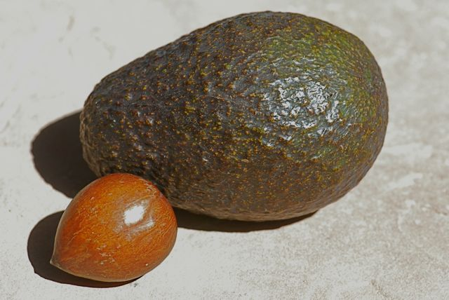
神對於我們禱告的回應方式

Slide 4
於是，乃縵帶著車馬到了以利沙的家，站在門前。
以利沙打發一個使者，對乃縵說：「你去在約旦河中沐浴七回，你的肉就必復原，而得潔淨。」乃縵卻發怒走了，說：「我想他必定出來見我，站著求告耶和華─他 神的名，在患處以上搖手，治好這大痲瘋。 大馬士革的河亞罷拿和法珥法豈不比以色列的一切水更好嗎？ 我在那裡沐浴不得潔淨嗎？」於是氣忿忿地轉身去了。 (列王紀下 2 Kings 5:9-12）
11 But Naaman went away angry and said, “I thought that he would surely come out to me and stand and call on the name of the Lord his God, wave his hand over the spot and cure me of my leprosy. 12 Are not Abana and Pharpar, the rivers of Damascus, better than all the waters of Israel? Couldn’t I wash in them and be cleansed?” So he turned and went off in a rage.

Slide 5
他的僕人進前來，對他說：「我父啊，先知若吩咐你做一件大事，你豈不做嗎？ 何況說你去沐浴而得潔淨呢？」於是乃縵下去，照著神人的話，在約旦河裡沐浴七回；他的肉復原，好像小孩子的肉，他就潔淨了。 (列王紀下 2 Kings 5:13-14）
Naaman’s servants went to him and said, “My father, if the prophet had told you to do some great thing, would you not have done it? How much more, then, when he tells you, ‘Wash and be cleansed’!” So he went down and dipped himself in the Jordan seven times, as the man of God had told him, and his flesh was restored and became clean like that of a young boy.

Slide 6
甚至有人將病人抬到街上，放在床上或褥子上，指望彼得過來的時候，或者得他的影兒照在甚麼人身上。 還有許多人帶著病人和被污鬼纏磨的，從耶路撒冷四圍的城邑來，全都得了醫治。 (使徒行傳 Acts 5:15-16）
As a result, people brought the sick into the streets and laid them on beds and mats so that at least Peter’s shadow might fall on some of them as he passed by. Crowds gathered also from the towns around Jerusalem, bringing their sick and those tormented by impure spirits, and all of them were healed.

Slide 7
5 我是葡萄樹，你們是枝子。 常在我裡面的，我也常在他裡面，這人就多結果子；因為離了我，你們就不能做甚麼。
7 你們若常在我裡面，我的話(ῥήματά)也常在你們裡面，凡你們所願意的，祈求，就給你們成就。 (約翰福音 John 15:5,7）
5 I am the vine; you are the branches. If you remain in me and I in you, you will bear much fruit; apart from me you can do nothing.
7 If you remain in me and my words (ῥήματά) remain in you, ask whatever you wish, and it will be done for you.

Slide 8
照顧你的內在生命 Ministering to Your Inner Life
盼望 Hope
感謝讚美 Give thanks and praises
默想 神的話語 Meditate on God’s words
選擇影響你的人 Choose people who influence you

Slide 9
播放 play video
『帶我進入祢的同在 』

