Slide 1
感恩的大能
The Power of Giving Thanks
波特蘭靈糧堂 BOLIP
November 8, 2015

Slide 2
興起，發光！ 因為你的光已經來到！ 耶和華的榮耀發現照耀你。 看哪，黑暗遮蓋大地，幽暗遮蓋萬民，耶和華卻要顯現照耀你； 他的榮耀要現在你身上。
(以賽亞書 Isaiah 60:1-2）
Arise, shine, for your light has come,
and the glory of the Lord rises upon you.
See, darkness covers the earth
and thick darkness is over the peoples,
but the Lord rises upon you
and his glory appears over you.

Slide 3
主的靈在我身上，因為他用膏膏我，叫我傳福音給貧窮的人；差遣我報告：被擄的得釋放，瞎眼的得看見，叫那受壓制的得自由， 報告 神悅納人的禧年。
(路加福音 Luke 4:18-19）
“The Spirit of the Lord is on me,
because he has anointed me
to proclaim good news to the poor.
He has sent me to proclaim freedom for the prisoners
and recovery of sight for the blind,
to set the oppressed free,
to proclaim the year of the Lord’s favor.”

Slide 4
耶穌拿起餅來，祝謝了，就分給那坐著的人；分魚也是這樣，都隨著他們所要的。 他們吃飽了，耶穌對門徒說：「把剩下的零碎收拾起來，免得有糟蹋的。」他們便將那五個大麥餅的零碎，就是眾人吃了剩下的，收拾起來，裝滿了十二個籃子。
(約翰福音 John 6:11-13）
Jesus then took the loaves, gave thanks, and distributed to those who were seated as much as they wanted. He did the same with the fish. When they had all had enough to eat, he said to his disciples, “Gather the pieces that are left over. Let nothing be wasted.” So they gathered them and filled twelve baskets with the pieces of the five barley loaves left over by those who had eaten.

Slide 5
當稱謝進入他的門；當讚美進入他的院。 當感謝他，稱頌他的名！ 因為耶和華本為善。他的慈愛存到永遠；他的信實直到萬代。
(詩篇 Psalm 100:4-5）
Enter his gates with thanksgiving
and his courts with praise;
give thanks to him and praise his name.
For the Lord is good and his love endures forever;
his faithfulness continues through all generations.

Slide 6
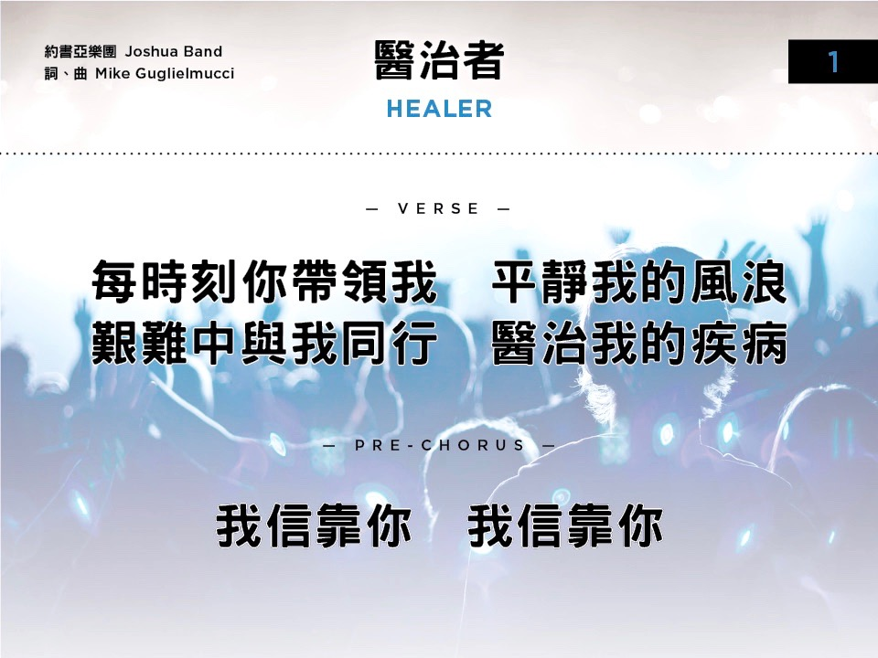

Slide 7
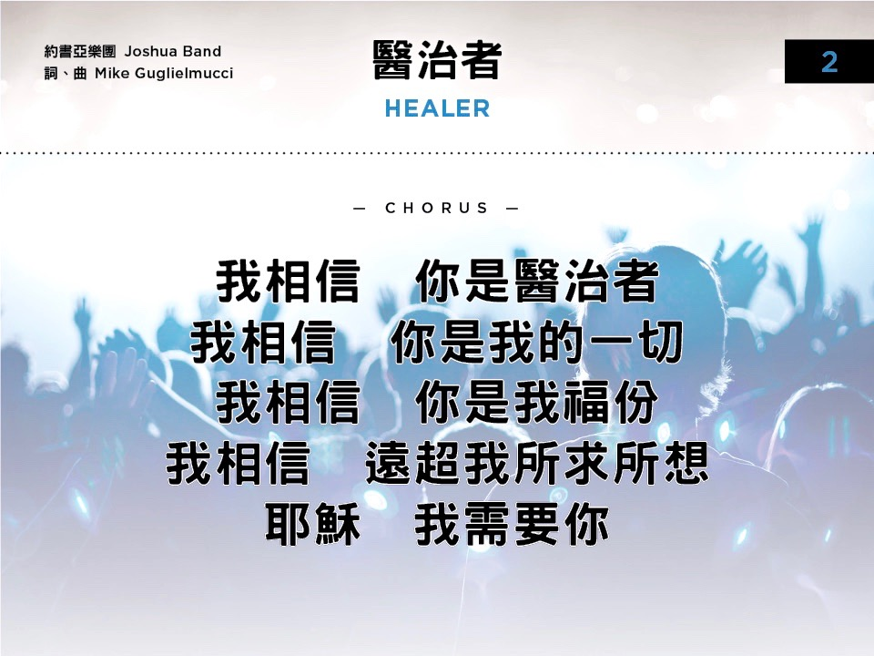

Slide 8
