Slide 1
成長的動力
The Ways to Growth
波特蘭靈糧堂 BOLIP
January 24, 2016

Slide 2
他又設個比喻對他們說：「天國好像一粒芥菜種，有人拿去種在田裡。 這原是百種裡最小的，等到長起來，卻比各樣的菜都大，且成了樹，天上的飛鳥來宿在它的枝上。」 (馬太福音 Matthew 13:31-32）
He told them another parable: “The kingdom of heaven is like a mustard seed, which a man took and planted in his field. Though it is the smallest of all seeds, yet when it grows, it is the largest of garden plants and becomes a tree, so that the birds come and perch in its branches.”

Slide 3
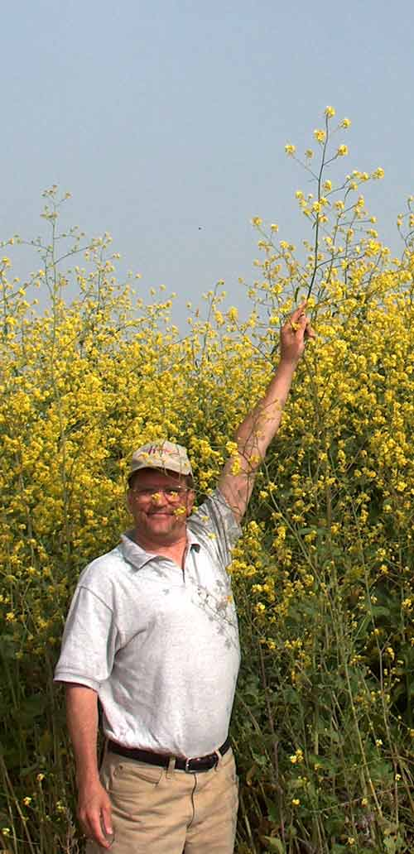

Slide 4

“Where Anything is Possible”

Slide 5
神會幫助我們成長 God will help us grow
家庭 Family
服事 Ministries
教會 Church

Slide 6
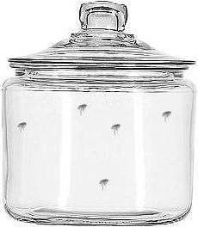
瓶子裡的跳蚤 Fleas in a jar

Slide 7
成長的要素 The Essential Elements of Growth
異象/夢想 Vision / Dream
信心 Faith
耐心 Patience

Slide 8
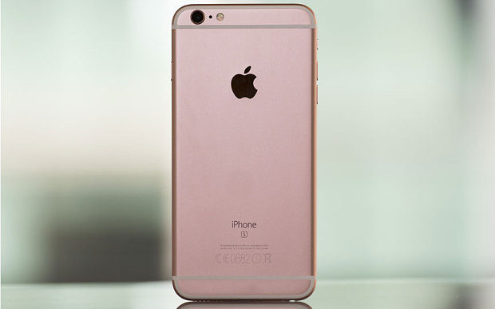

Slide 9
求我們主耶穌基督的 神，榮耀的父，將那賜人智慧和啟示的靈賞給你們，使你們真知道他，並且照明你們心中的眼睛，使你們知道他的恩召有何等指望，他在聖徒中得的基業有何等豐盛的榮耀；並知道他向我們這信的人所顯的能力是何等浩大，
(以弗所書 Ephesians 1:17-19）
I keep asking that the God of our Lord Jesus Christ, the glorious Father, may give you the Spirit of wisdom and revelation, so that you may know him better. I pray that the eyes of your heart may be enlightened in order that you may know the hope to which he has called you, the riches of his glorious inheritance in his holy people, and his incomparably great power for us who believe. That power is the same as the mighty strength

Slide 10
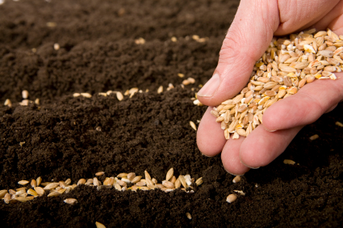
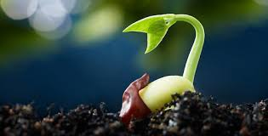

Slide 11
成長的要素 The Essential Elements of Growth
異象/夢想 Vision / Dream
信心 Faith
耐心 Patience

Slide 12
耶穌說：「是因你們的信心小。 我實在告訴你們，你們若有信心，像一粒芥菜種，就是對這座山說：『你從這邊挪到那邊』，它也必挪去；並且你們沒有一件不能做的事了。 (馬太福音 Matthew 17:20）
He replied, “Because you have so little faith. Truly I tell you, if you have faith as small as a mustard seed, you can say to this mountain, ‘Move from here to there,’ and it will move. Nothing will be impossible for you.”

Slide 13
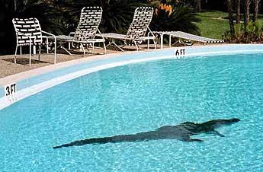
信心的腳步克服懼怕 Step of Faith

Slide 14
成長的要素 The Essential Elements of Growth
異象/夢想 Vision / Dream
信心 Faith
耐心 Patience

Slide 15
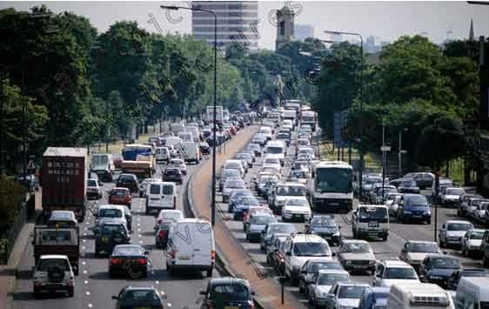

Slide 16
我的弟兄們，你們落在百般試煉中，都要以為大喜樂；因為知道你們的信心經過試驗，就生忍耐。 但忍耐也當成功，使你們成全、完備，毫無缺欠。 (雅各書 James 1:2-4）
Consider it pure joy, my brothers and sisters, whenever you face trials of many kinds, because you know that the testing of your faith produces perseverance. Let perseverance finish its work so that you may be mature and complete, not lacking anything.

Slide 17
所以，你們不可丟棄勇敢的心；存這樣的心必得大賞賜。 你們必須忍耐，使你們行完了 神的旨意，就可以得著所應許的。 因為還有一點點時候，那要來的就來，並不遲延；只是義人必因信得生。 他若退後，我心裡就不喜歡他。 (希伯來書 Hebrews 10:35-38）
So do not throw away your confidence; it will be richly rewarded. You need to persevere so that when you have done the will of God, you will receive what he has promised. For, “In just a little while, he who is coming will come and will not delay.” And, “But my righteous one will live by faith. And I take no pleasure in the one who shrinks back.”

Slide 18
Faith gets you going 信心啟動你向前
Patience keeps you going 耐心保持你繼續前進

Slide 19
“P.Q.” ?

Slide 20
“P.Q.” ?
Prayer / Perseverance

Slide 21
play video
『信心的旅途』

