Slide 1
神的話
The Word of God
波特蘭靈糧堂 BOLIP
March 20, 2016

Slide 2
你當竭力在 神面前得蒙喜悅，作無愧的工人，按著正意分解 (ὀρθοτομέω)真理的道。 (提摩太後書 2 Timothy 2:16）
Do your best to present yourself to God as one approved, a worker who does not need to be ashamed and who correctly handles (ὀρθοτομέω) the word of truth.

Slide 3
play video
『大衛鮑森舊約縱覽 - 利未記』

Slide 4
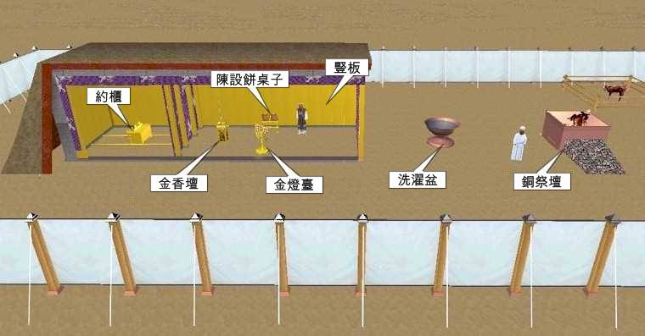
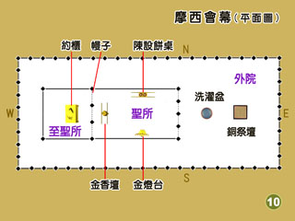

Slide 5
釋經學(hermeneutics) ─ 是解釋聖經的科學和藝術。 它之被稱為科學，乃是因為它受某一體系之內的規則所指引。 它之被稱為藝術，乃是因為應用這些規則時，必須靠聖靈和技巧，而不是機械式的仿效。
解經 (exegesis) - 范圍比較狹窄，它是指從歷史及文學背景中確定經文的意義。解經是切實地著手解釋聖經，而釋經學則包括決定經文意義的原則。

Slide 6
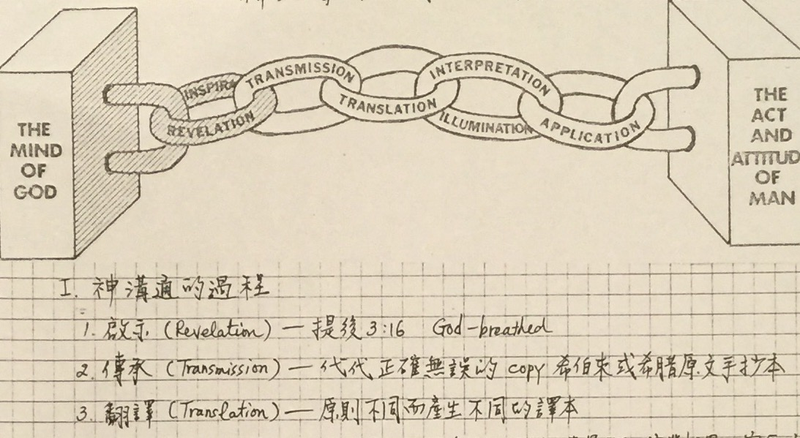

Slide 7
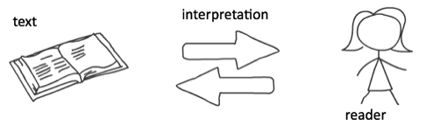
聖經經文
解釋
讀者

Slide 8
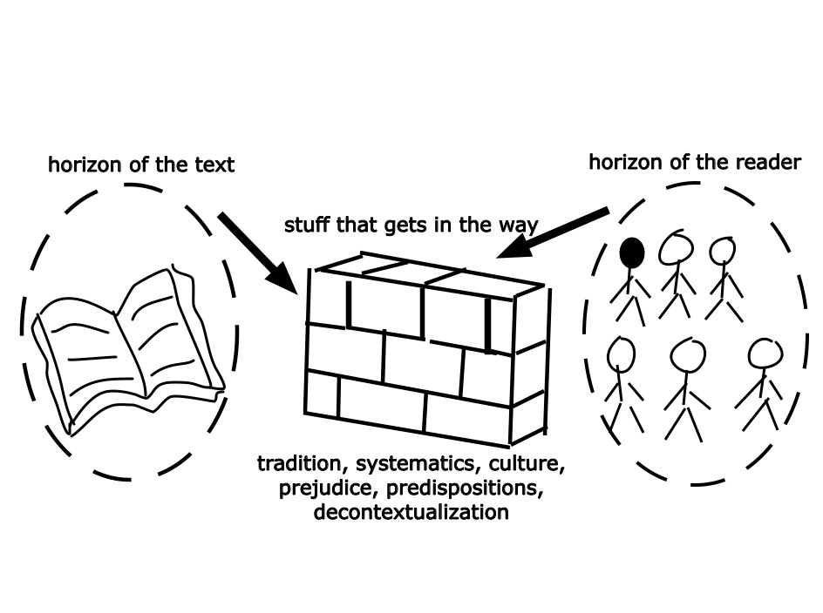
聖經經文
讀者
正確的理解經文所需要克服的障礙

Slide 9
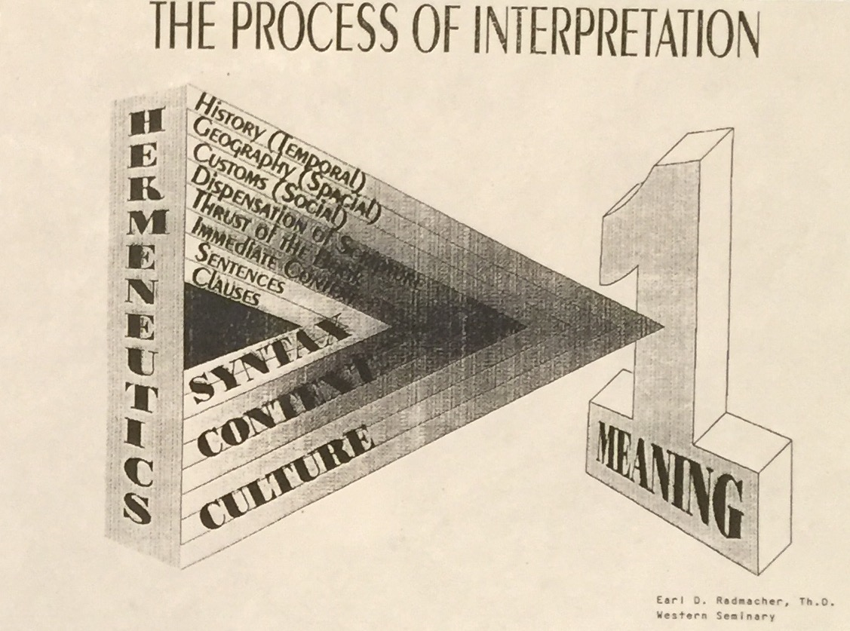
解釋經文的過程
Syntax – 句法
Context – 上下文
Culture – 文化背景

Slide 10
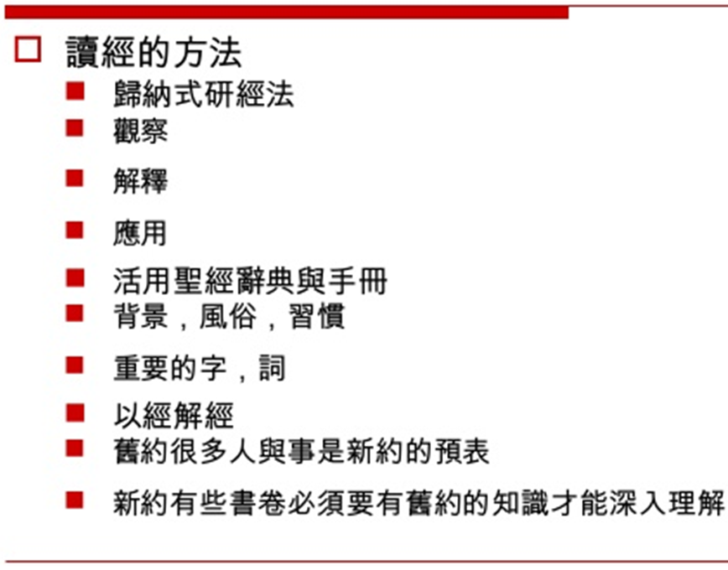

Slide 11
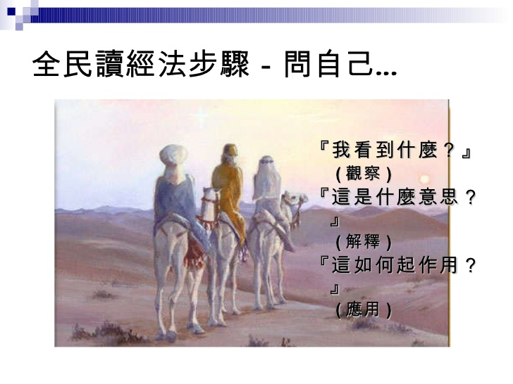

Slide 12
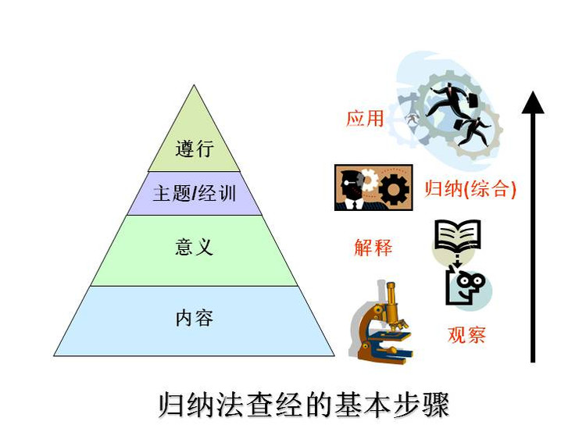

Slide 13
神愛世人，甚至將他的獨生子賜給他們，叫一切信他的，不致滅亡，反得永生。
(約翰福音 John 3:16）
For God so loved the world, that he gave his only Son, that whoever believes in him should not perish but have eternal life. (ESV)

Slide 14
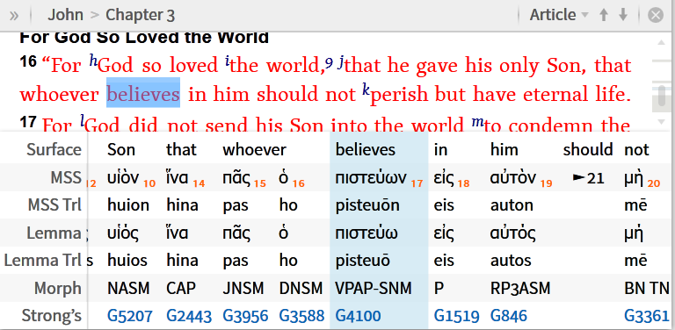
VPAP-SNM :
verb, present, active, participle, singular, nominative, masculine

Slide 15
所以，你們要去，使萬民作我的門徒，奉父、子、聖靈的名給他們施洗。 凡我所吩咐你們的，都教訓他們遵守，我就常與你們同在，直到世界的末了。
(馬太福音 Matthew 28:19-20）
Go therefore and make disciples of all nations, baptizing them in the name of the Father and of the Son and of the Holy Spirit, teaching them to observe all that I have commanded you. And behold, I am with you always, to the end of the age. (ESV)

Slide 16
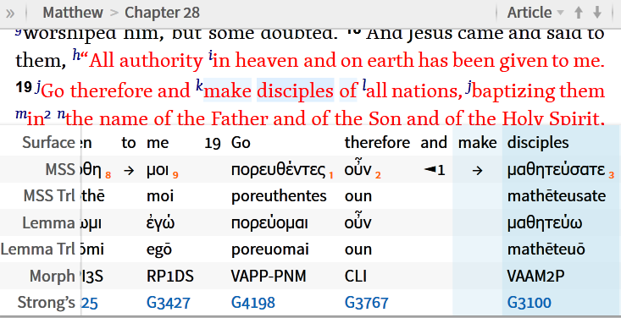
VAAM2P :
verb, aorist, active, imperative, second person, plural

Slide 17
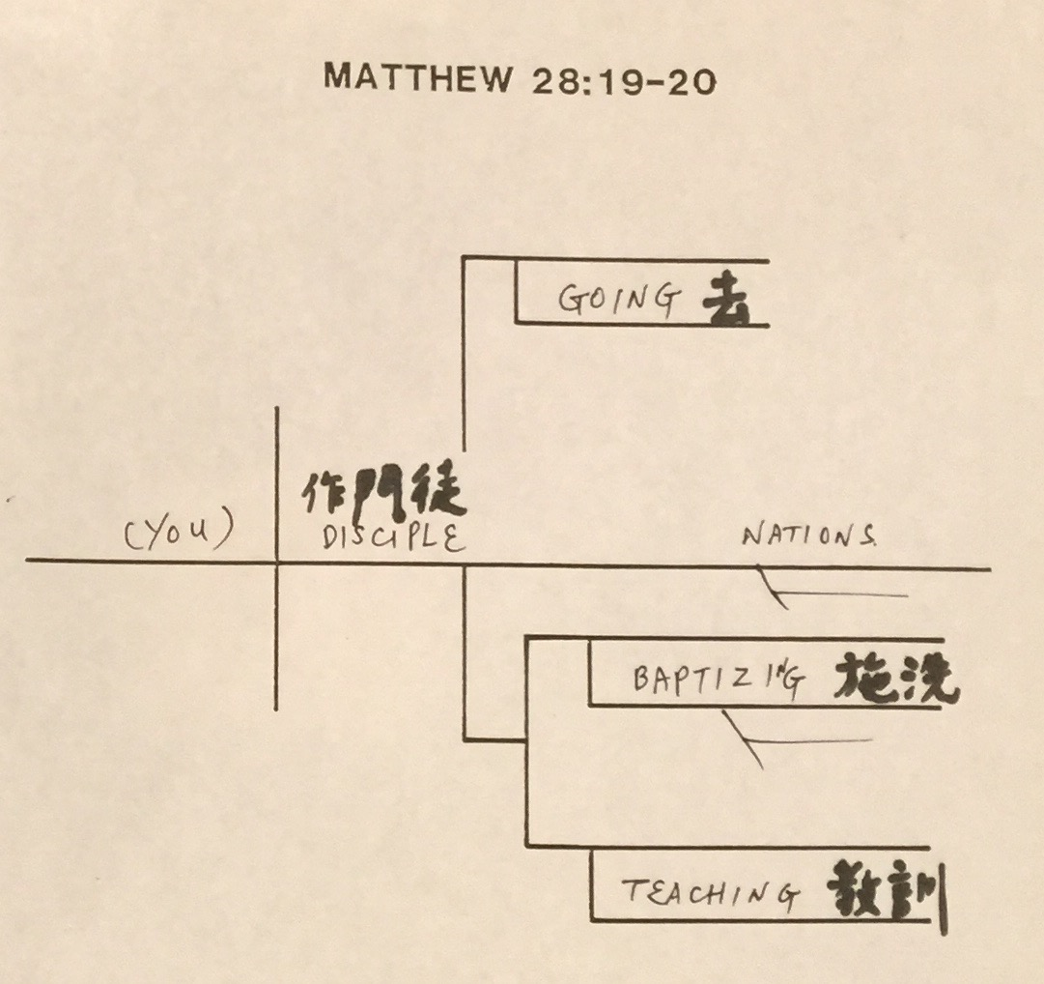

Slide 18
惟喜愛耶和華的律法，晝夜思想，這人便為有福！ 他要像一棵樹栽在溪水旁，按時候結果子，葉子也不枯乾。凡他所做的盡都順利。 (詩篇 Psalm 1:2-3）
but his delight is in the law of the Lord,
and on his law he meditates day and night.
He is like a tree
planted by streams of water
that yields its fruit in its season,
and its leaf does not wither.
In all that he does, he prospers.

Slide 19
見證分享
蕭慶松 教授夫婦

Slide 20
play video
『你的話』

