Slide 1
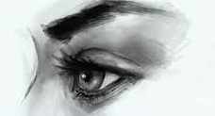
因他受的鞭傷，我們得醫治。
by his wounds we are healed.
A.D. ─
Anno Domini
in the year of our Lord
701 B.C.
Isaiah
以賽亞先知
33 A.D. Jesus
主耶穌受難

Slide 2
內在潛力的復活
Resurrection of Inner Potential
波特蘭靈糧堂 BOLIP
March 27, 2016

Slide 3
耶穌對她說：「復活在我，生命也在我。 信我的人雖然死了，也必復活； 凡活著信我的人必永遠不死。 你信這話嗎？」 (約翰福音 John 11:25-26）
Jesus said to her, “I am the resurrection and the life. The one who believes in me will live, even though they die; and whoever lives by believing in me will never die. Do you believe this?” (NIV)

Slide 4
約翰福音中的 7 個『我是 I Am』
我是生命的糧 The Bread Of Life 6:35
我是世上的光 The Light Of The World 8:12
我就是門 The Gate 10:9
我是好牧人 The Good Shepherd 10:11
復活在我，生命也在我 The Resurrection And The Life 11:25
我就是道路、真理、生命 The Way, The Truth, And The Life 14:6
我是真葡萄樹 The Vine 15:1

Slide 5
play video
『Know Your Why』

Slide 6
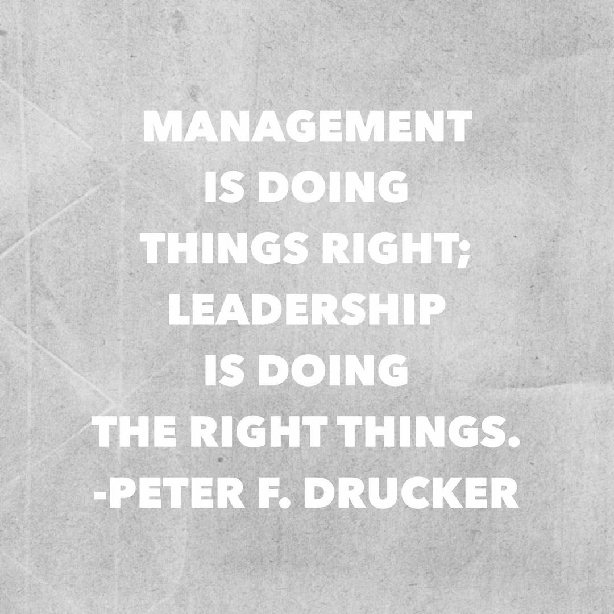

Slide 7
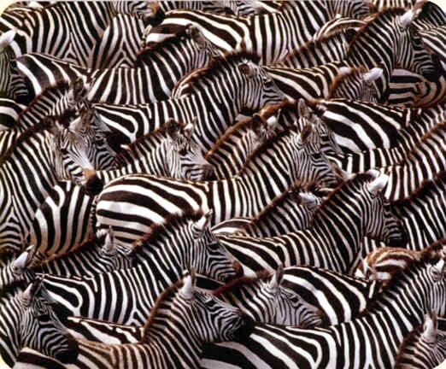

Slide 8
內裡的復活 Resurrection of Inner Man
傾聽聖靈的聲音，明白 神給你的使命 Listen to the Spirit to know God’s purpose for you
在信心和聖靈的創造力中運作 Operating in faith and creativity through the Spirit
忘記背後努力面前的，相信你是屬於 神Forget the past and press forward believing that you belong to God
建立良好的習慣 Building good habits

Slide 9
小子們哪，你們是屬 神的，並且勝了他們；因為那在你們裡面的，比那在世界上的更大。 (約翰一書 1 John 4:4）
You, dear children, are from God and have overcome them, because the one who is in you is greater than the one who is in the world. (NIV)

Slide 10
神能照著運行在我們心裡的大力充充足足地成就一切，超過我們所求所想的。 (以弗所書 Ephesians 3:20）
Now to him who is able to do immeasurably more than all we ask or imagine, according to his power that is at work within us, (NIV)

Slide 11
play video
『返璞歸真 Going Back To Nature』

