Slide 1

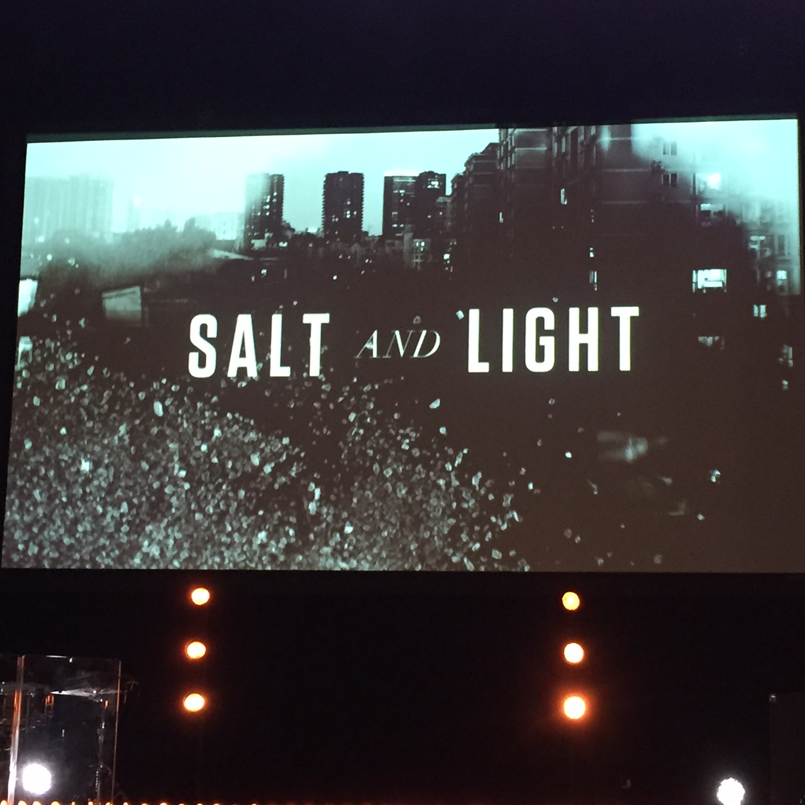

Slide 2
The joy of the Lord is my strength!
Saturate yourself in the promises of God
To have influence, be a friend

Slide 3
創造喜樂的事奉環境
Creating Joyful Environment to Serve the Lord
波特蘭靈糧堂
June 26, 2016

Slide 4
那時，門徒增多，有說希臘話的猶太人向希伯來人發怨言，因為在天天的供給上忽略了他們的寡婦。 十二使徒叫眾門徒來，對他們說：「我們撇下 神的道去管理飯食，原是不合宜的。 所以弟兄們，當從你們中間選出七個有好名聲、被聖靈充滿、智慧充足的人，我們就派他們管理這事。 但我們要專心以祈禱、傳道為事。」
(使徒行傳 Acts 6:1-4)

Slide 5
In those days when the number of disciples was increasing, the Hellenistic Jews among them complained against the Hebraic Jews because their widows were being overlooked in the daily distribution of food. So the Twelve gathered all the disciples together and said, “It would not be right for us to neglect the ministry of the word of God in order to wait on tables. Brothers and sisters, choose seven men from among you who are known to be full of the Spirit and wisdom. We will turn this responsibility over to them and will give our attention to prayer and the ministry of the word.” (使徒行傳 Acts 6:1-4)

Slide 6
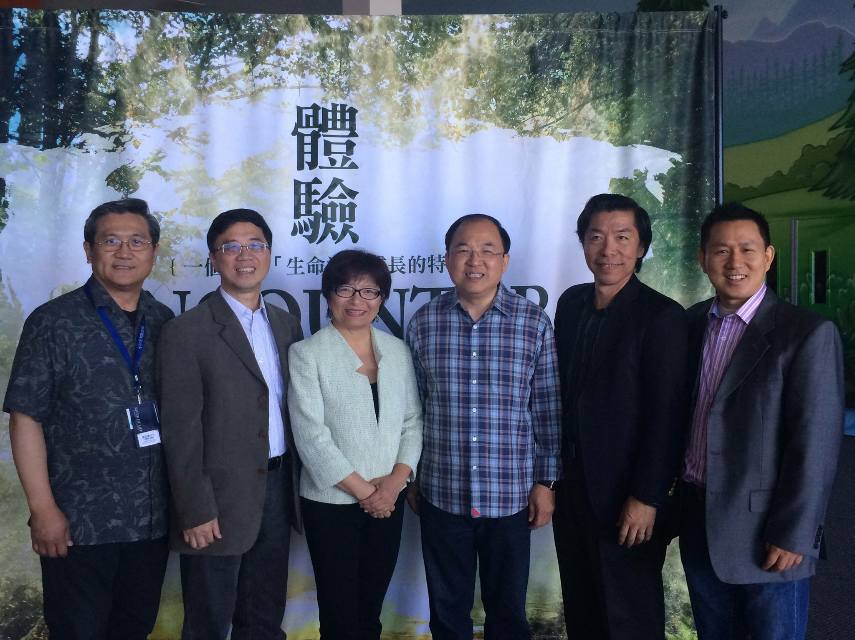

Slide 7
教會與職場有組織行為的共通點
Organizational behaviors are the common ground for church and marketplace
共識 consensus
制度 (管理的細節) admin structure
信任感與士氣 trust and morale

Slide 8
服事的定位與品質
Identification and evaluation of service to the Lord
做不好 did not do a good job
不好好做 did not want to do a good job

Slide 9
我照 神所給我的恩，好像一個聰明的工頭，立好了根基，有別人在上面建造；只是各人要謹慎怎樣在上面建造。 因為那已經立好的根基就是耶穌基督，此外沒有人能立別的根基。 若有人用金、銀、寶石、草木、禾秸在這根基上建造， 各人的工程必然顯露，因為那日子要將它表明出來，有火發現；這火要試驗各人的工程怎樣。 人在那根基上所建造的工程若存得住，他就要得賞賜。 人的工程若被燒了，他就要受虧損，自己卻要得救；雖然得救，乃像從火裡經過的一樣。 (哥林多前書 1 Cor. 3:10-15)

Slide 10
By the grace God has given me, I laid a foundation as a wise builder, and someone else is building on it. But each one should build with care. For no one can lay any foundation other than the one already laid, which is Jesus Christ. If anyone builds on this foundation using gold, silver, costly stones, wood, hay or straw, their work will be shown for what it is, because the Day will bring it to light. It will be revealed with fire, and the fire will test the quality of each person’s work. If what has been built survives, the builder will receive a reward. If it is burned up, the builder will suffer loss but yet will be saved—even though only as one escaping through the flames. (1 Cor. 3:10-15)

Slide 11
創造喜樂的事奉環境
Creating Joyful Environment to Serve the Lord
快樂的服事 serving joyfully
恩賜的配搭 synergy of gifting
積極的溝通 actively communicating

Slide 12
你們要常在我裡面，我也常在你們裡面。枝子若不常在葡萄樹上，自己就不能結果子；你們若不常在我裡面，也是這樣。 我是葡萄樹，你們是枝子。常在我裡面的，我也常在他裡面，這人就多結果子；因為離了我，你們就不能做甚麼。
(約翰福音 John 15:4-5)
Remain in me, as I also remain in you. No branch can bear fruit by itself; it must remain in the vine. Neither can you bear fruit unless you remain in me. I am the vine; you are the branches. If you remain in me and I in you, you will bear much fruit; apart from me you can do nothing.

Slide 13
play video
『返璞歸真』

