Slide 1
重燃盼望
Rekindle the Hope
波特蘭靈糧堂
Aug 28, 2016

Slide 2
Play Video
『家庭的代禱者』

Slide 3
不要效法這個世界，只要心意更新而變化，叫你們察驗何為 神的善良、純全、可喜悅的旨意。
(羅馬書 Romans 12:2)
Do not conform to the pattern of this world, but be transformed by the renewing of your mind. Then you will be able to test and approve what God’s will is—his good, pleasing and perfect will.

Slide 4
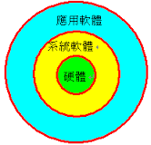
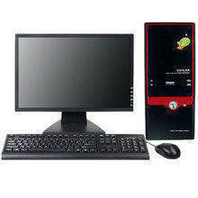

Slide 5
『憂鬱三角』
導致憂鬱的三個主要因素：人對自己、所處環境和未來的理解方式。

Slide 6


Slide 7
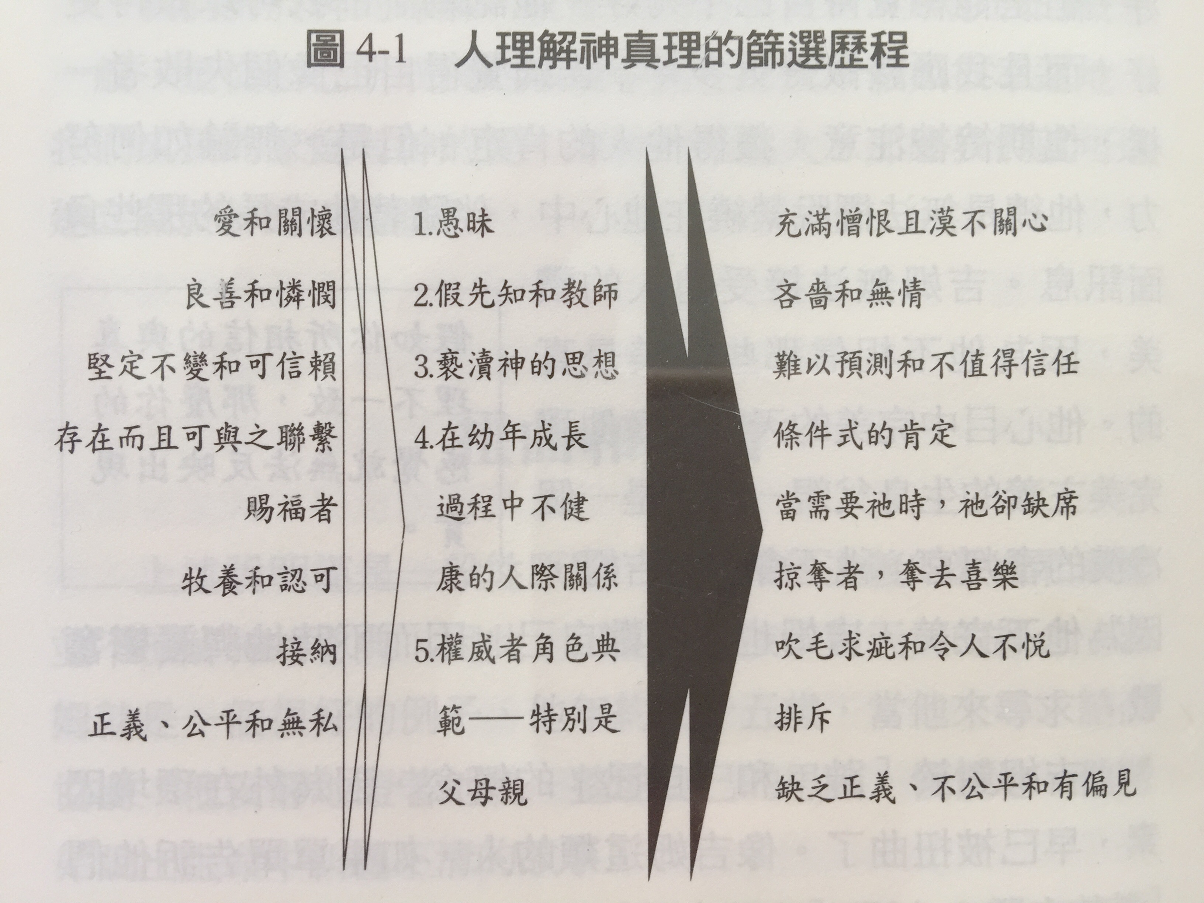

Slide 8
因為我們雖然在血氣中行事，卻不憑著血氣爭戰。 我們爭戰的兵器本不是屬血氣的，乃是在 神面前有能力，可以攻破堅固的營壘，將各樣的計謀，各樣攔阻人認識 神的那些自高之事，一概攻破了，又將人所有的心意奪回，使他都順服基督。 (哥林多後書 2 Corinthians 10:3-5)
5 We demolish arguments and every pretension that sets itself up against the knowledge of God, and we take captive every thought to make it obedient to Christ.

Slide 9
弟兄們，我還有未盡的話：凡是真實的、可敬的、公義的、清潔的、可愛的、有美名的，若有甚麼德行，若有甚麼稱讚，這些事你們都要思念。
(腓立比書 Philippians 4:8)
Finally, brothers and sisters, whatever is true, whatever is noble, whatever is right, whatever is pure, whatever is lovely, whatever is admirable—if anything is excellent or praiseworthy—think about such things.

Slide 10
神願意叫他們知道，這奧祕在外邦人中有何等豐盛的榮耀，就是基督在你們心裡成了有榮耀的盼望。
(歌羅西書 Colossians 1:27)
To them God has chosen to make known among the Gentiles the glorious riches of this mystery, which is Christ in you, the hope of glory.

Slide 11
神保護你
你是我藏身之處，又是我的盾牌；我甚仰望你的話語。
(詩篇 Psalm 119:114)
You are my refuge and my shield;
I have put my hope in your word.

Slide 12
神總是與你同在
神是我們的避難所，是我們的力量，是我們在患難中隨時的幫助。 (詩篇 Psalm 46:1)
God is our refuge and strength,
an ever-present help in trouble.

Slide 13
神總不撇下你
你平生的日子，必無一人能在你面前站立得住。我怎樣與摩西同在，也必照樣與你同在；我必不撇下你，也不丟棄你。 (約書亞記 Joshua 1:5)
No one will be able to stand against you all the days of your life. As I was with Moses, so I will be with you; I will never leave you nor forsake you.

Slide 14
神在你生命中有得勝的計畫
耶和華說：我知道我向你們所懷的意念是賜平安的意念，不是降災禍的意念，要叫你們末後有指望。 你們要呼求我，禱告我，我就應允你們。 (耶利米書 Jeremiah 29:11-12)
For I know the plans I have for you,” declares the Lord, “plans to prosper you and not to harm you, plans to give you hope and a future. Then you will call on me and come and pray to me, and I will listen to you.

Slide 15
神渴望幫助受傷害的人
耶和華靠近傷心的人，拯救靈性痛悔的人。 義人多有苦難，但耶和華救他脫離這一切 (詩篇 Psalm 34:18-19)
The Lord is close to the brokenhearted
and saves those who are crushed in spirit.
The righteous person may have many troubles,
but the Lord delivers him from them all;

Slide 16
神渴望幫助受傷害的人
耶和華靠近傷心的人，拯救靈性痛悔的人。 義人多有苦難，但耶和華救他脫離這一切 (詩篇 Psalm 34:18-19)
The Lord is close to the brokenhearted
and saves those who are crushed in spirit.
The righteous person may have many troubles,
but the Lord delivers him from them all;

Slide 17
但願使人有盼望的 神，因信將諸般的喜樂、平安充滿你們的心，使你們藉著聖靈的能力大有盼望！
(羅馬書 Romans 15:13)
May the God of hope fill you with all joy and peace as you trust in him, so that you may overflow with hope by the power of the Holy Spirit.

Slide 18
親愛的天父： 我相信祢樂意幫助內裡誠實的人得釋放，我向祢承認我曾被謊言和負面的思考模式所欺騙。 我奉主耶穌基督的名禱告，因著主耶穌基督的寶血和復活，天父祢必斥責所有謊言的靈。 我承認我有責任也有權柄抵擋魔鬼，魔鬼必定離開我逃跑了。祈求聖靈天天引導我進入真理，充滿光明聖潔的思想，使我藉著聖靈的能力大有盼望！ 奉我主耶穌基督得勝的名禱告，阿門！

Slide 19
Play Video
『立定心志』

