Slide 1
與 神同工
Co-workers in God’s Service
波特蘭靈糧堂
Sep 11, 2016

Slide 2
因為我們是與 神同工的；你們是 神所耕種的田地，所建造的房屋。
(哥林多前書 1 Corinthians 3:9)
For we are co-workers in God’s service; you are God’s field, God’s building.

Slide 3
天將晚的時候，門徒進前來，說：「這是野地，時候已經過了，請叫眾人散開，他們好往村子裡去，自己買吃的。」 耶穌說：「不用他們去，你們給他們吃吧！」門徒說：「我們這裡只有五個餅，兩條魚。」 (馬太福音 Matthew 14:15-17)
As evening approached, the disciples came to him and said, “This is a remote place, and it’s already getting late. Send the crowds away, so they can go to the villages and buy themselves some food.” Jesus replied, “They do not need to go away. You give them something to eat.” “We have here only five loaves of bread and two fish,” they answered.

Slide 4
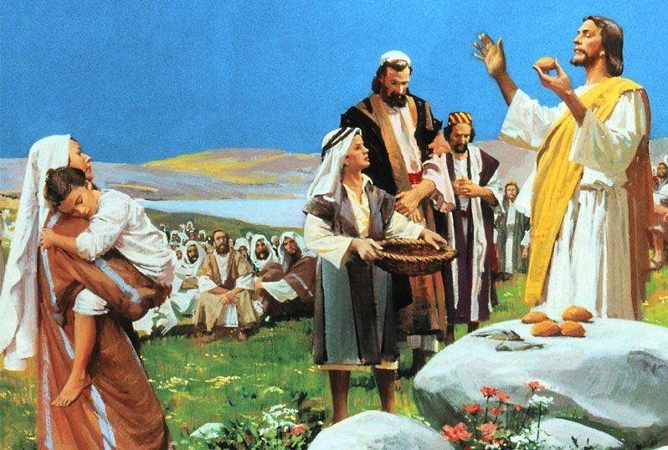

Slide 5
耶穌說：「拿過來給我。」 於是吩咐眾人坐在草地上，就拿著這五個餅，兩條魚，望著天祝福，擘開餅，遞給門徒，門徒又遞給眾人。他們都吃，並且吃飽了；把剩下的零碎收拾起來，裝滿了十二個籃子。 (馬太福音 Matthew 14:18-20)
“Bring them here to me,” he said. And he directed the people to sit down on the grass. Taking the five loaves and the two fish and looking up to heaven, he gave thanks and broke the loaves. Then he gave them to the disciples, and the disciples gave them to the people. They all ate and were satisfied, and the disciples picked up twelve basketfuls of broken pieces that were left over.

Slide 6


Slide 7


Slide 8
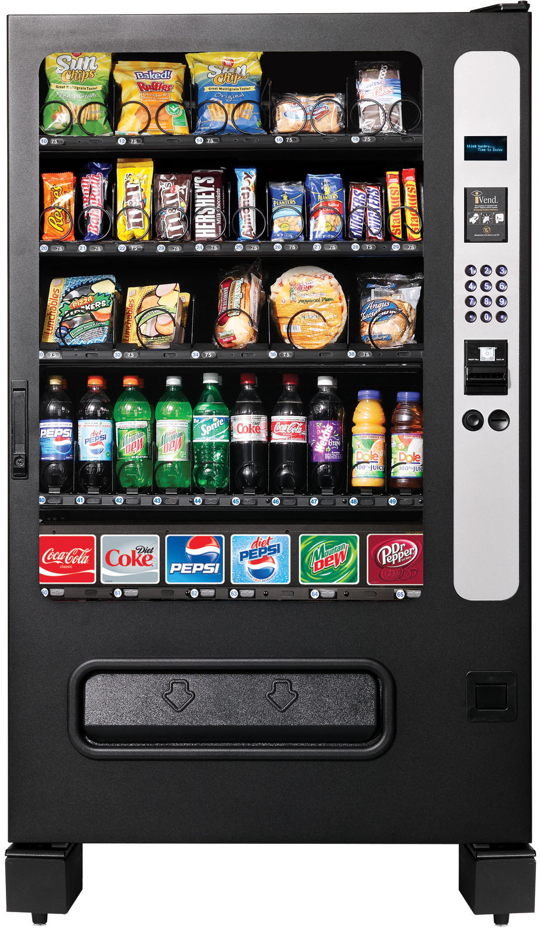
販賣機式的禱告?
“vending machine” style prayers?

Slide 9
禱告是一種轉化的過程
Prayer is a process of transformation

Slide 10
應當一無掛慮，只要凡事藉著禱告、祈求，和感謝，將你們所要的告訴神。神所賜、出人意外的平安必在基督耶穌裡保守你們的心懷意念。
(腓立比書 Philippians 4:6-7)
Do not be anxious about anything, but in every situation, by prayer and petition, with thanksgiving, present your requests to God. And the peace of God, which transcends all understanding, will guard your hearts and your minds in Christ Jesus.

Slide 11
門徒出去，到處宣傳福音。 主和他們同工，用神蹟隨著，證實所傳的道。阿們！ (馬可福音 Mark 16:20)
Then the disciples went out and preached everywhere, and the Lord worked with them and confirmed his word by the signs that accompanied it.

Slide 12
但聖靈降臨在你們身上，你們就必得著能力，並要在耶路撒冷、猶太全地，和撒馬利亞，直到地極，作我的見證。 (使徒行傳 Acts 1:8)
But you will receive power when the Holy Spirit comes on you; and you will be my witnesses in Jerusalem, and in all Judea and Samaria, and to the ends of the earth.

