Slide 1
進入 神聖潔同在中
Into the Presence of His Holiness
波特蘭靈糧堂
October 9, 2016

Slide 2
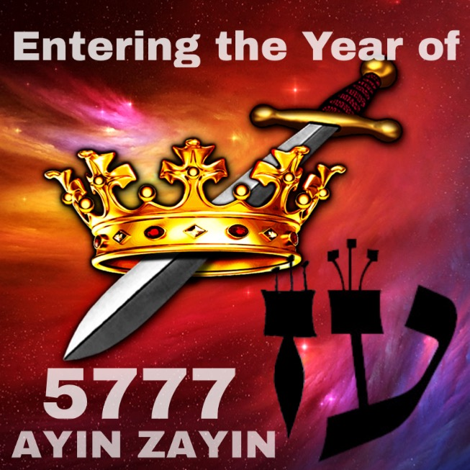

Slide 3
Moreover, we have all had human fathers who disciplined us and we respected them for it. How much more should we submit to the Father of spirits and live! They disciplined us for a little while as they thought best; but God disciplines us for our good, in order that we may share in his holiness.
再者，我們曾有生身的父管教我們，我們尚且敬重他，何況萬靈的父，我們豈不更當順服他得生嗎？ 生身的父都是暫隨己意管教我們；惟有萬靈的父管教我們，是要我們得益處，使我們在他的聖潔上有分。
(希伯來書 Hebrews 12:6-10)

Slide 4
No discipline seems pleasant at the time, but painful. Later on, however, it produces a harvest of righteousness and peace for those who have been trained by it.
凡管教的事，當時不覺得快樂，反覺得愁苦；後來卻為那經練過的人結出平安的果子，就是義。 (希伯來書 Hebrews 12:11)

Slide 5
Then the Lord reached out his hand and touched my mouth and said to me, “I have put my words in your mouth. See, today I appoint you over nations and kingdoms to uproot and tear down, to destroy and overthrow, to build and to plant.”
於是耶和華伸手按我的口，對我說：我已將當說的話傳給你。 看哪，我今日立你在列邦列國之上，為要施行拔出、拆毀、毀壞、傾覆，又要建立、栽植。
(耶利米書 Jeremiah 1:9-10)

Slide 6

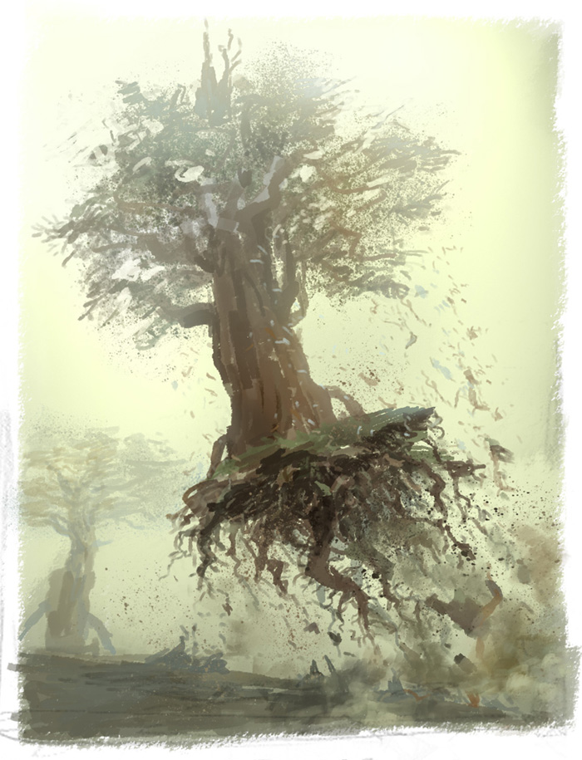
Uproot 拔出

Slide 7
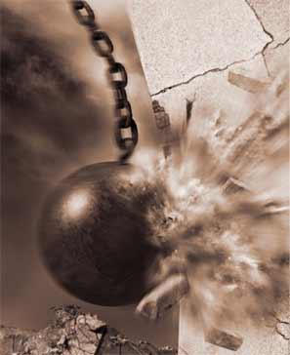
Tear Down 拆毀

Slide 8
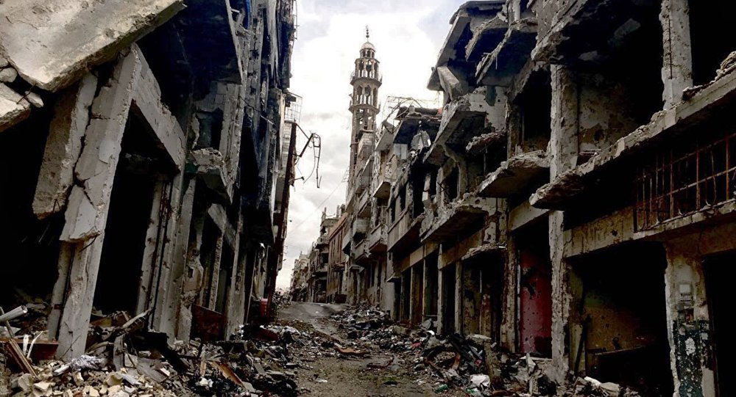
Destroy 毀壞

Slide 9
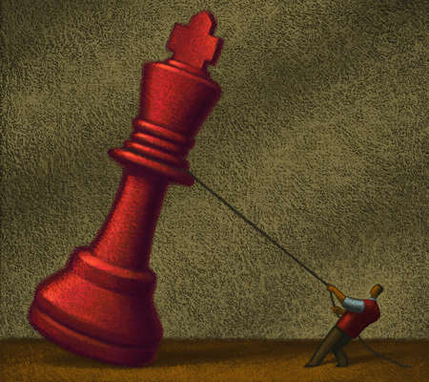
Overthrow 傾覆

Slide 10
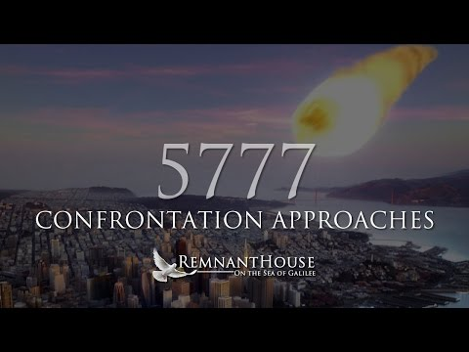

Slide 11
For the Lord is good and his love endures forever;
his faithfulness continues through all generations.
因為耶和華本為善。 他的慈愛存到永遠；他的信實直到萬代。 (詩篇 Psalm 100:5)

Slide 12


Slide 13
Let the wicked forsake their ways
and the unrighteous their thoughts.
Let them turn to the Lord, and he will have mercy on them, and to our God, for he will freely pardon.
“For my thoughts are not your thoughts,
neither are your ways my ways,”
declares the Lord.
“As the heavens are higher than the earth,
so are my ways higher than your ways
and my thoughts than your thoughts.
(以賽亞書 Isaiah 55:9-10)

Slide 14
惡人當離棄自己的道路；不義的人當除掉自己的意念。 歸向耶和華，耶和華就必憐恤他；當歸向我們的 神，因為 神必廣行赦免。 耶和華說：我的意念非同你們的意念；我的道路非同你們的道路。 天怎樣高過地，照樣，我的道路高過你們的道路；我的意念高過你們的意念。
(以賽亞書 Isaiah 55:7-9)

Slide 15
Play Video
『帶我進水深處
Into deep waters』

