Slide 1


Slide 2
預備主的道路
Prepare the Way of the Lord
波特蘭靈糧堂
October 16, 2016

Slide 3
耶和華對摩西說：「你曉諭以色列人說：耶和華的節期，你們要宣告為聖會的節期。
The Lord said to Moses, “Speak to the Israelites and say to them: ‘These are my appointed festivals, the appointed festivals of the Lord, which you are to proclaim as sacred assemblies.
(利未記 Leviticus 23:27-29)

Slide 4
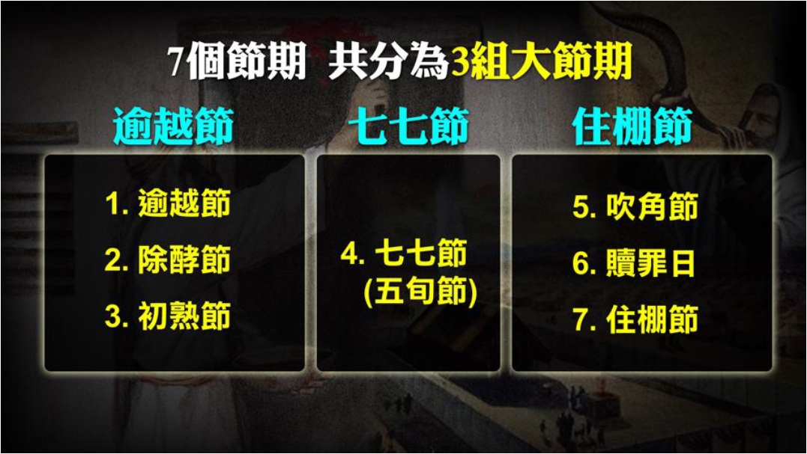

Slide 5
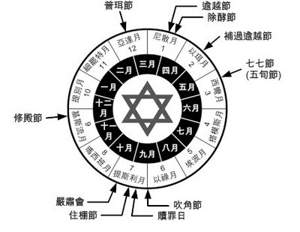

Slide 6
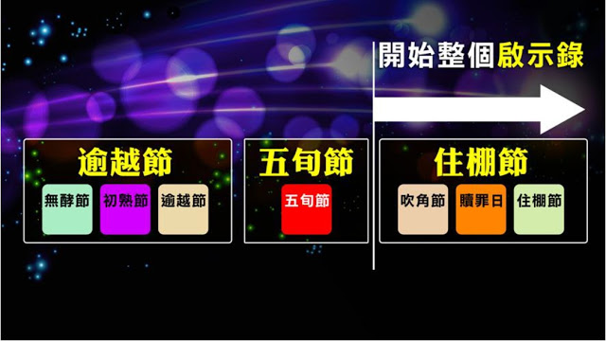

Slide 7
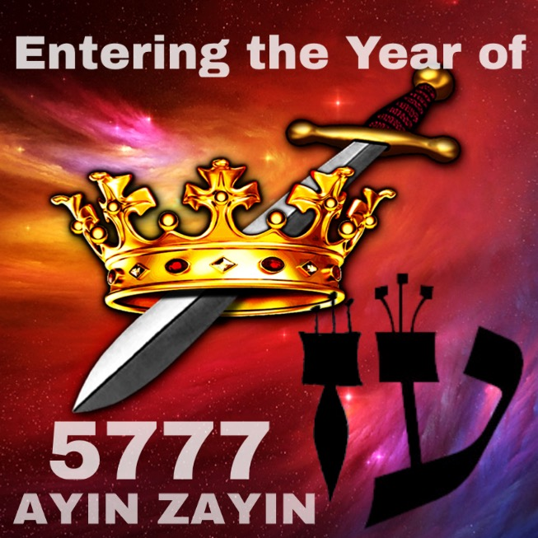

Slide 8
因為 神救眾人的恩典已經顯明出來，教訓我們除去不敬虔的心和世俗的情慾，在今世自守、公義、敬虔度日，等候所盼望的福，並等候至大的 神和我們救主耶穌基督的榮耀顯現。 (提多書 Titus 2:11-13)
我必快來，你要持守你所有的，免得人奪去你的冠冕。 (啟示錄 Revelation 3:11)
看哪，我必快來！ 凡遵守這書上預言的有福了！ (啟示錄 Revelation 22:7)

Slide 9

The Feast of Trumpets 吹角節

Slide 10
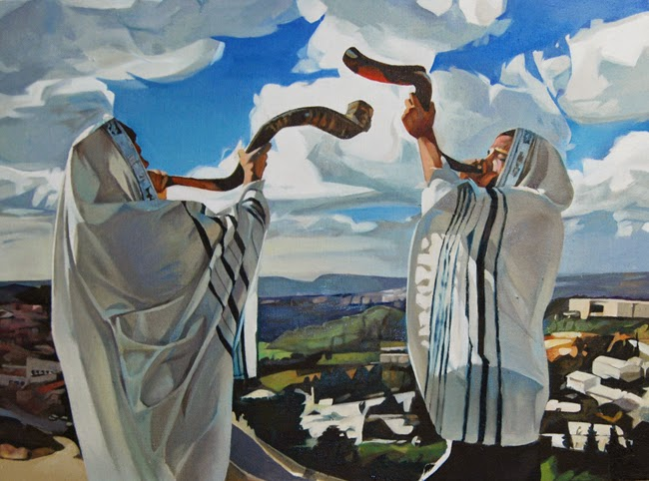

Slide 11
Say to the Israelites: ‘On the first day of the seventh month you are to have a day of sabbath rest, a sacred assembly commemorated with trumpet blasts.
你曉諭以色列人說：七月初一，你們要守為聖安息日，要吹角作紀念，當有聖會。
(利未記 Leviticus 23:24)

Slide 12
那時，人子的兆頭要顯在天上，地上的萬族都要哀哭。 他們要看見人子，有能力，有大榮耀，駕著天上的雲降臨。 他要差遣使者，用號筒的大聲，將他的選民，從四方，從天這邊到天那邊，都招聚了來。
(馬太福音 Matthew 24:30-31)

Slide 13
Then will appear the sign of the Son of Man in heaven. And then all the peoples of the earth will mourn when they see the Son of Man coming on the clouds of heaven, with power and great glory. And he will send his angels with a loud trumpet call, and they will gather his elect from the four winds, from one end of the heavens to the other.
(馬太福音 Matthew 24:30-31)

Slide 14
Listen, I tell you a mystery: We will not all sleep, but we will all be changed— in a flash, in the twinkling of an eye, at the last trumpet. For the trumpet will sound, the dead will be raised imperishable, and we will be changed.
我如今把一件奧祕的事告訴你們：我們不是都要睡覺，乃是都要改變，就在一霎時，眨眼之間，號筒末次吹響的時候。因號筒要響，死人要復活成為不朽壞的，我們也要改變。 (哥林多前書 1 Cor. 15:51-52)

Slide 15
因為主必親自從天降臨，有呼叫的聲音和天使長的聲音，又有 神的號吹響；那在基督裡死了的人必先復活。 以後我們這活著還存留的人必和他們一同被提到雲裡，在空中與主相遇。 這樣，我們就要和主永遠同在。 (帖撒羅尼迦前書 1 Thess. 4:16-17)

Slide 16
For the Lord himself will come down from heaven, with a loud command, with the voice of the archangel and with the trumpet call of God, and the dead in Christ will rise first. After that, we who are still alive and are left will be caught up together with them in the clouds to meet the Lord in the air. And so we will be with the Lord forever.
(帖撒羅尼迦前書 1 Thess. 4:16-17)

Slide 17
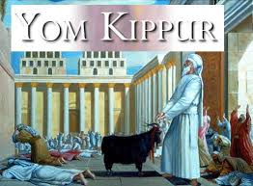
贖罪日

Slide 18
「七月初十是贖罪日；你們要守為聖會， 並要刻苦己心，也要將火祭獻給耶和華。 當這日，甚麼工都不可做；因為是贖罪日，要在耶和華─你們的 神面前贖罪。 當這日，凡不刻苦己心的，必從民中剪除。
(利未記 Leviticus 23:27-29)

Slide 19
The tenth day of this seventh month is the Day of Atonement. Hold a sacred assembly and deny yourselves, and present a food offering to the Lord. Do not do any work on that day, because it is the Day of Atonement, when atonement is made for you before the Lord your God. Those who do not deny themselves on that day must be cut off from their people.
(利未記 Leviticus 23:27-29)

Slide 20
弟兄們，我不願意你們不知道這奧祕（恐怕你們自以為聰明），就是以色列人有幾分是硬心的，等到外邦人的數目添滿了， 於是以色列全家都要得救。 如經上所記：必有一位救主從錫安出來，要消除雅各家的一切罪惡； (羅馬書 Romans 11:25-26)

Slide 21
I do not want you to be ignorant of this mystery, brothers and sisters, so that you may not be conceited: Israel has experienced a hardening in part until the full number of the Gentiles has come in, and in this way all Israel will be saved. As it is written: “The deliverer will come from Zion; he will turn godlessness away from Jacob.
(羅馬書 Romans 11:25-26)

Slide 22
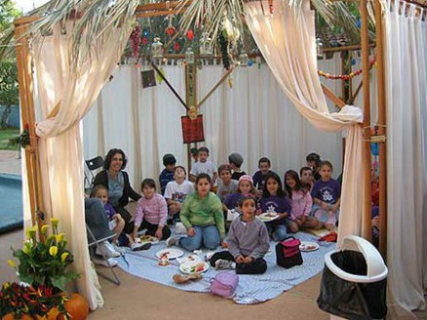
吹角節
The Feast of Tabernacles 住棚節

Slide 23
你曉諭以色列人說：這七月十五日是住棚節，要在耶和華面前守這節七日。 第一日當有聖會，甚麼勞碌的工都不可做。 七日內要將火祭獻給耶和華。第八日當守聖會，要將火祭獻給耶和華。 這是嚴肅會，甚麼勞碌的工都不可做。 (利未記 Lev. 23:34-36)

Slide 24
‘On the fifteenth day of the seventh month the Lord’s Festival of Tabernacles begins, and it lasts for seven days. The first day is a sacred assembly; do no regular work. For seven days present food offerings to the Lord, and on the eighth day hold a sacred assembly and present a food offering to the Lord. It is the closing special assembly; do no regular work.
(利未記 Lev. 23:34-36)

Slide 25
「你們收藏了地的出產，就從七月十五日起，要守耶和華的節七日。 第一日為聖安息；第八日也為聖安息。 第一日要拿美好樹上的果子和棕樹上的枝子，與茂密樹的枝條並河旁的柳枝，在耶和華─你們的 神面前歡樂七日。 (利未記 Lev. 23:39-40)

Slide 26
‘So beginning with the fifteenth day of the seventh month, after you have gathered the crops of the land, celebrate the festival to the Lord for seven days; the first day is a day of sabbath rest, and the eighth day also is a day of sabbath rest. On the first day you are to take branches from luxuriant trees—from palms, willows and other leafy trees—and rejoice before the Lord your God for seven days.
(利未記 Lev. 23:39-40)

Slide 27
每年七月間，要向耶和華守這節七日。 這為你們世世代代永遠的定例。 你們要住在棚裡七日；凡以色列家的人都要住在棚裡， 好叫你們世世代代知道，我領以色列人出埃及地的時候曾使他們住在棚裡。 我是耶和華─你們的 神。 (利未記 Lev. 23:41-43)

Slide 28
Celebrate this as a festival to the Lord for seven days each year. This is to be a lasting ordinance for the generations to come; celebrate it in the seventh month. Live in temporary shelters for seven days: All native-born Israelites are to live in such shelters so your descendants will know that I had the Israelites live in temporary shelters when I brought them out of Egypt. I am the Lord your God.’
(利未記 Lev. 23:41-43)

Slide 29
我聽見有大聲音從寶座出來說：「看哪， 神的帳幕在人間。 他要與人同住，他們要作他的子民。 神要親自與他們同在，作他們的 神。 神要擦去他們一切的眼淚；不再有死亡，也不再有悲哀、哭號、疼痛，因為以前的事都過去了。」 坐寶座的說：「看哪，我將一切都更新了！」又說：「你要寫上；因這些話是可信的，是真實的。」 (啟示錄 Revelation 21:3-5)

Slide 30
And I heard a loud voice from the throne saying, “Look! God’s dwelling place is now among the people, and he will dwell with them. They will be his people, and God himself will be with them and be their God. ‘He will wipe every tear from their eyes. There will be no more death’ or mourning or crying or pain, for the old order of things has passed away.” He who was seated on the throne said, “I am making everything new!” Then he said, “Write this down, for these words are trustworthy and true.”
(啟示錄 Revelation 21:3-5)

Slide 32
Play Video
『以利亞的日子
The Days of Elijah』

Slide 33
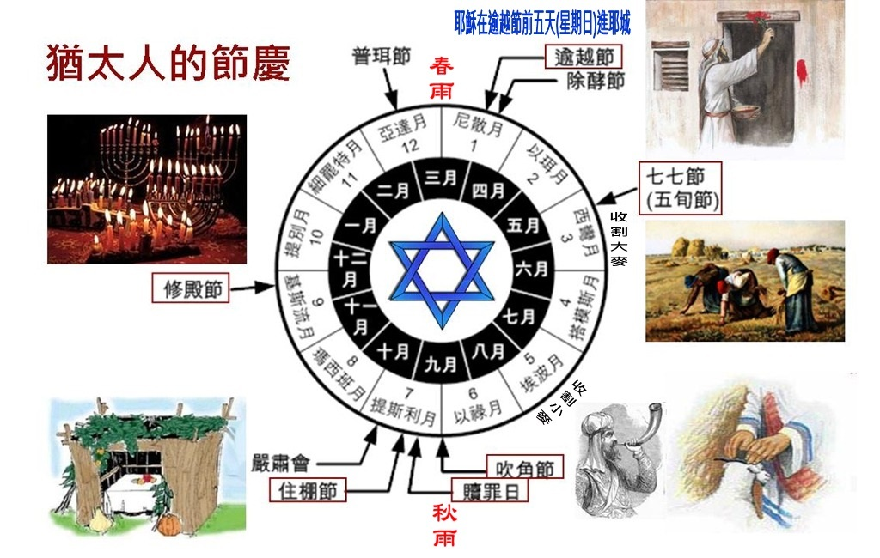

Slide 34
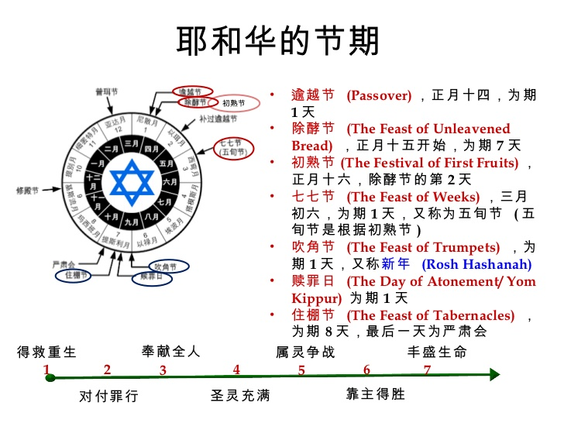

Slide 35
