Slide 1
雅各和利亞
Jacob and Leah
波特蘭靈糧堂
November 13, 2016

Slide 2
拉班有兩個女兒，大的名叫利亞，小的名叫拉結。 利亞的眼睛沒有神氣，拉結卻生得美貌俊秀。 雅各愛拉結，就說：「我願為你小女兒拉結服事你七年。」 拉班說：「我把她給你，勝似給別人，你與我同住吧！」 雅各就為拉結服事了七年；他因為深愛拉結，就看這七年如同幾天。
16 Now Laban had two daughters; the name of the older was Leah, and the name of the younger was Rachel. 17 Leah had weak eyes, but Rachel had a lovely figure and was beautiful. 18 Jacob was in love with Rachel and said, “I’ll work for you seven years in return for your younger daughter Rachel.” (創世記 Genesis 29:16-20)

Slide 3
雅各對拉班說：「日期已經滿了，求你把我的妻子給我，我好與她同房。」 拉班就擺設筵席，請齊了那地方的眾人。到晚上，拉班將女兒利亞送來給雅各，雅各就與她同房。 拉班又將婢女悉帕給女兒利亞作使女。 到了早晨，雅各一看是利亞，就對拉班說：「你向我做的是甚麼事呢？ 我服事你，不是為拉結嗎？你為甚麼欺哄我呢？」
25 When morning came, there was Leah! So Jacob said to Laban, “What is this you have done to me? I served you for Rachel, didn’t I? Why have you deceived me?” (創世記 Genesis 29:21-25)

Slide 4
後來，我察看我手所經營的一切事和我勞碌所成的功。 誰知都是虛空，都是捕風；在日光之下毫無益處。
Yet when I surveyed all that my hands had done
and what I had toiled to achieve,
everything was meaningless, a chasing after the wind; nothing was gained under the sun.
(傳道書 Ecclesiastes 2:11)

Slide 5
所以，你們若真與基督一同復活，就當求在上面的事；那裡有基督坐在 神的右邊。你們要思念上面的事，不要思念地上的事。因為你們已經死了，你們的生命與基督一同藏在 神裡面。 基督是我們的生命，他顯現的時候，你們也要與他一同顯現在榮耀裡。 (歌羅西書 Colossians 3:1-4)
Since, then, you have been raised with Christ, set your hearts on things above, where Christ is, seated at the right hand of God. Set your minds on things above, not on earthly things. For you died, and your life is now hidden with Christ in God. When Christ, who is your life, appears, then you also will appear with him in glory.

Slide 6
“If we find ourselves with a desire that nothing in this world can satisfy, the most probable explanation is that we were made for another world.”
-- C.S. Lewis (Mere Christianity)
『如果我們有一種欲望是這世上的萬事萬物都無法滿足的，最適當的解釋就是：人乃是為另一個世界而造。』
-- 魯益士 (反璞歸真)

Slide 7


Slide 8
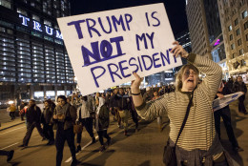

Slide 9
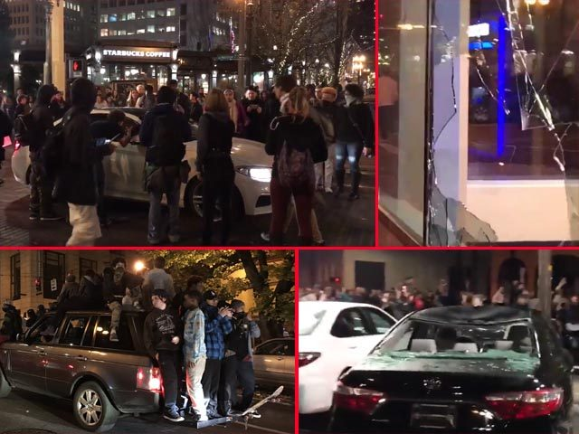

Slide 10
『我不相信任何一個地上的王
會是人類最終的拯救；
我只相信再不好的年代
神都有機會翻轉。』
『我不相信今天就算選出基督徒當總統，
就會比現在更好的治理或改變；
我只相信每個基督徒好好的敬畏 神
活出見證，並為國家禱告，
才能帶來轉化和改變。』

Slide 11
我勸你，第一要為萬人懇求、禱告、代求、祝謝；為君王和一切在位的，也該如此，使我們可以敬虔、端正、平安無事地度日。 這是好的，在 神我們救主面前可蒙悅納。
(提摩太前書 1 Timothy 2:1-2)
I urge, then, first of all, that petitions, prayers, intercession and thanksgiving be made for all people—for kings and all those in authority, that we may live peaceful and quiet lives in all godliness and holiness.

Slide 13
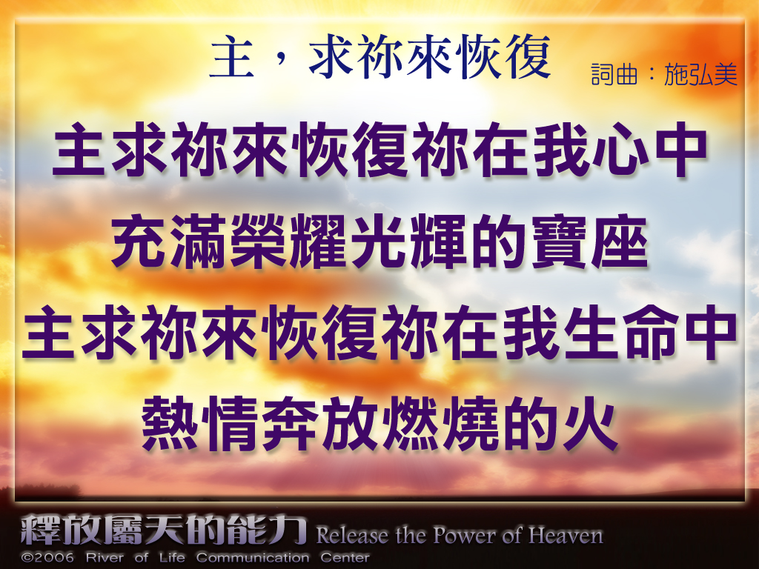

Slide 14
