Slide 1
我主和主基督的國
The kingdom of our Lord and of His Messiah
波特蘭靈糧堂
February 5, 2017

Slide 2
因有一嬰孩為我們而生；有一子賜給我們。政權必擔在他的肩頭上；他名稱為「奇妙策士、全能的 神、永在的父、和平的君」。 他的政權與平安必加增無窮。
（以賽亞書 Isaiah 9:6-7a)
For to us a child is born, to us a son is given,
and the government will be on his shoulders.
And he will be called
Wonderful Counselor, Mighty God,
Everlasting Father, Prince of Peace.
Of the greatness of his government and peace
there will be no end.

Slide 3
及至時候滿足， 神就差遣他的兒子，為女子所生，且生在律法以下，要把律法以下的人贖出來，叫我們得著兒子的名分。 （加拉太書 Galatians 4:4)
But when the set time had fully come, God sent his Son, born of a woman, born under the law, to redeem those under the law, that we might receive adoption to sonship.

Slide 4
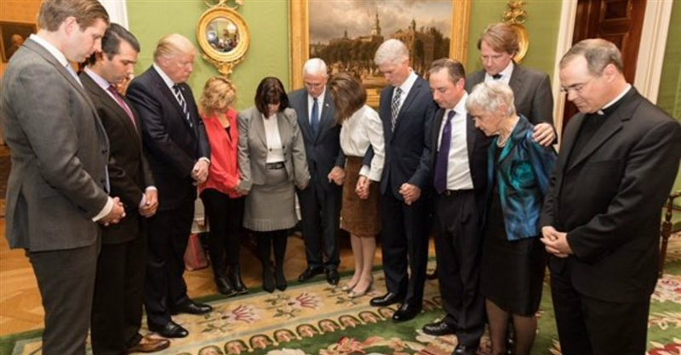
President Trump praying with Pence and Gorsuch families in White House

Slide 5
Play Video
“Trump – I will destroy Johnson amendment”

Slide 6
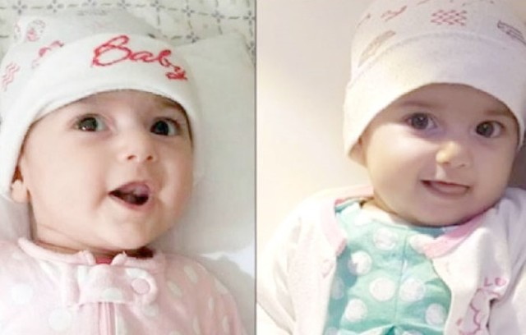

Slide 7
你們是世上的光。 城造在山上是不能隱藏的。 人點燈，不放在斗底下，是放在燈臺上，就照亮一家的人。 你們的光也當這樣照在人前，叫他們看見你們的好行為，便將榮耀歸給你們在天上的父。
（馬太福音 Matthew 5:14-15)
You are the light of the world. A town built on a hill cannot be hidden. Neither do people light a lamp and put it under a bowl. Instead they put it on its stand, and it gives light to everyone in the house. In the same way, let your light shine before others, that they may see your good deeds and glorify your Father in heaven.

Slide 8
天國好像寶貝藏在地裡，人遇見了就把它藏起來，歡歡喜喜地去變賣一切所有的，買這塊地。 （馬太福音 Matt 13:44-46)
The kingdom of heaven is like treasure hidden in a field. When a man found it, he hid it again, and then in his joy went and sold all he had and bought that field.

Slide 9
你們要先求他的國和他的義，這些東西都要加給你們了。 （馬太福音 Matthew 6:33)
But seek first his kingdom and his righteousness, and all these things will be given to you as well.

Slide 10
第七位天使吹號，天上就有大聲音說：世上的國成了我主和主基督的國；他要作王，直到永永遠遠。 （啟示錄 Revelation 11:15)
The seventh angel sounded his trumpet, and there were loud voices in heaven, which said:
“The kingdom of the world has become
the kingdom of our Lord and of his Messiah,
and he will reign for ever and ever.”

Slide 11
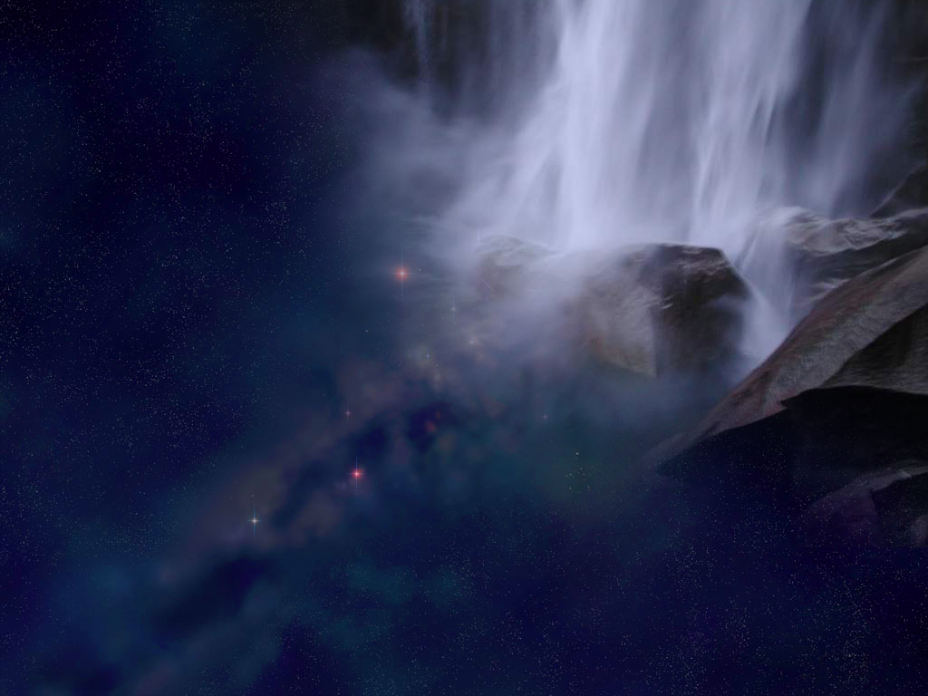
願祢榮耀降臨
Let Your Glory Fall In This Room
-David Ruis-
CCLI 11089041

Slide 12
1.父神創造的主 顯明祢創造心意
興起祢所揀選的百姓 在這地同心前進
宇宙萬物都在嘆息 等候祢能力彰顯
求主釋放祢的恩膏 哦 神就在這時刻
Father of creation, unfold Your sovereign plan
Raise up a chosen generation
That will march through the land
All of creation is longing
For Your unveiling of power
Would You release Your anointing
Oh God let this be the hour

Slide 13
願祢榮耀降臨此地
讓它從我們中間流到萬邦
願祢恩膏充滿此地
我們同心尋求祢面
Let Your glory fall in this room
Let it go forth from here to the nations
Let Your fragrance rest in this place
As we gather to seek Your face

Slide 14
2.統管萬國的主 這世界仍要看見
祢的應許完全彰顯 教會要全然得勝
求祢憐憫觸摸我們 使我們靠祢剛強
勝過我們一切軟弱 使我們奮勇爭戰
Ruler of the nations the world has yet to see
The full release of Your promise
The church in victory
Turn to us Lord and touch us
Make us strong in your might
Overcome our weakness
That we could stand up and fight

Slide 15
願祢榮耀降臨此地
讓它從我們中間流到萬邦
願祢恩膏充滿此地
我們同心尋求祢面
Let Your glory fall in this room
Let it go forth from here to the nations
Let Your fragrance rest in this place
As we gather to seek Your face

Slide 16
願祢國度降臨^{(願祢國度降臨)}
願你旨意成全^{(願你旨意成全)}
讓全地看見^{(讓全地看見)}
神兒子的榮耀 (2次)
Let Your kingdom come
Let Your will be done
Let us see on earth
The glory of Your Son (2x)

Slide 17
願祢榮耀降臨此地
讓它從我們中間流到萬邦
願祢恩膏充滿此地
我們同心尋求祢面
Let Your glory fall in this room
Let it go forth from here to the nations
Let Your fragrance rest in this place
As we gather to seek Your face

