Slide 1
深知所信
I Know Whom I Believe
波特蘭靈糧堂
February 26, 2017

Slide 2
我們既有這許多的見證人，如同雲彩圍著我們，就當放下各樣的重擔，脫去容易纏累我們的罪，存心忍耐，奔那擺在我們前頭的路程，仰望為我們信心創始成終的耶穌。
（希伯來書 Hebrews 12:1-2a)
Therefore, since we are surrounded by such a great cloud of witnesses, let us throw off everything that hinders and the sin that so easily entangles. And let us run with perseverance the race marked out for us, fixing our eyes on Jesus, the pioneer and perfecter of faith.

Slide 3
見證分享 Testimony sharing
楊子煌 & 王麗枝 夫婦

Slide 4
只要你們在所信的道上恆心，根基穩固，堅定不移，不至被引動失去（原文是離開）福音的盼望。 這福音就是你們所聽過的，也是傳與普天下萬人聽的，我－保羅也作了這福音的執事。
（歌羅西書 Colossians 1:23)
if you continue in your faith, established and firm, and do not move from the hope held out in the gospel. This is the gospel that you heard and that has been proclaimed to every creature under heaven, and of which I, Paul, have become a servant.

Slide 5
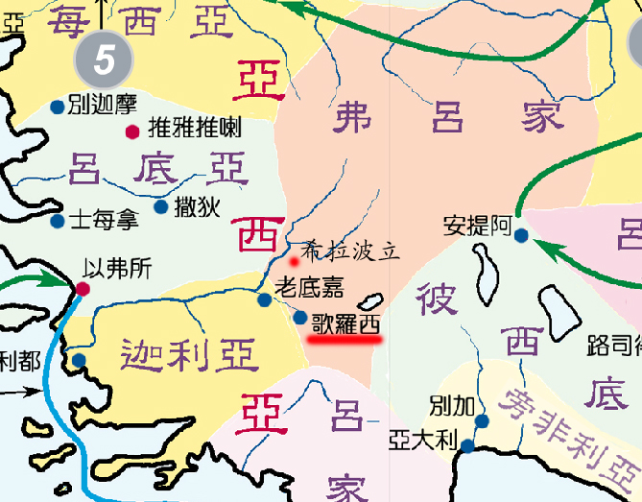


Slide 6
宗教(規條) 或是 信仰(關係)？

Slide 7
神的屬性：
超越性
內住性

Slide 8
你們若是與基督同死，脫離了世上的小學，為甚麼仍像在世俗中活著、服從那「不可拿、不可嘗、不可摸」等類的規條呢？ 這都是照人所吩咐、所教導的。 說到這一切，正用的時候就都敗壞了。 這些規條使人徒有智慧之名，用私意崇拜，自表謙卑，苦待己身，其實在克制肉體的情慾上是毫無功效。（歌羅西書 Colossians 2:20-22)

Slide 9
你們禱告，不可像外邦人，用許多重複話，他們以為話多了必蒙垂聽。 你們不可效法他們；因為你們沒有祈求以先，你們所需用的，你們的父早已知道了。 （馬太福音 Matthew 6:7-8)
And when you pray, do not keep on babbling like pagans, for they think they will be heard because of their many words. Do not be like them, for your Father knows what you need before you ask him.

Slide 10
一般宗教的禱告所看重的：
禱告的次數
禱告的時間長短
禱告時的犧牲/獻祭
禱告的強度

Slide 11
一般宗教活動所期待的：
得到神的悅納 Favor / Acceptance
禱告得以達到神的面前 Access

Slide 12
所以，你們禱告要這樣說：我們在天上的父：願人都尊你的名為聖。 願你的國降臨；願你的旨意行在地上，如同行在天上。（馬太福音 Matthew 6:9-10)
This, then, is how you should pray:
“‘Our Father in heaven,
hallowed be your name,
your kingdom come,
your will be done,
on earth as it is in heaven.

Slide 13
人非有信，就不能得 神的喜悅；因為到 神面前來的人必須信有 神，且信他賞賜那尋求他的人。
（希伯來書 Hebrews 11:6)
And without faith it is impossible to please God, because anyone who comes to him must believe that he exists and that he rewards those who earnestly seek him.

Slide 14
『最近有人向我介紹摩門教，聽起來也不錯？』

Slide 15

Good idea God idea

Slide 16
於是女人見那棵樹的果子好作食物，也悅人的眼目，且是可喜愛的，能使人有智慧，就摘下果子來吃了，又給她丈夫，她丈夫也吃了。
（創世記 Genesis 3:6)
When the woman saw that the fruit of the tree was good for food and pleasing to the eye, and also desirable for gaining wisdom, she took some and ate it. She also gave some to her husband, who was with her, and he ate it.

Slide 17
認識異端
辨識異端
  三位一體的真神 (神論)
  道成肉身的基督 (基督論)
  因信稱義的真理 (救恩論)
  聖經是唯一的權威 (聖經論)

Slide 18
若基督沒有復活，我們所傳的便是枉然，你們所信的也是枉然；
（哥林多前書 1 Corinthians 15:14)
And if Christ has not been raised, our preaching is useless and so is your faith.

Slide 19
因為 神本性一切的豐盛都有形有體地居住在基督裡面，你們在他裡面也得了豐盛。 他是各樣執政掌權者的元首。（歌羅西書 Colossians 2:9-10)
For in Christ all the fullness of the Deity lives in bodily form, and in Christ you have been brought to fullness. He is the head over every power and authority.

Slide 20
Play Video
“唯有耶穌”

