Slide 1
福音的權能
The Power of Gospel
波特蘭靈糧堂
May 28, 2017

Slide 2
但聖靈降臨在你們身上，你們就必得著能力，並要在耶路撒冷、猶太全地，和撒馬利亞，直到地極，作我的見證。
（使徒行傳 Acts 1:8)
But you will receive power when the Holy Spirit comes on you; and you will be my witnesses in Jerusalem, and in all Judea and Samaria, and to the ends of the earth.

Slide 3
見證分享
劉藝清 姐妹

Slide 4
我們有這寶貝放在瓦器裡，要顯明這莫大的能力是出於 神，不是出於我們。 （哥林多後書 2 Corinthians 4:7)
But we have this treasure in jars of clay to show that this all-surpassing power is from God and not from us.

Slide 5


Slide 6
他就設立十二個人，要他們常和自己同在，也要差他們去傳道，並給他們權柄趕鬼。 （馬可福音 Mark 3:14-15)
He appointed twelve that they might be with him and that he might send them out to preach and to have authority to drive out demons.

Slide 7
被 神所愛的弟兄啊，我知道你們是蒙揀選的；因為我們的福音傳到你們那裡，不獨在乎言語，也在乎權能和聖靈，並充足的信心。
（帖撒羅尼迦前書 1 Thessalonians 1:4-5)
For we know, brothers and sisters loved by God, that he has chosen you, because our gospel came to you not simply with words but also with power, with the Holy Spirit and deep conviction.

Slide 8
1910 ─ 18% 基督徒在非西方國家之內
2010 ─ 61% 基督徒在非西方國家之內
未得之民 Unreached People Groups

Slide 9
戴紹曾 (戴德生 Hudson Taylor 的曾孫)：
『中國人，你在哪裡？』
『我準備死在中國。
假如我有千條性命，
絕不留下一條不給基督！』

Slide 10
他又對他們說：「你們往普天下去，傳福音給萬民聽。信而受洗的，必然得救；不信的，必被定罪。 信的人必有神蹟隨著他們，就是奉我的名趕鬼；說新方言；手能拿蛇；若喝了甚麼毒物，也必不受害；手按病人，病人就必好了。」主耶穌和他們說完了話，後來被接到天上，坐在 神的右邊。門徒出去，到處宣傳福音。主和他們同工，用神蹟隨著，證實所傳的道。阿們！ (馬可福音 16:15-20)

Slide 11
只因不法的事增多，許多人的愛心才漸漸冷淡了。 惟有忍耐到底的，必然得救。 這天國的福音要傳遍天下，對萬民作見證，然後末期才來到。
（馬太福音 Matthew 24:12-14)
And because lawlessness will be increased, the love of many will grow cold. But the one who endures to the end will be saved. And this gospel of the kingdom will be proclaimed throughout the whole world as a testimony to all nations, and then the end will come.

Slide 12
主所應許的尚未成就，有人以為他是耽延，其實不是耽延，乃是寬容你們，不願有一人沉淪，乃願人人都悔改。
（彼得後書 2 Peter 3:9)
The Lord is not slow in keeping his promise, as some understand slowness. Instead he is patient with you, not wanting anyone to perish, but everyone to come to repentance.

Slide 13


Slide 14


Slide 15
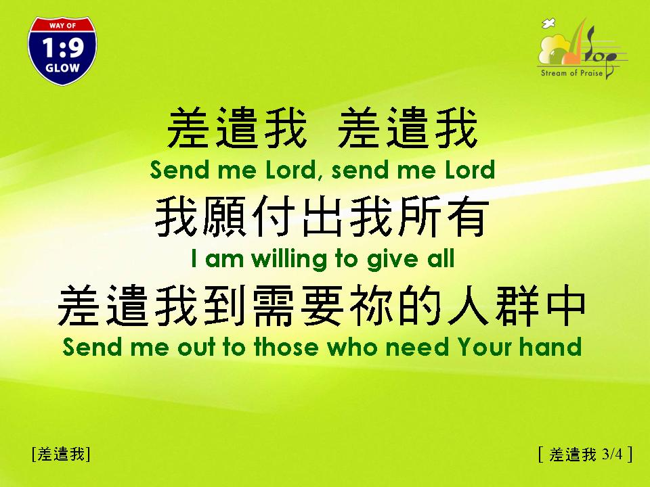

Slide 16


