Slide 1
蒙福的人生
A Blessed Life
波特蘭靈糧堂
June 11, 2017

Slide 2
你們要先求他的國和他的義，這些東西都要加給你們了。 所以，不要為明天憂慮，因為明天自有明天的憂慮；一天的難處一天當就夠了。
（馬太福音 Matthew 6:33-34)
But seek first his kingdom and his righteousness, and all these things will be given to you as well. Therefore do not worry about tomorrow, for tomorrow will worry about itself. Each day has enough trouble of its own.

Slide 3
給一個人如果『蒙福』，就表示萬事都會超自然的為你效力
When a person is “blessed”, all things in life will supernaturally serve you

Slide 4
她說：「我指著永生耶和華─你的 神起誓，我沒有餅，罈內只有一把麵，瓶裡只有一點油；我現在找兩根柴，回家要為我和我兒子做餅；我們吃了，死就死吧！」（列王紀上 1 Kings 17:12)
“As surely as the Lord your God lives,” she replied, “I don’t have any bread—only a handful of flour in a jar and a little olive oil in a jug. I am gathering a few sticks to take home and make a meal for myself and my son, that we may eat it—and die.”

Slide 5
以利亞對她說：「不要懼怕！ 可以照你所說的去做吧！ 只要先為我做一個小餅拿來給我，然後為你和你的兒子做餅。 因為耶和華─以色列的 神如此說：罈內的麵必不減少，瓶裡的油必不缺短，直到耶和華使雨降在地上的日子。」（列王紀上 1 Kings 17:13-14)
Elijah said to her, “Don’t be afraid. Go home and do as you have said. But first make a small loaf of bread for me from what you have and bring it to me, and then make something for yourself and your son. For this is what the Lord, the God of Israel, says: ‘The jar of flour will not be used up and the jug of oil will not run dry until the day the Lord sends rain on the land.’”

Slide 6
婦人就照以利亞的話去行。她和她家中的人，並以利亞，吃了許多日子。 罈內的麵果不減少，瓶裡的油也不缺短，正如耶和華藉以利亞所說的話。
（列王紀上 1 Kings 17:15-16)
She went away and did as Elijah had told her. So there was food every day for Elijah and for the woman and her family. 16 For the jar of flour was not used up and the jug of oil did not run dry, in keeping with the word of the Lord spoken by Elijah.

Slide 7
給予使我們領受能力
Giving is empowerment
God - Generosity
Satan - Selfish

Slide 8
神樂意超自然的供應你，但你必須要先尊榮祂。
God loves to supernaturally provide you but you must honor Him first.

Slide 9
蒙福人生的根基在於
尊榮文化
The foundation of a blessed life is the culture of honor

Slide 10


Slide 11
地上所有的，無論是地上的種子是樹上的果子，十分之一是耶和華的，是歸給耶和華為聖的。（利未記 Leviticus 27:30)
A tithe of everything from the land, whether grain from the soil or fruit from the trees, belongs to the Lord; it is holy to the Lord.

Slide 12
又有撒冷王麥基洗德帶著餅和酒出來迎接；他是至高 神的祭司。 他為亞伯蘭祝福，說：「願天地的主、至高的 神賜福與亞伯蘭！ 至高的 神把敵人交在你手裡，是應當稱頌的！」亞伯蘭就把所得的拿出十分之一來，給麥基洗德。（創世記 Genesis 14:18-20)
Then Melchizedek king of Salem brought out bread and wine. He was priest of God Most High, 19 and he blessed Abram, saying, “Blessed be Abram by God Most High, Creator of heaven and earth. And praise be to God Most High, who delivered your enemies into your hand.” Then Abram gave him a tenth of everything.

Slide 14
萬軍之耶和華說：你們要將當納的十分之一全然送入倉庫，使我家有糧，以此試試我，是否為你們敞開天上的窗戶，傾福與你們，甚至無處可容。 萬軍之耶和華說：我必為你們斥責蝗蟲，不容牠毀壞你們的土產。 你們田間的葡萄樹在未熟之先也不掉果子。（瑪拉基書 Malachi 3:10-11)
Bring the whole tithe into the storehouse, that there may be food in my house. Test me in this,” says the Lord Almighty, “and see if I will not throw open the floodgates of heaven and pour out so much blessing that there will not be room enough to store it. I will prevent pests from devouring your crops, and the vines in your fields will not drop their fruit before it is ripe,” says the Lord Almighty.

Slide 15
十在聖經中所代表的是考試，或是一個考驗的時刻。 十一奉獻是個考試，然而這也是聖經中唯一告訴我們可以試驗 神的地方。
The number of 10 symbolizes test or a testing period. Tithing is a test, yet it’s the only area that we can test God according to Bible.

Slide 17
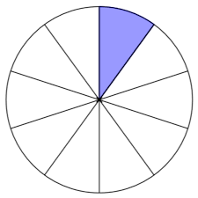


Slide 18
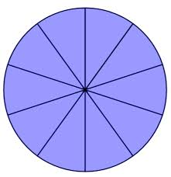

Slide 19
要相信在 神的祝福中擁有 90% 遠比不在 神的祝福中擁有 100% 還要好！
Trust that it is better to own 90% with God’s blessings than to own 100% without His blessings!

Slide 20
經濟不景氣的時候才是十一奉獻的最好時刻！
Economic distress is the best time for tithing!

Slide 21
你們知道我們主耶穌基督的恩典：他本來富足，卻為你們成了貧窮，叫你們因他的貧窮，可以成為富足。
（哥林多後書 2 Corinthians 8:9)
For you know the grace of our Lord Jesus Christ, that though he was rich, yet for your sake he became poor, so that you through his poverty might become rich.

Slide 22
十字架救贖的大能和耶穌基督的寶血一次就解決了三個領域的問題：
罪
疾病
貧窮

Slide 23
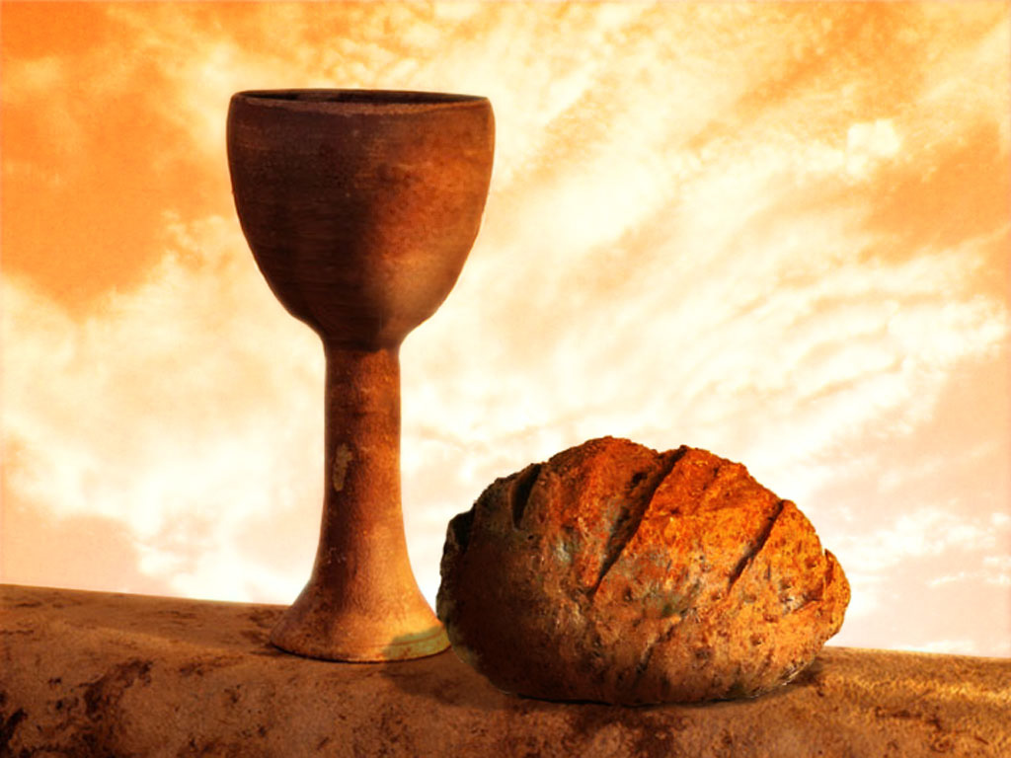
同領聖餐 Holy Communion

Slide 24
Play Video
『主我獻上生命給你』

