Slide 1
我們在天上的父
Our Father in Heaven
楊靄權 牧師
June 18, 2017

Slide 2
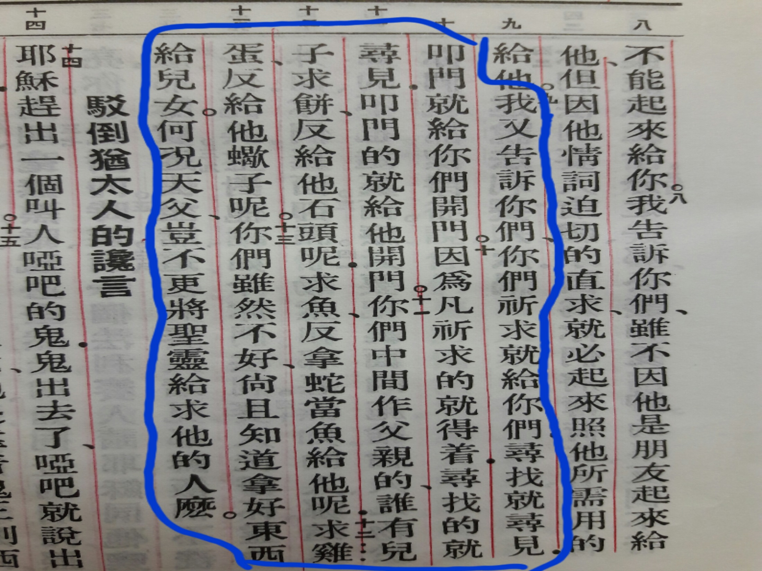

Slide 3
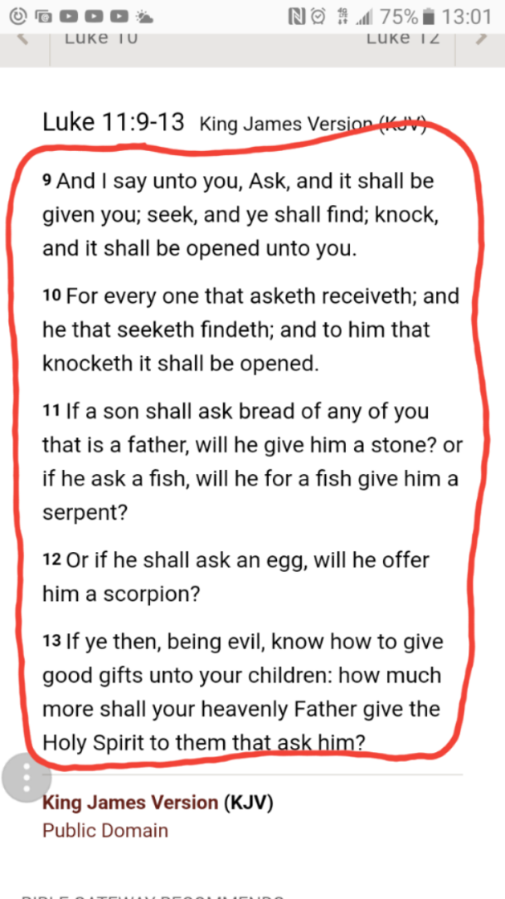

Slide 4
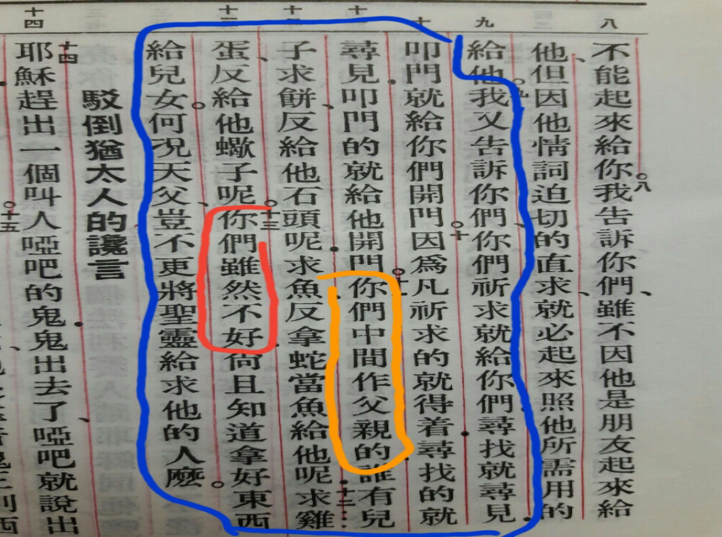

Slide 5
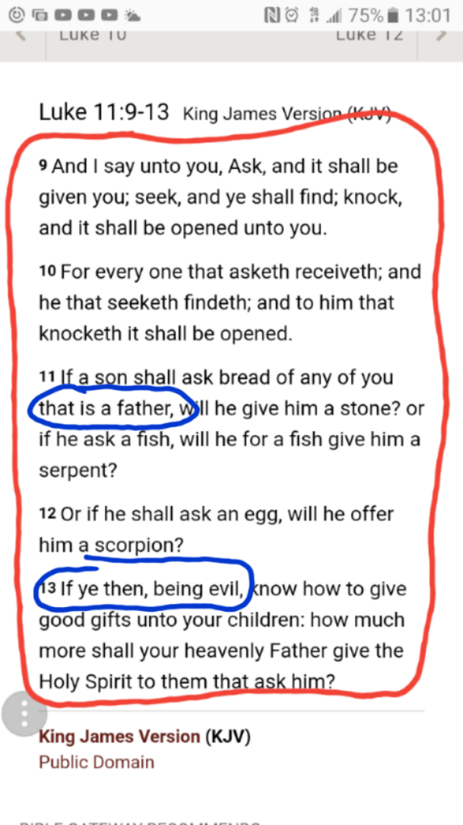

Slide 6
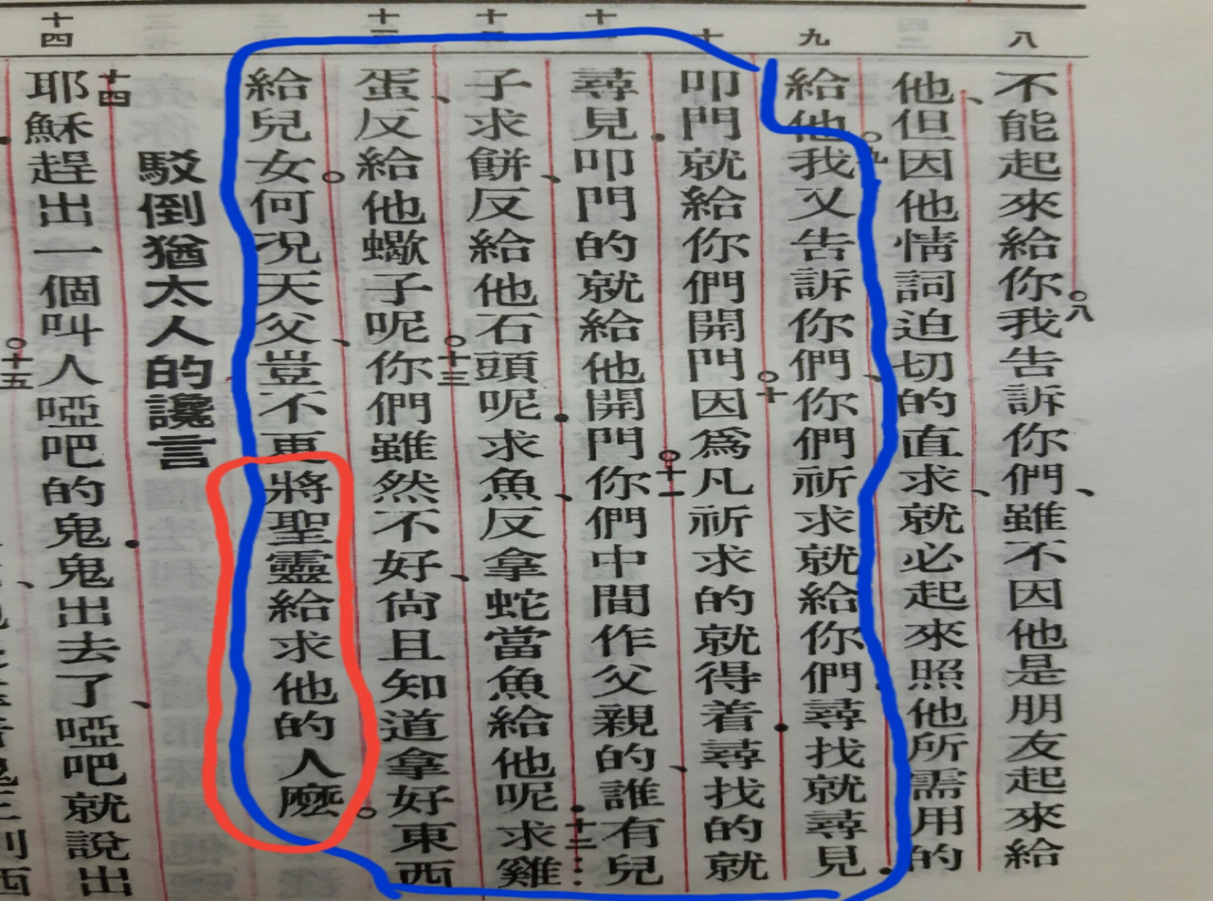

Slide 7
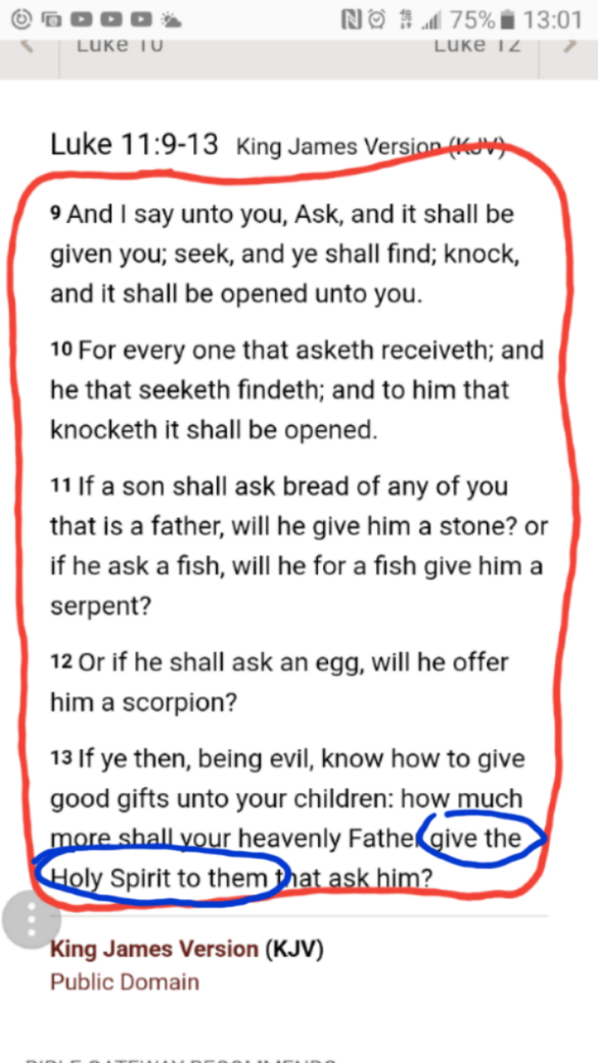

Slide 8


Slide 9

天父阿，求你開門，求你開門!
Heavenly Father, please open the door!

Slide 10
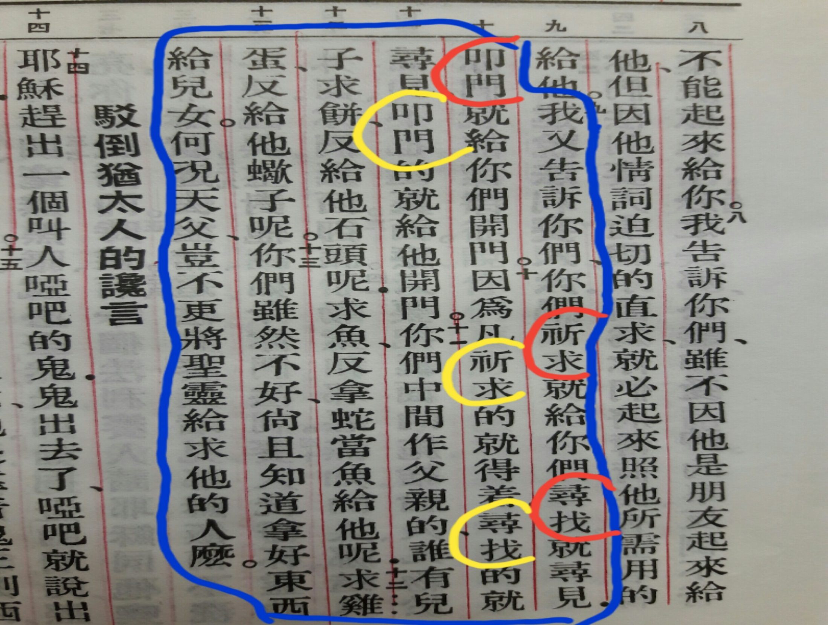

Slide 11
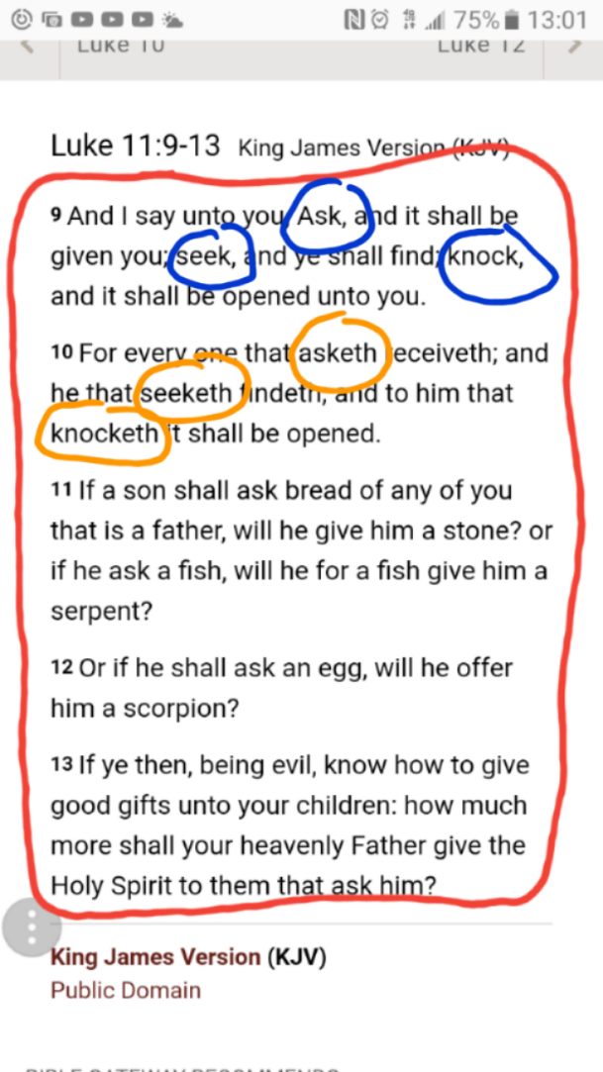

Slide 12


Slide 13


Slide 14
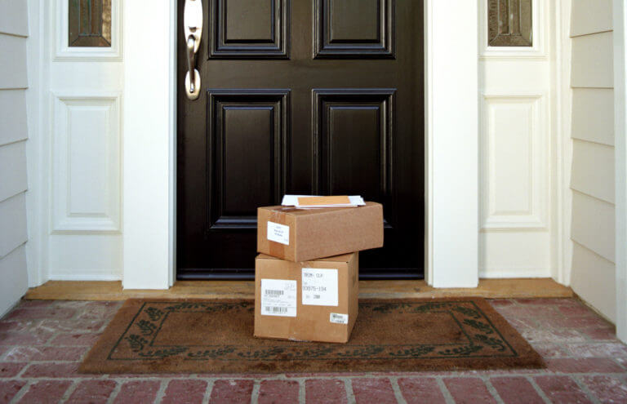

Slide 16
天父阿，求你開門，求你開門!
Heavenly Father, please open the door!

Slide 17


Slide 18
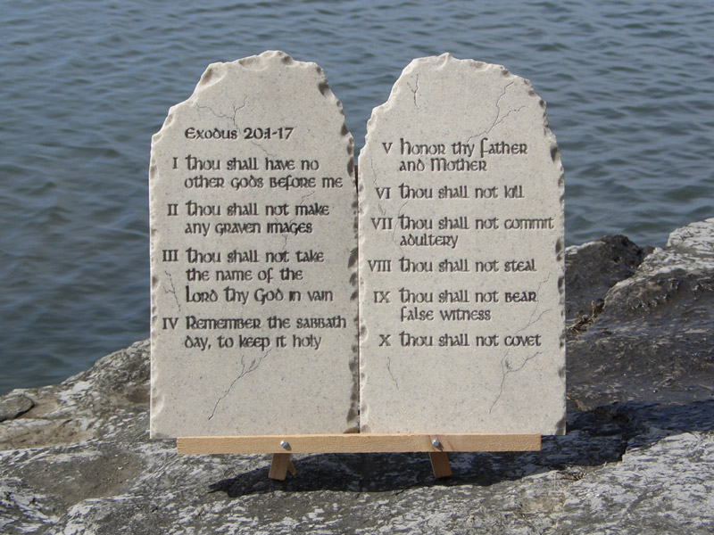

Slide 19


Slide 20


Slide 21
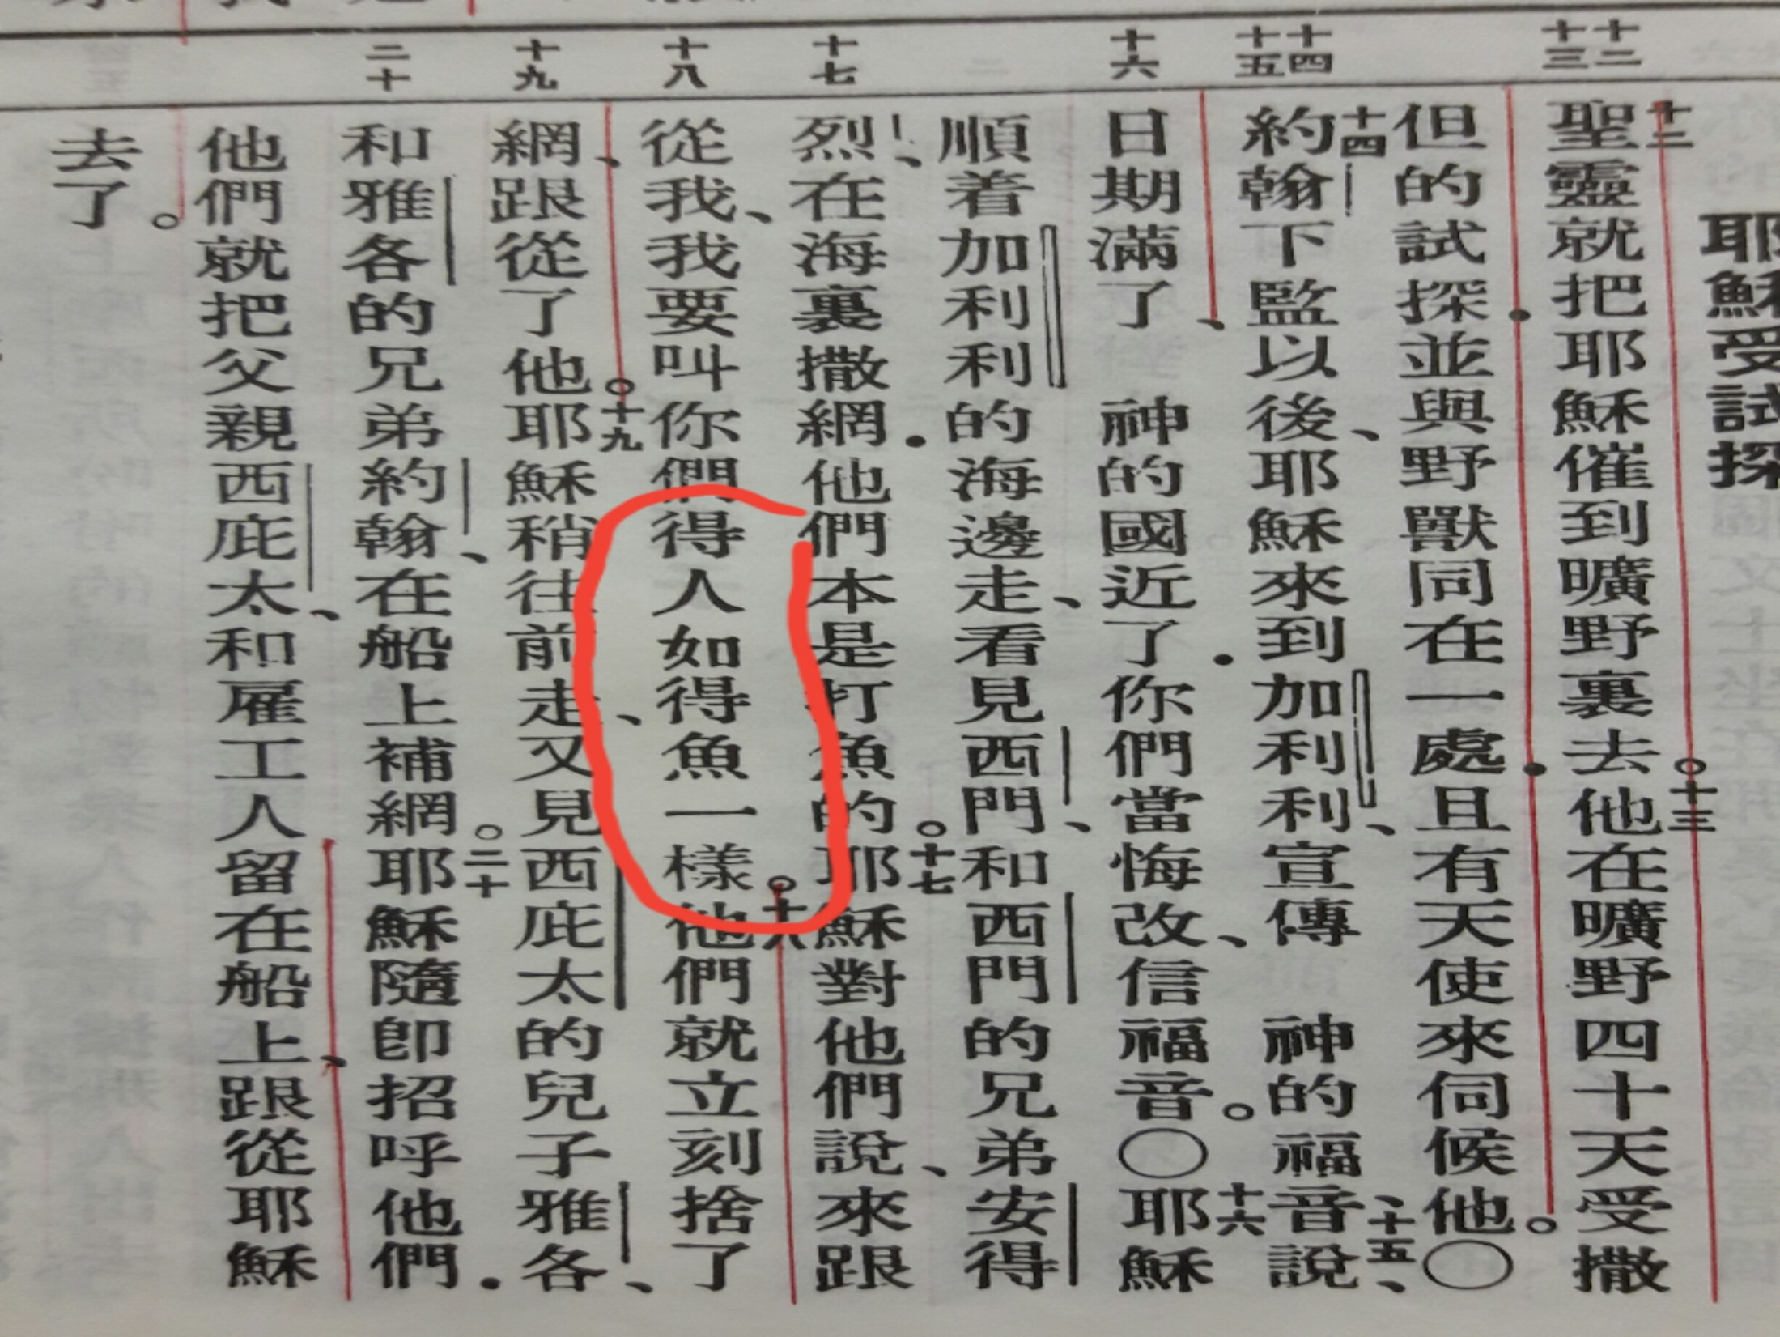

Slide 22
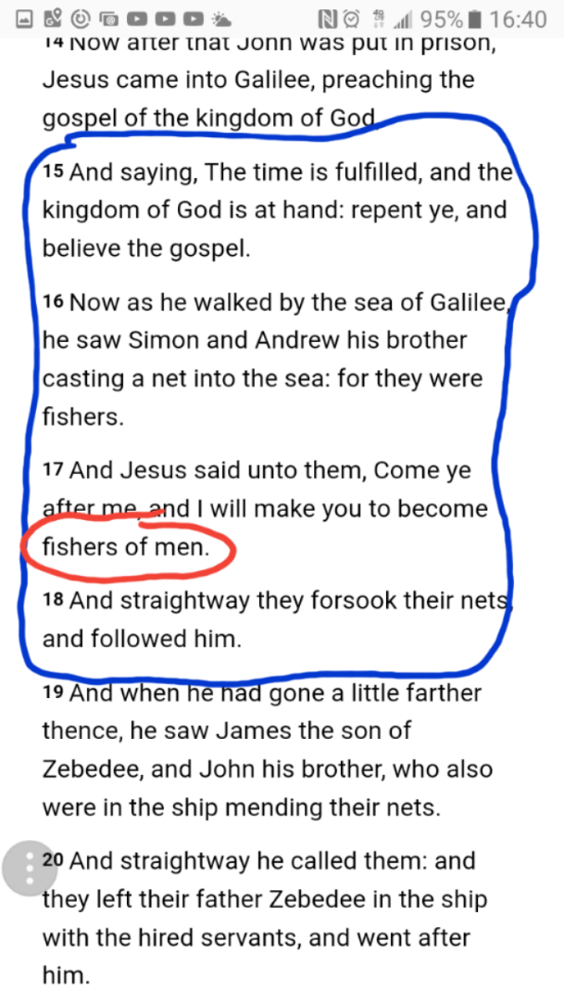

Slide 23
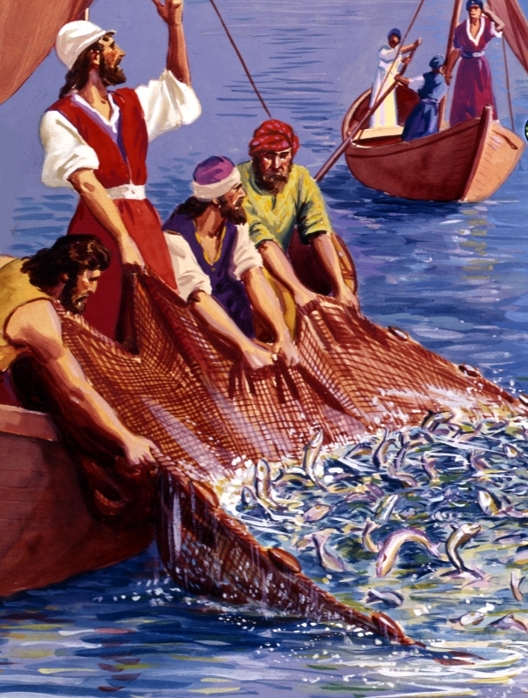

Slide 24
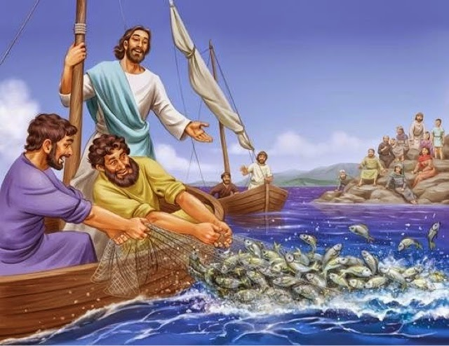

Slide 25


Slide 26


Slide 27


Slide 28


Slide 29
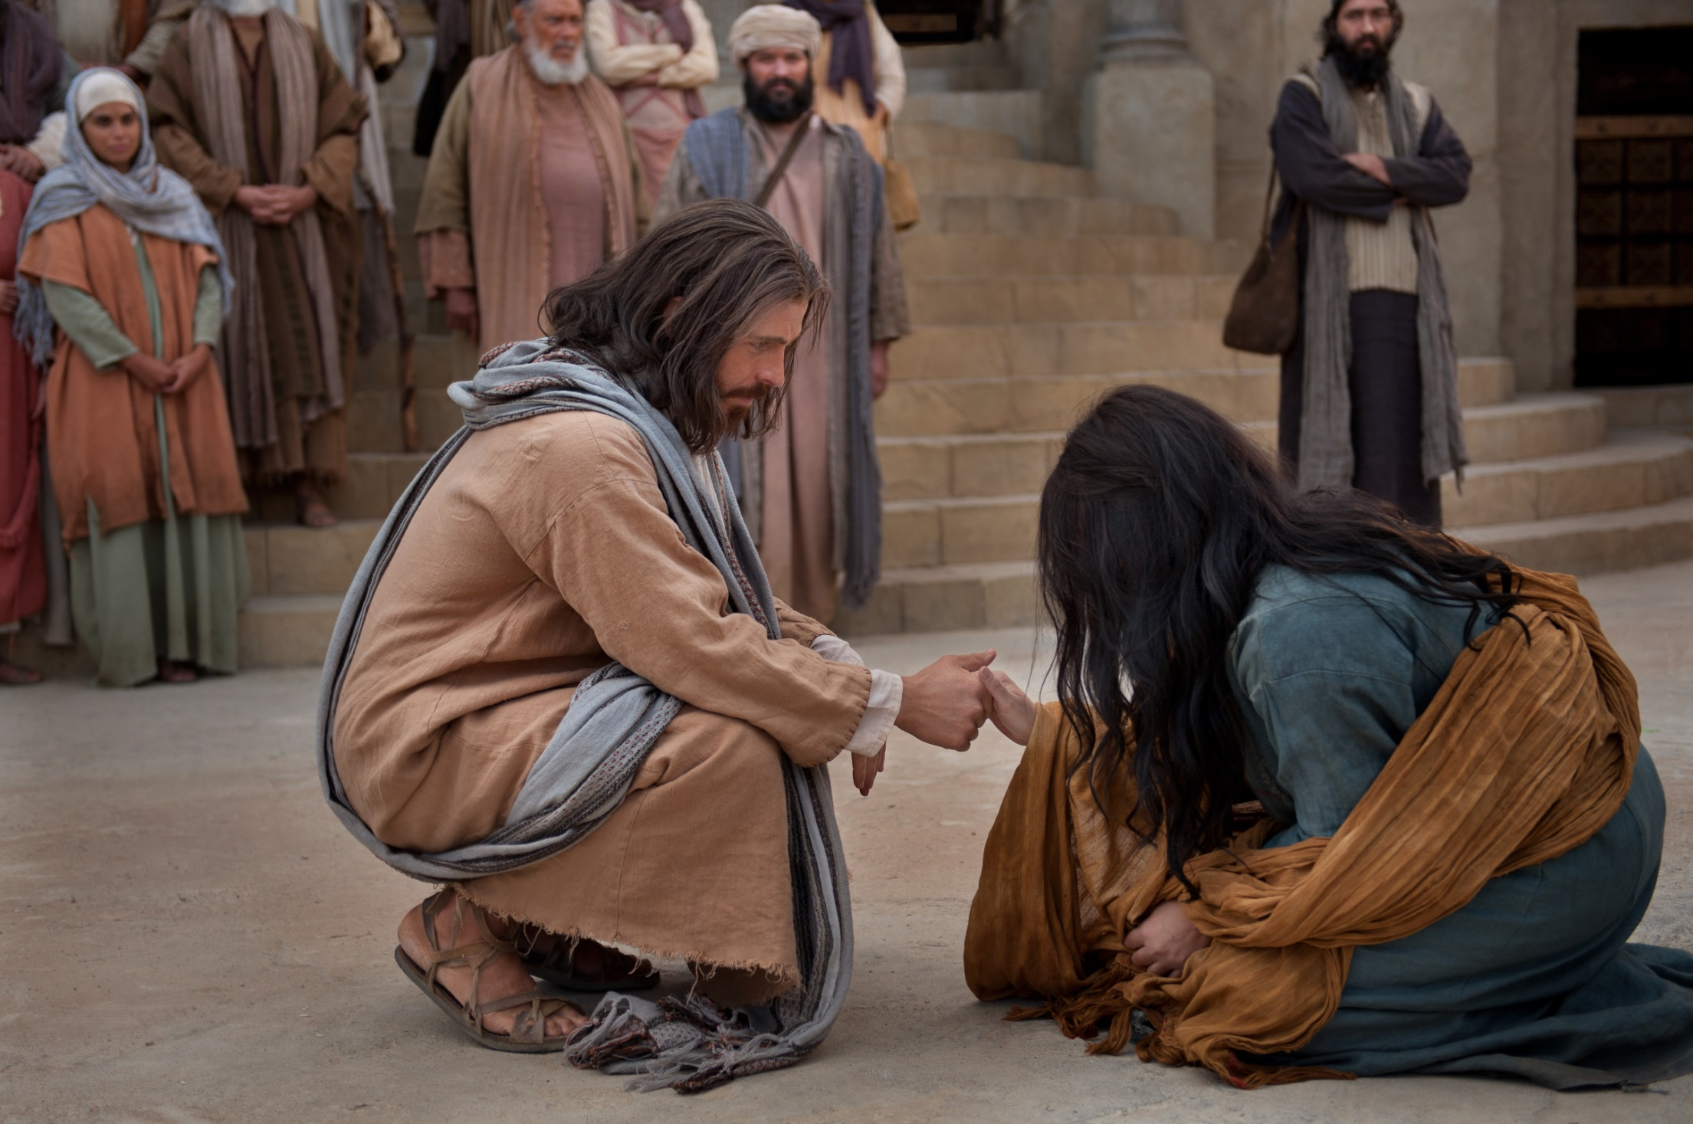

Slide 30


Slide 32
天父阿，求你開門，求你開門!
Heavenly Father, please open the door!

Slide 33
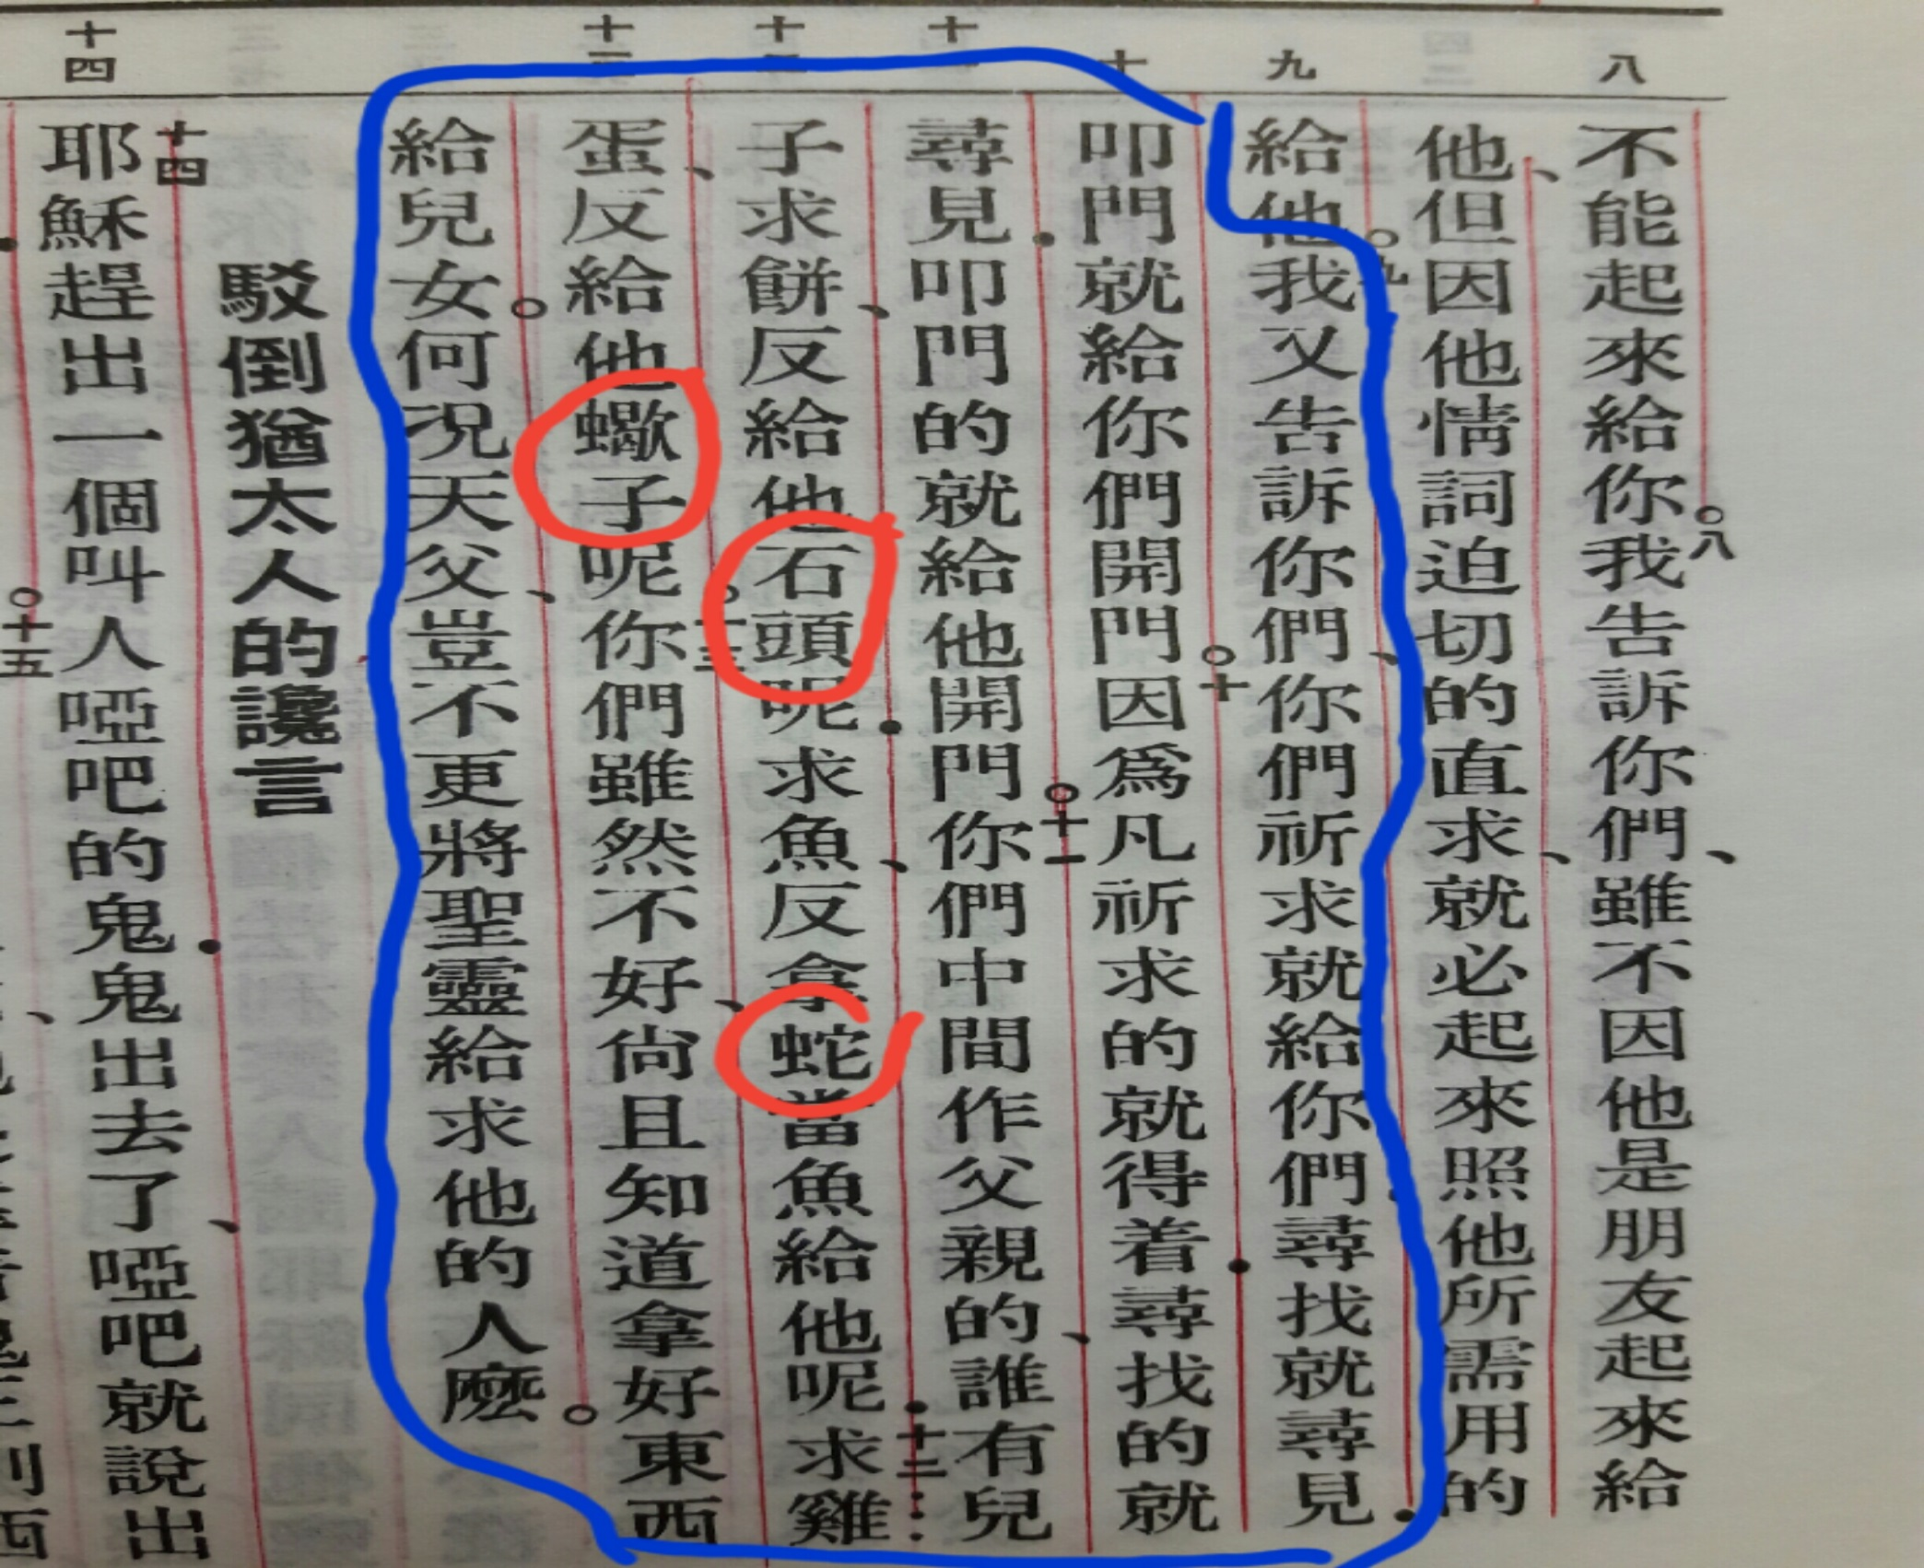

Slide 34
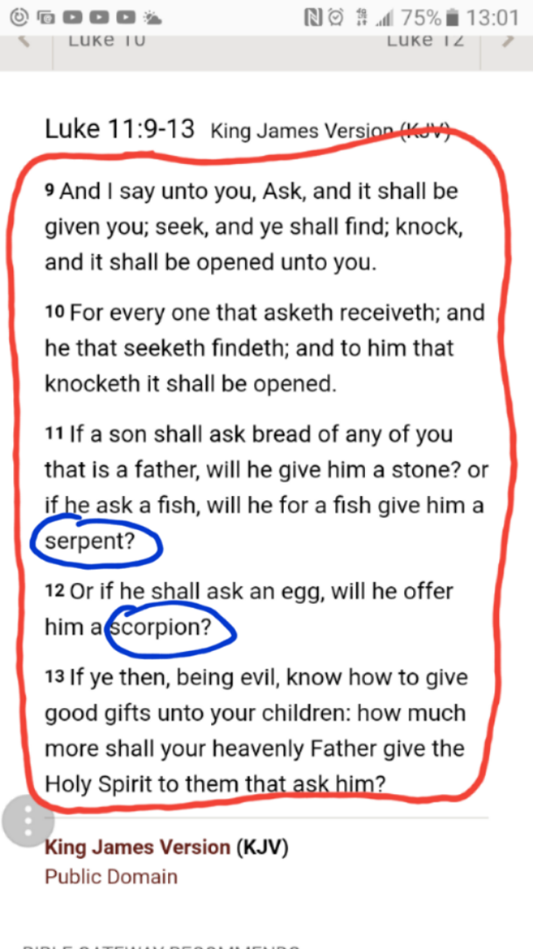

Slide 35
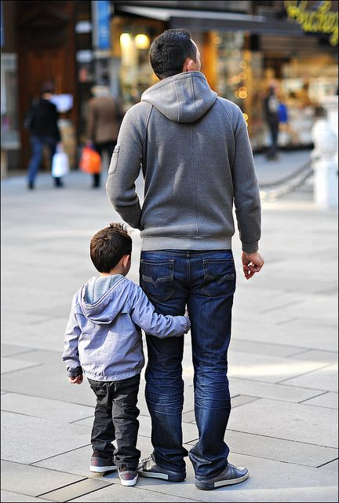

Slide 36
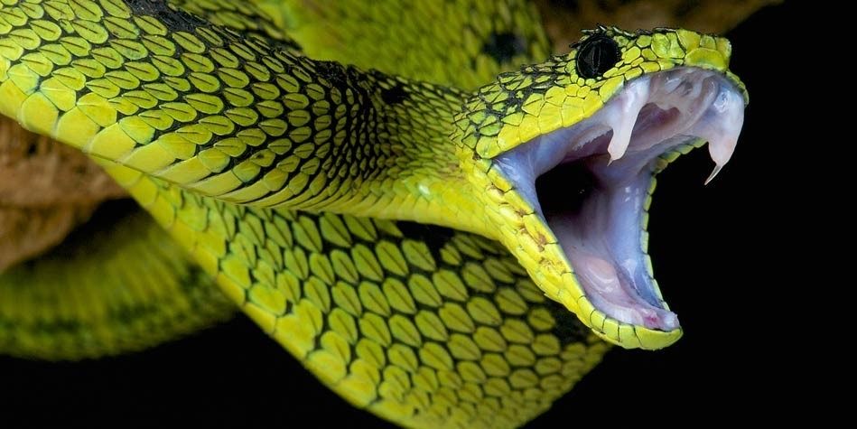

Slide 37


Slide 38


Slide 39


Slide 40


Slide 41
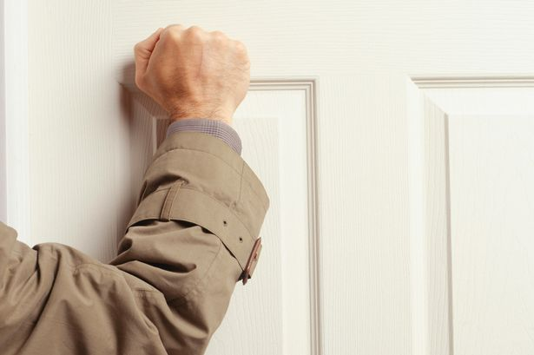

Slide 42
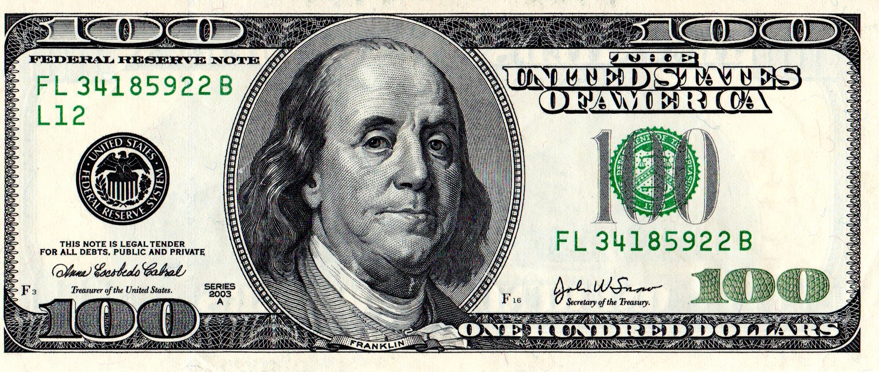

Slide 44
天父阿，求你開門，求你開門!
Heavenly Father, please open the door!

