Slide 1
天開了
Heaven Opened
波特蘭靈糧堂
August 20, 2017

Slide 2
他從水裡一上來，就看見天裂開了，聖靈彷彿鴿子，降在他身上。 又有聲音從天上來，說：「你是我的愛子，我喜悅你。」
（馬可福音 Mark 1:10-11)
Just as Jesus was coming up out of the water, he saw heaven being torn open and the Spirit descending on him like a dove. And a voice came from heaven: “You are my Son, whom I love; with you I am well pleased.”

Slide 3
耶穌又大聲喊叫，氣就斷了。 忽然，殿裡的幔子從上到下裂為兩半，地也震動，磐石也崩裂
（馬太福音 Matthew 27:50-51)
And when Jesus had cried out again in a loud voice, he gave up his spirit. At that moment the curtain of the temple was torn in two from top to bottom. The earth shook, the rocks split

Slide 4
弟兄們，我們既因耶穌的血得以坦然進入至聖所，是藉著他給我們開了一條又新又活的路，從幔子經過，這幔子就是他的身體。
（希伯來書 Hebrews 10:19-20)
Therefore, brothers and sisters, since we have confidence to enter the Most Holy Place by the blood of Jesus, by a new and living way opened for us through the curtain, that is, his body,

Slide 5
一個人對「天開了」的認識和察覺取決於我們屬靈的成熟度和對聖靈的順服。

Slide 6
「事工」導向
「同在」導向

Slide 7
神人曾對王說：「明日約到這時候，在撒馬利亞城門口，二細亞大麥要賣銀一舍客勒，一細亞細麵也要賣銀一舍客勒。」 那軍長對神人說：「即便耶和華使天開了窗戶，也不能有這事。」神人說：「你必親眼看見，卻不得吃。」（列王紀下 2 Kings 7:18-19)
19 The officer had said to the man of God, “Look, even if the Lord should open the floodgates of the heavens, could this happen?” The man of God had replied, “You will see it with your own eyes, but you will not eat any of it!”

Slide 8
約翰在監裡聽見基督所做的事，就打發兩個門徒去，問他說：「那將要來的是你嗎？還是我們等候別人呢？」
（馬太福音 Matthew 11:2-3)
When John, who was in prison, heard about the deeds of the Messiah, he sent his disciples to ask him, “Are you the one who is to come, or should we expect someone else?”

Slide 9
耶穌回答說：「你們去，把所聽見、所看見的事告訴約翰。 就是瞎子看見，瘸子行走，長大痲瘋的潔淨，聾子聽見，死人復活，窮人有福音傳給他們。 凡不因我跌倒的就有福了！」（馬太 11:4-6)
4 Jesus replied, “Go back and report to John what you hear and see: 5 The blind receive sight, the lame walk, those who have leprosy are cleansed, the deaf hear, the dead are raised, and the good news is proclaimed to the poor.

Slide 10
知識的言語
Word of knowledge is not a
“fix-it” spiritual gift
- Shawn Bolz

Slide 11
「事工」導向
「同在」導向

Slide 12
有一件事，我曾求耶和華，我仍要尋求：就是一生一世住在耶和華的殿中，瞻仰他的榮美，在他的殿裡求問。 因為我遭遇患難，他必暗暗地保守我；在他亭子裡，把我藏在他帳幕的隱密處，將我高舉在磐石上。（詩篇 Psalm 27:4-5)
4 One thing I ask from the Lord, this only do I seek:
that I may dwell in the house of the Lord all the days of my life, to gaze on the beauty of the Lord and to seek him in his temple. 5 For in the day of trouble he will keep me safe in his dwelling; he will hide me in the shelter of his sacred tent

Slide 13
你們要先求他的國和他的義，這些東西都要加給你們了。
（馬太福音 Matthew 6:33)
But seek first his kingdom and his righteousness, and all these things will be given to you as well.

Slide 14
主就是那靈；主的靈在哪裡，那裡就得以自由。 我們眾人既然敞著臉得以看見主的榮光，好像從鏡子裡返照，就變成主的形狀，榮上加榮，如同從主的靈變成的。（哥林多後書 2 Corinthians 3:17-18)
Now the Lord is the Spirit, and where the Spirit of the Lord is, there is freedom. 18 And we all, who with unveiled faces contemplate[a] the Lord’s glory, are being transformed into his image with ever-increasing glory, which comes from the Lord, who is the Spirit.

Slide 15
當我們超越世上充滿憂慮、懼怕和危機的現實，常常活在「天開了」的真實中，藉著 神的同在所帶出來的影響力和改變將無可限量！

Slide 17
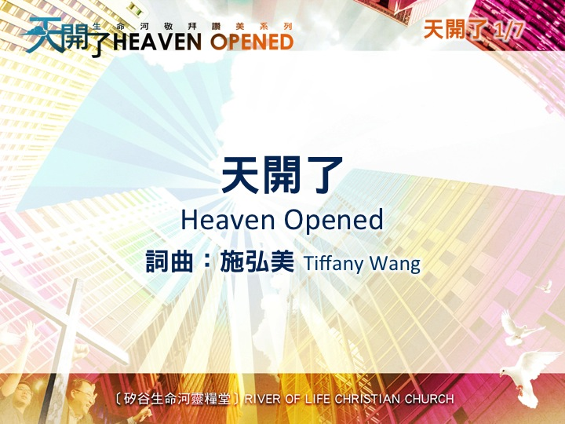

Slide 18
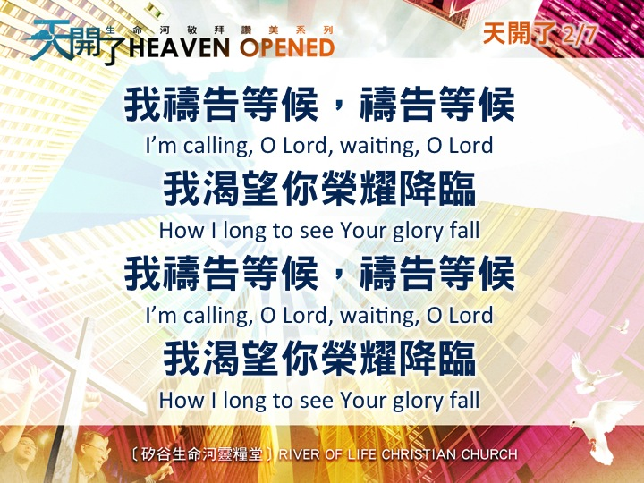

Slide 19


Slide 20
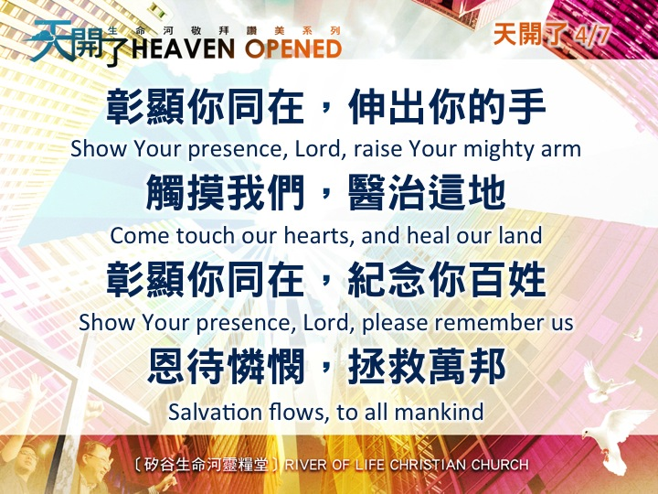

Slide 21
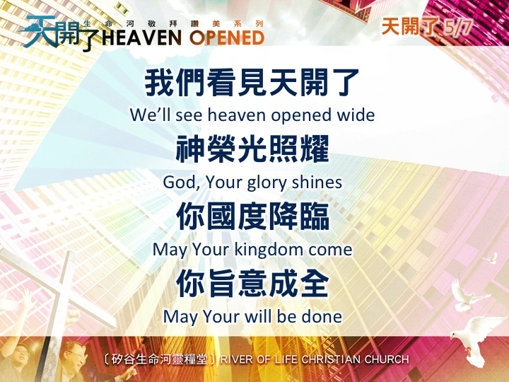

Slide 22
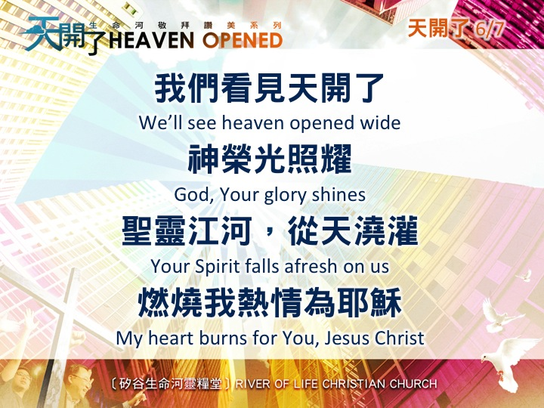

Slide 23
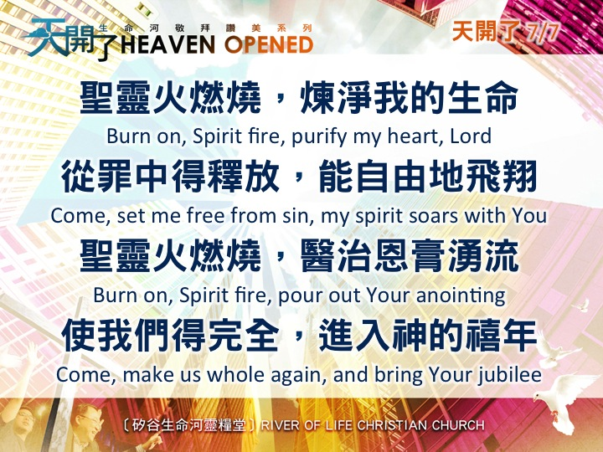

Slide 24
Play Video
“成為神蹟的器皿”

