Slide 1
觸動 神的心
Touching God’s Heart
波特蘭靈糧堂
August 27, 2017

Slide 2
我所揀選的禁食不是要鬆開凶惡的繩，解下軛上的索，使被欺壓的得自由，折斷一切的軛嗎？ 不是要把你的餅分給飢餓的人，將飄流的窮人接到你家中，見赤身的給他衣服遮體，顧恤自己的骨肉而不掩藏嗎？ （以賽亞書 Isaiah 58:6-7)
Is not this the kind of fasting I have chosen: to loose the chains of injustice and untie the cords of the yoke,
to set the oppressed free and break every yoke? Is it not to share your food with the hungry and to provide the poor wanderer with shelter

Slide 3
這樣，你的光就必發現如早晨的光；你所得的醫治要速速發明。 你的公義必在你前面行；耶和華的榮光必作你的後盾。那時你求告，耶和華必應允；你呼求，他必說：我在這裡。（以賽亞書 Isa 58:8-9)
Then your light will break forth like the dawn, and your healing will quickly appear; then your righteousness will go before you, and the glory of the Lord will be your rear guard. Then you will call, and the Lord will answer; you will cry for help, and he will say: Here am I.

Slide 4
你若從你中間除掉重軛和指摘人的指頭，並發惡言的事，你心若向飢餓的人發憐憫，使困苦的人得滿足，你的光就必在黑暗中發現；你的幽暗必變如正午。（以賽亞書 Isaiah 58:9-10)
If you do away with the yoke of oppression, with the pointing finger and malicious talk, and if you spend yourselves in behalf of the hungry and satisfy the needs of the oppressed, then your light will rise in the darkness, and your night will become like the noonday.

Slide 5
耶和華也必時常引導你，在乾旱之地使你心滿意足，骨頭強壯。 你必像澆灌的園子，又像水流不絕的泉源。那些出於你的人必修造久已荒廢之處；你要建立拆毀累代的根基。 你必稱為補破口的，和重修路徑與人居住的。（賽 58:11-12)
The Lord will guide you always; he will satisfy your needs in a sun-scorched land and will strengthen your frame. You will be like a well-watered garden, like a spring whose waters never fail. Your people will rebuild the ancient ruins and will raise up the age-old foundations

Slide 6
Play Video
“Prayer that touches God’s heart”

Slide 7
大衛又聚集以色列中所有挑選的人三萬。 大衛起身，率領跟隨他的眾人前往，要從巴拉‧猶大將 神的約櫃運來；這約櫃就是坐在二基路伯上萬軍之耶和華留名的約櫃。 他們將 神的約櫃從岡上亞比拿達的家裡抬出來，放在新車上；亞比拿達的兩個兒子烏撒和亞希約趕這新車。（撒母耳記下 2 Samuel 6:1-3)
3 They set the ark of God on a new cart and brought it from the house of Abinadab, which was on the hill. Uzzah and Ahio, sons of Abinadab, were guiding the new cart

Slide 8
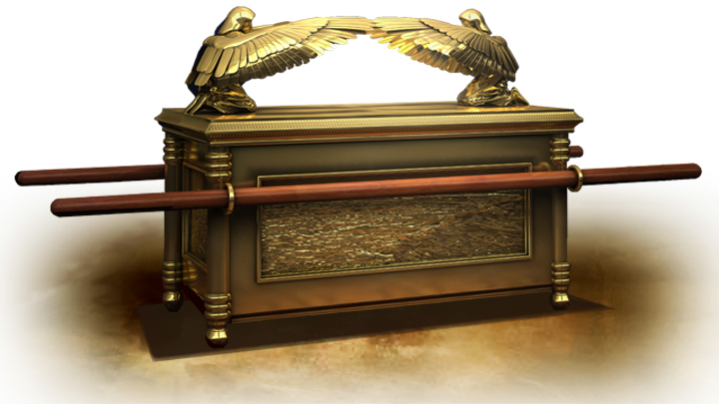

Slide 9
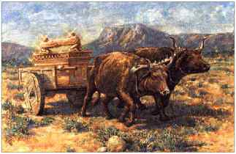

Slide 10
他們將 神的約櫃從岡上亞比拿達家裡抬出來的時候，亞希約在櫃前行走。 大衛和以色列的全家在耶和華面前，用松木製造的各樣樂器和琴、瑟、鼓、鈸、鑼，作樂跳舞。（撒母耳記下 2 Sam 6:4-5)
with the ark of God on it, and Ahio was walking in front of it. David and all Israel were celebrating with all their might before the Lord, with castanets, harps, lyres, timbrels, sistrums and cymbals.

Slide 11
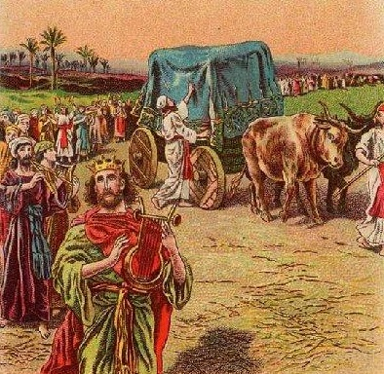

Slide 12
到了拿艮的禾場，因為牛失前蹄，烏撒就伸手扶住 神的約櫃。 神耶和華向烏撒發怒，因這錯誤擊殺他，他就死在 神的約櫃旁。 大衛因耶和華擊殺烏撒，心裡愁煩，就稱那地方為毘列斯‧烏撒，直到今日。（撒母耳記下 2 Samuel 6:6-7)
When they came to the threshing floor of Nakon, Uzzah reached out and took hold of the ark of God, because the oxen stumbled. The Lord’s anger burned against Uzzah because of his irreverent act; therefore God struck him down, and he died there beside the ark of God.

Slide 14
那日，大衛懼怕耶和華，說：「耶和華的約櫃怎可運到我這裡來？」 於是大衛不肯將耶和華的約櫃運進大衛的城，卻運到迦特人俄別‧以東的家中。 耶和華的約櫃在迦特人俄別‧以東家中三個月；耶和華賜福給俄別‧以東和他的全家。 （撒母耳記下 2 Samuel 6:9-11)
David was afraid of the Lord that day and said, “How can the ark of the Lord ever come to me?” He was not willing to take the ark of the Lord to be with him in the City of David. Instead, he took it to the house of Obed-Edom the Gittite. 11 The ark of the Lord remained in the house of Obed-Edom the Gittite for three months, and the Lord blessed him and his entire household.

Slide 15
“Is That Really You, God?”
「主，真是祢嗎？」
─ Loren Cunningham
Youth With A Mission

Slide 16
當時他的聲音震動了地，但如今他應許說：「再一次我不單要震動地，還要震動天。」 這再一次的話，是指明被震動的，就是受造之物都要挪去，使那不被震動的常存。（希伯來書 Hebrews 12:26-27)
At that time his voice shook the earth, but now he has promised, “Once more I will shake not only the earth but also the heavens.” The words “once more” indicate the removing of what can be shaken—that is, created things—so that what cannot be shaken may remain.

Slide 17
弟兄們，我心裡所願的，向 神所求的，是要以色列人得救。 我可以證明，他們向 神有熱心，但不是按著真知識；因為不知道 神的義，想要立自己的義，就不服 神的義了。（羅馬書 Romans 10:1-3)
2 For I can testify about them that they are zealous for God, but their zeal is not based on knowledge. Since they did not know the righteousness of God and sought to establish their own, they did not submit to God’s righteousness.

Slide 18
他就設立十二個人，要他們常和自己同在，也要差他們去傳道，並給他們權柄趕鬼。（馬可福音 Mark 3:14-15)
He appointed twelve that they might be with him and that he might send them out to preach and to have authority to drive out demons.

Slide 19
「事工」導向
「同在」導向

Slide 20
說：必有童女懷孕生子；人要稱他的名為以馬內利。（以馬內利翻出來就是「 神與我們同在」。）
（馬太福音 Matthew 1:23)
The virgin will conceive and give birth to a son, and they will call him Immanuel (which means “God with us”).

Slide 21
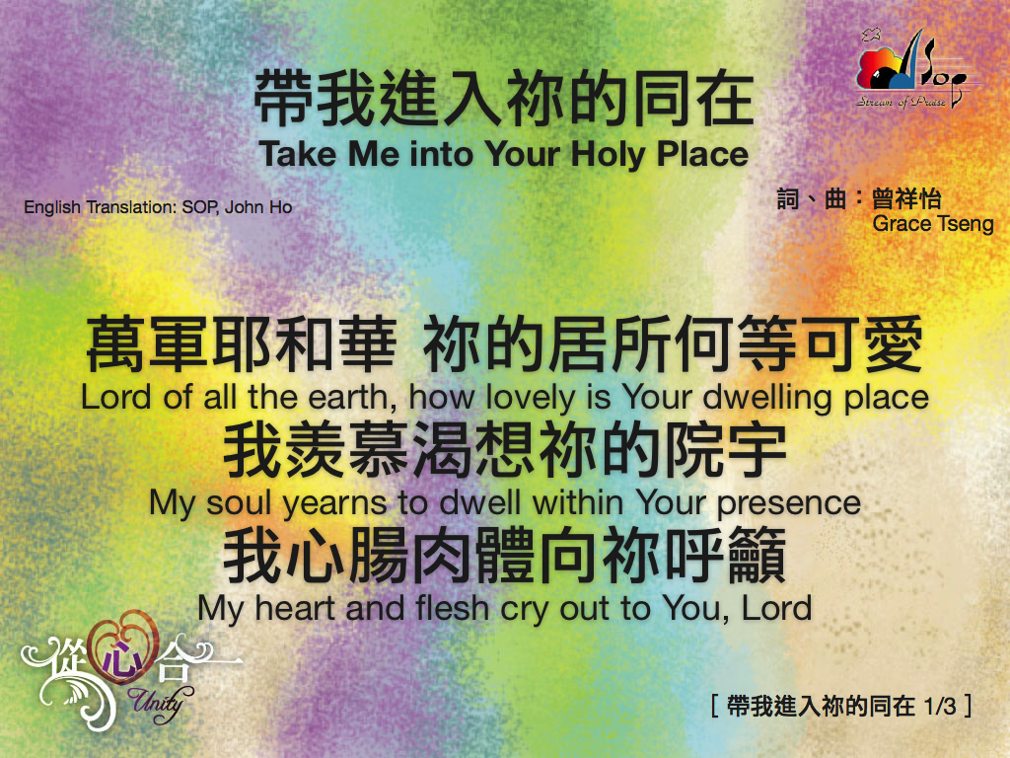

Slide 22
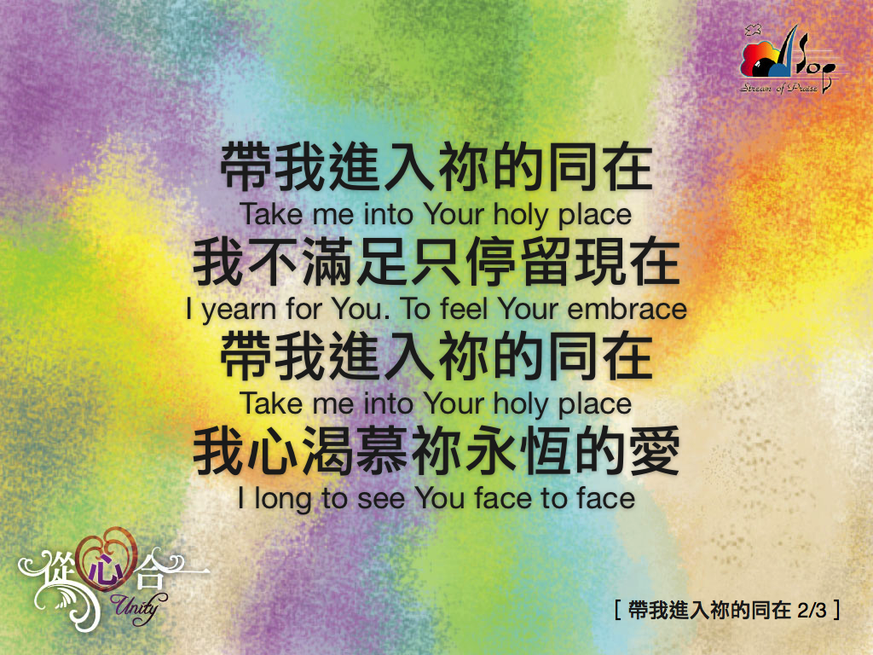

Slide 23
