Slide 1
帶來改變的愛
Love That Bring Forth Changes
波特蘭靈糧堂
September 10, 2017

Slide 2
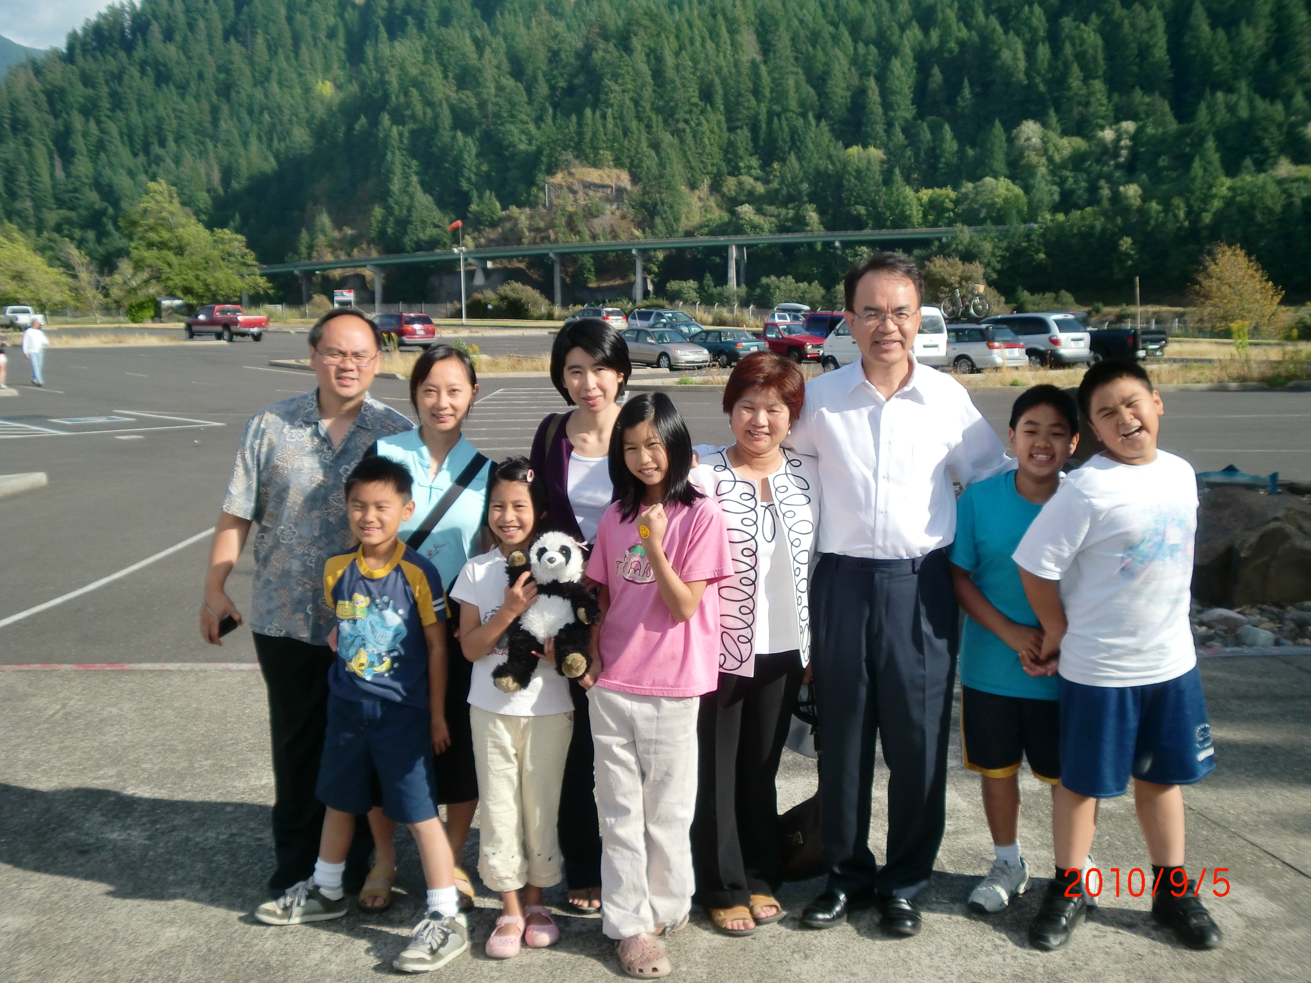

Slide 3
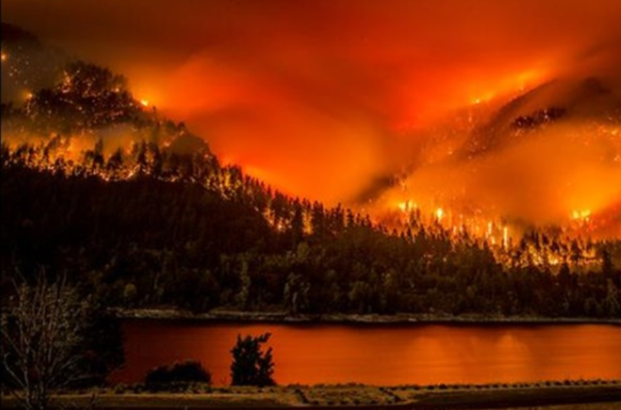

Slide 4
Teen suspected of starting massive Oregon wildfire, state police say
By Madison Park, CNNated
7:04 PM ET, Wed September 6, 2017

Slide 5
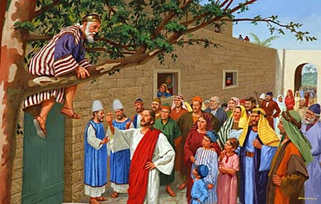

Slide 6
耶穌進了耶利哥，正經過的時候，有一個人名叫撒該，作稅吏長，是個財主。 他要看看耶穌是怎樣的人；只因人多，他的身量又矮，所以不得看見，就跑到前頭，爬上桑樹，要看耶穌，因為耶穌必從那裡經過。 （路加福音 Luke 19:1-4)
But Jesus entered Jericho and was passing through. A man was there by the name of Zacchaeus; he was a chief tax collector and was wealthy. He wanted to see who Jesus was, but because he was short he could not see over the crowd. So he ran ahead and climbed a sycamore-fig tree to see him, since Jesus was coming that way.

Slide 7
耶穌到了那裡，抬頭一看，對他說：「撒該，快下來！ 今天我必住在你家裡。」 他就急忙下來，歡歡喜喜地接待耶穌。 眾人看見，都私下議論說：「他竟到罪人家裡去住宿。」
（路加福音 Luke 19:5-7)
When Jesus reached the spot, he looked up and said to him, “Zacchaeus, come down immediately. I must stay at your house today.” So he came down at once and welcomed him gladly. All the people saw this and began to mutter, “He has gone to be the guest of a sinner.”

Slide 8
撒該站著對主說：「主啊，我把所有的一半給窮人；我若訛詐了誰，就還他四倍。」 耶穌說：「今天救恩到了這家，因為他也是亞伯拉罕的子孫。 人子來，為要尋找、拯救失喪的人。」（Lk 19:8-10)
But Zacchaeus stood up and said to the Lord, “Look, Lord! Here and now I give half of my possessions to the poor, and if I have cheated anybody out of anything, I will pay back four times the amount.” Jesus said to him, “Today salvation has come to this house, because this man, too, is a son of Abraham. For the Son of Man came to seek and to save the lost.”

Slide 9
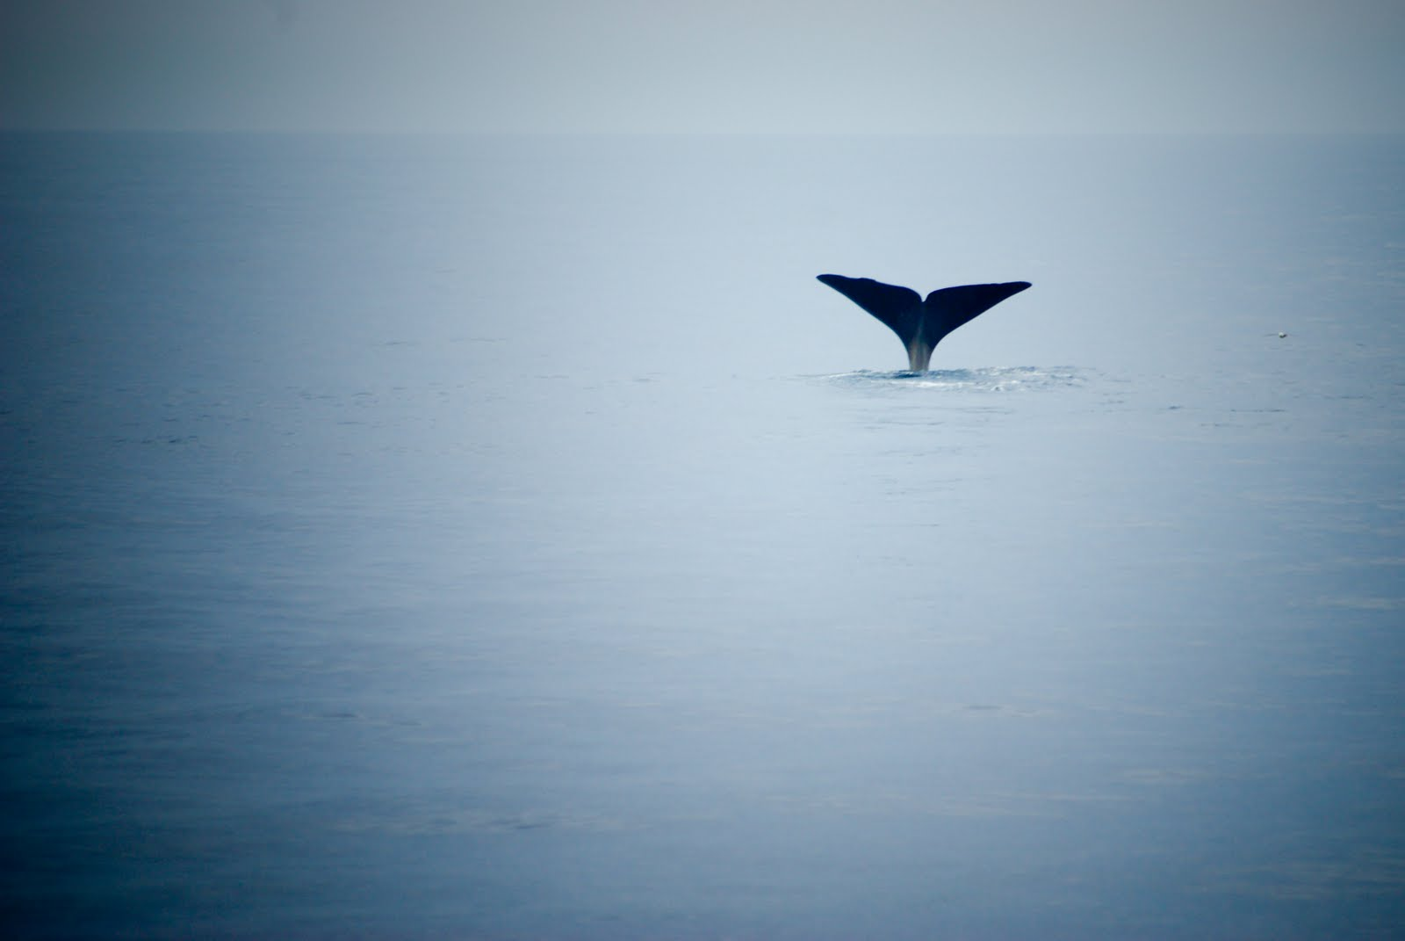
這事約拿大大不悅，且甚發怒

Slide 10

先知約拿

Slide 11
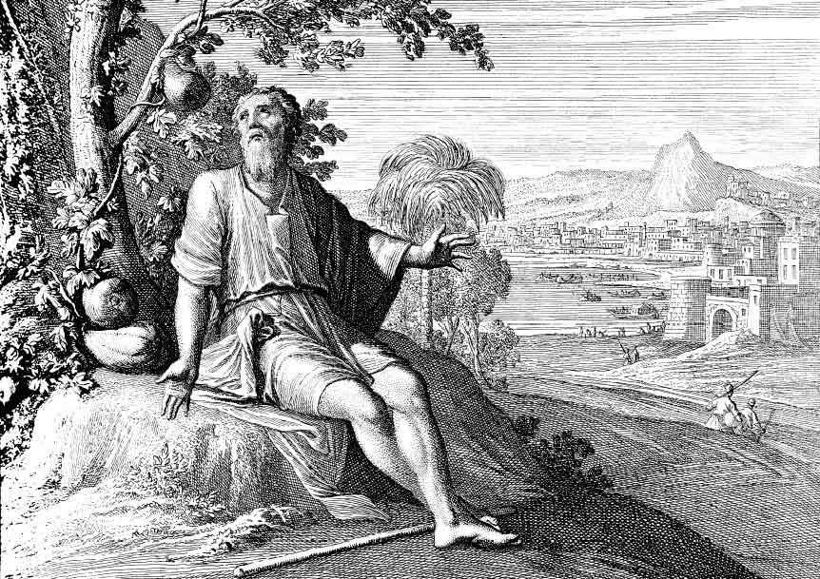
這事約拿大大不悅，且甚發怒（約拿書 Jonah 4:1)

Slide 12
神對約拿說：「你因這棵蓖麻發怒合乎理嗎？」他說：「我發怒以至於死，都合乎理！」（約拿書 Jonah 4:9)
Then God said to Jonah, “Do you have good reason to be angry about the plant?” And he said, “I have good reason to be angry, even to death.”

Slide 13
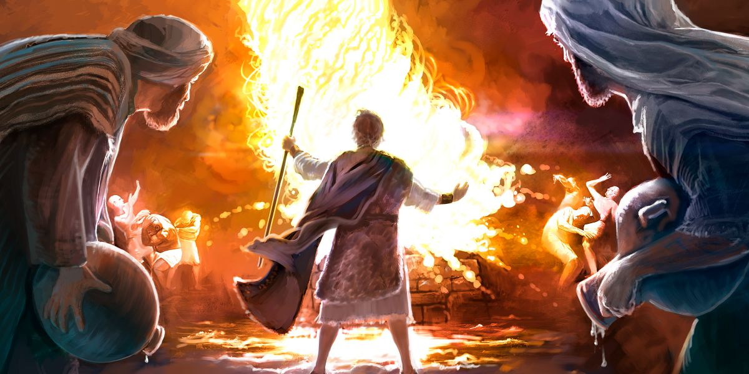

Slide 14
那裡的人不接待他，因他面向耶路撒冷去。 他的門徒雅各、約翰看見了，就說：「主啊，你要我們吩咐火從天上降下來燒滅他們，像以利亞所做的嗎？」
（路加福音 Luke 9:53-54)
but the people there did not welcome him, because he was heading for Jerusalem. When the disciples James and John saw this, they asked, “Lord, do you want us to call fire down from heaven to destroy them?”

Slide 15
耶穌轉身責備兩個門徒，說：「你們的心如何，你們並不知道。 人子來不是要滅人的性命，是要救人的性命。」說著就往別的村莊去了。
（路加福音 Luke 9:55-56)
But He turned and rebuked them, and said, “You do not know what kind of spirit you are of; for the Son of Man did not come to destroy men’s lives, but to save them.” And they went on to another village.

Slide 16
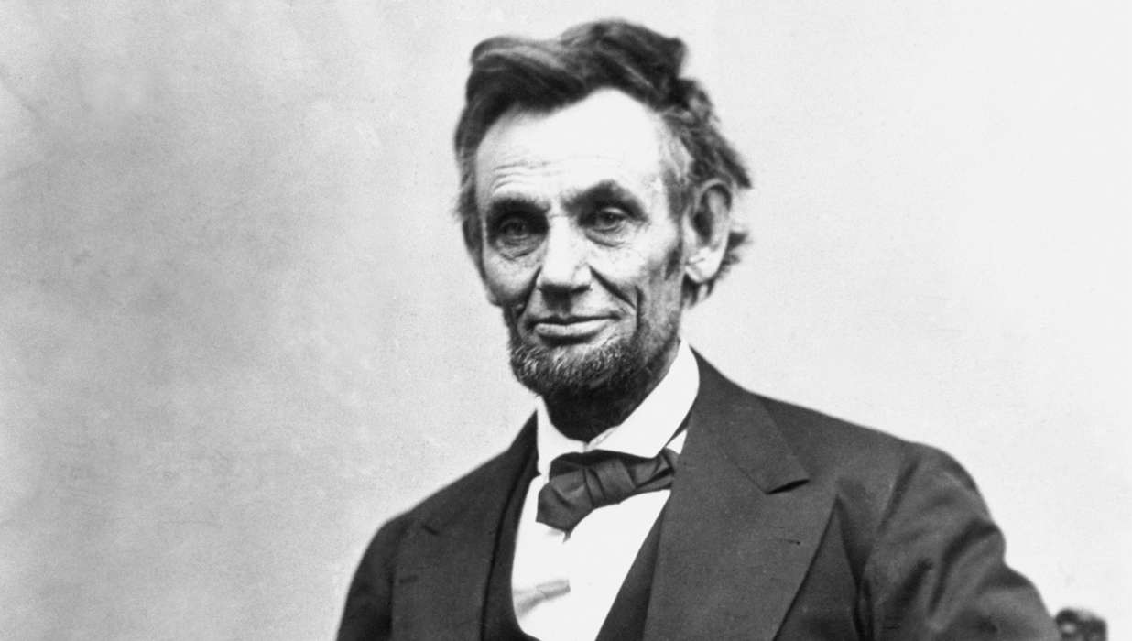
President Abraham Lincoln

Slide 17
“林肯先生，你不過是一個鞋匠的兒子，希望你在每次演講之前，多想想自己是什麼身份。”
林肯非常鎮定地說：“雖然我的父親已經去世了，但是非常感謝你讓我再次想起了他，雖然我做總統可能不會像我父親做鞋匠那樣做得完美，但我一定會記住你的忠告。”

Slide 18
有人覺得林肯對待政敵的態度太過寬容：“為什麼你會想和你的敵人成為朋友呢？ 難道你不應該設法去打擊他們，讓他們難以翻身嗎？”
然而林肯卻說：“把敵人變為自己的朋友時，你的政敵還會存在嗎？化敵為友才是最好的消滅政敵的方法。”這就是林肯的智慧和胸懷。

Slide 19
親愛的弟兄啊，我們應當彼此相愛，因為愛是從 神來的。 凡有愛心的，都是由 神而生，並且認識 神。
（約翰一書 1 John 4:7)
Beloved, let us love one another, for love is from God; and everyone who loves is born of God and knows God.

Slide 21
(1) The Power of Your Love 因你愛的大能
Lord, I come to you;
let my heart be changed, renewed,
主, 我親近你, 使我心變化更新,
flowing from the grace that I’ve found in you.
我知在主裡, 你恩典湧流.
And Lord, I’ve come to know
the weaknesses I see in me
在主慈愛裡, 我心中一切軟弱
will be stripped away by the power of your love.
都將被挪去,因你愛的大能.

Slide 22
(C) The Power of Your Love 因你愛的大能
Hold me close, let your love surround me.
擁抱我, 讓你愛圍繞我,
Bring me near, draw me to your side.
吸引我, 靠近你身旁.
And as I wait, I’ll rise up like the eagle,
我等候, 將如鷹展翅上騰
and I will soar with you, your Spirit leads me on
我要與你飛翔, 你聖靈引領我,
in the power of your love.
在你大能愛中

Slide 23
(2) The Power of Your Love 因你愛的大能
Lord, unveil my eyes; let me see you face to face,
主, 開啟我眼, 使我與你面對面,
the knowledge of your love as you live in me.
明白你的愛, 你在我裡面.
Lord, renew my mind,
as your will unfolds in my life,
更新我心意, 向我顯明你旨意,
in living every day by the power of your love.
每天生命中, 因你愛的大能.

Slide 24
(C) The Power of Your Love 因你愛的大能
Hold me close, let your love surround me.
擁抱我, 讓你愛圍繞我,
Bring me near, draw me to your side.
吸引我, 靠近你身旁.
And as I wait, I’ll rise up like the eagle,
我等候, 將如鷹展翅上騰
and I will soar with you, your Spirit leads me on
我要與你飛翔, 你聖靈引領我,
in the power of your love.
在你大能愛中

