Slide 1
住棚節的活水
Living Water of Feast of Tabernacle
波特蘭靈糧堂
October 8, 2017

Slide 2
play video
「住棚節」

Slide 3
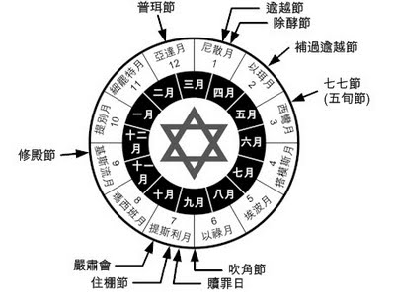

Slide 4
「你們收藏了地的出產，就從七月十五日起，要守耶和華的節七日。第一日為聖安息；第八日也為聖安息。第一日要拿美好樹上的果子和棕樹上的枝子，與茂密樹的枝條並河旁的柳枝，在耶和華─你們的 神面前歡樂七日。
（利未記 Leviticus 23:39-40)
39 “‘So beginning with the fifteenth day of the seventh month, after you have gathered the crops of the land, celebrate the festival to the Lord for seven days; the first day is a day of sabbath rest, and the eighth day also is a day of sabbath rest.

Slide 5
每年七月間，要向耶和華守這節七日。這為你們世世代代永遠的定例。 你們要住在棚裡七日；凡以色列家的人都要住在棚裡，好叫你們世世代代知道，我領以色列人出埃及地的時候曾使他們住在棚裡。 我是耶和華─你們的 神。」
（利未記 Leviticus 23:41-43)
41 Celebrate this as a festival to the Lord for seven days each year. This is to be a lasting ordinance for the generations to come; celebrate it in the seventh month.

Slide 6
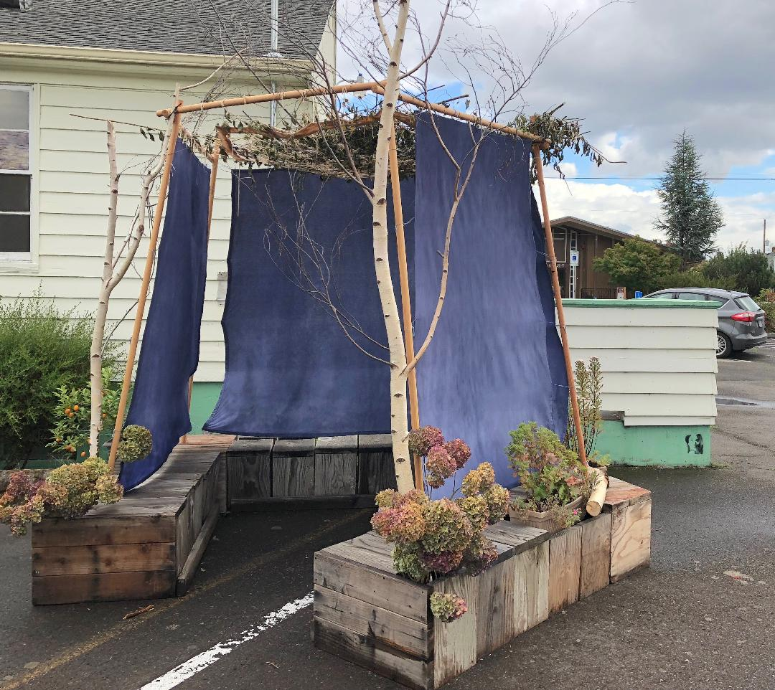

Slide 7
住棚節 (Sukkot,字面含義是棚子)。
住棚節，又稱聖幕節 (Feast of Tabernacle)。 今年的住棚節是 10月4-12日。 用棚子的居住; 來紀念以色列人漂流曠野，以棚為家四十年的歲月。 棚子的居住; 也提醒我們在這世上只不過是客旅，暫時居住在會壞的棚子(身體)裡。 豫表在世界的末了，基督將引進新耶路撒冷， 神的帳幕在人間 (啟 21:3)。

Slide 8
我聽見有大聲音從寶座出來說：「看哪， 神的帳幕在人間。 他要與人同住，他們要作他的子民。 神要親自與他們同在，作他們的 神。 （啟示錄 Revelation 21:3)
On the last and greatest day of the festival, Jesus stood and said in a loud voice, “Let anyone who is thirsty come to me and drink. Whoever believes in me, as Scripture has said, rivers of living water will flow from within them.” By this he meant the Spirit, whom those who believed in him were later to receive.

Slide 9
住棚節大祭司的求雨祭

Slide 10
看哪！ 神是我的拯救；我要倚靠他，並不懼怕。 因為主耶和華是我的力量，是我的詩歌，他也成了我的拯救。所以，你們必從救恩的泉源歡然取水。
（以賽亞書 Isaiah 12:2-3)
Surely God is my salvation;
I will trust and not be afraid.
The Lord, the Lord himself, is my strength and my defense;
he has become my salvation.”
With joy you will draw water
from the wells of salvation.

Slide 11
節期的末日，就是最大之日，耶穌站著高聲說：「人若渴了，可以到我這裡來喝。 信我的人就如經上所說：『從他腹中要流出活水的江河來。』」 耶穌這話是指著信他之人要受聖靈說的。
（約翰福音 John 7:37-39)
On the last and greatest day of the festival, Jesus stood and said in a loud voice, “Let anyone who is thirsty come to me and drink. Whoever believes in me, as Scripture has said, rivers of living water will flow from within them.” By this he meant the Spirit, whom those who believed in him were later to receive.

Slide 12
耶穌回答說：「凡喝這水的還要再渴； 人若喝我所賜的水就永遠不渴。 我所賜的水要在他裡頭成為泉源，直湧到永生。」（約翰福音 John 4:13-14)
Jesus answered, “Everyone who drinks this water will be thirsty again, but whoever drinks the water I give them will never thirst. Indeed, the water I give them will become in them a spring of water welling up to eternal life.”

Slide 13
耶和華的話臨到我說：「你去向耶路撒冷人的耳中喊叫說，耶和華如此說：你幼年的恩愛，婚姻的愛情，你怎樣在曠野，在未曾耕種之地跟隨我，我都記得。（耶利米書 Jeremiah 2:1-2)
The word of the Lord came to me: “Go and proclaim in the hearing of Jerusalem:
“This is what the Lord says:
“‘I remember the devotion of your youth, how as a bride you loved me and followed me through the wilderness,
through a land not sown.

Slide 15
play video
「充滿我」

