Slide 1
看見將來的事
Perceiving Our Future
波特蘭靈糧堂
October 22, 2017

Slide 2
耶和華又有話對他說：「這人必不成為你的後嗣；你本身所生的才成為你的後嗣。」 於是領他走到外邊，說：「你向天觀看，數算眾星，能數得過來嗎？」又對他說：「你的後裔將要如此。」 亞伯蘭信耶和華，耶和華就以此為他的義。（創世記 Genesis 15:4-6)
5 He took him outside and said, “Look up at the sky and count the stars—if indeed you can count them.” Then he said to him, “So shall your offspring be.”

Slide 3


Slide 4
或保羅，或亞波羅，或磯法，或世界，或生，或死，或現今的事，或將來的事，全是你們的；並且你們是屬基督的，基督又是屬 神的。
（哥林多前書 1 Corinthians 3:21-22)
whether Paul or Apollos or Cephas or the world or life or death or the present or the future—all are yours, and you are of Christ, and Christ is of God.

Slide 5
只等真理的聖靈來了，他要引導你們明白（原文是進入）一切的真理；因為他不是憑自己說的，乃是把他所聽見的都說出來，並要把將來的事告訴你們。（約翰福音 John 16:13)
But when he, the Spirit of truth, comes, he will guide you into all the truth. He will not speak on his own; he will speak only what he hears, and he will tell you what is yet to come.

Slide 6
大衛派幾個利未人在耶和華的約櫃前事奉，頌揚，稱謝，讚美耶和華─以色列的 神：為首的是亞薩，其次是撒迦利雅、雅薛、示米拉末、耶歇、瑪他提雅、以利押、比拿雅、俄別‧以東、耶利，鼓瑟彈琴；惟有亞薩敲鈸，大發響聲；祭司比拿雅和雅哈悉常在 神的約櫃前吹號。（歷代志上 1 Chronicles 16:4-5)
21 He appointed some of the Levites to minister before the ark of the Lord, to extol, thank, and praise the Lord, the God of Israel:

Slide 7
正如經上所寫的：此後，我要回來，重新修造大衛倒塌的帳幕，把那破壞的重新修造建立起來，叫餘剩的人，就是凡稱為我名下的外邦人，都尋求主。
（使徒行傳 Acts 15:16-17)
After this I will return and rebuild David’s fallen tent.
Its ruins I will rebuild, and I will restore it, that the rest of mankind may seek the Lord, even all the Gentiles who bear my name, says the Lord, who does these things

Slide 8
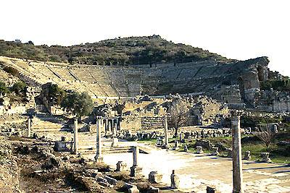
以弗所 Ephesus

Slide 9
凡住在以弗所的，無論是猶太人，是希臘人，都知道這事，也都懼怕；主耶穌的名從此就尊大了。 那已經信的，多有人來承認訴說自己所行的事。 平素行邪術的，也有許多人把書拿來，堆積在眾人面前焚燒。 他們算計書價，便知道共合五萬塊錢。 主的道大大興旺，而且得勝，就是這樣。（使徒行傳 Acts 19:17-20)
17 When this became known to the Jews and Greeks living in Ephesus, they were all seized with fear, and the name of the Lord Jesus was held in high honor.

Slide 10
但我要仍舊住在以弗所，直等到五旬節； 因為有寬大又有功效的門為我開了，並且反對的人也多。
（哥林多前書 1 Corinthians 16:8-9)
But I will stay on at Ephesus until Pentecost, because a great door for effective work has opened to me, and there are many who oppose me.

Slide 11
求我們主耶穌基督的 神，榮耀的父，將那賜人智慧和啟示的靈賞給你們，使你們真知道他，並且照明你們心中的眼睛，使你們知道他的恩召有何等指望，他在聖徒中得的基業有何等豐盛的榮耀；（以弗所書 Ephesians 1:17-18)
17 I keep asking that the God of our Lord Jesus Christ, the glorious Father, may give you the Spirit of wisdom and revelation, so that you may know him better.

Slide 12
先知性的加速
Prophetic Haste

Slide 13
你們豈不說『到收割的時候還有四個月』嗎？ 我告訴你們，舉目向田觀看，莊稼已經熟了，可以收割了。 收割的人得工價，積蓄五穀到永生，叫撒種的和收割的一同快樂。（約翰福音 John 4:35-36)
Don’t you have a saying, ‘It’s still four months until harvest’? I tell you, open your eyes and look at the fields! They are ripe for harvest. Even now the one who reaps draws a wage and harvests a crop for eternal life, so that the sower and the reaper may be glad together.

Slide 14
耶和華說：日子將到，耕種的必接續收割的；踹葡萄的必接續撒種的；大山要滴下甜酒；小山都必流奶。
（阿摩司書 Amos 9:13)
“The days are coming,” declares the Lord,
“when the reaper will be overtaken by the plowman
and the planter by the one treading grapes.
New wine will drip from the mountains
and flow from all the hills,

Slide 16


Slide 17


Slide 18
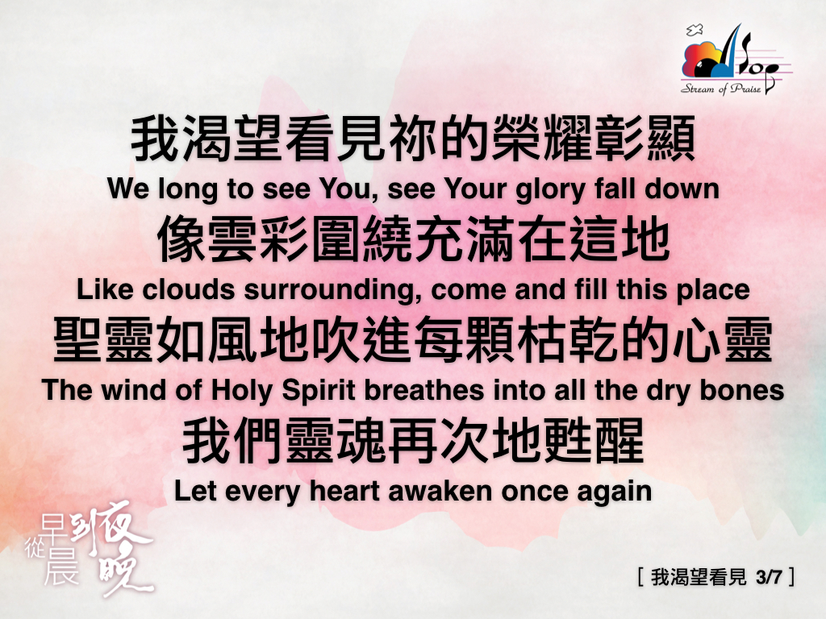

Slide 19


Slide 20
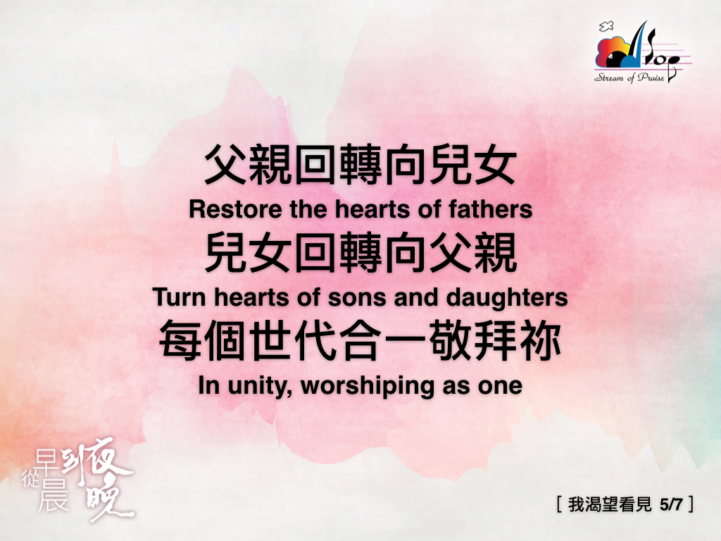

Slide 21


Slide 22
