Slide 1
警醒
Watching
波特蘭靈糧堂
October 29, 2017

Slide 2
主人來了，看見僕人警醒，那僕人就有福了。（路加福音 Luke 12:37a)
It will be good for those servants whose master finds them watching when he comes.

Slide 3
你們要恆切禱告，在此警醒感恩。（歌羅西書 Colossians 4:2)
Continue in prayer, and watch in the same with thanksgiving;

Slide 4
但那等候耶和華的必重新得力。 他們必如鷹展翅上騰；他們奔跑卻不困倦，行走卻不疲乏。（以賽亞書 Isaiah 40:31)
Yet those who wait for the Lord
Will gain new strength;
They will mount up with wings like eagles,
They will run and not get tired,
They will walk and not become weary. (NASB)

Slide 5
是我們等候 神，還是
神等候我們？
Are we waiting for the Lord, or is the Lord waiting for us?

Slide 6
『十架七言』
耶穌嘗了那醋，就說：「成了！」 便低下頭，將靈魂交付 神了。
（約翰福音 John 19:30)
Therefore when Jesus had received the sour wine, He said, “It is finished!” And He bowed His head and gave up His spirit. (NASB)

Slide 7
「成了！」 或是
「快要成了！」？
“It is finished!” or
“It is almost finished!” ？

Slide 8
興起，發光！ 因為你的光已經來到！耶和華的榮耀發現照耀你。 看哪，黑暗遮蓋大地，幽暗遮蓋萬民，耶和華卻要顯現照耀你；他的榮耀要現在你身上。（以賽亞書 Isaiah 60:1-2)
“Arise, shine; for your light has come, And the glory of the Lord has risen upon you. “For behold, darkness will cover the earth And deep darkness the peoples; But the Lord will rise upon you
And His glory will appear upon you.

Slide 9
主耶穌第一次再來
主耶穌第二次再來？
主耶穌第三次再來？
The Lord’s first coming
The Lord’s second coming ?
The Lord’s third coming ?

Slide 10
耶路撒冷啊，我在你城上設立守望的，他們晝夜必不靜默。 呼籲耶和華的， 你們不要歇息，也不要使他歇息，直等他建立耶路撒冷，使耶路撒冷在地上成為可讚美的。（以賽亞書 Isaiah 62:6-7)
On your walls, O Jerusalem, I have appointed watchmen; All day and all night they will never keep silent. You who remind the Lord, take no rest for yourselves; And give Him no rest until He establishes And makes Jerusalem a praise in the earth.

Slide 11
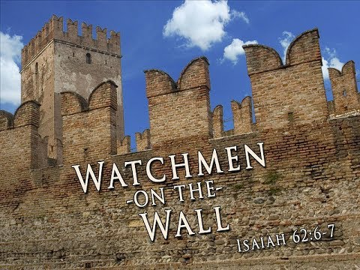

Slide 12
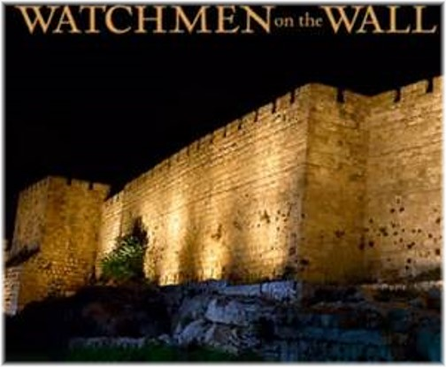

Slide 13
主對我如此說：你去設立守望的，使他將所看見的述說。 他看見軍隊，就是騎馬的一對一對地來，又看見驢隊，駱駝隊，就要側耳細聽。 他像獅子吼叫，說：主啊，我白日常站在望樓上，整夜立在我守望所。（以賽亞書 Isaiah 21:6-8)
8 Then the lookout called, “O Lord, I stand continually by day on the watchtower,
And I am stationed every night at my guard post.

Slide 14
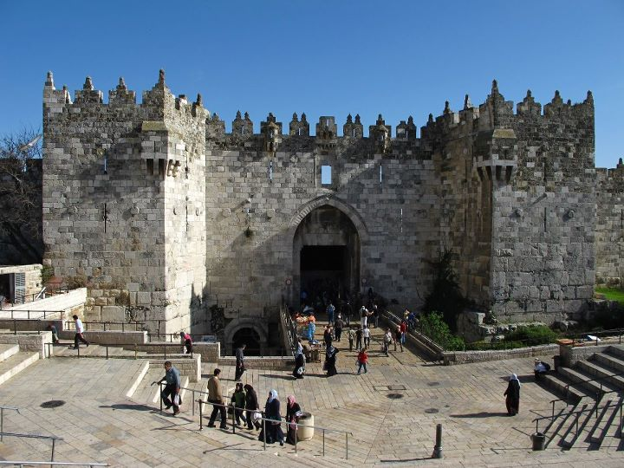

Slide 15
我在他們中間尋找一人重修牆垣，在我面前為這國站在破口防堵，使我不滅絕這國，卻找不著一個。
（以西結書 Ezekiel 22:30)
I searched for a man among them who would build up the wall and stand in the gap before Me for the land, so that I would not destroy it; but I found no one.

Slide 16
你們都是光明之子，都是白晝之子。 我們不是屬黑夜的，也不是屬幽暗的。
所以，我們不要睡覺像別人一樣，總要警醒謹守。
（帖撒羅尼迦前書 1 Thessalonians 5:5-6)
You are all the children of light, and the children of the day: we are not of the night, nor of darkness. Therefore let us not sleep, as do others; but let us watch and be sober.

Slide 17
play video
「禱告的大軍
A Praying Army」

