Slide 1
無敵「不沾鍋」
Invincible ‘Nonstick’ Lifestyle
波特蘭靈糧堂
November 5, 2017

Slide 2
耶穌一下船，就有一個被污鬼附著的人從墳塋裡出來迎著他。 那人常住在墳塋裡，沒有人能捆住他，就是用鐵鍊也不能；因為人屢次用腳鐐和鐵鍊捆鎖他，鐵鍊竟被他掙斷了，腳鐐也被他弄碎了；總沒有人能制伏他。（馬可福音 Mark 5:2-4)
2 When He got out of the boat, immediately a man from the tombs with an unclean spirit met Him, 3 and he had his dwelling among the tombs. And no one was able to bind him anymore, even with a chain;

Slide 3
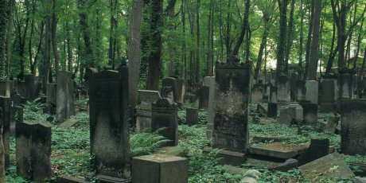
墳墓代表甚麼？

Slide 4
他遠遠地看見耶穌，就跑過去拜他，大聲呼叫說：「至高 神的兒子耶穌，我與你有甚麼相干？ 我指著 神懇求你，不要叫我受苦！」是因耶穌曾吩咐他說：「污鬼啊，從這人身上出來吧！」
（馬可福音 Mark 5:6-8)
6 Seeing Jesus from a distance, he ran up and bowed down before Him; 7 and shouting with a loud voice, he said, “What business do we have with each other, Jesus, Son of the Most High God? I implore You by God, do not torment me!”

Slide 5
耶穌問他說：「你名叫甚麼？」回答說：「我名叫『群』，因為我們多的緣故」； 就再三地求耶穌，不要叫他們離開那地方。 在那裡山坡上，有一大群豬吃食； 鬼就央求耶穌說：「求你打發我們往豬群裡，附著豬去。」（馬可福音 Mark 5:6-8)
9 And He was asking him, “What is your name?” And he said to Him, “My name is Legion; for we are many.” 10 And he began to implore Him earnestly not to send them out of the country.

Slide 6
在會堂裡，有一個人被污鬼附著。 他喊叫說：「拿撒勒人耶穌，我們與你有甚麼相干？ 你來滅我們嗎？ 我知道你是誰，乃是 神的聖者。」 耶穌責備他說：「不要作聲！ 從這人身上出來吧。」 污鬼叫那人抽了一陣瘋，大聲喊叫，就出來了。（馬可福音 Mark 1:23-26)
23 Just then there was a man in their synagogue with an unclean spirit; and he cried out, 24 saying, “What business do we have with each other, Jesus Nazareth?

Slide 7
眾人都驚訝，以致彼此對問說：「這是甚麼事？ 是個新道理啊！ 他用權柄吩咐污鬼，連污鬼也聽從了他。」
（馬可福音 Mark 1:27)
They were all amazed, so that they debated among themselves, saying, “What is this? A new teaching with authority! He commands even the unclean spirits, and they obey Him.”

Slide 8
如果我們期待要有權柄制服仇敵，我們就不能容許仇敵在我們身上有合法的權柄
If we desire to have authority over an enemy, we must not give the enemy legal authority over us

Slide 9
我實實在在地告訴你們，我所做的事，信我的人也要做，並且要做比這更大的事，因為我往父那裡去。 你們奉我的名無論求甚麼，我必成就，叫父因兒子得榮耀。（約翰福音 John 14:12-13)
Truly, truly, I say to you, he who believes in Me, the works that I do, he will do also; and greater works than these he will do; because I go to the Father. Whatever you ask in My name, that will I do, so that the Father may be glorified in the Son.

Slide 10
以後我不再和你們多說話，因為這世界的王將到。 他在我裡面是毫無所有；
（約翰福音 John 14:30)
I will not speak much more with you, for the ruler of the world is coming, and he has nothing in Me;

Slide 11
你們都是光明之子，都是白晝之子。 我們不是屬黑夜的，也不是屬幽暗的。
所以，我們不要睡覺像別人一樣，總要警醒謹守。
（帖撒羅尼迦前書 1 Thessalonians 5:5-6)
You are all the children of light, and the children of the day: we are not of the night, nor of darkness. Therefore let us not sleep, as do others; but let us watch and be sober.

Slide 12
耶穌在我們裡面敲門？
Jesus knocking the door inside of us?

Slide 13
play video
「求祢為我造清潔的心」

Slide 14
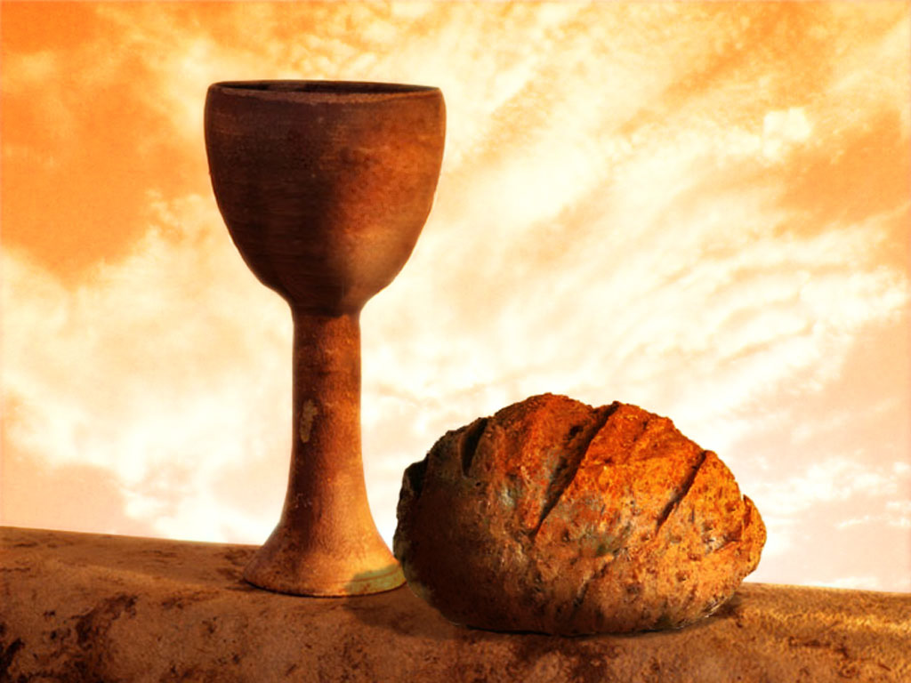
同領聖餐 Holy Communion

