Slide 1
本於信，以至於信
From Faith to Faith
波特蘭靈糧堂
November 19, 2017

Slide 2
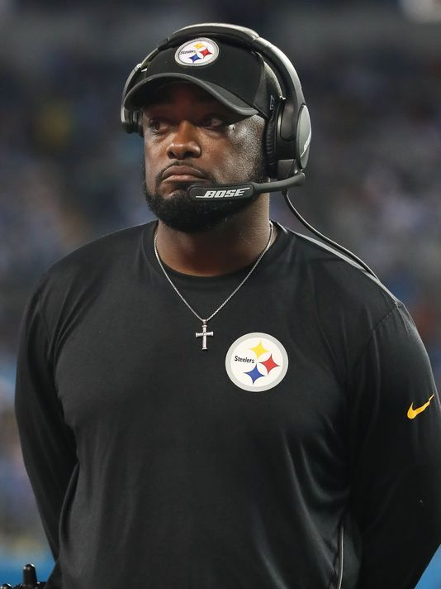
「只有當你對所面臨的處境失去把握時，你才會感到有壓力。」
“You only feel pressure when you don’t know what’s going on.”
- Mike Tomlin
“Football is what we do; faith is who we are all the time."

Slide 3
這些事以後，耶穌在提比哩亞海邊又向門徒顯現。 他怎樣顯現記在下面：有西門•彼得和稱為低土馬的多馬，並加利利的迦拿人拿但業，還有西庇太的兩個兒子，又有兩個門徒，都在一處。
（約翰福音 John 21:1-2)
Afterward Jesus appeared again to his disciples, by the Sea of Galilee. It happened this way: Simon Peter, Thomas, Nathanael from Cana in Galilee, the sons of Zebedee, and two other disciples were together.

Slide 4
這些事以後，耶穌在提比哩亞海邊又向門徒顯現。 他怎樣顯現記在下面：有西門•彼得和稱為低土馬的多馬，並加利利的迦拿人拿但業，還有西庇太的兩個兒子，又有兩個門徒，都在一處。
（約翰福音 John 21:3-4)
“I’m going out to fish,” Simon Peter told them, and they said, “We’ll go with you.” So they went out and got into the boat, but that night they caught nothing. Early in the morning, Jesus stood on the shore, but the disciples did not realize that it was Jesus.

Slide 5
耶穌就對他們說：「小子！你們有吃的沒有？」他們回答說：「沒有。」 耶穌說：「你們把網撒在船的右邊，就必得著。」他們便撒下網去，竟拉不上來了，因為魚甚多。（約翰福音 John 21:5-6)
He called out to them, “Friends, haven’t you any fish?”
“No,” they answered. He said, “Throw your net on the right side of the boat and you will find some.” When they did, they were unable to haul the net in because of the large number of fish.

Slide 6
因為 神的義正在這福音上顯明出來；這義是本於信，以至於信。 如經上所記：「義人必因信得生。」
（羅馬書 Romans 1:17)
For in it the righteousness of God is revealed from faith to faith; as it is written, “But the righteous man shall live by faith.”

Slide 7
本於信，以至於信
vs.
本於信，以至於「理性」？

Slide 8
知道「What ─ 做什麼」
vs.
知道「Why ─ 為什麼」

Slide 9
play video
「Know your Why」

Slide 10
當我們知道我們的 ‘Why’ (和 ‘Who’), 我們的 ‘What’ 會更加有果效和影響力，因為我們正在邁向我們的命定。
When we know our ‘Why’, our ‘What’ will have more impact because we are walking toward our Purpose.

Slide 11
耶穌說：「我不是對你說過，你若信，就必看見 神的榮耀嗎？」
（約翰福音 John 11:40)
Jesus said to her, “Did I not say to you that if you believe, you will see the glory of God?”

Slide 12
play video
「你若相信」

Slide 13
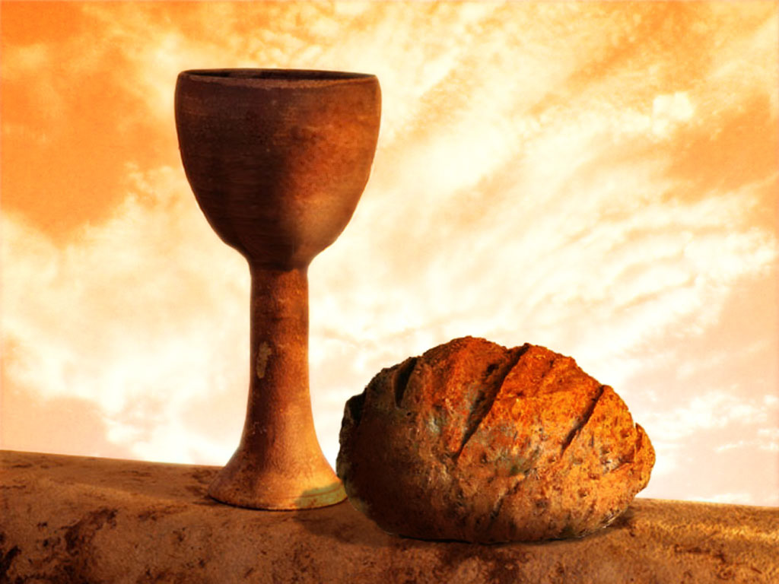
同領聖餐 Holy Communion

